Slide 1
RocksDB Festival 4nd
Supported by IITP, StarLab.
AUG 23, 2021
박경미, 황예진
kmi0817@naver.com, hyj3463@naver.com
BGR

Slide 2
RocksDB Festival
Contents
This Week
Related Options
Discussion
Experiment
- level_compaction_dynamic_level_bytes
- max_bytes_for_level_multiplier
Next week
‹#›

Slide 3
RocksDB Festival
This Week
Focus on “Space Amplification” among 3 amplifications
☞ Study both documents
1. https://github.com/facebook/rocksdb/wiki/Space-Tuning
2. https://rocksdb.org/blog/2015/07/23/dynamic-level.html
Enable the level_compaction_dynamic_level_bytes to reduce
Space Amplification!!
Disk
L0
SST
SST
L1
SST
SST
L2
SST
SST
SST
L3
SST
SST
SST
SST
SST
L4
SST
SST
SST
SST
SST
SST
L5
SST
SST
SST
SST
SST
SST
SST
SST
L6
SST
SST
SST
SST
SST
SST
SST
SST
SST
SST
‹#›

Slide 4
RocksDB Festival
Related Options
level_compaction_dynamic_level_bytes=false (default)
Disk
L0
SST
SST
L1
ST
SST
L2
SST
SST
SST
L3
SST
SST
SST
SST
SST
L4
L5
L6
‹#›

Slide 5
RocksDB Festival
Related Options
level_compaction_dynamic_level_bytes=true
if “max_bytes_for_level_base / max_bytes_for_level_multiplier”?
maybe the size of that level is 0
Disk
L0
SST
SST
L1
L2
L3
L4
SST
L5
SST
SST
SST
L6
SST
SST
SST
SST
SST
SST
SST
‹#›

Slide 6
RocksDB Festival
This Week
and max_bytes_for_level_multiplier. (default:10)
Often using 8, but 10 is the optimized value.
If level_compaction_dynamic_level_bytes = false, all default values
ex) L2 size = L1 size * 10
Disk
L0
SST
SST
L1
SST
SST
L2
SST
SST
SST
L3
SST
SST
SST
SST
SST
L4
SST
SST
SST
SST
SST
SST
L5
SST
SST
SST
SST
SST
SST
SST
SST
L6
SST
SST
SST
SST
SST
SST
SST
SST
SST
SST
‹#›

Slide 7
RocksDB Festival
Discussion
Calculate Space Amplification
Disk’s DB File size / User data size
but, this value is hard to understand in db_bench.
☞ Use “Size of the entire level / Size of the last level”
‹#›

Slide 8
RocksDB Festival
Discussion
When level_compaction_dynamic_level_bytes is false
L1's target will be max_bytes_for_level_base(default:256MB).
Target_Size(Ln+1) = Target_Size(Ln) * max_bytes_for_level_multiplier
max_bytes_for_level_multiplier = 10 (default)
L1
L2
L3
L4 (max)
N
10N
100N
1000N
* N = max_bytes_for_level_base
‹#›

Slide 9
RocksDB Festival
Discussion
When level_compaction_dynamic_level_bytes is true
Target size of the last level will always be actual size of the level.
Target_Size(Ln-1) = Target_Size(Ln) / max_bytes_for_level_multiplier
What’s the size of N ??
max_bytes_for_level_multiplier = 10 (default)
L1
L2
L3
L4 (max)
0.001N
0.01N
0.1N
N
if max_bytes_for_level_base / max_bytes_for_level_multiplier ?
=> maybe the size of that level is 0
‹#›

Slide 10
RocksDB Festival
Experiment Info
RocksDB version 6.21
CPU 1 * Intel(R) Core(TM) i5-7500 CPU @ 3.40GHz
Key 64 bytes
Values 1KB
Entries 5,000,000
turn off compression
Other options are defaults
‹#›

Slide 11
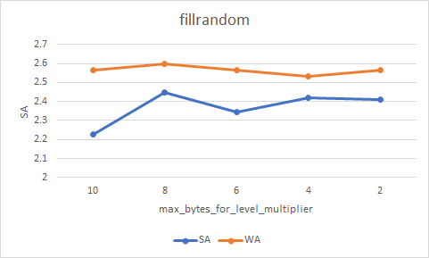
RocksDB Festival
Experiment 1
level_compaction_dynamic_level_bytes=false, fillrandom
Minimum SA is 10
Minimum WA is 4, but there is less difference from 10.
‹#›

Slide 12
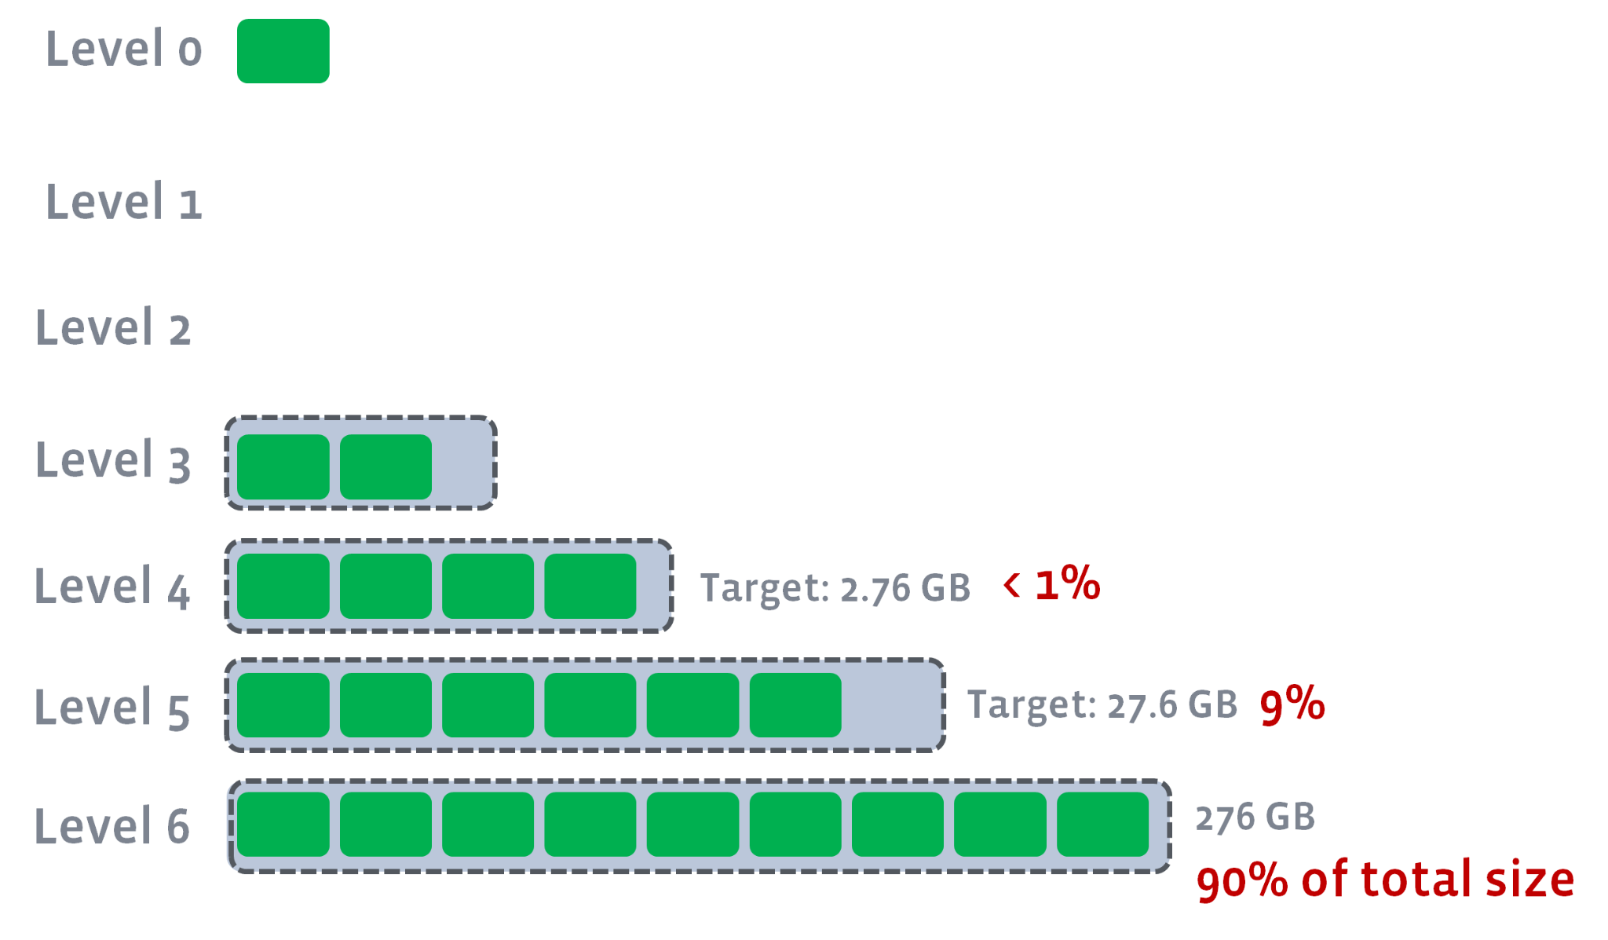
RocksDB Festival
Discussion
According to RocksDB Wiki, level_compaction_dynamic_level_bytes==true
RocksDB has 90% of the data in Lmax by default...
https://github.com/facebook/rocksdb/wiki/Leveled-Compaction
‹#›

Slide 13
RocksDB Festival
Discussion
But checked db_bench using fillrandom,
level_compaction_dynamic_level_bytes==true
the results were...
Disk
L0
SST
SST
SST
L1
L2
L3
L4
L5
SST
SST
SST
SST
SST
SST
SST
Why??
L6
SST
SST
SST
‹#›

Slide 14
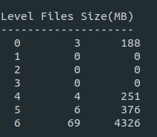
RocksDB Festival
Discussion
checked db_bench using fillseq,
level_compaction_dynamic_level_bytes==true
the results were...
Disk
L0
SST
L1
L2
L3
L4
L5
SST
SST
L6
SST
SST
SST
SST
SST
SST
SST
SST
SST
‹#›

Slide 15
RocksDB Festival
Next week
study to solve questions this week.
Continue this week's experiment about Space Amplification!
‹#›

Slide 16

Discussion

