Slide 1
RocksDB Festival
Supported by IITP, StarLab.
July 19, 2021
Team Member: 고산하 김정민 이성준
E-mail: sanha0498@gmail.com
Team Name: 세 얼간이

Slide 2
Contents
팀 소개
팀원 구성
주제 선정
Space Amplification related
예상 결과

Slide 3
Team Intro
Team 세 얼간이 (찐 얼간이)
고산하 32170140 sanha0498@gmail.com
김정민 32170939 jeongmin981@gmail.com
이성준 32173058 sung0651@naver.com

Slide 4
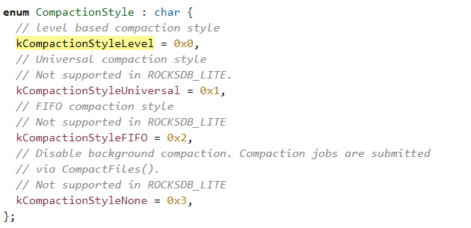
RocksDB Festival
Topics
Performance Comparison of space amplifications by compaction
(Universal vs leveled Compaction)
Analyzing characteristics and codes of these two compactions
Tunning options that impact behavior of Compactions
CompactionFamilyOption::compaction_style
4

Slide 5
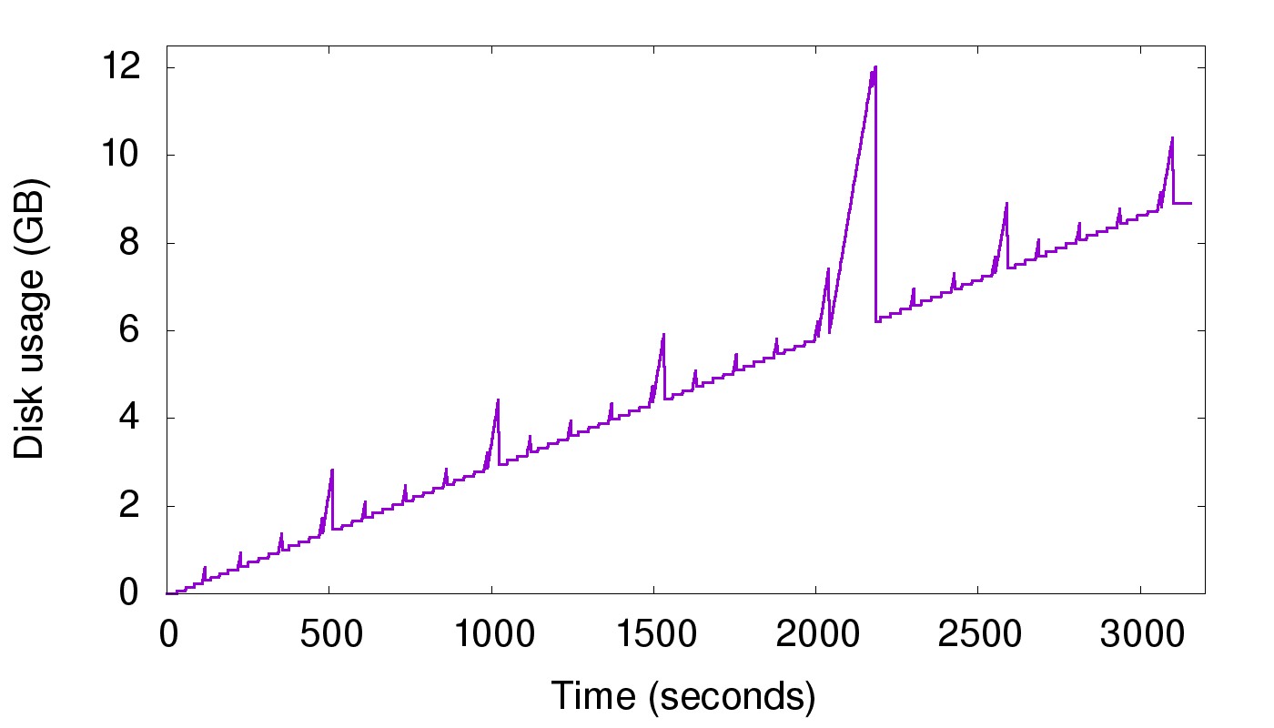
RocksDB Festival
기대 결과
By analyzing the characteristics and codes of these compactions, we can learn about the options of these compactions and how the code progresses.
Anticipate and Graph performance about space amplification for Universal and Leveled.
1 node, 1 cpu, Using size-tiered compaction Case

Slide 6

Discussion

