Slide 1
RocksDB Festival What is the RocksDB
Supported by IITP, StarLab.
July 5, 2021
Hojin Shin, Jongmoo Choi
choijm@dankook.ac.kr
http://embedded.dankook.ac.kr/~choijm

Slide 2

RocksDB Festival: Contents
Contents
What is data
How to manage data
This is Key-Value Store
The basics of key value: LevelDB
Our Goal: RocksDB
2

Slide 3
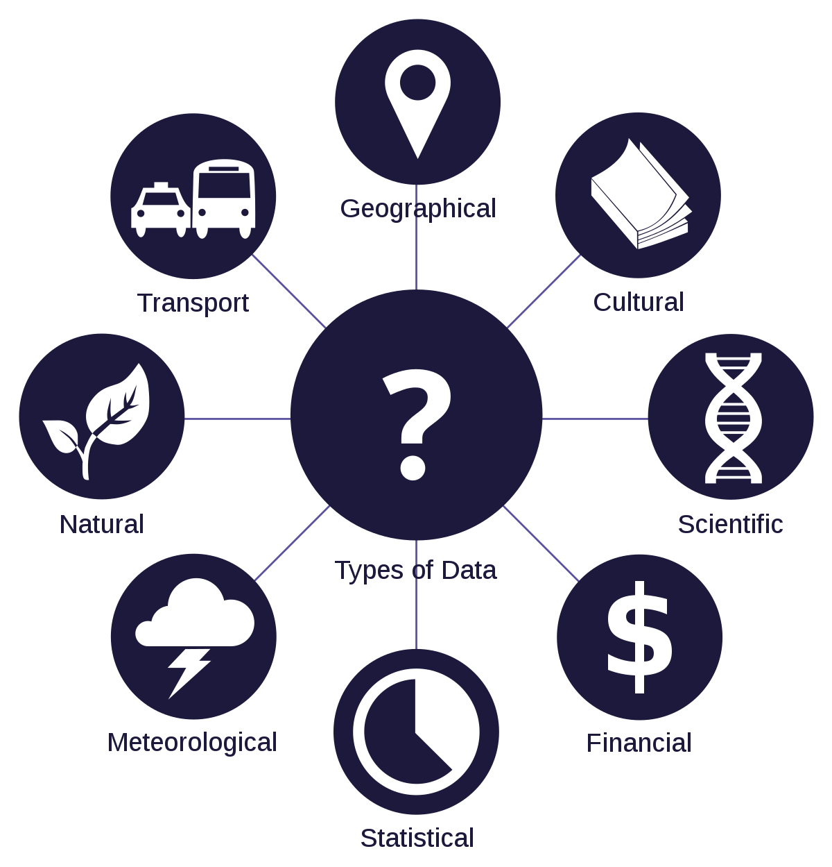

RocksDB Festival: What is the Data
Data
1) Units of information, often numeric, that are collected through observation.
2) Fact on which a theory is based
3) Data in the form of letters, numbers, sounds, pictures that a computer can process
3

Slide 4
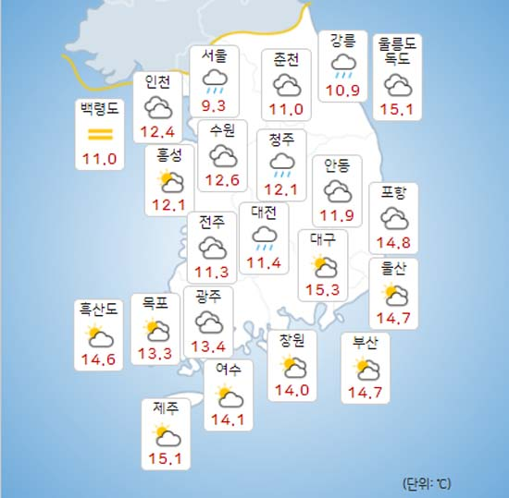
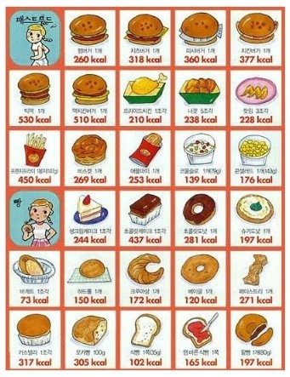
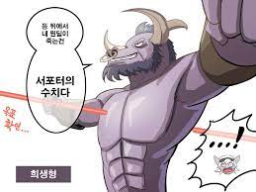
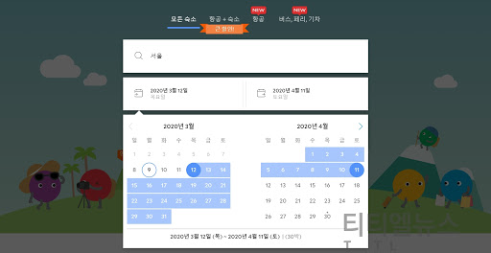
RocksDB Festival: What is the Data
Information
Information is obtained by processing data
A form in which data is processed according to its meaning and purpose for specific decision-making
4

Slide 5
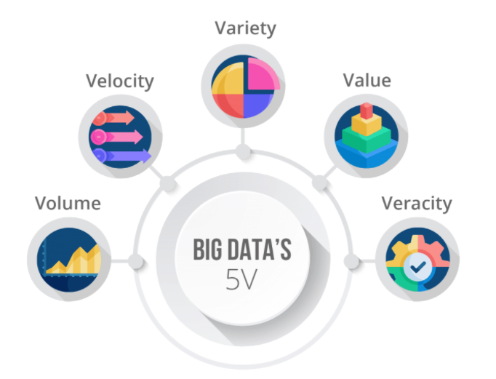
RocksDB Festival: What is the Data
Big Data
A large amount of structured data that exceed existing DB management tools
Set of unstructured data that is not in the form of data
Features = 5V
5

Slide 6
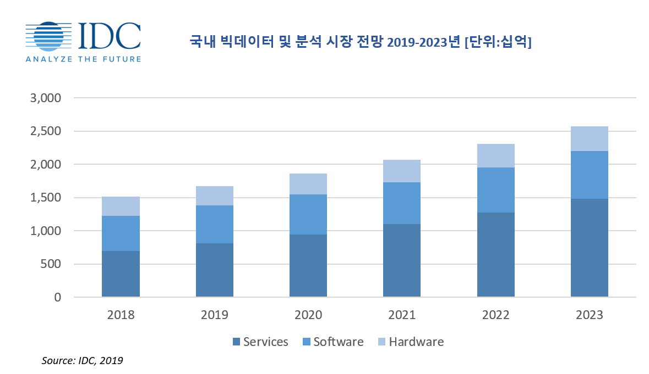
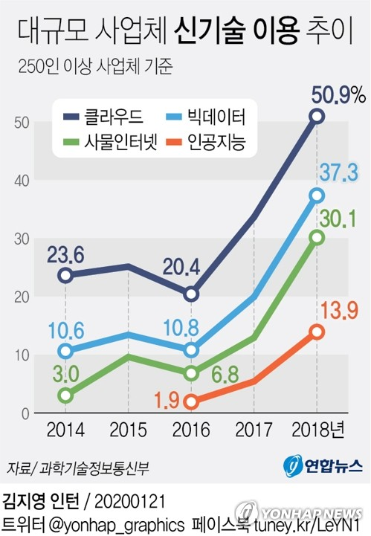
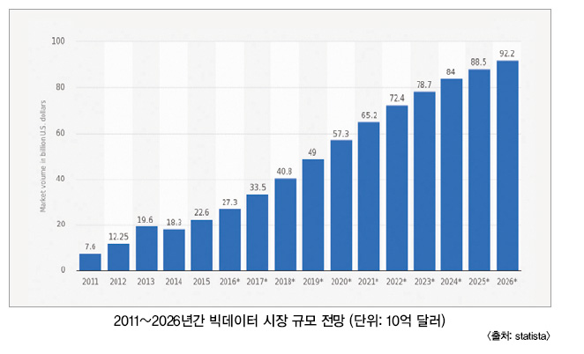
RocksDB Festival: What is the Data
Big Data Prospects
6

Slide 7
RocksDB Festival : What is the Data
Kind of Data
Structured Data
Data organized and processed into a form suitable for immediate statistical analysis
Data stored in fixed fields
Unstructured Data
One piece of data, not a set of data, is objectified as collected data
Difficult to understand the meaning of a value because there is no set rule
Semi-structured Data
File type, metadata (schema of structured data inside data)
7

Slide 8

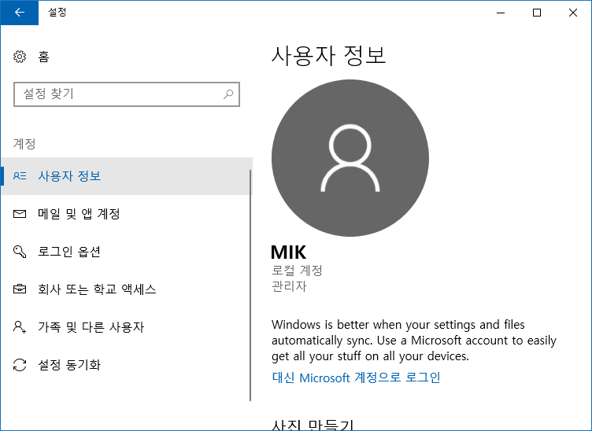

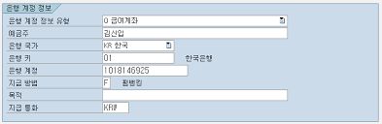
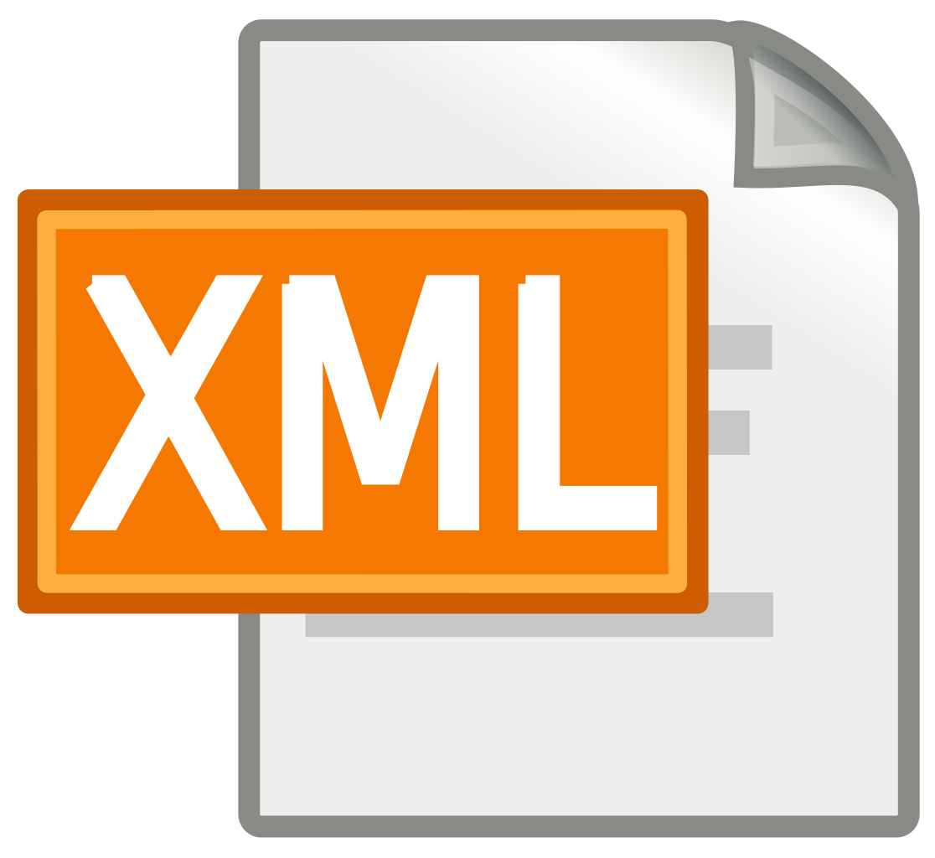
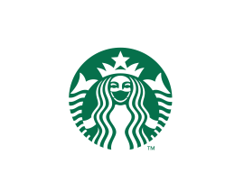
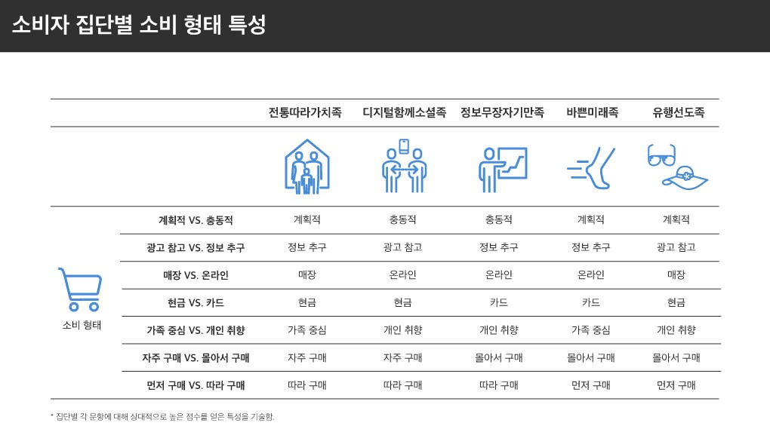

RocksDB Festival: How to manage Data
Various Data
8

Slide 9
RocksDB Festival: How to manage Data
Various Data
Semi-structured Data
Structured Data
Unstructured Data
9

Slide 10
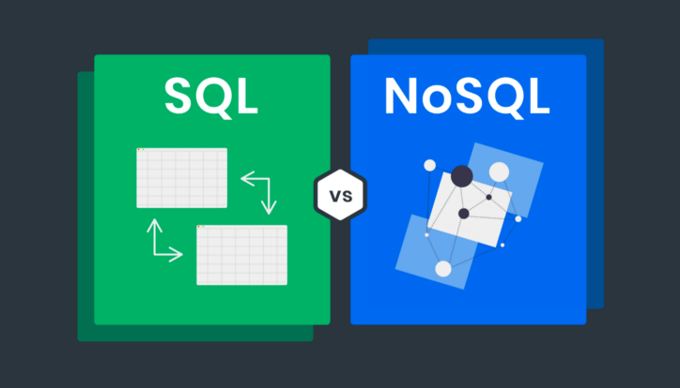
RocksDB Festival: How to manage Data
Data management
SQL (Structured Query Language)
Interact with a particular type of database
Can store, modify, delete and retrieve data from RDBMS
Features
Strict schema
Relation
NoSQL (Not only SQL)
Adjust the stored data at any time and add new "fields“
Key-value, document, wide-column, graph
Features
No schema
No Relation
10

Slide 11







RocksDB Festival: How to manage Data
Data management cont’
SQL
RDBMS(Relational DataBase Management System)
Easy to perform transactions by minimizing data redundancy through normalization
Data integrity – Accuracy, consistence
MSSQL, MySQL, Oracle
NoSQL
Does not define relationships between data
Store large amounts of data
LevelDB, RocksDB, Cassandra, MongoDB, Memcached
SQL
NoSQL
11

Slide 12
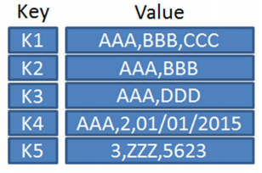
RocksDB Festival: This is Key-Value Store
Key-Value Store
A type of non-relational database that uses key-value methods to store data
Key is a unique identifier and cannot overlapping value
Value can be anything – integer, string, JSON, image …
Hash function is used to process the key
Key-Value Overview
12

Slide 13
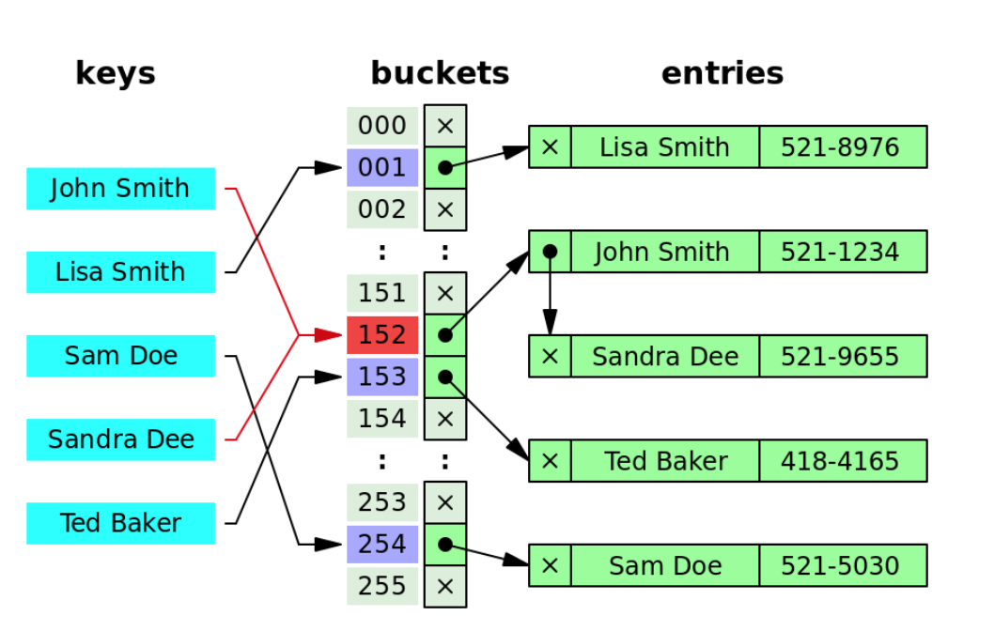
RocksDB Festival: This is Key-Value Store
Hash-Table
Data structure that stores value in key
When searching for data about a key, if you execute hash function only once ➔ store and delete data is fast
Mapping ➔ Called Hashing
Data access: insert, delete, retrieve O(1)
Problem
Hash collision ➔ Can solve using “Chaining”
Hash Table Overview
13

Slide 14
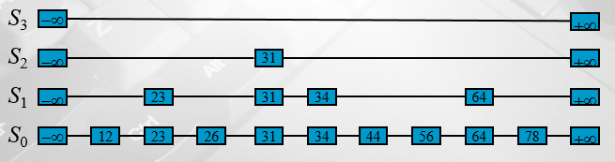
RocksDB Festival: This is Key-Value Store
Skiplist
A data structure that enables fast search, insert, and delete with an algorithm applied to a sorted linked list
Useful in multithreaded system architectures
Complexity : O(logn)
Skiplist Overview
14

Slide 15
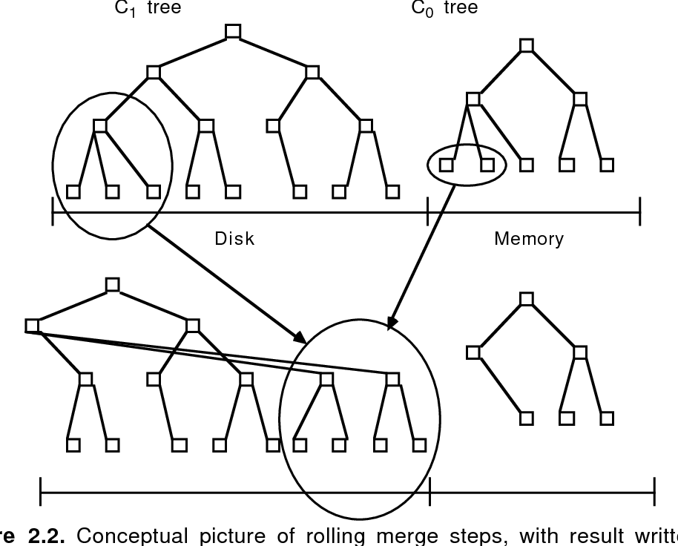
RocksDB Festival: This is Key-Value Store
LSM(Log Structured Merge)-Tree
Patrick O’Neil, The Log-Structured Merge Tree, 1996
Has 0~L levels, L0 is in memory others are in disk(storage)
Buffer located in L0 stores data and when buffer full, flushed to lower level one by one
Not In-place-update, using Append
Write
Memory buffer construct skiplist, maintain input data’s order
Read
When reading, all files are checked
Memory ➔ Immutable memory ➔ Disk
LSM Tree Overview
15

Slide 16
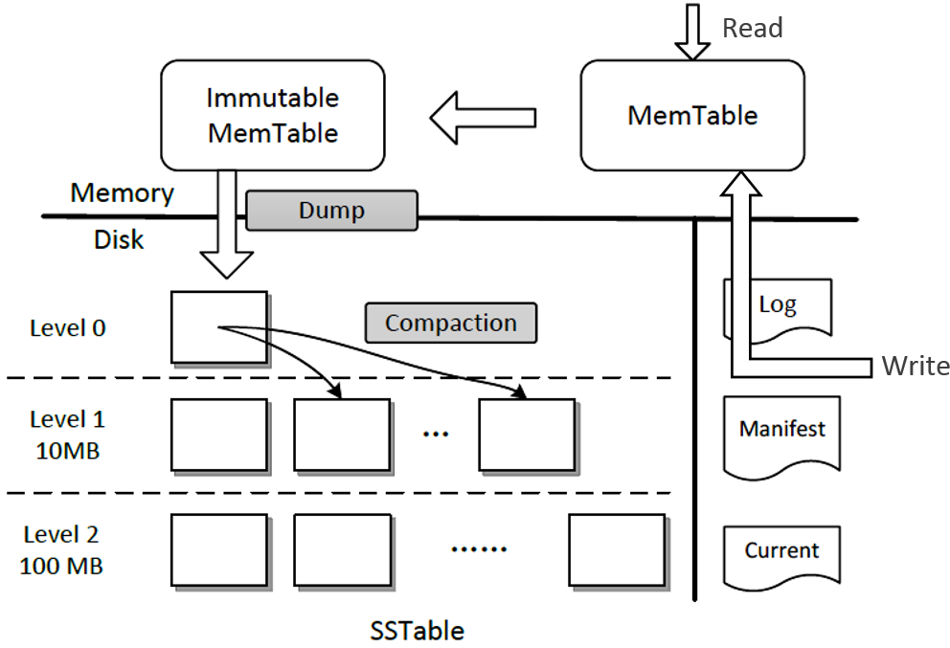
RocksDB Festival: LevelDB
LevelDB
Google’s opensource project
Developed in the programming language C++
Data is stored after sorting by key
Operation : Put(K, V), Get(K), Delete(K)
Multiple operations can be created and processed in one batch
Limitation
Single processing: only one process can access DB
Not support SQL query
LevelDB Overview
16

Slide 17
RocksDB Festival: RocksDB
Overview
RocksDB is a storage engine for server workloads (Developed by Facebook)
Data stored by key and value
Flexibility: Support various production env. (Memory, Flash, HDD)
Operation: Get(K), NewIterator(), Put(K,V), Delete(K) …
Memtable: In-memory data structure
Log: Sequential write into storage
SSTable: Sorted data (L1 >) in storage
WAL(Write-Ahead-Log): Before flush memtable, do flush log
17

Slide 18
RocksDB Festival: RocksDB
Overview cont’
Column Family
Supports partitioning database into multiple column families
Update
Put API inserts a single key-value into the database
Get, Iterator
Get a single key-value from the database using the Get API
Iterator API allows applications to perform range scans on the database
Compaction
Removes multiple copies of the same key that may occur when overwriting an existing key
Write throughput depends on compactions speed
18

Slide 19
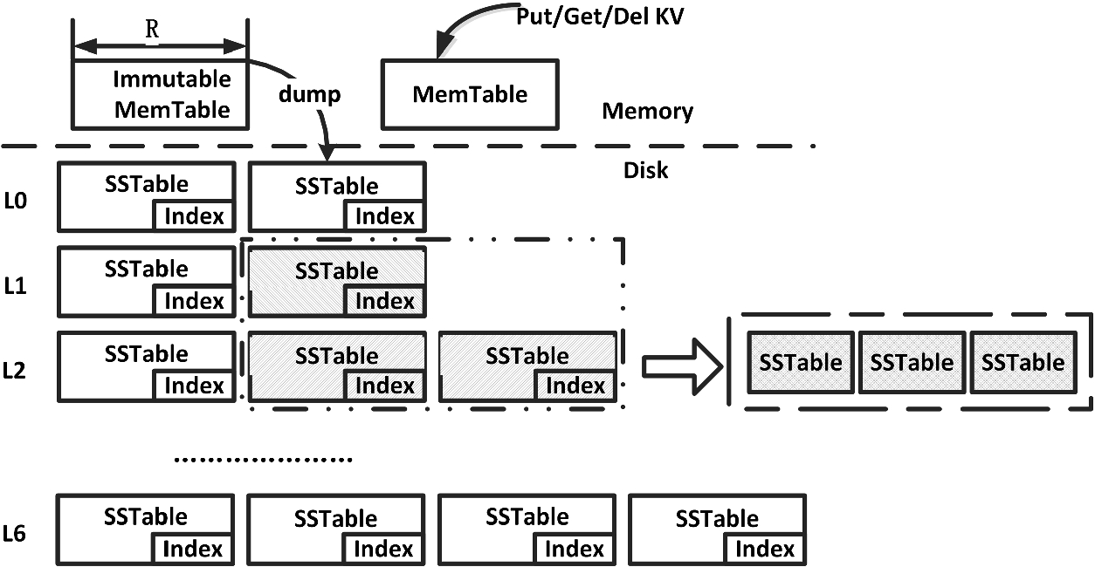
RocksDB Festival: RocksDB
RocksDB Architecture
RocksDB Architecture
19

Slide 20
RocksDB Festival: RocksDB
Main Terminology for RocksDB: MemTable
Memtable is an in-memory data-structure that holds data before being flushed to the SST file
When memtable full, it becomes immutable memtable
The background thread flushes the contents of the memtable to the SST file
Memtable has a skiplist structure
Insert and check first when performing Put() and Get()
Skiplist, HashSkiplist, HashLinklist, Vector
20

Slide 21
RocksDB Festival: RocksDB
Main Terminology for RocksDB: SSTable
SSTable (Sorted String Table)
SSTable that exist in levels other than L0 have an ordered state
Inside, there are data blocks, index blocks, bloom filter blocks, etc
Index block
The data block containing the range containing the lookup key is used for lookup
Has a binary search data structure
Bloom filter
Given an arbitrary key, this bit array may be used to determine if the key may exist or does not exist in the key set
21

Slide 22
RocksDB Festival: RocksDB
Main Terminology for RocksDB: Compaction
Compaction is for update
Prevents overlapping key-value pair from accumulating for existing key
Data in L0 is the hot data, and the lower level is the cold data
Compaction uses a background thread
Various Type
Leveled compaction, Tiered(Universal) compaction, FIFO compaction
22

Slide 23
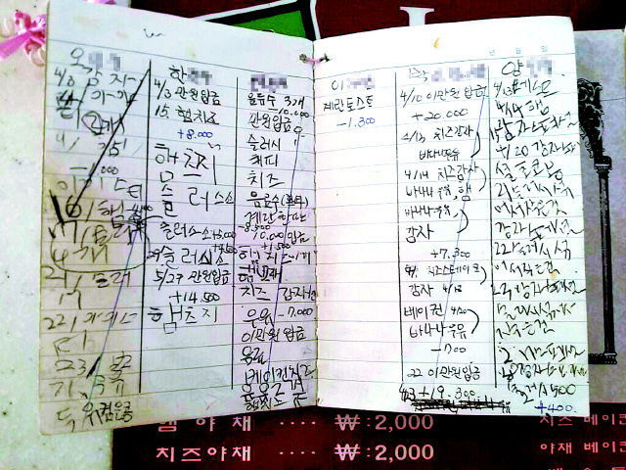
RocksDB Festival: RocksDB
Main Terminology for RocksDB: WAL(Write-Ahead-Log)
Record the WAL of memtable and disk for every update
Used for recovery in the event of an unexpected shutdown or error
Memtable securely as storage(disk) when flushed, the WAL is deleted.
23

Slide 24
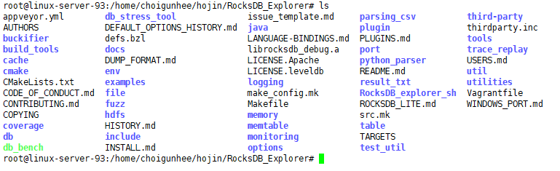
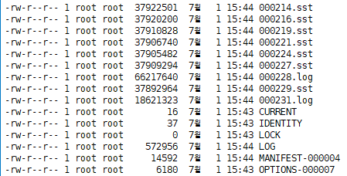
RocksDB Festival: RocksDB
RocksDB preview
24

Slide 25
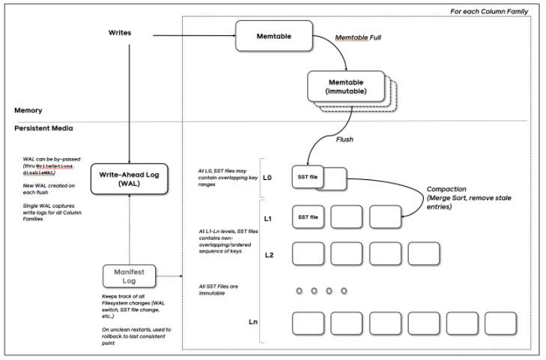
RocksDB Festival: RocksDB
Preview next week
RocksDB Architecture
RocksDB Operation (Compaction, WAL, Read, Write …)
RocksDB Benchmark
25

Slide 26
Discussion

