Slide 1
RocksDB Festival
Supported by IITP, StarLab.
July 5, 2021
김한얼, 이규열
yulmam1@naver.com
눈치 빨라지고 싶어요

Slide 2
RocksDB Festival
Title
Bloom filter
Bloom filter experiment
HDD, SSD
2

Slide 3
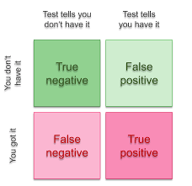
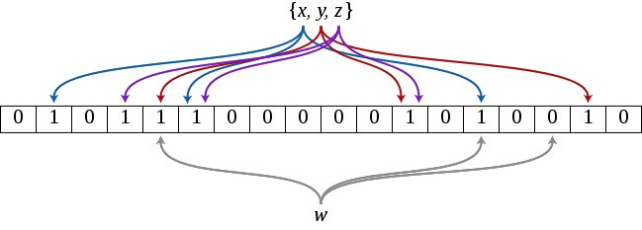
RocksDB Festival
Bloom filter
Wiki
A Bloom filter is a space-efficient probabilistic data structure, conceived by Burton Howard Bloom in 1970, that is used to test whether an element is a member of set.
Feature
false positive matches are possible, but false nagatives are not
즉 확실히 있다는 것에 초점이 맞춰진 자료구조가 아니라 확실히 없다는 것에 초점이 맞춰진 자료구조
3

Slide 4
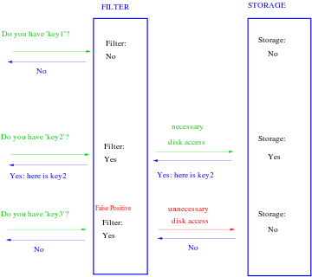
RocksDB Festival
Feature
4

Slide 5
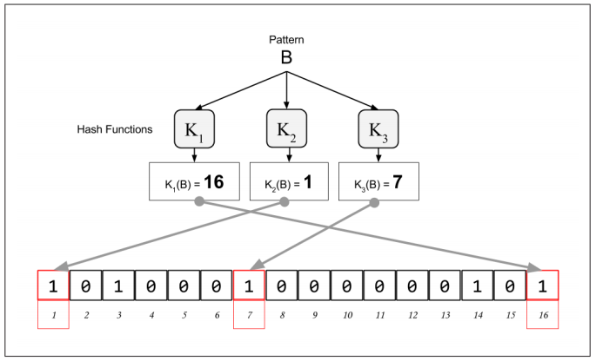
RocksDB Festival
Principle
5

Slide 6
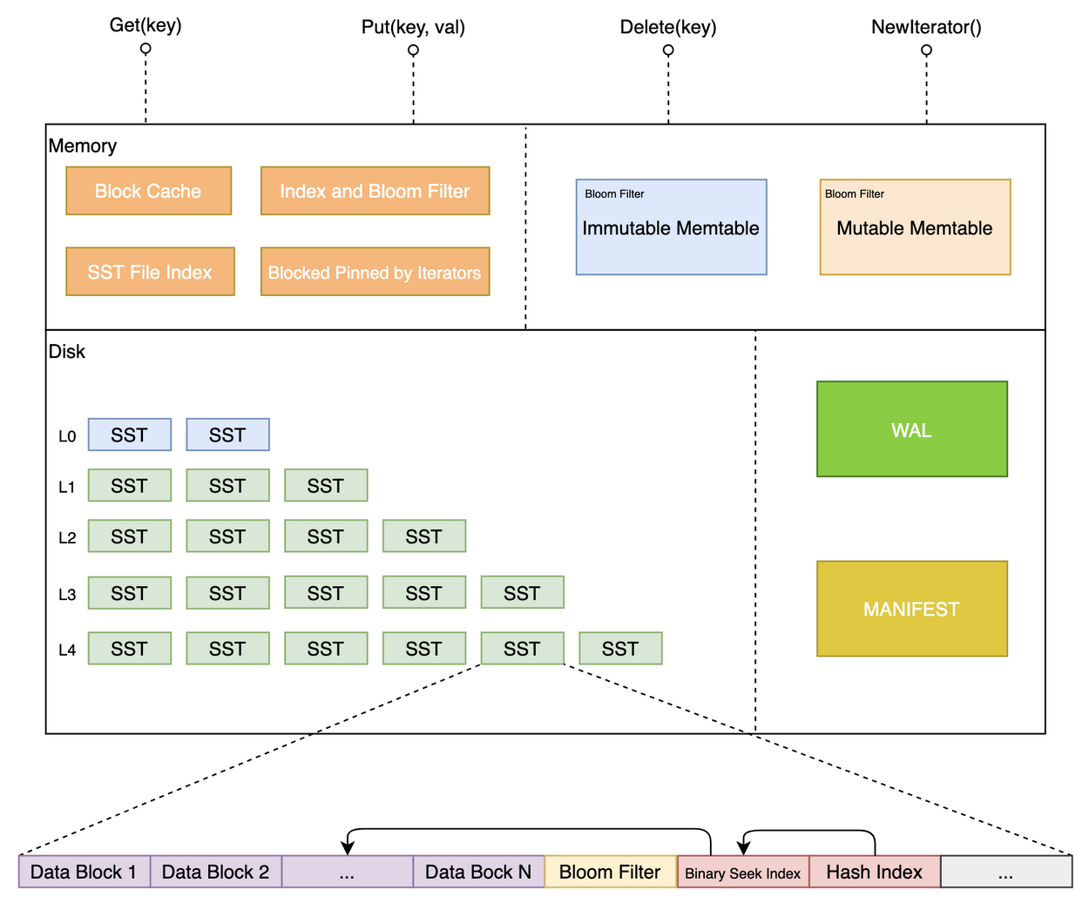
RocksDB Festival
SST table
6

Slide 7
RocksDB Festival
Old format(block based filter)
Original bloom filter creates filters for each individual data block in SST file
Given the target key, we goes to the index block to get the “data block ID” where this key may reside.
Using the “data block ID”, we goes to the filter block and get the correct “offset of filter”.
Using the “offset of filter”, we goes to the actual filter and do the checking.
New format(full filter)
New bloom filter creates filter for all keys in SST file
Given the target key, we goes directly to the filter block and conduct the filter checking.
7

Slide 8
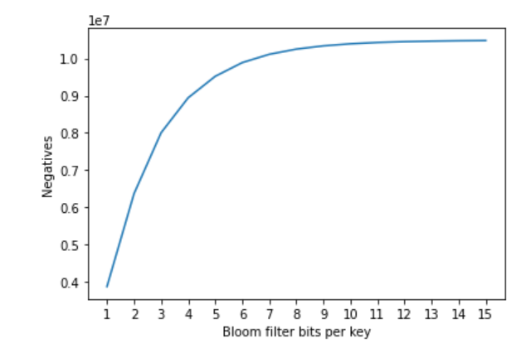
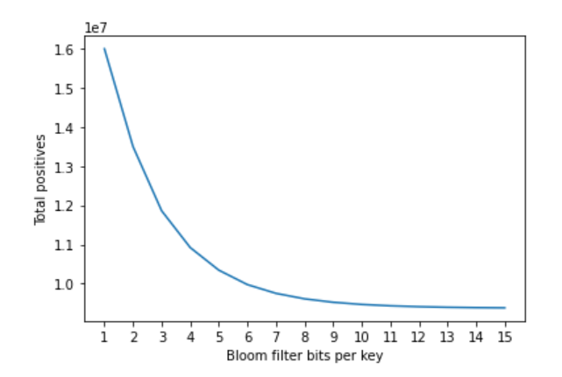
RocksDB Festival
readrandom num = 10,000,000 key = 16 value = 100 Full filter CPU Intel(R) Core(TM) i7-10510U
8

Slide 9
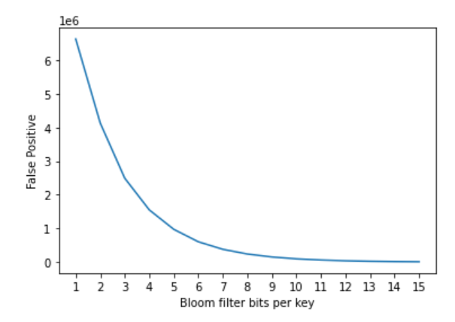
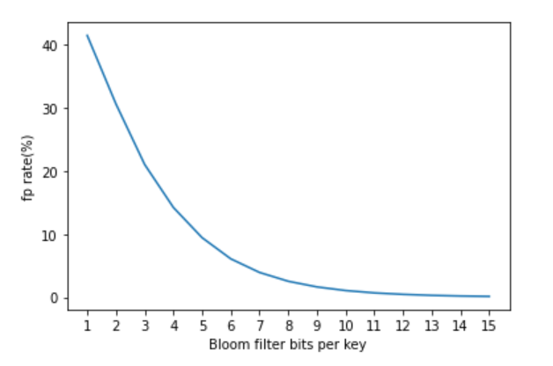
RocksDB Festival
9

Slide 10
RocksDB Festival
Trade off
Allocating more bits for each key can reduce the false positive rate, but the volume of all Bloom filters also increases
If the volume of Bloom filters exceeds the memory capacity, some filters will be swapped out to secondary storage, which induces extra I/Os and increases the read amplification.
Solution??
Some KV pairs are hot and frequently accessed, while most KV pairs are seldom accessed
allocate more bits to the Bloom filters for hot KV pairs
It’s not easy task…….
10

Slide 11
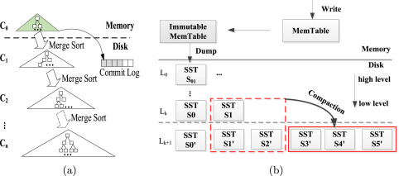
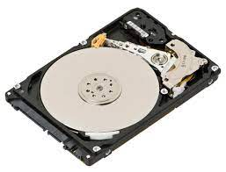
RocksDB Festival
HDD VS SSD
1. Differences between random and sequential performance
2. SSDs have a large degree of internal parallelism
3. SSDs can wear out through repeated writes
11

Slide 12
RocksDB Festival
NEXT WEEK
1. Experiments on hdd and ssd
2. SST File formats
12

