Slide 1
RocksDB Festival 2nd
Supported by IITP, StarLab.
July 2, 2021
박경미, 황예진
kmi0817@naver.com, hyj3463@naver.com
BGR

Slide 2
RocksDB Festival
Contents
Memtable & SSTable Overview
Related Options
Experiment
- memtable sizes
- SSTable sizes
- various memtable + SSTable sizes
- level0 file num compaction trigger
Next week
2

Slide 3
RocksDB Festival
Overview
Memory
Write
Memtable
Immutable
Memtable
Read
Disk
L0
SST
SST
L1
SST
SST
SST
WAL
L2
SST
SST
SST
SST
L3
SST
SST
SST
SST
SST
3

Slide 4
RocksDB Festival
Discussion
Occurred Write-Amplification
How can we reduce write amplification?
reduce number of compaction…
Disk
L0
SST
SST
L1
SST
SST
WAL
SST
SST
SST
L2
SST
SST
SST
SST
L3
SST
SST
SST
SST
SST
4

Slide 5
RocksDB Festival
Experiment Info
RocksDB version 6.21
CPU 1 * Intel(R) Core(TM) i5-7500 CPU @ 3.40GHz
Key 16 bytes
Values 1KB
Entries 4,000,000
Other options are defaults
5

Slide 6
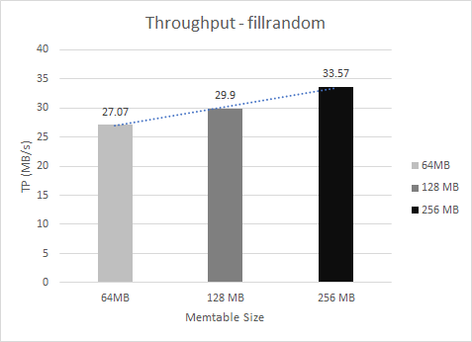
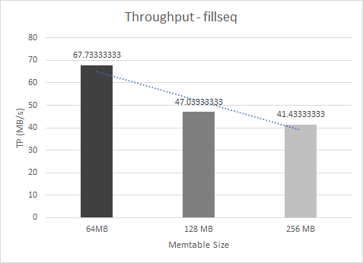
RocksDB Festival
Experiment
memtable sizes
Immutable
Memtable
Memtable
Immutable
Memtable
Memtable
Why...?
6

Slide 7
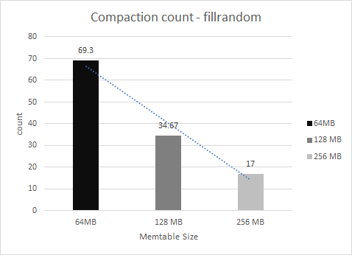
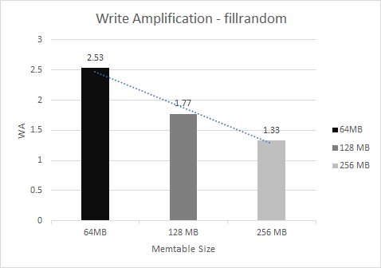
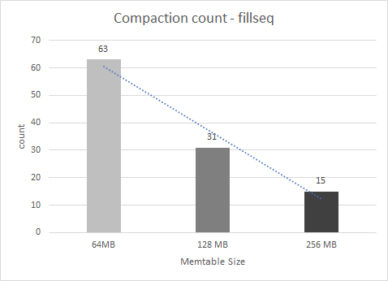
RocksDB Festival
Experiment
memtable sizes
Do not affect WA when sequential write
7

Slide 8
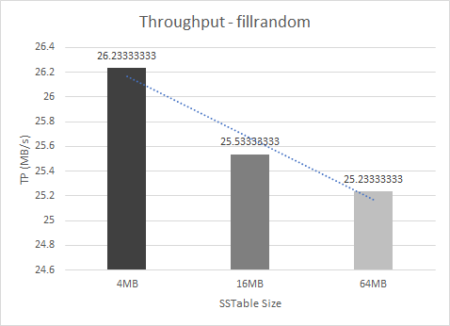
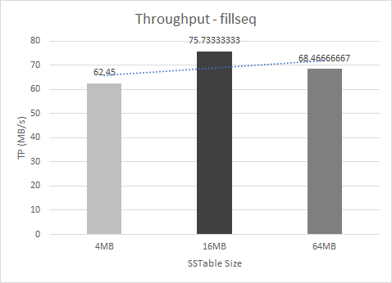
RocksDB Festival
Experiment
SSTable sizes
SST
64MB
SST
16MB/4MB
SST
※ 1MB, 256KB, 64KB… too many open files
8

Slide 9
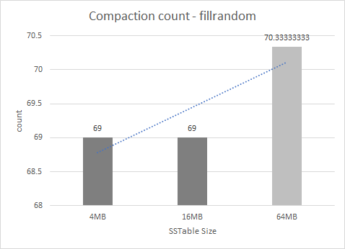
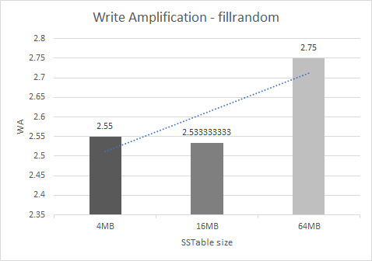
RocksDB Festival
Experiment
SSTable sizes
Reduce both compaction and WA when smaller
+) Do not affect sequential write.
9

Slide 10
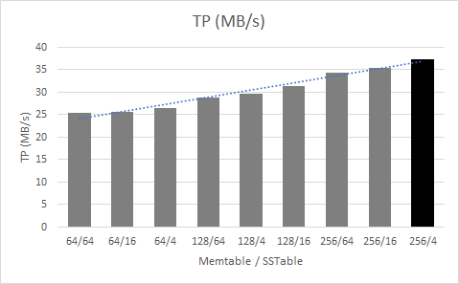
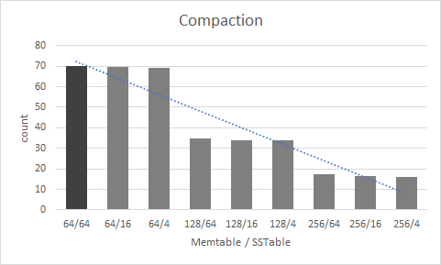
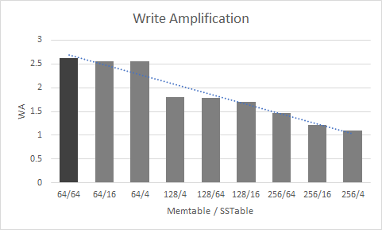
RocksDB Festival
Experiment
various memtable(64,128,256MB) + SSTable sizes(4,16,64MB)
10

Slide 11
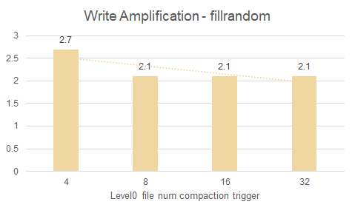
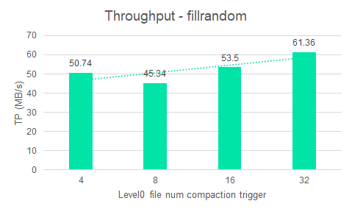
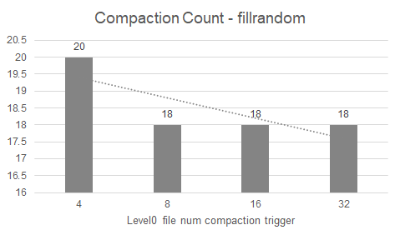
RocksDB Festival
Experiment
level0 file num compaction trigger
The number of WA and compaction does
not continue to decrease.
but, Throughput increases.
11
Notes:
./db_bench --level0_file_num_compaction_trigger=N --value_size=1024 --benchmarks="fillrandom,readrandom,stats"

Slide 12
RocksDB Festival
Next week
Disadvantages of increasing memtable size
Performance differences depending on cache size (the options remain the same)
Change the number of memtable
Use max_background_compactions, max_background_flushes
Other ways to reduce Write Amplification !
12

Slide 13

Discussion

