Slide 1
RocksDB Festival
Supported by IITP, StarLab.
July 19, 2021
강정현, 김산, 허진
rilac1@naver.com, waterfog9580@gmail.com, jinh2352@gmail.com
Team: JSJ

Slide 2
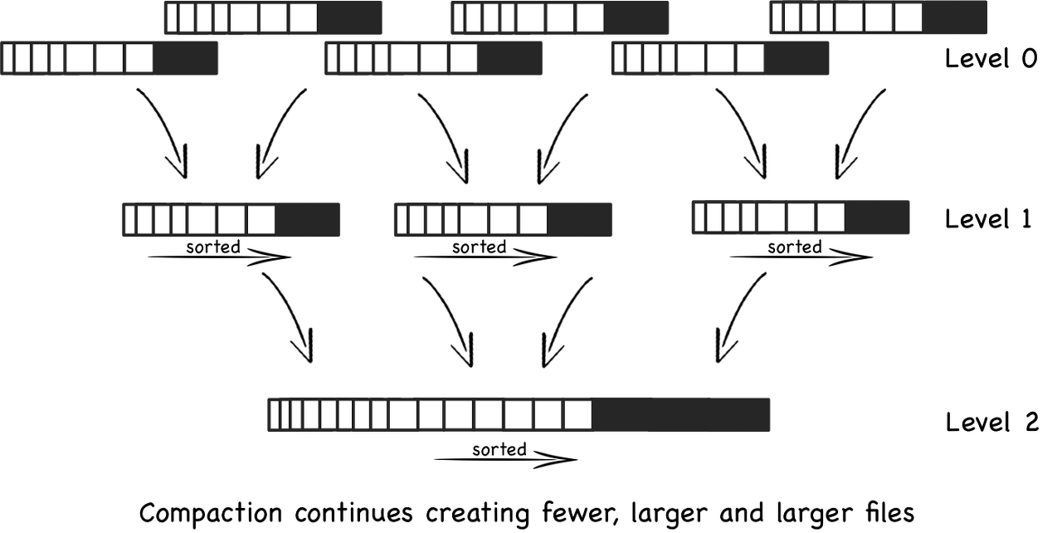
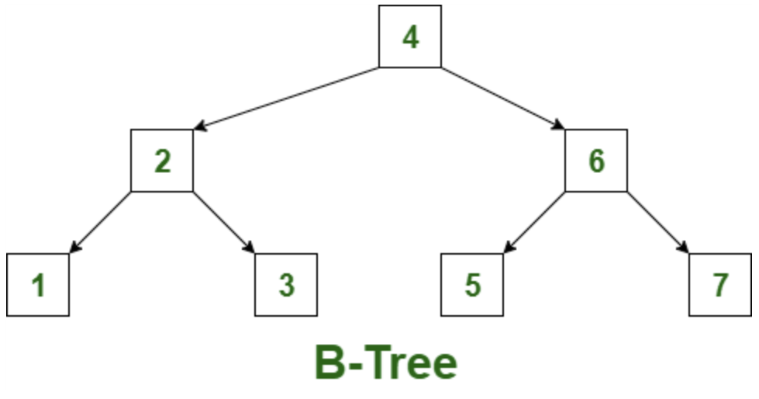
RocksDB Festival
RocksDB vs MongoDB
Data Structure
Rocks DB
Mongo DB
LSM-Tree
(out-place update)
-> Write Good!
B-Tree
(in-place update)
-> Read Good!
2

Slide 3
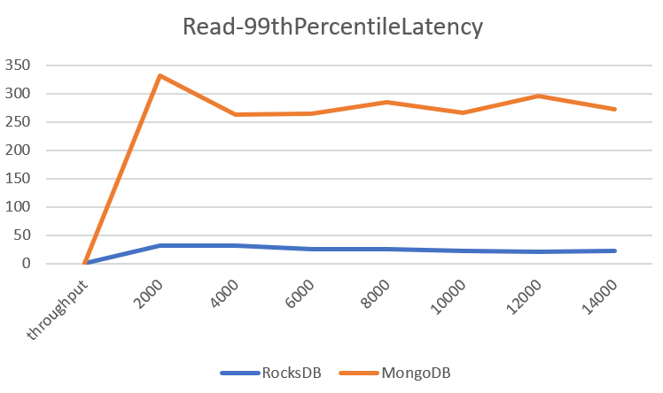
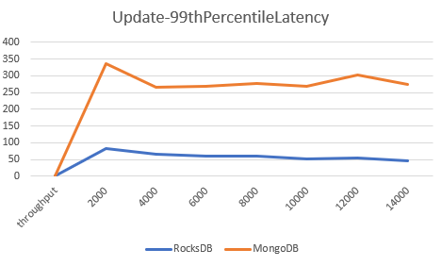
RocksDB Festival
RocksDB vs MongoDB
YCSB Bench
Latency : 99thPercentile Latency
Throughput : Operation/sec (YCSB의 target 옵션을 통해 제한하면서 실험 진행)
Record : 100,000
Workload : Read(50%), Write(50%)
3
Notes:
RocksDB: 임베디드 데이터베이스
MongoDB: 분산처리 방식의 데이터베이스

Slide 4


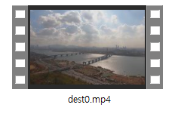
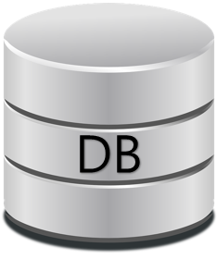
RocksDB Festival
RocksDB vs MongoDB
Mongo / Rocks
PUT
GET
latency Check
4

Slide 5
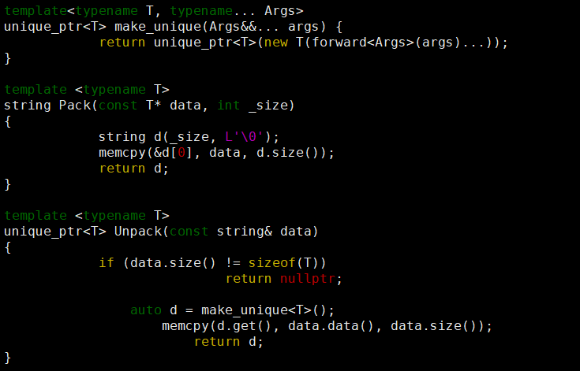
RocksDB Festival
RocksDB PUT & GET API
RocksDB API only supports std::string types.
Need to pack
input string(binary)

Slide 6
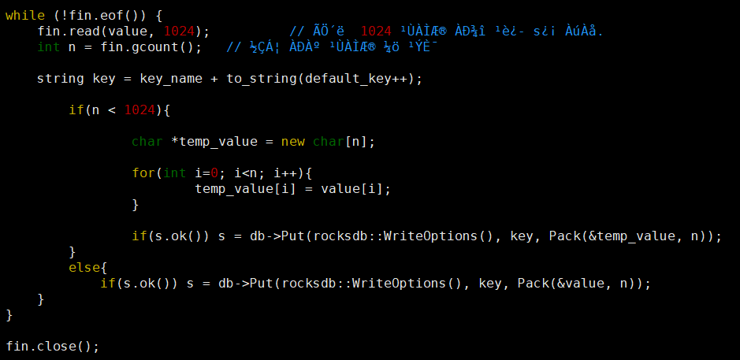
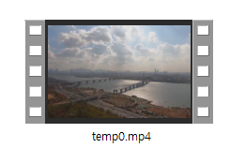
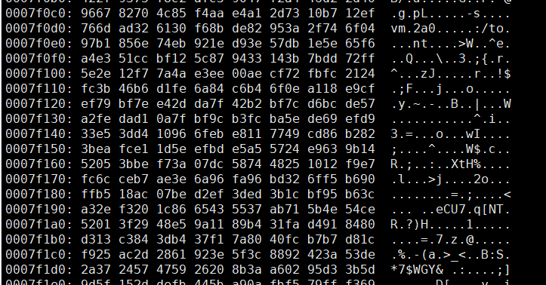
RocksDB Festival
Key
1024B
Key
1024B
Key
1024B
Key
398B

Slide 7
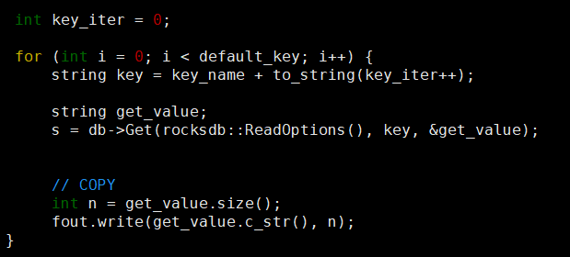
RocksDB Festival
Key
1024B
Key
1024B
Key
1024B
Key
398B

Slide 8
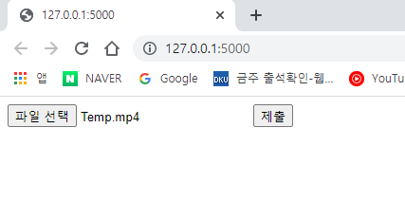
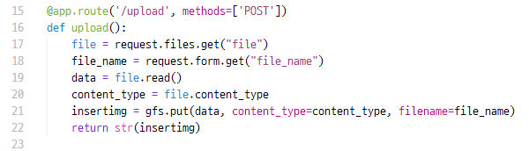
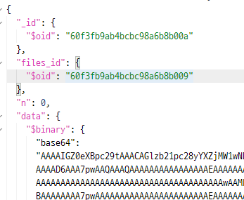
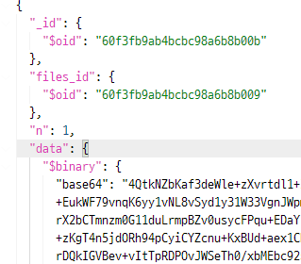
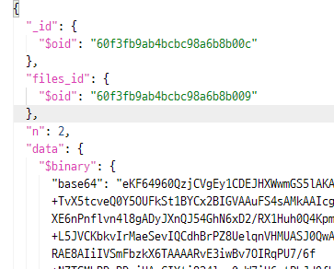
RocksDB Festival
MongoDB
GridFS
8

Slide 9
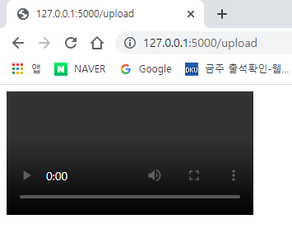
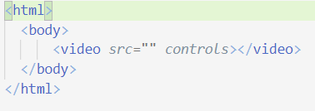
RocksDB Festival
MongoDB
Video Upload
???
9

Slide 10

Discussion

