Slide 1
The Design and Implementation of a Log-Structured File System
Rosenblum, M., & Ousterhout, J. K., 1992 ACM Transactions on Computer Systems
2024. 07. 10
Presentation by Nakyeong Kim
nkkim@dankook.ac.kr

Slide 2
Introduction
Design
Log-structured File System
Segment Cleaning
Crash Recovery
Evaluation
Conclusion
Key Take Away

Slide 3
1. Introduction
Background
Main memories are dramatically grown up
Large file caches can absorb read requests
Disk traffic will become dominated by writes
Disk’s random I/O performance is very poor
Decreasing mechanical cost is limited
Existing file systems(e.g., FFS) spread information in disk: many small accesses
Bandwidth usage for new data is less than 5%
Metadata is written synchronously
Floppy disk,
Tape, CD-ROM …
HDD
Flash-based SSD
80’s PC era
BSD FFS
SunOS 4.0.3
Linux project started
1984
1989
1991
1992
Published
Notes:
HDD

Slide 4
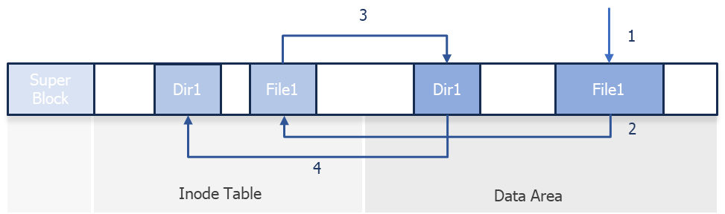

1. Introduction
Log-structured File System
Write all changes to disk sequentially in a single operation ➔ Log
Convert small synchronous random writes to large asynchronous sequential transfers ➔ Write buffer
FFS
LFS

Slide 5
1. Introduction
Write buffer
Memory
Flush
Disk
…
Log-structured File System
Sequential write (Log)
Write all changes to disk sequentially in a single operation ➔ Log
Convert small synchronous random writes to large asynchronous sequential transfers ➔ Write buffer
FFS
LFS

Slide 6
1. Introduction
Write buffer
Memory
Flush
Disk
…
Log-structured File System
Sequential write (Log)
Write all changes to disk sequentially in a single operation ➔ Log
Convert small synchronous random writes to large asynchronous sequential transfers ➔ write buffer
FFS
LFS
🤔
1. How to retrieve information from log?
2. How to manage free space on disk?

Slide 7
2. Design
Metadata
Data
Direct block 0
Data
How to retrieve information from log?
…
Direct block 9
Data
Indirect block 0
Block
Inode structure
Same as FFS
Written in append like data: not fixed position
“Inode map” map inode number and disk address
Inode map also keep moving
…
Data
Inode
inum
address
file1
2
dir1
4
…
…
Super Block
File1
Data
File1
Inode
Dir1
Data
Dir1
Inode
Inode Map
…
Address
0
1
2
3
4
5
Notes:
- Threading: 유효한 데이터를 제자리에 두고 새로 쓴 free extent를 연결한다. 이는 더 심각한 단편화를 초래하며, 큰 연속 쓰기가 불가능해진다.
Copying: 유효한 데이터를 기존과 다른 위치에 새로 쓴다.

Slide 8

2. Design
How to retrieve information from log?
Inode structure
Same as FFS
Written in append like data: not fixed position
“Inode map” map inode number and disk address
Inode map also keep moving
Checkpoint region(fixed) update inode map’s address periodically
inum
address
file1
3
dir1
5
…
…
Super Block
Checkpoint Region
File1
Data
File1
Inode
Dir1
Data
Dir1
Inode
Inode Map
…
…
Address
0
1
2
3
4
5
6
Notes:
- Threading: 유효한 데이터를 제자리에 두고 새로 쓴 free extent를 연결한다. 이는 더 심각한 단편화를 초래하며, 큰 연속 쓰기가 불가능해진다.
Copying: 유효한 데이터를 기존과 다른 위치에 새로 쓴다.

Slide 9
2. Design
Segment summary block: identify contents of segment
Segment usage table: counts valid data and store last write time
How to manage free space on disk?
Segment
Large fixed-size extents (512KB ~ 1MB)
Write in append
Read data sequentially from beginning to end
Segment summary block contains the file number and block number (per write)
Out-of-place update (need to be cleaned)
Write buffer
Memory
Flush
…
Disk
Segment 1
Segment 2
Segment 3
Sequential write
Data
Data
Inode
Data
Inode
Inode Map
Segment Usage Table
Not used
Segment Summary Block
Notes:
최초에는 disk가 하나의 커다란 extent이지만, 데이터 수정이 반복되면서 내부 단편화가 생긴다. Free space를 효율적으로 관리하기 위해 threading, copying과 같은 방식이 사용되었으나, LFS에서는 이들의 혼합 기법을 사용한다.
Threading: 유효한 데이터를 제자리에 두고 새로운 free extent를 찾는다. 이는 더 심각한 단편화를 초래하며, 큰 연속 쓰기가 불가능해진다.
Copying: 유효한 데이터를 기존과 다른 위치에 새로 쓴다.

Slide 10
2. Design
Segment Cleaning
Make free spaces by removing invalid data
Executed when # of clean segments drops below threshold
Clean a few tens of segments (typically 50~100) at a time
Identify which blocks of each segment are valid (which block belongs to each file)
If block pointer is valid, it is a live (no free block list or bitmap)
It distinguishes blocks overwritten or deleted
It is also useful during crash recovery
Notes:
3, 4 is primary factor

Slide 11
2. Design
Invalid data
Initial data
Updated data
Segment Cleaning
Read selected segments into memory
Identify valid data
Write valid data back to new segments
A: 1
B: 2
C: 3
A: 4
B: 5
D: 6
E: 7
E: 8
C: 3
A: 4
B: 5
D: 6
E: 8
Segment old
Segment new
Notes:
3, 4 is primary factor

Slide 12
2. Design
Invalid data
Initial data
Updated data
Segment Cleaning
Read selected segments into memory
Identify valid data
Write valid data back to new segments
A: 1
B: 2
C: 3
A: 4
B: 5
D: 6
E: 7
E: 8
C: 3
A: 4
B: 5
D: 6
E: 8
Segment old
Segment new
1. Which segmentation should be cleaned?
2. How should valid blocks be grouped when written out?
Notes:
3, 4 is primary factor

Slide 13
2. Design
Invalid data
Initial data
Updated data
Segment Cleaning
Read selected segments into memory
Identify valid data
Write valid data back to new segments
A: 1
B: 2
C: 3
A: 4
B: 5
D: 6
E: 7
E: 8
A: 1
B: 2
C: 3
A: 4
B: 5
D: 6
E: 7
E: 8
C: 3
A: 4
B: 5
D: 6
E: 8
A: 1
B: 2
C: 3
A: 4
B: 5
D: 6
E: 7
E: 8
Segment old
Segment new
1. Which segmentation should be cleaned?
2. How should valid blocks be grouped when written out?
Notes:
3, 4 is primary factor

Slide 14
2. Design
Simulator
Settings
Use 4KB files
Overwrite one of files with new data
Constant disk utilization(75%), no read traffic
Run until all clean segments are exhausted
Random access pattern
Uniform: same selection probability per segments
Hot-and-cold: locality
Hot: 10% of files, 90% of times
Cold: 90% of files, 10% of times
Notes:
To compare cleaning policies, we define write cost.
Low disk utilization means that the count of valid data in segment is low and copy overhead grow decreasing.

Slide 15
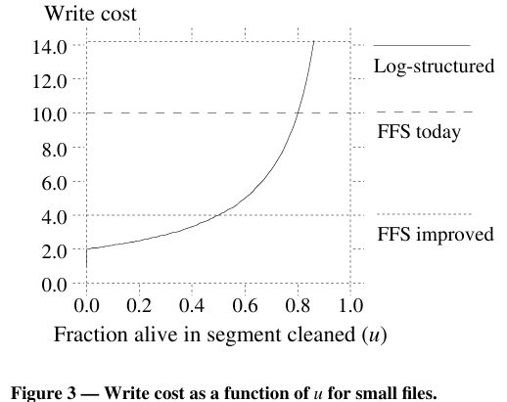
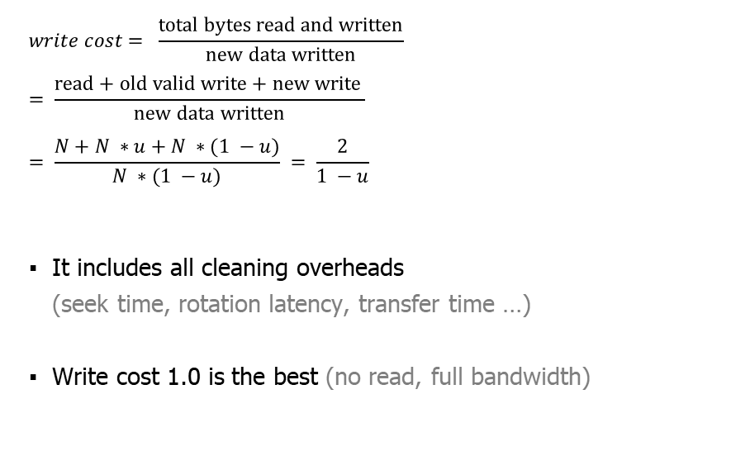

2. Design
$u$: utilization of segments, still valid, inverse of bandwidth
$N$: count of segments
Segment Cleaning Cost
$$write cost= \frac{\text{total} \text{bytes} \text{read} \text{and} \text{written}}{\text{new} \text{data} \text{written}}= \frac{\text{read}+\text{old} \text{valid} \text{write}\text{ + }\text{new} \text{write} }{\text{new} \text{data} \text{written}}$$
$$= \frac{N+N ∗u+N ∗(1 −u)}{N ∗(1 −u)} = \frac{2}{1 −u}$$
It includes all cleaning overheads (seek time, rotation latency, transfer time …)
Write cost 1.0 is the best (no read, full bandwidth)
Notes:
To compare cleaning policies, we define write cost.
Low disk utilization means that the count of valid data in segment is low and copy overhead grow decreasing.

Slide 16
2. Design
$u$: utilization of segments, still valid, inverse of bandwidth
$N$: count of segments
Segment Cleaning Cost
$$write cost= \frac{\text{total} \text{bytes} \text{read} \text{and} \text{written}}{\text{new} \text{data} \text{written}}= \frac{\text{read}+\text{old} \text{valid} \text{write}\text{ + }\text{new} \text{write} }{\text{new} \text{data} \text{written}}$$
$$= \frac{N+N ∗u+N ∗(1 −u)}{N ∗(1 −u)} = \frac{2}{1 −u}$$
It includes all cleaning overheads (seek time, rotation latency, transfer time …)
Write cost 1.0 is the best (no read, full bandwidth)
Logging, delayed writes,
disk request sorting
Notes:
To compare cleaning policies, we define write cost.
Low disk utilization means that the count of valid data in segment is low and copy overhead grow decreasing.

Slide 17
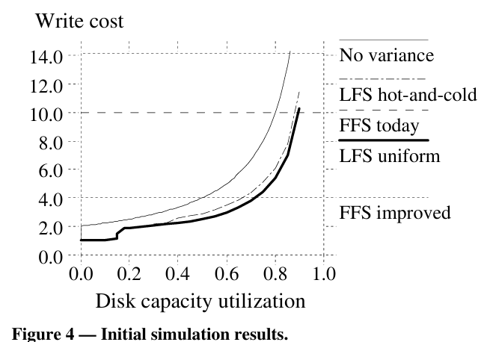
2. Design
Segment Cleaning Cost based on Access Pattern
Cleaner used greedy policy (least-utiilized segments)
Segment utilization and disk utilization ⬇ ➔ performance and storage cost⬆
For high performance + low cost ➔ bimodal segment distribution
Localized pattern(better grouping) result worse performance than no locality
Notes:
To compare cleaning policies, we define write cost.
Low disk utilization means that the count of valid data in segment is low and copy overhead grow decreasing.

Slide 18
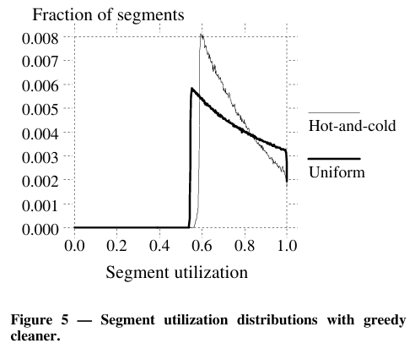
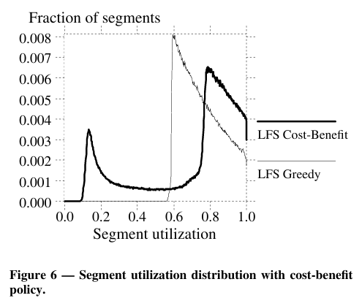

2. Design
Hot segments
Cold segments
Segment Selection Policy
Greedy
Select least-utilized segments
Cold segments linger very long time (more valuable)
Hot and cold segments must be treated differently
Cost-benefit
$\frac{\text{benefit}}{\text{cost}} = \frac{\text{free} \text{space} \text{generated}\text{ ∗ }\text{age} \text{of} \text{data}}{\text{cost}}= \frac{\left(1 − u\right) ∗ age}{1 + u}$
Select grouped segments by age
Allow cold segments to be cleaned at much higher than hot
Notes:
To compare cleaning policies, we define write cost.
Low disk utilization means that the count of valid data in segment is low and copy overhead grow decreasing.

Slide 19
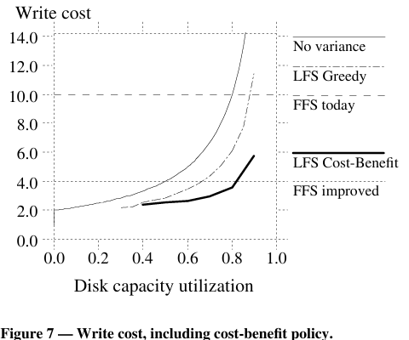
2. Design
Cost-Benefit Policy
Use cost-benefit policy in hot-and-cold access pattern
Reduce write cost by as 50% over
Get better even as locality increases
x2
Notes:
Higher locality, worse performance
Under greedy policy, segment doesn’t get cleaned until it becomes the least utilized. So, every segment’s utilization drops to cleaning threshold including cold segments

Slide 20
2. Design
Segment summary block: identify contents of segment
Segment usage table: counts valid data and store last write time
Crash Recovery
If crashed, check the latest checkpoint: roll-forward
Because updating checkpoint region executed periodically, there is likely to be non-updated data
Recover recently-written file data from segment summary blocks
If block indicates presence of new inode, update inode map
If not, new version of file on disk incomplete (ignore)
Adjust utilizations in segment usage table
To restore consistency between directories and inodes, log includes “directory operation log”
checkpoints
crash
roll-forward

Slide 21
3. Evaluation
Environment
Comparison
Sprite LFS
SunOS 4.0.3
Machine
Sun-4/260 with 32MB RAM
Sun SCSI3 HBA
Wren IV disk (1.3MB/sec): 300MB formatted
SunOS: 8KB block size
Sprite LFS: 4KB block size, 1MB segment
Notes:
3, 4 is primary factor

Slide 22
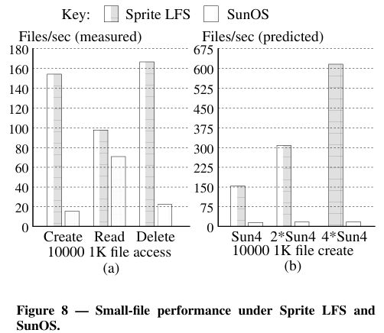
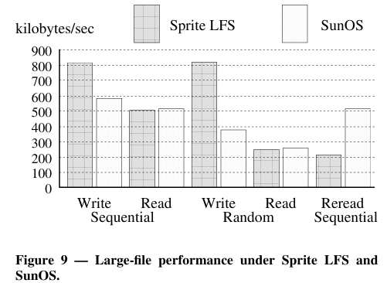
3. Evaluation
Benchmark
Assume no cleaning happened
x10
Small file performance
High speed for creation and deletion
Disk busy:
Sprite LFS: 17%
SunOS: 85%
Large file performance
Higher write bandwidth (faster for random I/O)
Low performance in case of reading file sequentially after written randomly
Notes:
3, 4 is primary factor

Slide 23
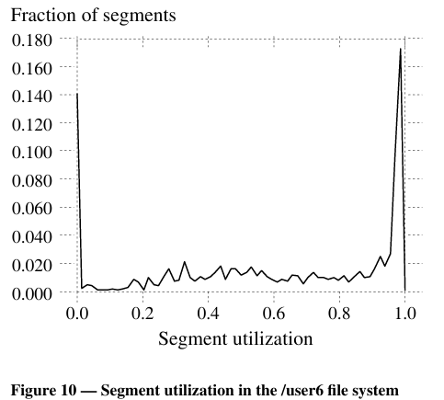
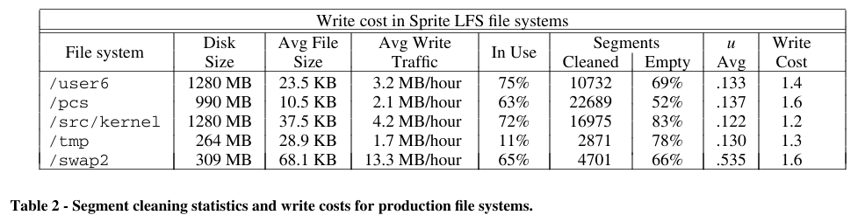
3. Evaluation
Record statistics over a period of 4 months
Cleaning Overhead with Real File System
Never written
Cleaning overhead limit long-term write performance to 70% of maximum sequential write bandwidth
More than half of segments cleaned were totally empty
There are a few differences between simulated and real-world environments (more locality)
Disk capacity utilization
Notes:
Higher locality, worse performance
Under greedy policy, segment doesn’t get cleaned until it becomes the least utilized. So, every segment’s utilization drops to cleaning threshold including cold segments

Slide 24
4. Conclusion
Disk random I/O performance is very bad, and existing FSs(like FFS) have many small synchronous random writes. We propose an LFS that uses a write buffering, append-only(log) approach to make all writes sequential, asynchronous, one large operation.
To efficiently manage free space, we use a segment with a fixed size of large extent and perform a segment cleaning process to clean up invalid data. To determine which segments to clean, we adopt a cost-benefit policy that considers the age of the data.
Compared to FFS, LFS outperforms in all cases except reads to large files. In practice environment, there is much overhead than predicted.

Slide 25
5. Key Take Away
 | LFS | NAND flash based SSD
Structure | Append-only, Erase-Before-Write
Write Unit | Extent (based on write buffer) | Page
Erase Unit | Segment | Block
Operation
Free Space Mgmt. | Segment Cleaning | Garbage Collection
Mapping | Inode Map, Segment Summary Block | LPN to PPN

Slide 26

Q&A

Slide 27
Thank you!

