Slide 1
LeaFTL: A Learning-based Flash Translation Layer for Solid-State Drives
Jinghan Sun, Shaobo Li, Yunxin Sun, Chao Sun, Dejan Vucinic, and Jian Huang. 2023.
In Proceedings of the 28th ACM International Conference on Architectural Support for Programming Languages and Operating Systems, Volume 2 (ASPLOS 2023).
2024. 07. 31
Presentation by Yeongyu Choi
choiyg@dankook.ac.kr

Slide 2
Introduction
Background
LeaFTL
Evaluation
Conclusion

Slide 3
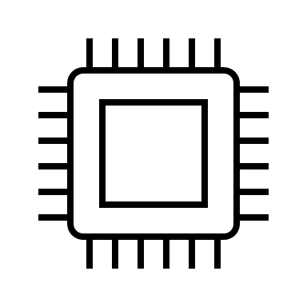



Introduction
Embedded Processor
DRAM Buffer
DRAM
Controller
Less Scalable
- High Cost
- Limited Capacity
SSD
PCIe Interface
Internal Bus
Flash Controller
Flash Channels
Flash
Block
…
Flash
Block
SSD DRAM is still the Bottleneck

Slide 4
Introduction
Modern SSDs
Address Mapping Table
Logical Address | Physical Address
LPA0 | PPA0
LPA1 | PPA1
… | …
Direct LPA-PPA mappings require 8 Bytes per mapping
SSD
RAM
DRAM Capacity can’t keep up with SSD Capacity

Slide 5

Approaches on Mappings
Page-Level Mapping:
Direct LPA-PPA mapping for fast lookup
Entire mapping table requires large storage space
Block-Level Mapping:
Reduce mapping table size by storing via blocks
Other Approaches
Instead of 1:1 mapping in Page-level Mapping
Exploit learning techniques to identify various LPA-PPA mapping patterns
Overhead in Lookup in flash page
Hybrid Mapping:
Takes advantage of a mix of Page-level and Block-level Mappings
Incurs in significant GC Overhead

Slide 6
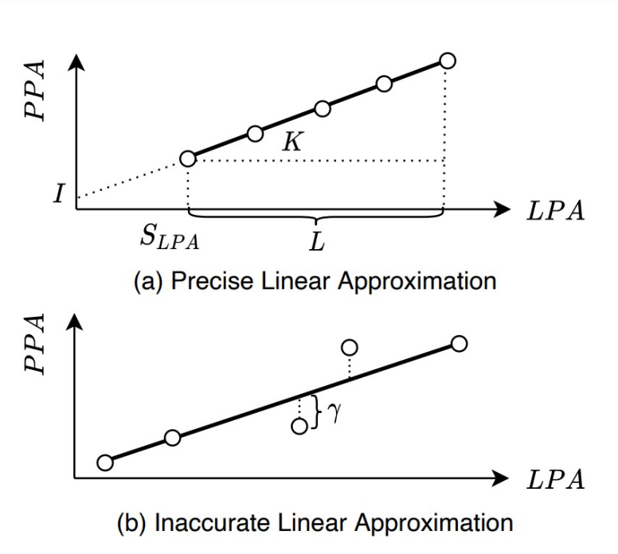
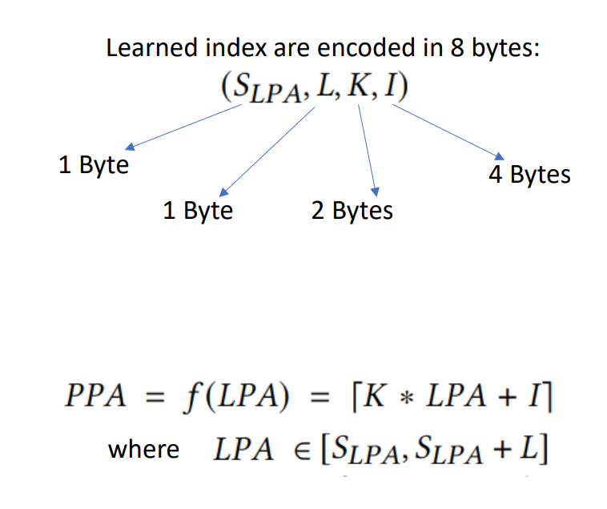
Learning-Based Techniques

Slide 7
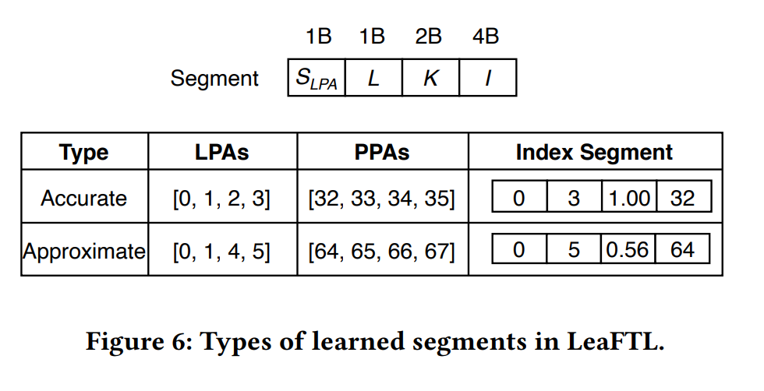
Learned Index Segment
Accurate segments
Approximate segments
Piecewise Linear Regression
(Accurate segments)
Exact PPA
(Approximate segments)
Not exact PPA, error bound [−𝛾,𝛾]
LPA = 2
⌈1.00 ∗ 2 + 32⌉
[ K * LPA + I]
PPA = 34
LPA = 4
⌈0.56 ∗ 4 + 64⌉
[ K * LPA + I]
PPA = 66.24(67)

Slide 8

Log-Structed Address Mapping Table
Piecewise Linear Regression
Non-overlapping segments are sorted by their LPA ranges
Overlapping segments are allowed across levels
Level 0
32 48
100 200
202 210
Level 1
16 127
206 240

Slide 9
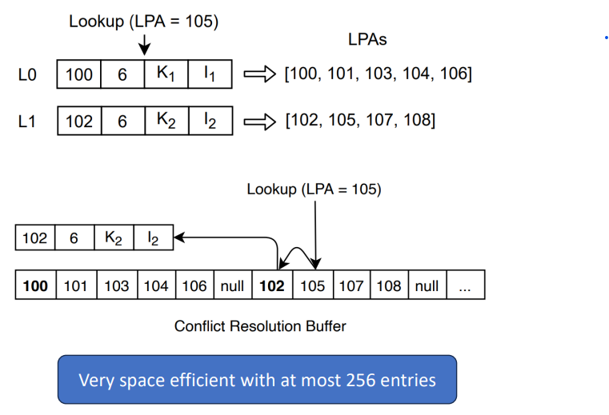
Conflict Resolution Buffer
Possible to get inaccurate PPA
- Affect to segment compaction
CRB is a nearly sorted list, follows its insertion deletion and lookup are fast
Each LPA takes only 1 byte and its structured guarantees no redundant LPAs
Separate segments

Slide 10

Log-Structured Table Operations
Workload
Write
LPA $∈206\sim 240$
Piecewise Linear Regression
New segments are appended to the topmost level
Level 0
16 127
206 240
Level 1
If it is approximate it is added to CRB

Slide 11

Log-Structured Table Operations
Workload
Write
LPA $∈32\sim 48$
Piecewise Linear Regression
New segments are appended to the topmost level
Level 0
32 48
206 240
Level 1
16 127
If it is approximate it is added to CRB

Slide 12

Log-Structured Table Operations
Workload
Read
LPA $=80$
Search from the topmost level, and always find the first matching segment
Level 0
32 48
100 128
206 240
Level 1
16 127
Level 2
0 256

Slide 13
Log-Structured Table Operations
Level 0
0 48
49 128
206 255
Level 0
0 128
172 205
206 255
Level 1
16 127
Level 1
Level 2
32 128
172 255
Level 2
Before Compaction
After Compaction

Slide 14

Misprediction Verification with OOB Metadata (OOB:Out-of-Band)
Workload
Read
LPA $=32$
LPA verification with the reverse mapping
Learned Mapping Table
Predicted PPA
OOB
Flash Page
PPA2
PPA3
PPA4
PPA5
Flash Data | LPA3
OOB stores the corresponding LPA for the flash page

Slide 15
Verifying Address Translation with OOB Metadata (OOB:Out-of-Band)
Workload
Read
LPA $=32$
Learned Mapping Table
Predicted PPA
Flash Page
PPA2
PPA3
PPA4
PPA5
OOB
OOB
OOB
OOB
OOB
misprediction happens
It is time consuming to search the correct flash page

Slide 16
Verifying Address Translation with OOB Metadata (OOB:Out-of-Band)
Workload
Read
LPA $=32$
Learned Mapping Table
Predicted PPA
Flash Page
PPA2
PPA3
PPA4
PPA5
Flash Data | LPA3

Slide 17
Verifying Address Translation with OOB Metadata (OOB:Out-of-Band)
LPA verification with the reverse mapping
Workload
Read
LPA $=32$
Learned Mapping Table
PPA1 | PPA2 | PPA3 | PPA4 | PPA5
LPA1 | LPA2 | LPA3 | LPA4 | LPA5
Predicted PPA
Flash Page
PPA2
PPA3
PPA4
PPA5
Flash Data | OOB
OOB stores an accurate reverse mapping of 2γ + 1 neighbor flash pages

Slide 18
Verifying Address Translation with OOB Metadata (OOB:Out-of-Band)
Workload
Read
LPA $=32$
Learned Mapping Table
PPA1 | PPA2 | PPA3 | PPA4 | PPA5
Accurate Flash Page
LPA1 | LPA2 | LPA3 | LPA4 | LPA5
Flash Page
PPA2
PPA3
PPA4
PPA5
Reducing the misprediction penalty from log(γ) flash page reads to only one flash read

Slide 19
Optimized Flash Allocation
Flushed flash pages
Write Buffer
LPA=76 | 32 | 33 | 34 | 77 | 38 | 41 | 17 | 15 | 36 | … | …
Four new linear segments are created
Learned Mapping Table
76
32 34
77
38
76 | 32 | 33
34 | 77 | 38
Flash Blocks
Flushing flash pages from the write buffer directly is less optimal
Flash Chip

Slide 20
Optimized Flash Allocation
Flushed flash pages
Write Buffer
LPA=32 | 33 | 34 | 38 | 76 | 77 | 41 | 17 | 15 | 36 | … | …
Fewer linear segments are created
Learned Mapping Table
32 38
76 77
32 | 33 | 34
36 | 76 | 77
Active Blocks
Optimization: Flash pages are sorted by their LPAs before flushed from the write buffer
Flash Chip

Slide 21
Coordinated Garbage Collection
Valid pages
Garbage Collection
Write Buffer
Learned Address Mapping
New segments are learned and updated to the topmost level
Valid pages
L0
76 | 32 | 33
34 | 15 | 77
Invalid pages
L1
L2
Flash Chip
Address Mapping Table

Slide 22
Coordinated Garbage Collection
Valid pages
Garbage Collection
Write Buffer
Learned Address Mapping
New segments are learned and updated to the topmost level
Valid pages
L0
76 | 32 | 33
34 | 15 | 77
Invalid pages
L1
L2
Flash Chip
Address Mapping Table
LeaFTL learns new segments to avoid messing up existing segments in GC

Slide 23
Put It All Together
I/O Request
Block I/O Interface
Write-back
Data Cache
LPA Lookup
Write Buffer
Mapping Table Updates
Learned Mapping Table
L0
SLPA ELPA
Verification with OOB Metadata
Optimized
Block
Allocation
L1
L2
Write to Flash Blocks
Read Flash Page
…
…
Check OOB
Flash
Flash
Flash
OOB
OOB
OOB

Slide 24
Evaluation
Implementation Details
SSD configuration
Parameter | Value | Parameter | Value
Capacity | 2TB | #Channels | 16
Page size | 4KB | OOB Size | 128B
DRAM size | 1GB | Pages/block | 256
Read latency | 20us | Write latency | 200us
Erase | 1.5ms | Overprovisioning ratio | 20%
- WiscSim Simulator
- A Real 1TB Open-Channel SSD with 16 channels
Workloads
Comparison
- Block I/O Traces: from enterprise servers and university servers
- Data-Intensive Applications: FileBench, BenchBase
DFTL: Demand-based caching FTL
S-FTL: Compresses sequential LPA-PPA entries
LeaFTL with different error bounds (0, 1, 4, 8, 16)

Slide 25
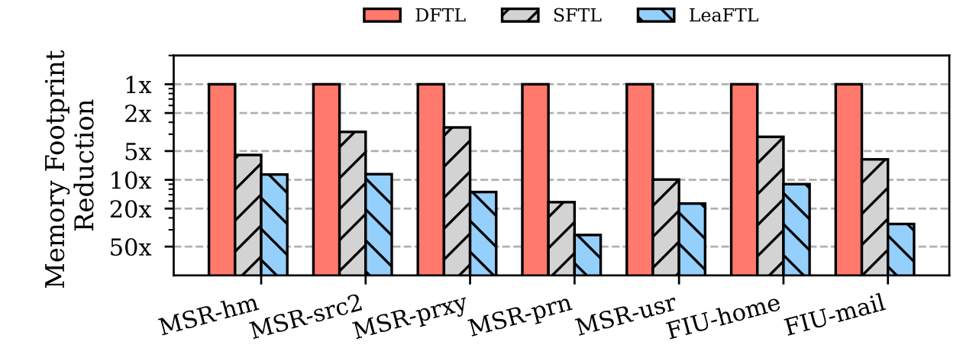
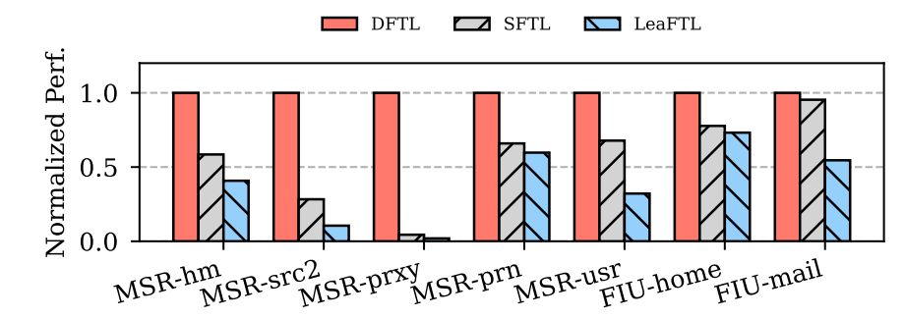
Evaluation
Memory Footprint Analysis & Performance Analysis
Avg. x2.9 memory saving
Lower is Better
Avg. x1.4 reduced storage access latency

Slide 26
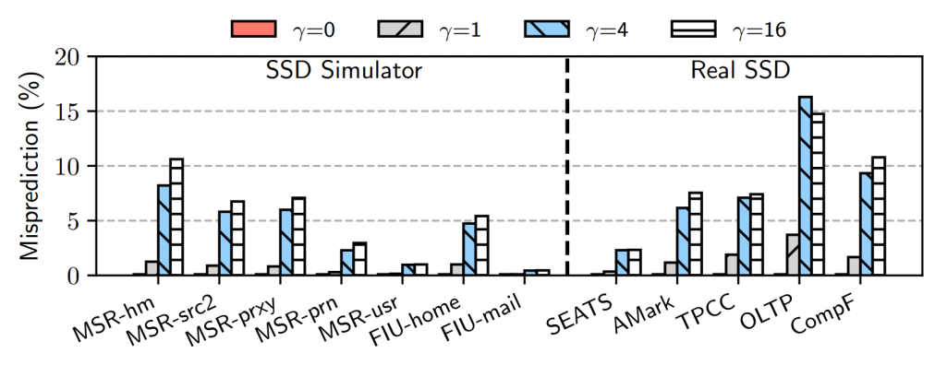
Evaluation
Misprediction
Error bound γ = 16,
misprediction ratio <10% Avg.
Every misprediction incurs in only one additional flash read

Slide 27
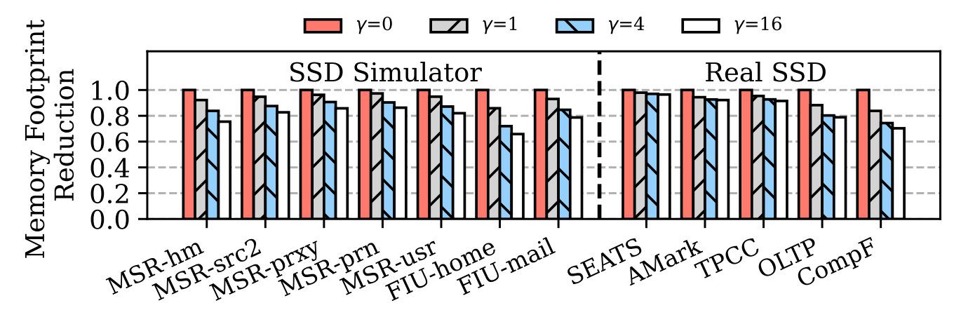
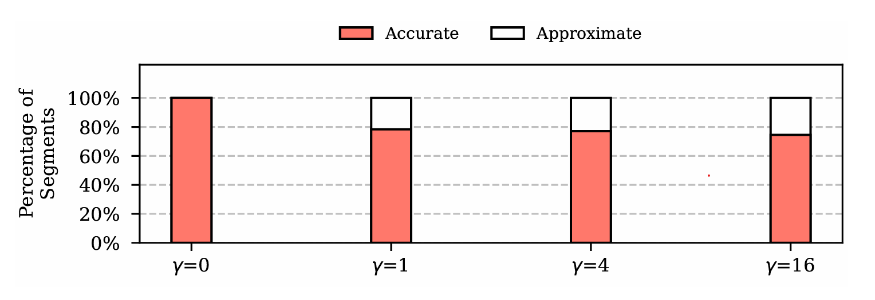
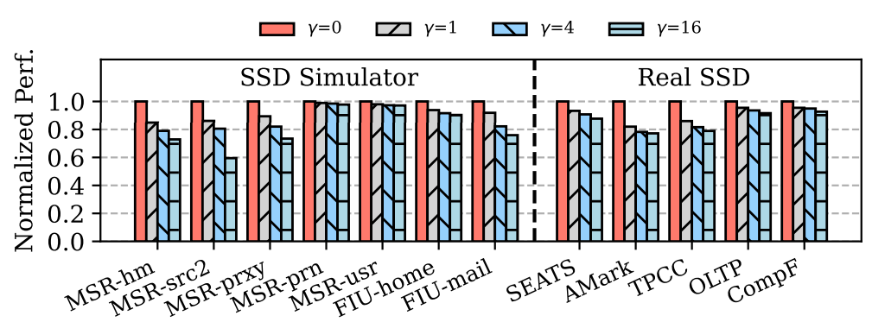
Evaluation
Memory Footprint Analysis on Different γ
Avg. x1.3 memory saving (Real SSD Avg. x1.2)
Lower is Better
Avg. x1.3 reduced storage access latency
(Real SSD Avg. x1.2)

Slide 28
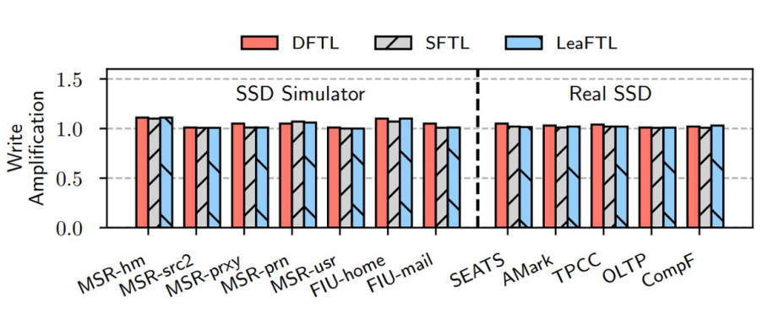
Evaluation
Write Amplification Factor Analysis
WAF, the ratio between the actual and requested flash writes
Lower is Better

Slide 29
Conclusion
LeaFTL uses a simple but effective learning-based technique to reduce memory consumption
LeaFTL stores learned segments in a log-structured manner to avoid re-learning
LeaFTL uses OOB metadata to verify its address translation
LeaFTL consumes 2.9x less memory and improves performance by 1.4x

Slide 30
Thank you

