Slide 1
LevelDB-Study
Team_Cache Benchmark Experiment
Made by Subin Hong, Seungwon Ha
E-Mail: zed6740@dankook.ac.kr, 12gktmddnjs@naver.com

Slide 2
Contents 1. Cache Definition 2. LRU Cache Structure in LevelDB 3. Benchmark Experiment 3-1. Hypothesis 3-2. Design 3-3. Run Experiment 3-4. Result and Discussion
Cache Definition
- What is Cache
LRU Cache Structure in LevelDB
- What is LRU, analysis LRU structure in leveldb
Benchmarks Experiment
- Hypothesis, Design, Run Experiment, Result and Discussion

Slide 3
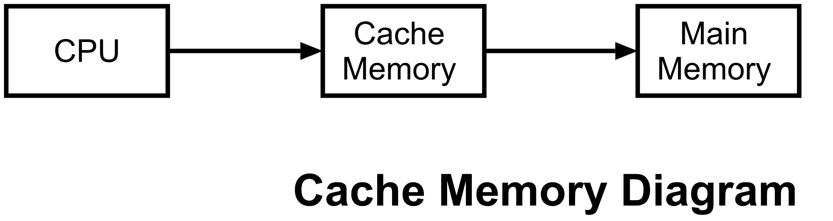
Cache Definition - What is Cache

Slide 4
Cache Definition - What is Cache
Cache vs Main Memory
+ Fast access
High cost
Small capacity
- Slow access
+ Cheap cost
+ Big capacity

Slide 5
LRU Cache Structure in LevelDB -What is LRU
LRU(Least Recently Used)
Access | Hit/Miss | Evict | Cache state
0 | Miss |  | 0

Slide 6
LRU Cache Structure in LevelDB -What is LRU
LRU(Least Recently Used)
Access | Hit/Miss | Evict | Cache state
0 | Miss |  | 0
1 | Miss |  | 0,1

Slide 7
LRU Cache Structure in LevelDB -What is LRU
LRU(Least Recently Used)
Access | Hit/Miss | Evict | Cache state
0 | Miss |  | 0
1 | Miss |  | 0,1
2 | Miss |  | 0,1,2

Slide 8
LRU Cache Structure in LevelDB -What is LRU
LRU(Least Recently Used)
Access | Hit/Miss | Evict | Cache state
0 | Miss |  | 0
1 | Miss |  | 0,1
2 | Miss |  | 0,1,2
0 | Hit |  | 1,2,0

Slide 9
LRU Cache Structure in LevelDB -What is LRU
LRU(Least Recently Used)
Access | Hit/Miss | Evict | Cache state
0 | Miss |  | 0
1 | Miss |  | 0,1
2 | Miss |  | 0,1,2
0 | Hit |  | 1,2,0
1 | Hit |  | 2,0,1

Slide 10
LRU Cache Structure in LevelDB -What is LRU
LRU(Least Recently Used)
Access | Hit/Miss | Evict | Cache state
0 | Miss |  | 0
1 | Miss |  | 0,1
2 | Miss |  | 0,1,2
0 | Hit |  | 1,2,0
1 | Hit |  | 2,0,1
3 | Miss | 2 | 0,1,3
Least Recently Used…. (2)

Slide 11
LRU Cache Structure in LevelDB -What is LRU
LRU(Least Recently Used)
Access | Hit/Miss | Evict | Cache state
0 | Miss |  | 0
1 | Miss |  | 0,1
2 | Miss |  | 0,1,2
0 | Hit |  | 1,2,0
1 | Hit |  | 2,0,1
3 | Miss | 2 | 0,1,3
0 | Hit |  | 1,3,0

Slide 12
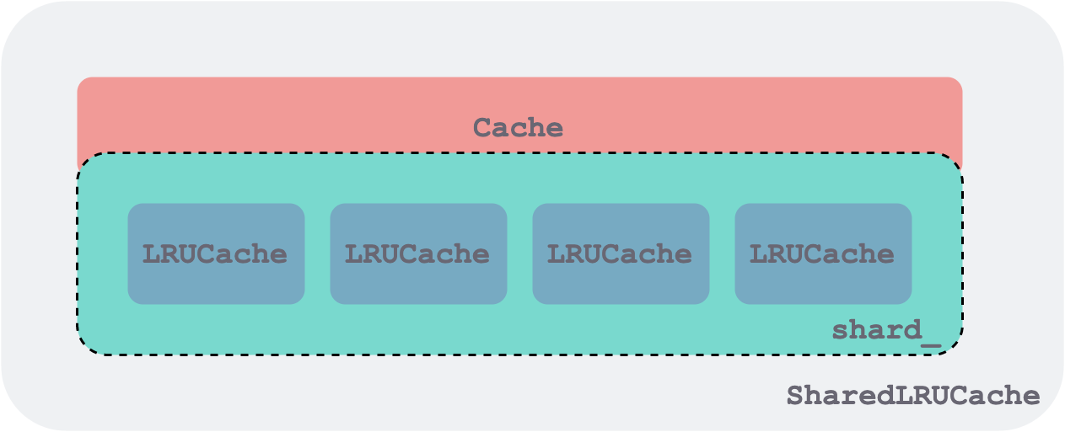
LRU Cache Structure in LevelDB - sharding in LevelDB

Slide 13
LRU Cache Structure in LevelDB - sharding
What is sharding?
Separate the data because of the capacity issue

Slide 14
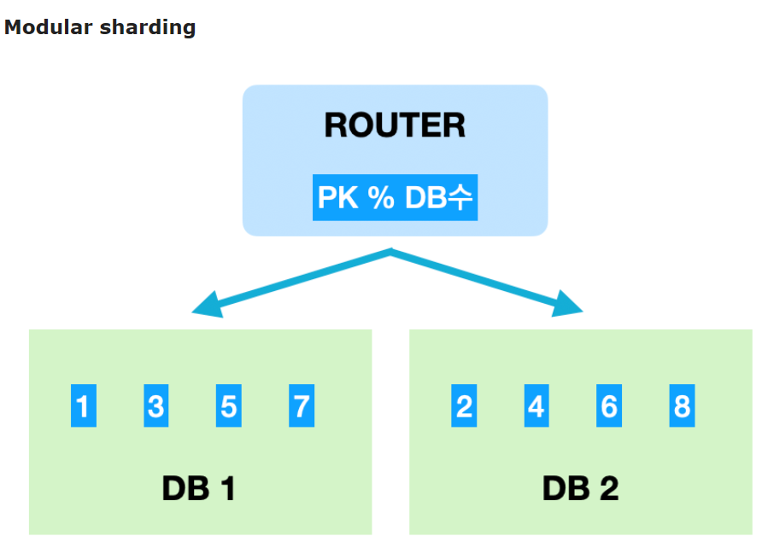
LRU Cache Structure in LevelDB - sharding

Slide 15
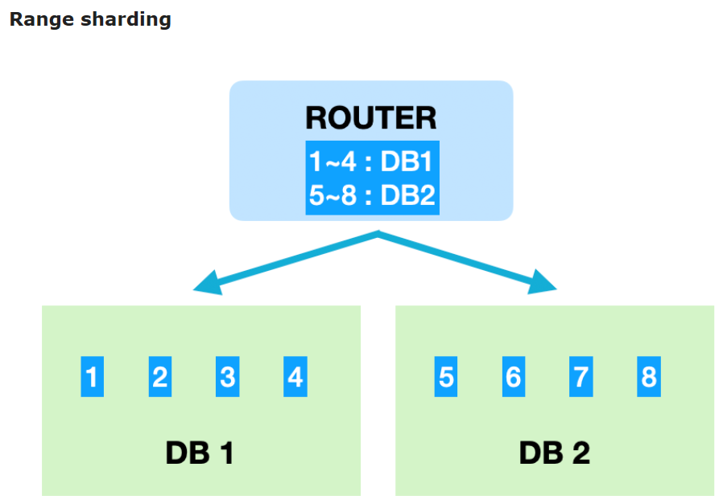
LRU Cache Structure in LevelDB - sharding

Slide 16
LRU Cache Structure in LevelDB - sharding in LevelDB

Slide 17
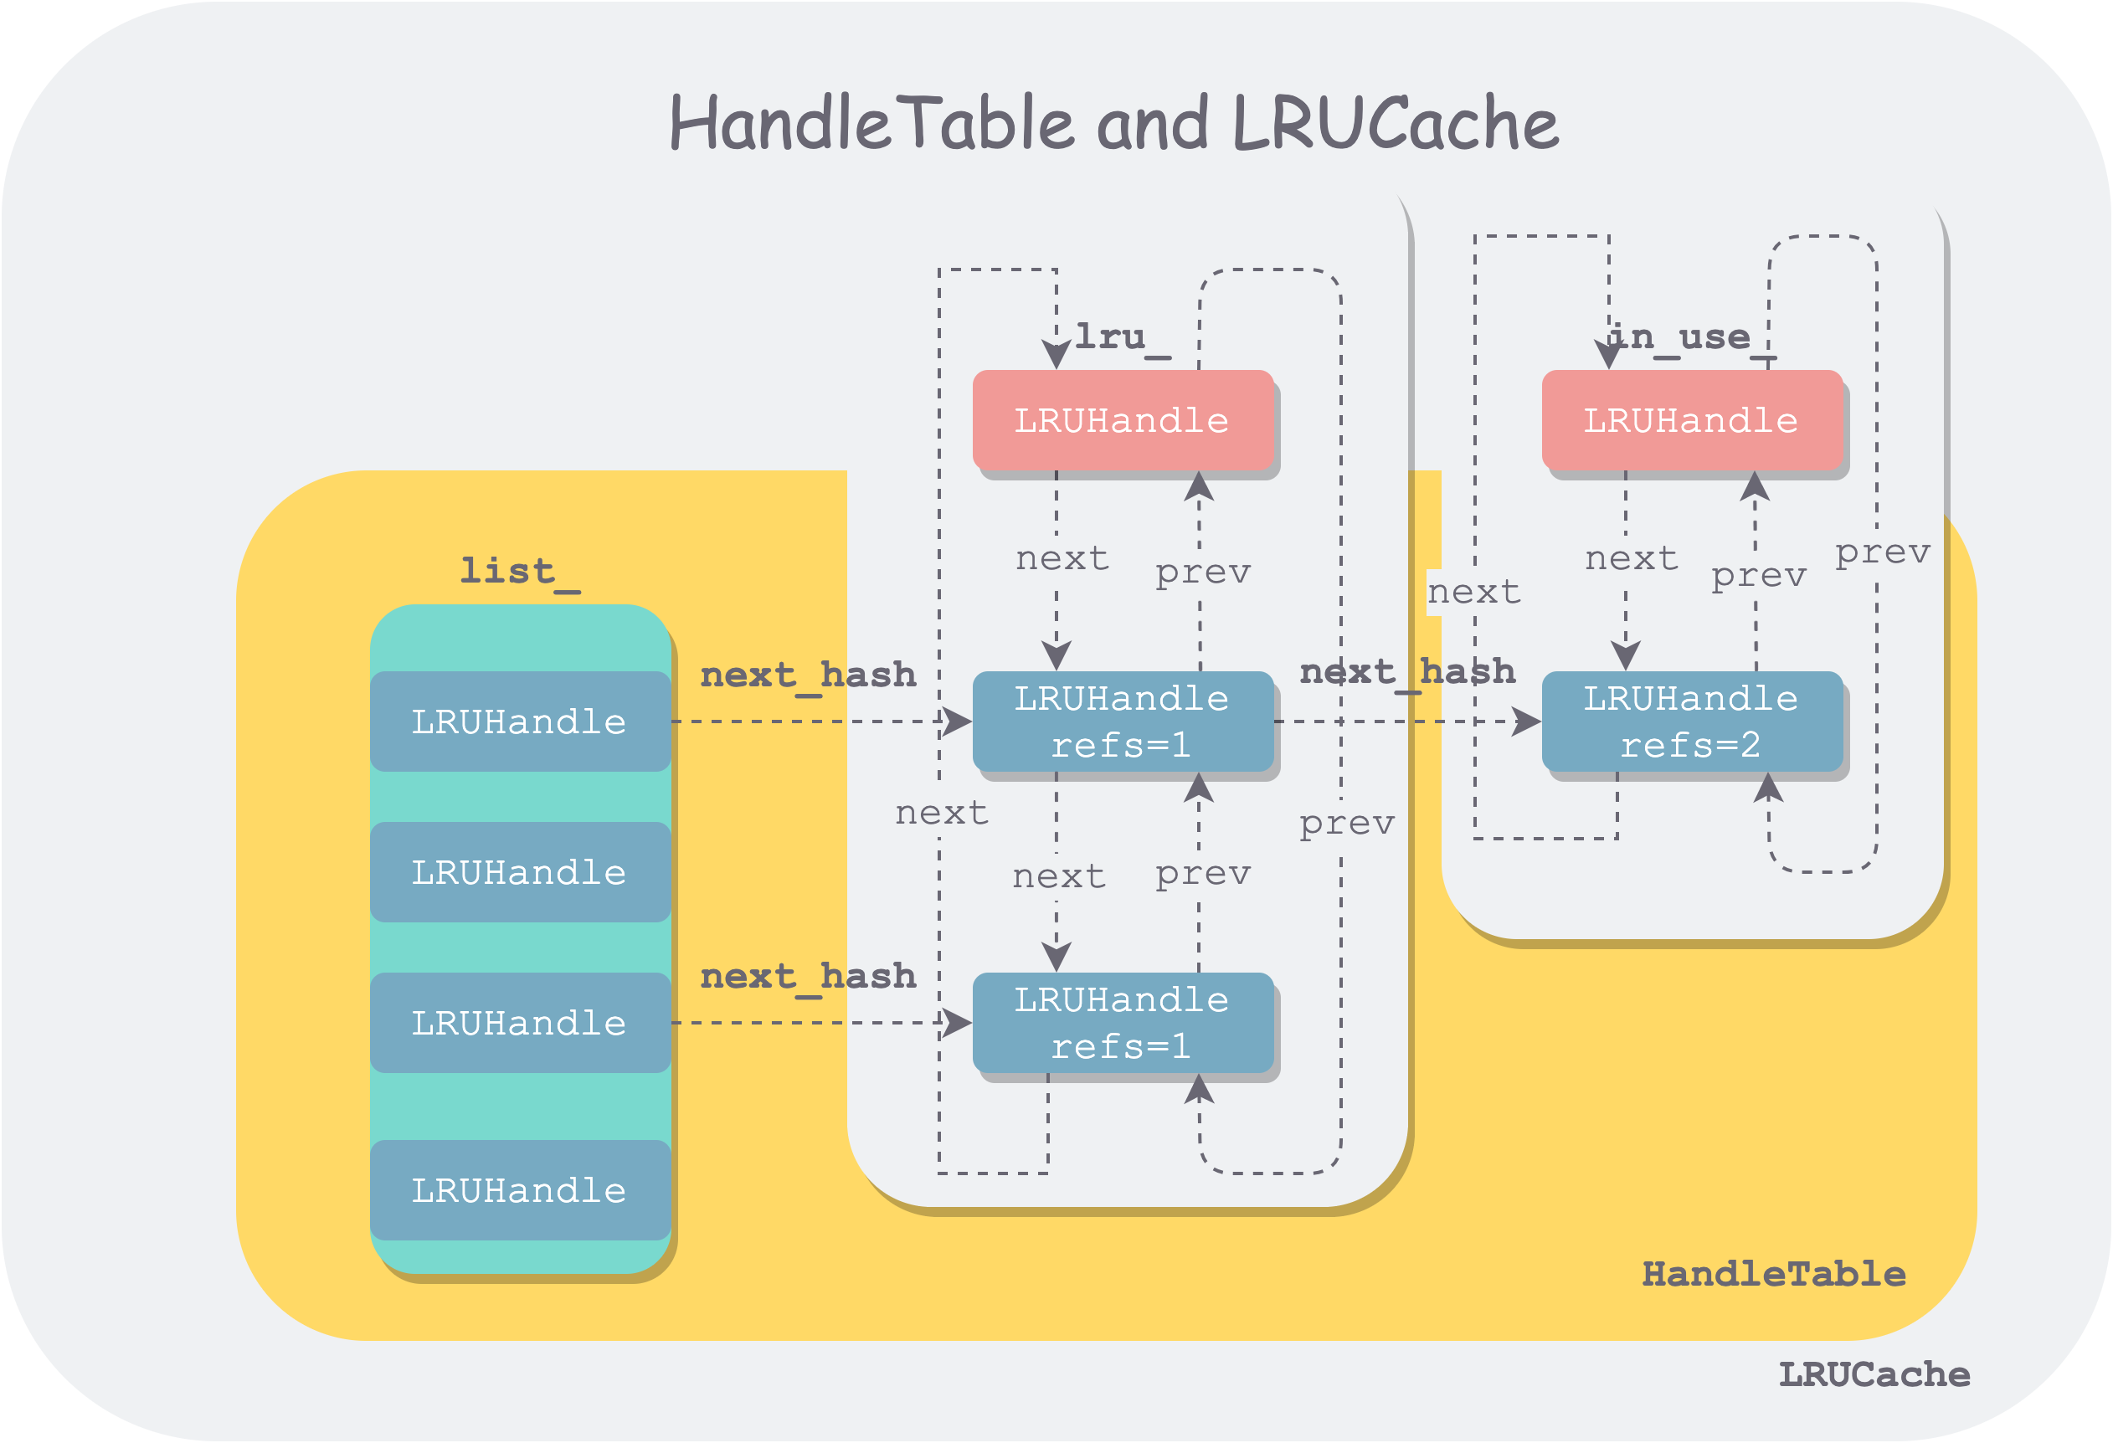
LRU Cache Structure in LevelDB - analysis LRU structure in leveldb

Slide 18
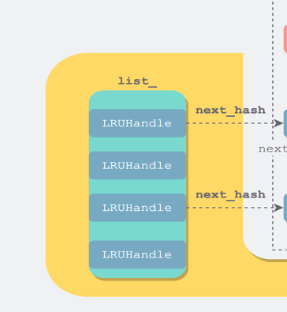
LRU Cache Structure in LevelDB - hash table

Slide 19
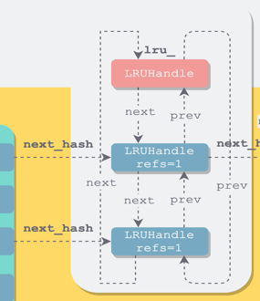
LRU Cache Structure in LevelDB - hash table

Slide 20
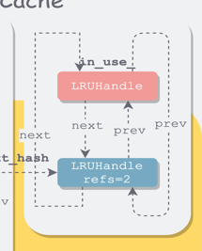
LRU Cache Structure in LevelDB - hash table

Slide 21
Benchmarks Experiment - Hypothesis
Cache increases read performance by reducing disk I/O.
If so, it is obvious that increasing the size of cache_size will help improve latency performance.
Check latency when cache_size, block_size(options) change!

Slide 22
Benchmarks Experiment - Design
In the case of fillrandom, the latency results are too random, so the experiment is conducted through fillseq.
Check benchmarks
readhot, readrandom, seekrandom
Cache_size
- [-1,5000,100000]
Block_size
- [4,8,32,128,256,512…]

Slide 23
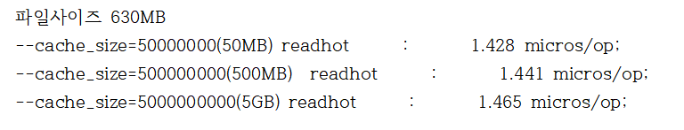
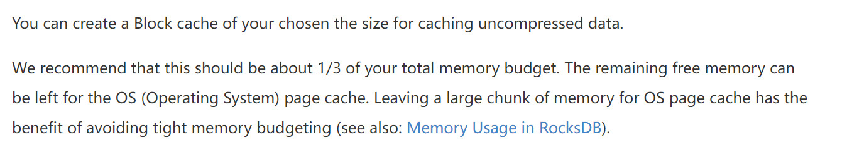
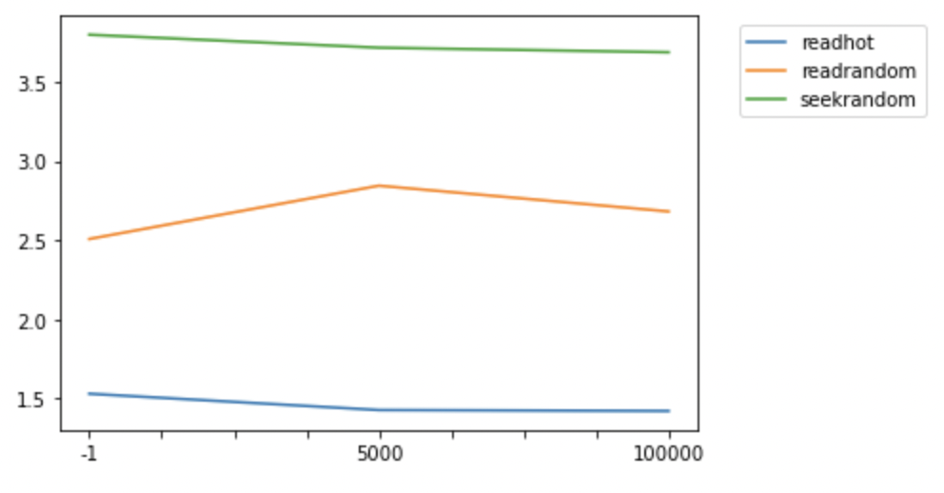
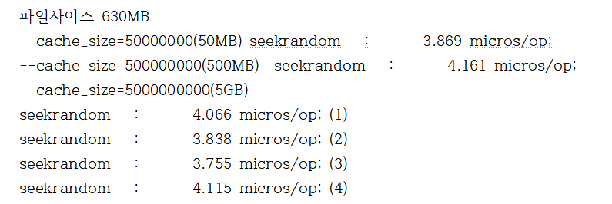
Benchmarks Experiment - Run Experiment
Enviroment : --num=10000000(rawsize=1GB) => to check high latency change!
latency
Cache_size

Slide 24
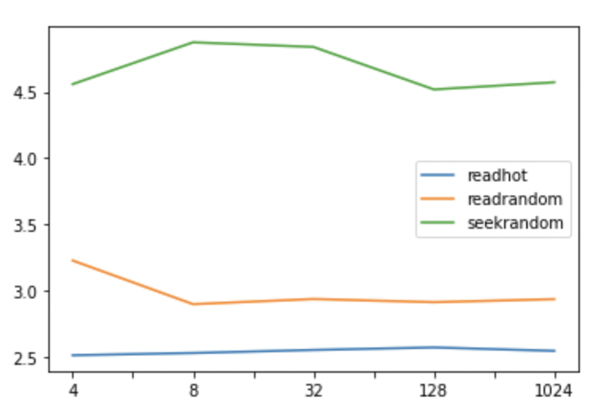
Benchmarks Experiment - Run Experiment
Enviroment :non
latency
Block_size

Slide 25

Benchmarks Experiment - Result and Discussion
Cache_size improves read latency! But, the size should be appropriately adjusted according to the size of the file.
It is conceivable that block_size has nothing to do with read latency improve.

Slide 26
Reference
https://velog.io/@jelkov/%EC%BA%90%EC%8B%9C
https://chowdera.com/2022/187/202207061327595599.html
https://wiesen.github.io/post/leveldb-cache/
https://bbs.huaweicloud.com/blogs/251517
https://www.bookstack.cn/read/rocksdb-en/b3616cd1498e196f.md
https://www.bookstack.cn/read/rocksdb-en/5dd063f6b6ed224d.md#Block%20Cache%20Size
https://techblog.woowahan.com/2687/
https://velog.io/@gil0127/%EC%8B%B1%EA%B8%80%EC%8A%A4%EB%A0%88%EB%93%9CSingle-thread-vs-%EB%A9%80%ED%8B%B0%EC%8A%A4%EB%A0%88%EB%93%9C-Multi-thread-t5gv4udj

