Slide 1
Dowload validations charts

Slide 2
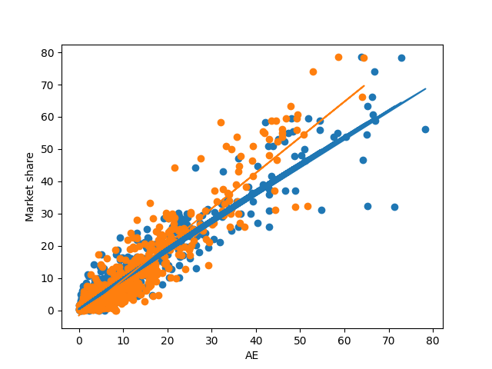

Slide 3
