Slide 1
Project Roadmap/Overview
TMF/FG

Slide 2

Goal
Apply Multi-Task Learning (MTL) to DD architecture to facilitate improved VS capabilities, focusing on integrating data from the protein/ligand complex (already computed in DD workflow) to improving outcomes in visual inspection

Slide 3
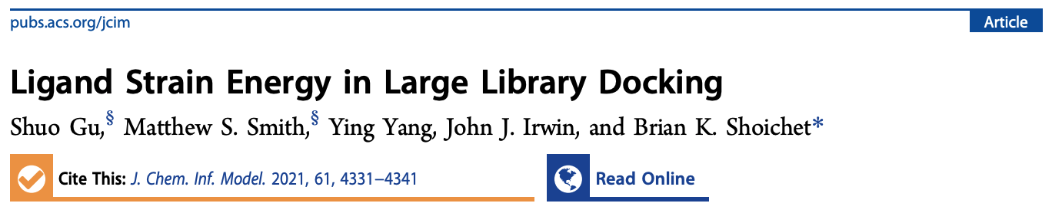


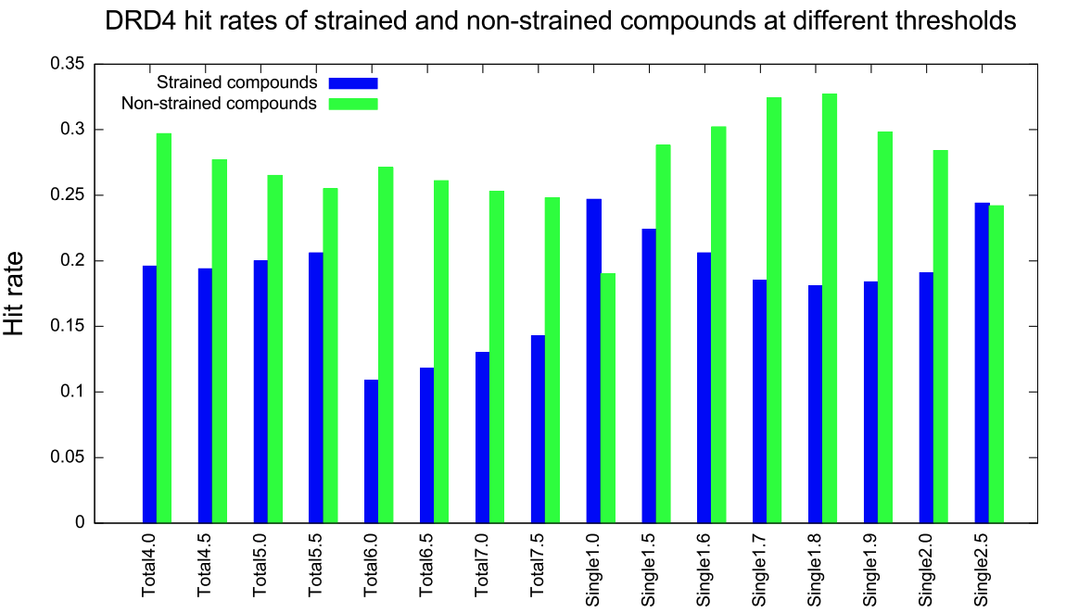
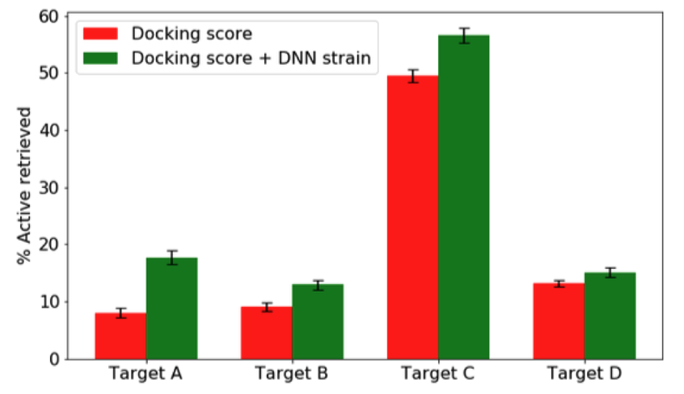
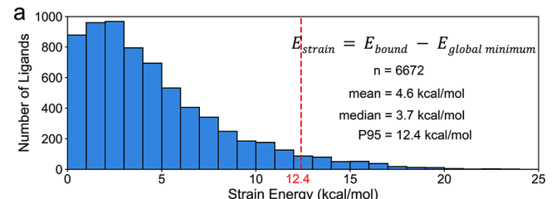
Primary MTL Feature: Strain
Recent focus in the VS community seems to be focusing on ligand strain in a given docked pose (energetic cost of the conformer found via docking, usually versus a global/local minima conformer).
Pattern matching to known CSD torsions
Retrospective enrichment of VS results from Lyu 2019 ULVS
Retrospective enrichment of VS for 40 targets + known actives/DUD-E decoys
QM calculations of observed ligand strains in high quality PDB dataset (good electron density, ligand quality, etc) (Fig 1)
Good analysis of how molecular properties influence strain, when strain is less useful (charge, high H-Bonding, etc)
Pfizer, lots of propreitary data not shared
QM calculations -> train ML model (private) -> Infer on VS results

Slide 4
Some context
Ligand strain is not a straight forward “less is better” hueristic. Intuitively, highly strained ligands can still minimize P/L complex energy such that it is preferred. This is more or less what a docking score is trying to tell you.
Most methods do not capture intramolecular effects (within the ligand), even if we ignore the protein itself. Considering the P/L complex, many molecular properties can be associated with strain (Tong, 2021). Hbonds, charge, and non-aromatic carbons can drive strain. Important to consider how strain will affect chemical space coverage if implemented into DD.
It does however seem that highly strained molecules are less likely to bind when assessing “true” retrospective VS (Gu, 2021 and Rai, 2022). Seems wise to set a “cut off” of when strain is simply more likely to be bad than good to truncate unwanted chemical space.

Slide 5
Proposed Workflow
Setting a strain “cut off” requires a dataset that can describe “high quality” crystal structures (like Tong, 2021). This cut off should capture the extent of ligand strain feasible in solved complexes.
Retrospective use of these strain cut-offs should improve VS results (Gu 2021, Rai 2022) – in either “true” VS settings (known actives/inactives) or docking actives vs decoys.
A strain method that can do both of these should be implemented into DD in a retrospective and then prospective manner (like the original and follow up DD papers).

Slide 6
My current focus:
Uses SMARTs based substructure searches of a given conformer to assess strain by comparison to an XML dataset of torsion energies derived from the CSD and statistics (if a given torsion is never observed in the CSD == high energy).
Pro’s:
Fast and scalable.
Demonstrated utility in retrospective VS.
Con’s:
Code requires conversion to mol2 for native function, or custom SDF supplier functions. Thorough investigation of these approaches have me worried about the actual methodology of the code.
Francesco’s conversion tool via MOE to go SDF -> MOL2 does reproduce his (limited) results closely, but it is hard to know why based on how the code works.

Slide 7
Code
I have two GitHub files exploring the issues I’ve had with the code:
https://github.com/DKchemistry/debugging-strain/blob/main/explanation.md (read second)
https://github.com/DKchemistry/debugging-strain/blob/main/DebuggingEfforts.ipynb (read first)
These can be hard to read as they are effectively me engaging with the code in real-time. If you use it yourself and spend awhile reading it, its more intuitive.
The overall issue is two-fold: (1) I don’t understand/agree with his decision to only account for certain energies. For instance, if a given torsion pattern has multiple non-duplicate matches, only 1 seems to be used (why?) and (2) it seems like his code is doing the opposite of what he states in the paper (favoring specific over general torsions). This debugging/conceptual understanding is on going.

Slide 8
Code (cont.)
The other issue in debugging his code is that the author only supplies 3 example molecules. So even if I get a perfect match between my SDF supplier method or Francesco’s Mol2 conversion method, I can’t be sure I am actually reproducing the calculations used in the retrospective VS (I would need his actual 3D conformers to do this).
Instead, I can try to reproduce his results with other data (running my own decoy study). This involves setting a strain cut off on the Tong 2021 dataset and then running some sort of VS with known actives/inactives/decoys (in progress).

Slide 9
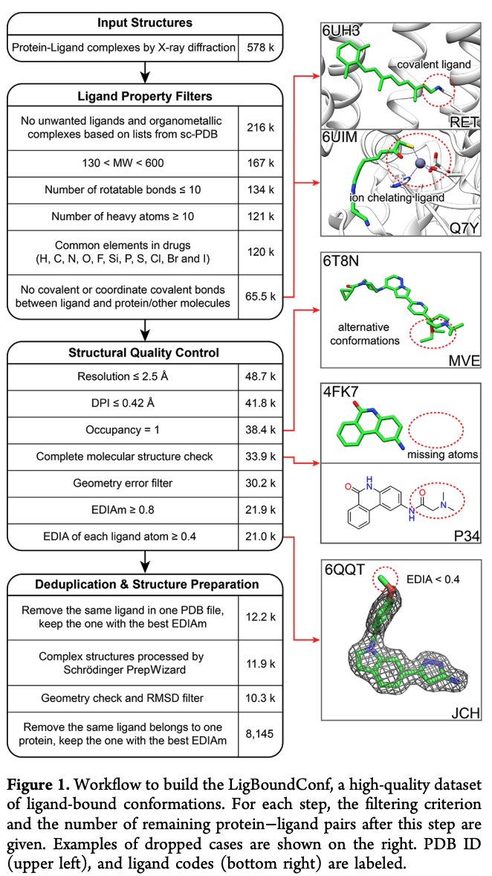
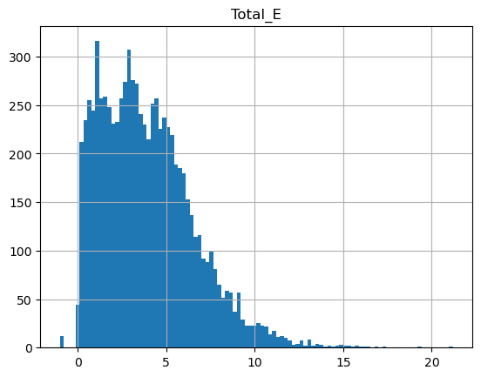
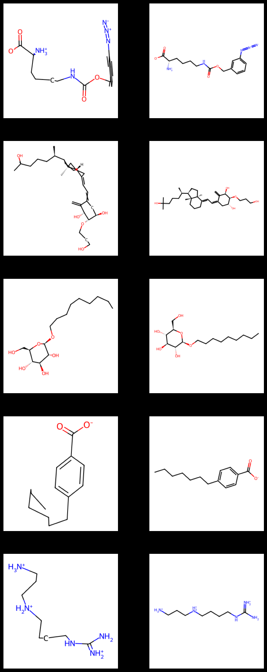
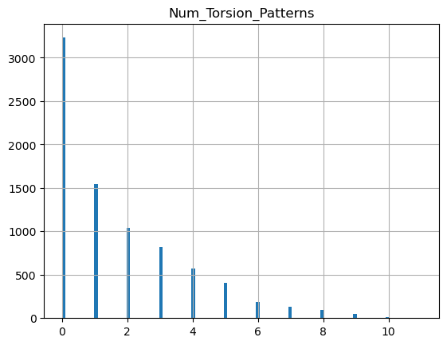
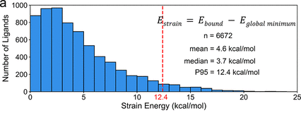
Proposed Workflow: LigBoundConf Data
Strain Calc.*
Data Viz.**
* Example uses custom SDF supplier
** 3D/2D viz of most strained
https://github.com/DKchemistry/LigBoundConfData/blob/main/Strain.ipynb

Slide 10
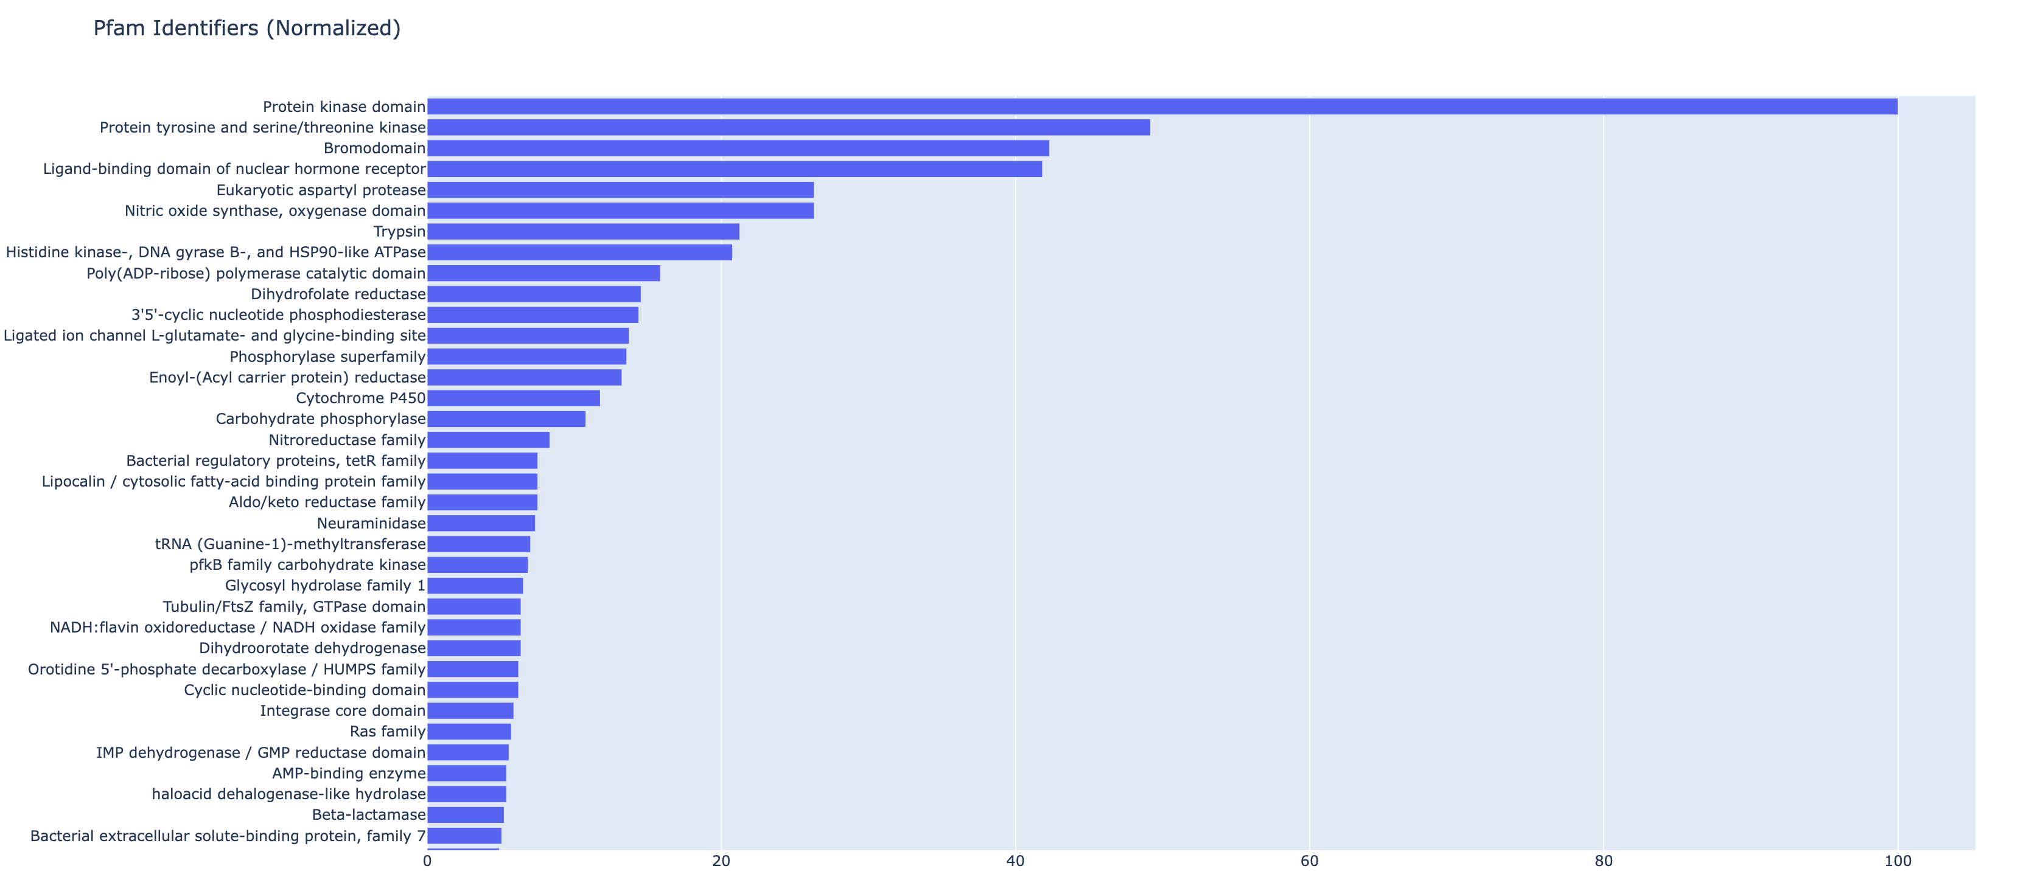
Proposed Workflow: LigBoundConf Data
Useful to know what target space dataset covers, not trivial, however I used a naïve approach (SIFTs PDB -> Pfam conversion via API)
https://github.com/DKchemistry/LigBoundConfData/blob/main/bar_chart_normalized.html

Slide 11
Proposed Workflow: LigBoundConf Data
Now to decide how to set up docking study (choice of PDBs, amount of targets, amount of decoys, computational pipeline, enrichment assessment)
Can try conversion to MOL2 instead of my SDF function via MOE
Still need to better understand what the Strain energy code is doing prior to real implementation for scientific confidence

