Slide 2
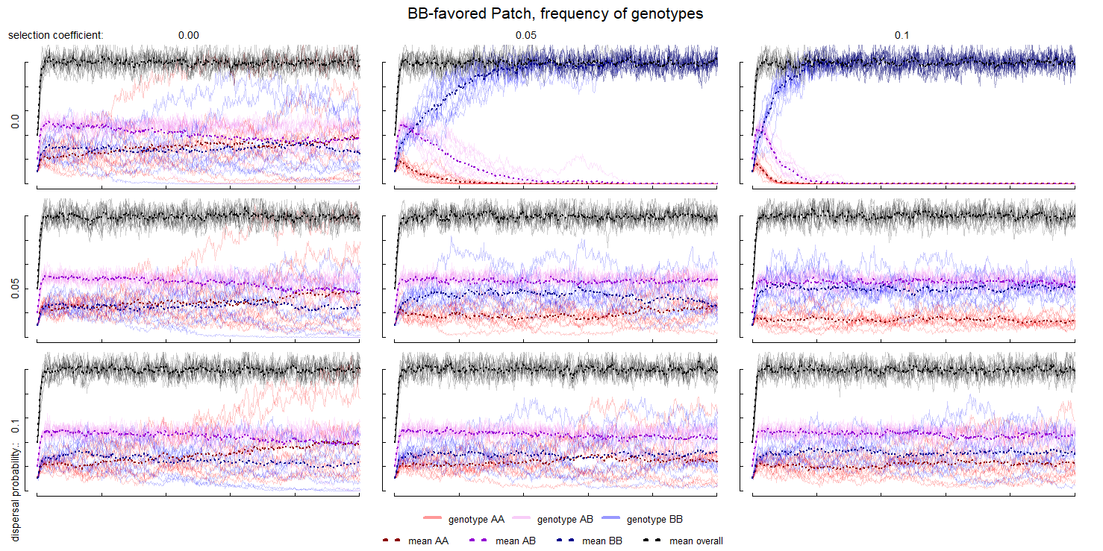
Parameter Space Exploration
Dispersal rates: 0%, 5%, 10%
Selection coefficients: {0, 0.05, 0.1}
Relative to the 100 gametes produced by individuals with BB genotype, AA would produce: {100, 95, 90}
Notes:
cbind(disp_patch_1, disp_matrix_1)

Slide 3
Parameter Space Exploration I
The difference in genotype frequencies becomes less pronounced with increasing dispersal
The favored genotype becomes more dominant with increasing selection coefficient

Slide 4
Parameter Space Exploration II
Without dispersal the less favored genotype will go extinct, this happens earlier given a higher selection coefficient

Slide 5
Parameter Space Exploration III
With no preference for any genotype, random chance can lead to the dominance of one gene. This happens more often with little to no dispersal, as this effectively reduces the population size leading to founder effect.
Averaged over several runs, this leads to homozygotous genotypes to become dominant

