Slide 1

Lesson Objective
Introduction
Basic Data Type
Pointer variable

Slide 2
INPUT
main
OUTPUT
printf
So_nguyen
%d
%c
scanf
Getchar()
%
EOF
I
e
3
e
Putchar()

Slide 3
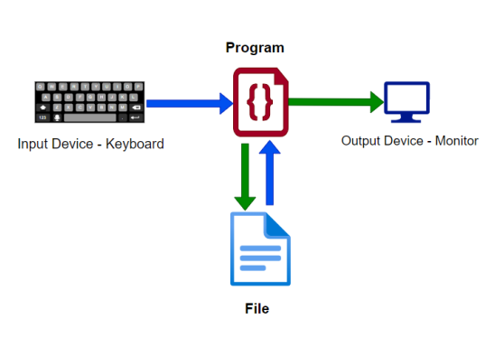
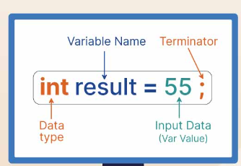
1. Introduction
Syntax

Slide 4
1. Introduction
How to get input: scanf
How to print to console: printf

Slide 5
2. Basic data type
Build-in
Basic
Modifier
User-defined
Structure
Enum
Union

Slide 6
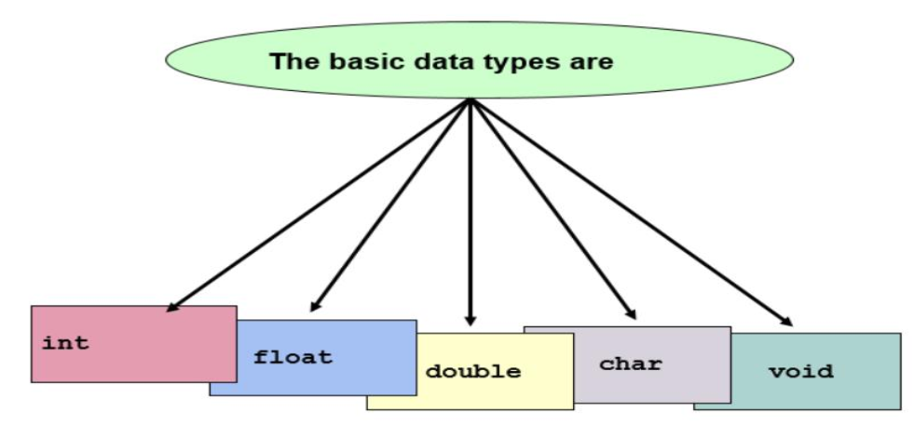
2. Basic data type

Slide 7
2. Basic data type
RAM
GPU
CPU
HDD/SSD
hello.c
program

Slide 8
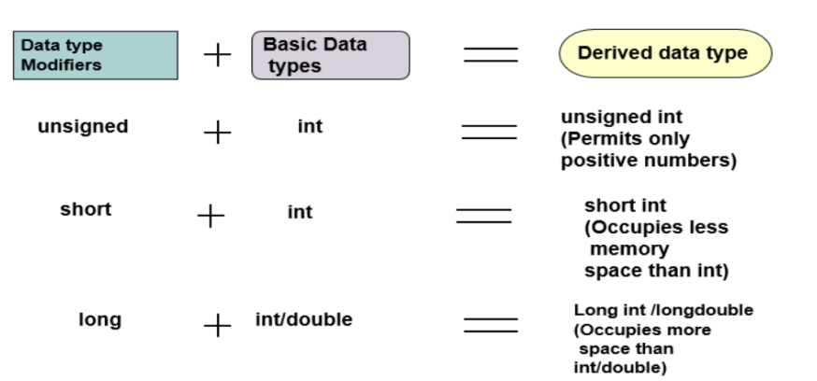
2. Basic data type

Slide 9
2. Basic data type
Exercise: input these variables and
Int
Float
Char
Exercise: print sizeof each data-type

Slide 10
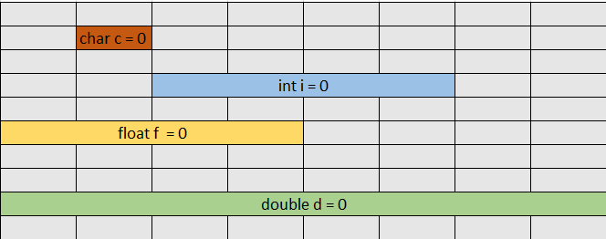
Open point: use variable
Memory occupy
Meaningful: int x?
Exercise
Use void type
Opps. Has driver
license? (int?)

Slide 11
Open point: use variable
Compare
int x;
int x = 1;
Why void? When use void?

Slide 12
3. Pointer variable
What is the pointer?
Does pointer has address itself?
NULL pointer

Slide 13
Open point
What is the variable?
Why we need variable?

Slide 14

6. Q&A

