Slide 1

Lesson Objective
Introduction
Array
String
Decision
Looping

Slide 2
1. Introduction
How to deal with large program
Multiple input, how to approach?
Eg: manage 1, 2, 5, 10, 100 students?
Separate each variable
Array

Slide 3
2. Array
What is the array?
Array in C
Declare array
When use array

Slide 4
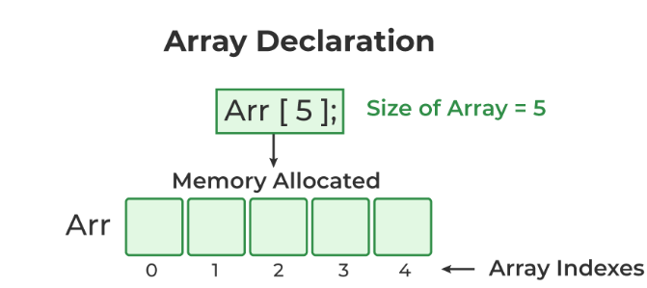
2. Array

Slide 5
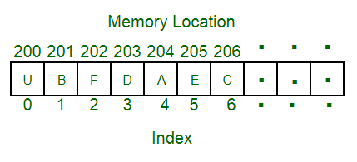
2. Array
Static array: out-of-range issue
Access array via pointer to an array

Slide 6
2. Array
Array operation
Initialization
Access array element

Slide 7
2. Array
Array sorting algorithm branstorm
Bubble sort
Selection sort
Insertion sort

Slide 8
3. String
What is the string?
Pointer to string
String function
Build-in
User-defined

Slide 9
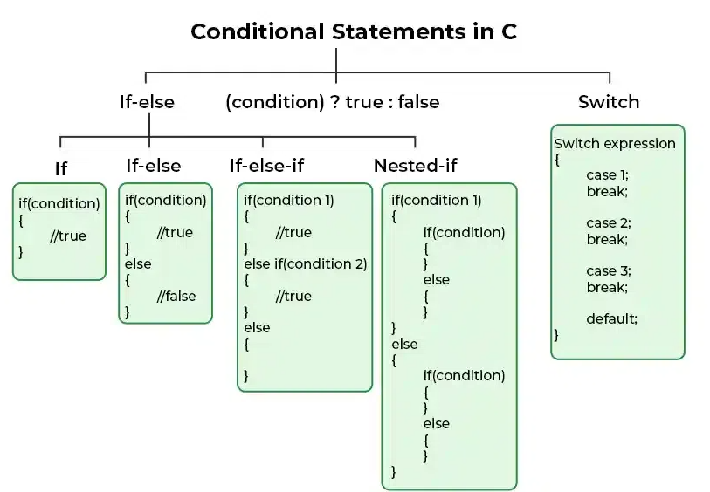
4. Decision

Slide 10
4. Decision
If
If else
If –else if-else
Nested
Switch case

Slide 11
5. Looping method
For loop
While
Do-while
Brainstorm

Slide 12
5. Jump statement
Break
Continue
Return
Compare
Exercise

Slide 13

5. Q&A

