Slide 1

Lesson Objective
Reminder:
Compare loop
If-else-if ladder (tax exercise)
Ternary operation
Pointer basic
Function

Slide 2
1. Pointer
What is the pointer
Ex: print pointer
Pointer value
Pointer address
Ex: given an address. Use pointer to access (read/write)

Slide 3
1. Pointer
Pointer increment/decrement
Pointer exercise to read array[8]
NULL pointer

Slide 4
2. stdio, stdint
Stdin, stdout
Stdint: why important (different architecture)

Slide 5
3. Function
Function declaration
Function definition
Function call
Pass by value vs reference
Function pointer

Slide 6
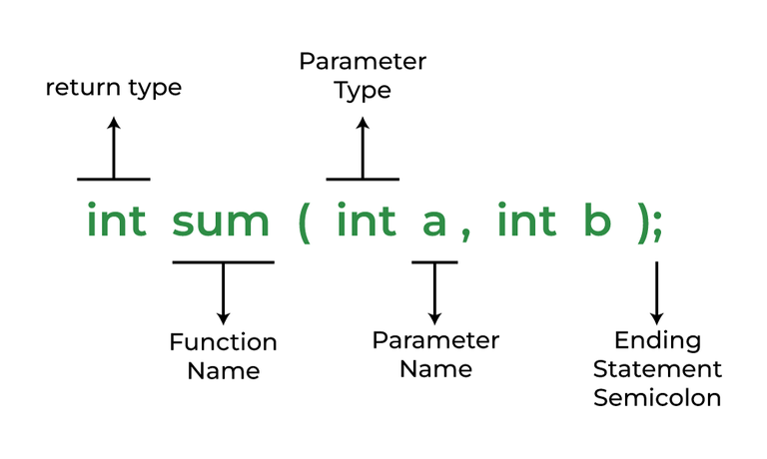
3. Function

Slide 7
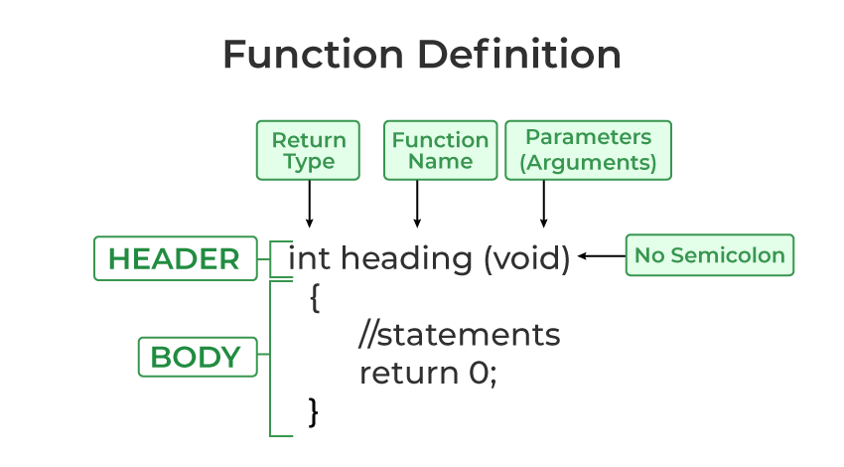
3. Function

Slide 8
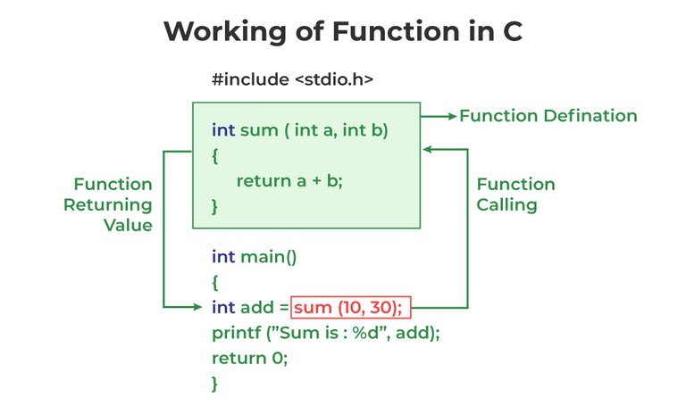
3. Function

Slide 9
3. Function
Build-in function
User-defined function

Slide 10
3. Function
Pass by reference. Purpose
Pass by value. Purpose

Slide 11
3. Function
Function like-macro (medium)
Function keyword (advance)
Static
Inline
Extern

Slide 12
4. Open point
#define SIZE 10 or array[10]
Const keyword, when used?

Slide 13

4. Q&A

