Slide 1

Lesson Objective
Clocktree: RCC chapter
Input source
SYSCLOCK
AHB prescaler
APB1 prescaler
APB2 prescaler
Max AHB, APB1, APB2 clock rate

Slide 2
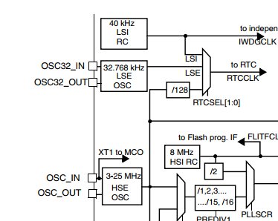
Input source
LSI
LSE
HSE
HSI

Slide 3
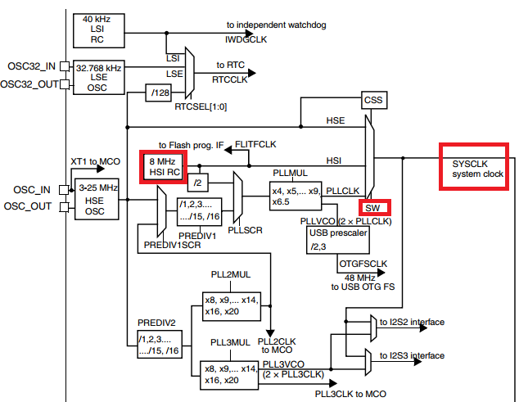
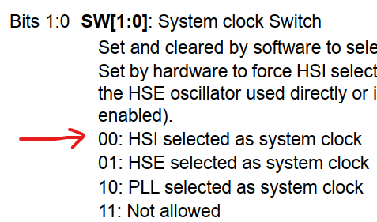
SYSCLK
Default clock input
SW select input mux
RCC_CFGR:
Default: 0x0000_0000

Slide 4
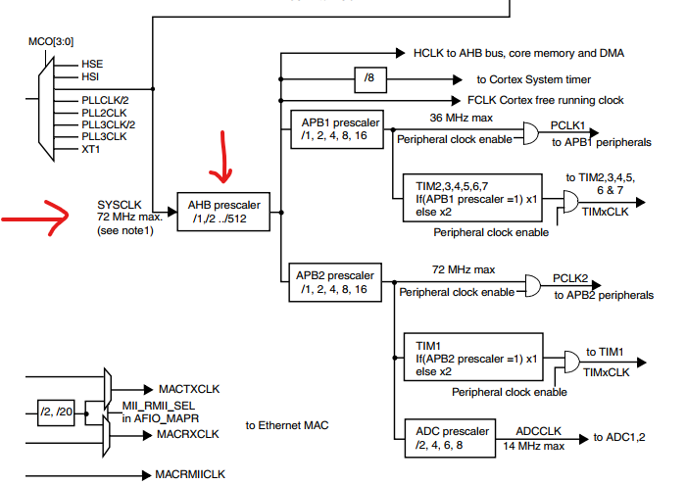
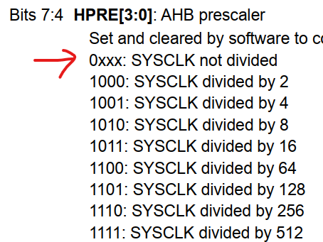
AHB Prescaler
RCC_CFGR:
Default: 0x0000_0000

Slide 5
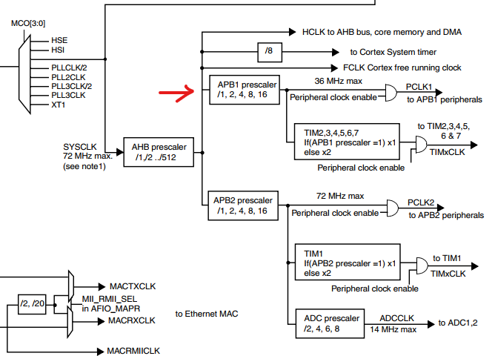
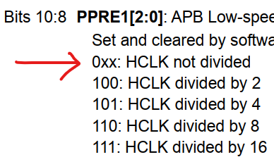
APB1 Prescaler
RCC_CFGR:
Default: 0x0000_0000

Slide 6
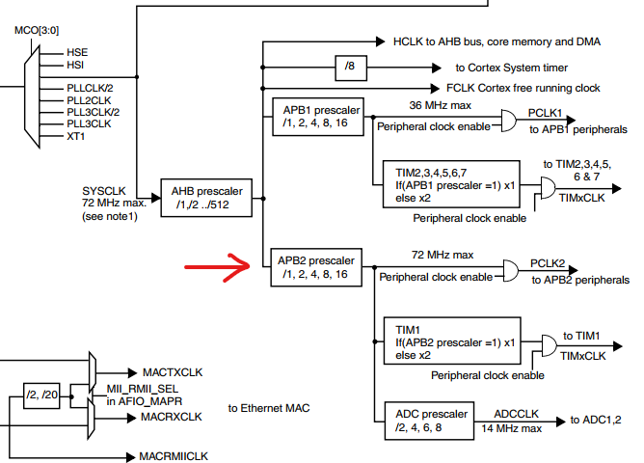
APB2 Prescaler
RCC_CFGR:
Default: 0x0000_0000

Slide 7
Max clock rate
AHB: 72MHz
APB1: 36MHz
APB2: 72MHz

Slide 8

4. Q&A

