Slide 1

Lesson Objective
Review
What is Timer?
Important register
Operation mode

Slide 2
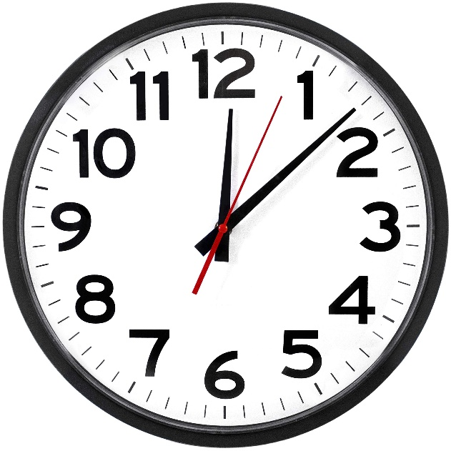
Timer
A device that measure times
Based on count-up or count-down
Example: clock – how it works?

Slide 3
Timer in F103
17: Basic timers (TIM6 and TIM7)
16: General-purpose timers (TIM9 to TIM14)
15: General-purpose timers (TIM2 to TIM5)
14 Advanced-control timers (TIM1 and TIM8)
What is the different?

Slide 4
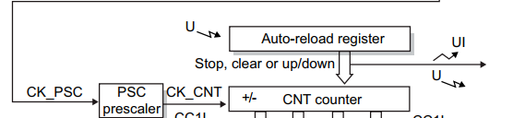
Timer in F103
Overview about block diagram
Time-base unit

Slide 5
Timer in F103
Important register:
PSC
CNT
ARR

Slide 6
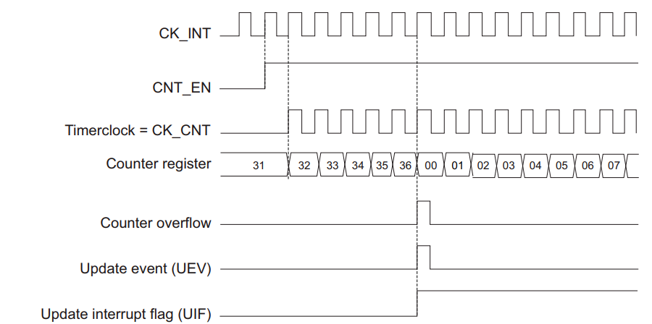
Counter mode
Upcounting

Slide 7
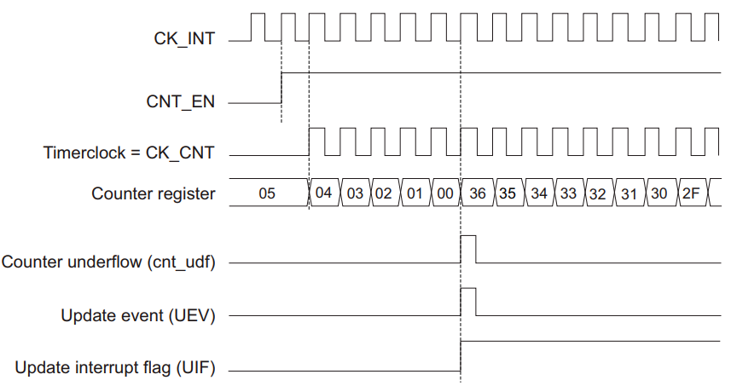
Counter mode
Downcounting

Slide 8
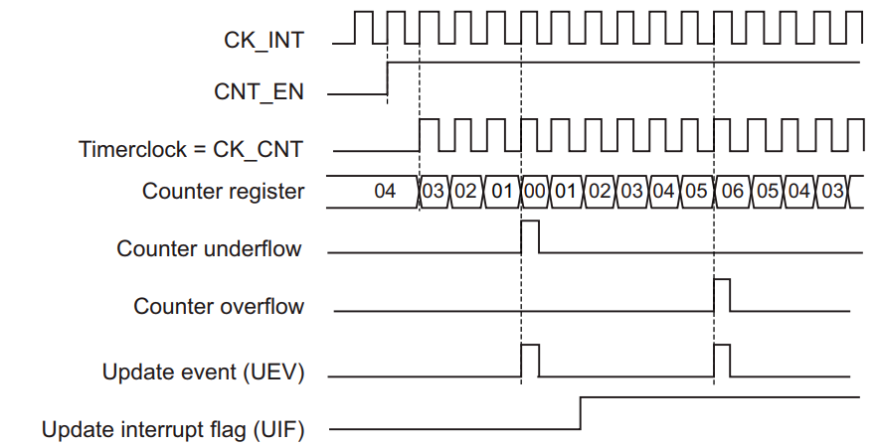
Counter mode
Center-aligned

Slide 9
Debug issue
Write CNT = 0, but when debug, will see value != 0
step
Memory
CPU
I/O
GPIO
Timer
ADC
State1
State2
State3

Slide 10
Input clock source
Internal clock (CK_INT)
External clock mode1
External clock mode2
Internal trigger inputs (ITRx)

Slide 11

4. Q&A

