Slide 1

Lesson Objective
What is ADC
Analog signal
Digital signal
Sample frequency
Resolution
ADC tree in STM32F103

Slide 2
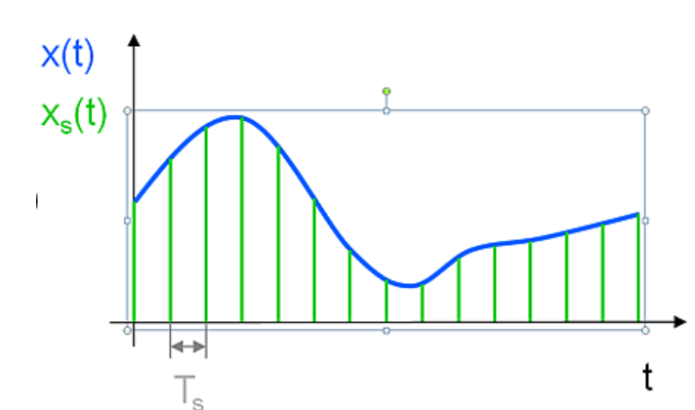
Sample rate

Slide 3
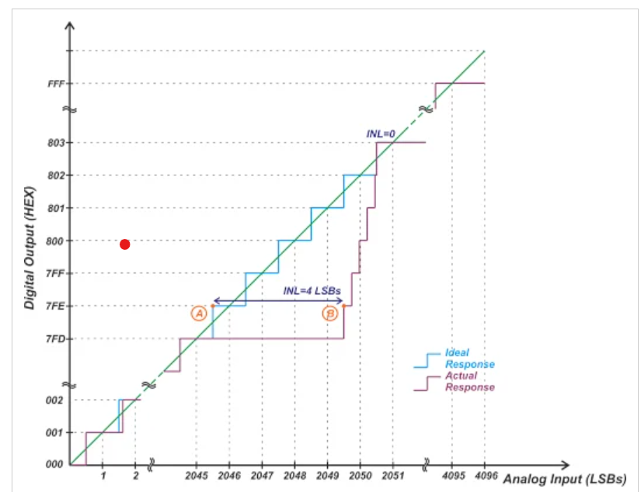
ADC resolution

Slide 4
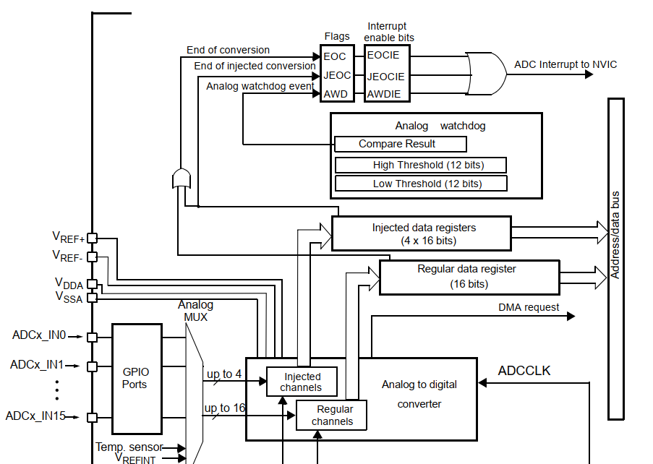
ADC tree

Slide 5

4. Q&A

