Slide 1
Airline On-Time Performance Statistics
Group 2 – Aliyu, David, Indu, Saudia
Data Engineering track

Slide 2
Data Set
Data obtained from Data World
https://data.world/dot/airline-on-time-performance-statistics
Flight level data from the US Department of Transportation for August 2018
Clean Data
Three CSVs provided
Airports – 6,510 rows
Airport code and description -
Air Carriers – 1,656 rows
Air Carrier Code and description -
August 2018 Nationwide – 701,352 rows
Flights data with any delays for the month of August 2018
Some acronyms in the data:
NAS – National Airspace System
CRS – Computer Reservation System

Slide 3
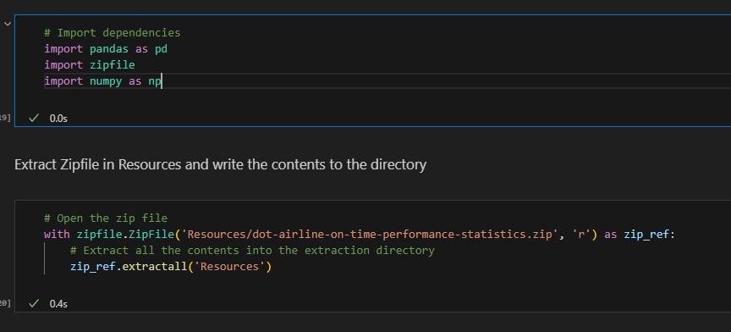
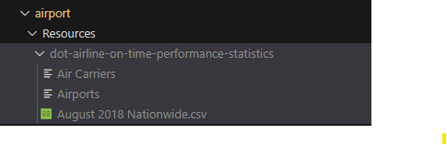
Data Extraction
Dataset downloaded from Source is a zip file
Import zipfile - pandas library to extract the zip file and write the contents to a directory
Files extracted to Resources folder

Slide 4
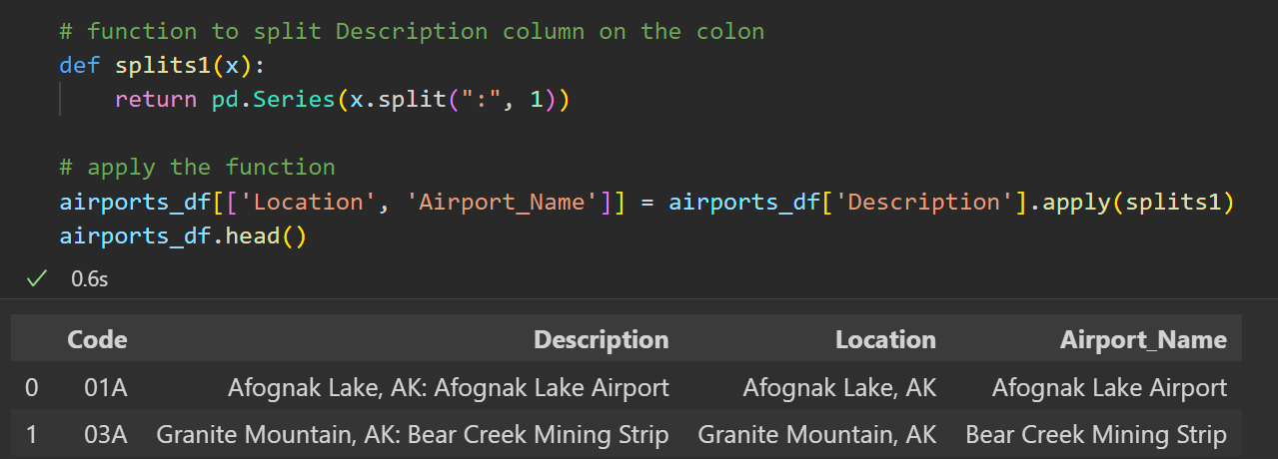
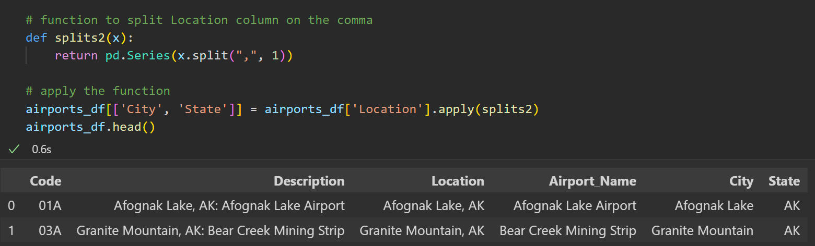
Data Cleaning: split function
Notes:
We learned the split function in class but it was fun to actually apply it. Started with just Code and Description, eventually deleted the columns that were no longer needed.

Slide 5
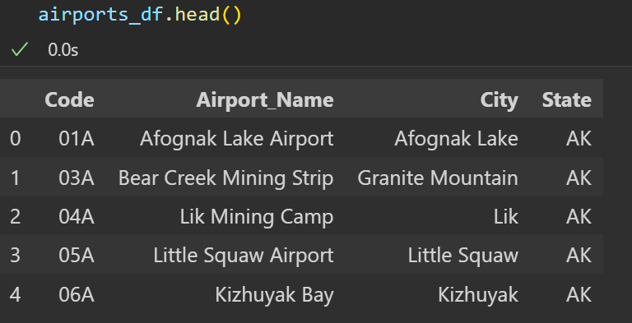
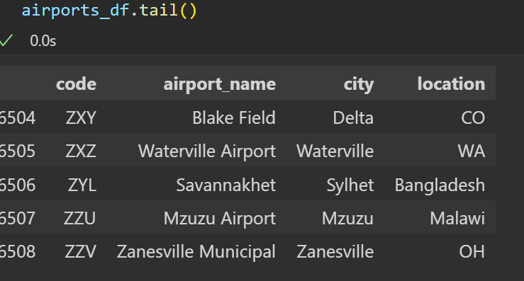
Data Cleaning: Understand your Data
Notes:
I used .head() to look at the dataframes, but when we went to load it into the database we were running into errors, turns out there are airports outside of the US and not every one was a 2 digit state. Updated to column title to location for accuracy.
Lesson learned = look at all your data and don’t assume.

Slide 6
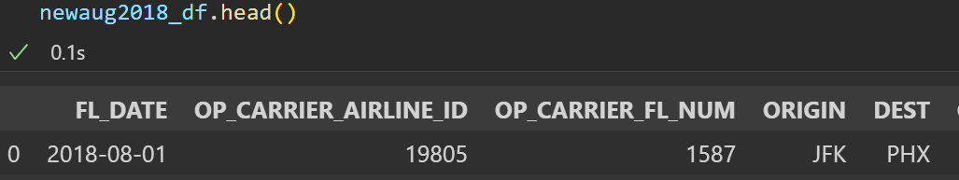
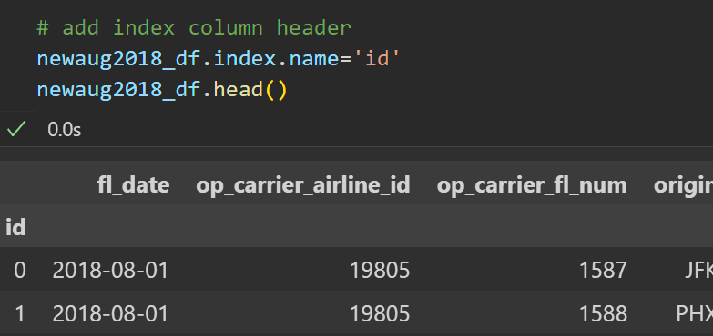
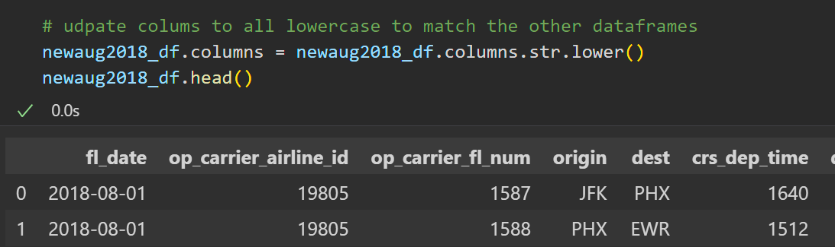
Data Cleaning: str.lower & index.name
Notes:
columns.str.lower was a quick, easy way to change all the column headers to lower case rather than rename everything
We wanted to keep the index as it was useful as a primary key, but we needed a column header. Index.name allowed us to add that.

Slide 7
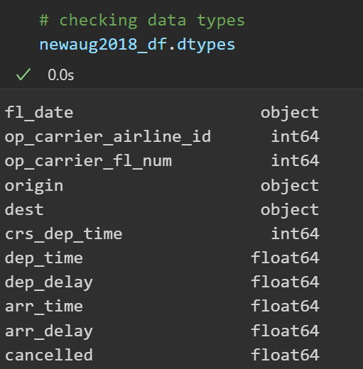
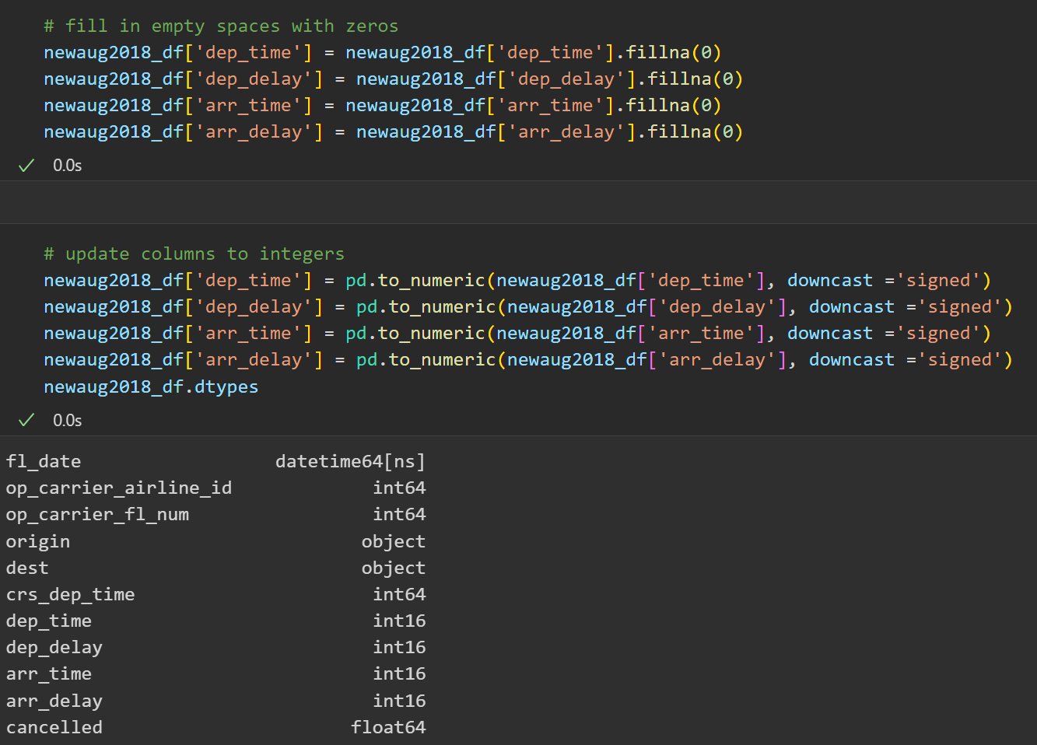
Data Cleaning: .fillna & downcast
Notes:
Used .fillna(0) to put zeros in all the empty spaces in the columns that we were changing to the integer data type
The to_numeric function in pandas is used to convert the given argument to a numeric type. The argument is converted to float64 or int64 by default, based on what is provided in the arguments. We can use the downcast parameter if we want to convert data to a particular type.
Downcast - Specifies conversion to a particular datatype. Can be int, signed, unsigned or float. By default, it is None. If it is not None, pandas will downcast the data to the smallest data type possible.
https://www.educative.io/answers/what-is-the-tonumeric-function-in-pandas

Slide 8
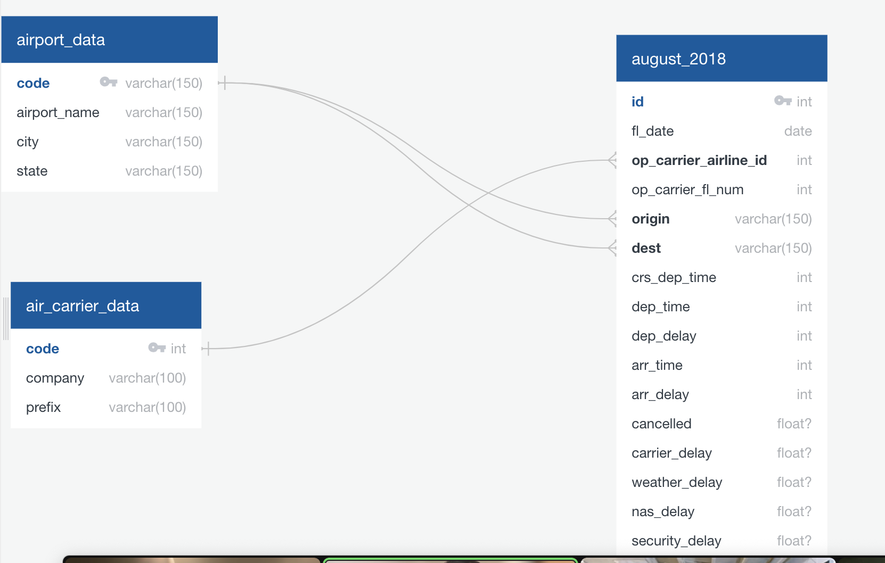
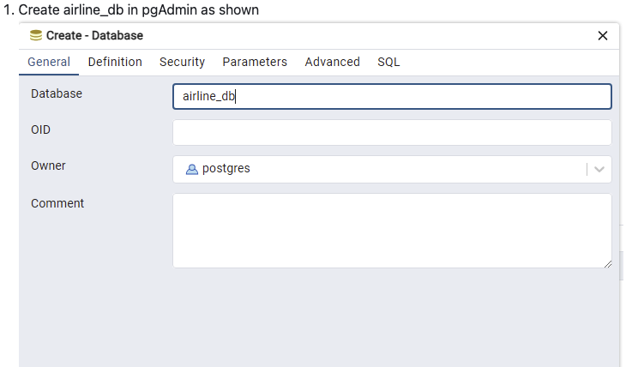
Data Modeling: Using ERD and Database Creation
Notes:
After creating the file and completing the necessary cleaning, a diagram was drafted using a free tool called http://www.quickdatabasediagrams.com/. This diagram illustrated the linking of foreign keys to their respective primary keys, as depicted above.
PostgreSQL (pgAdmin4) serves as the SQL database utilized for storing the data obtained from the CSV files. The name for the database was airline_db

Slide 9
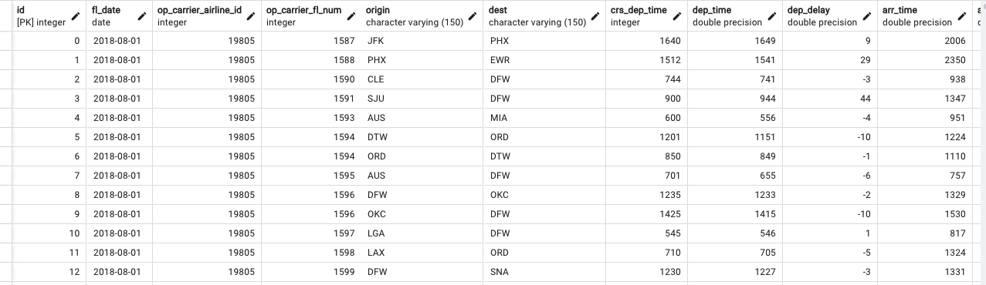
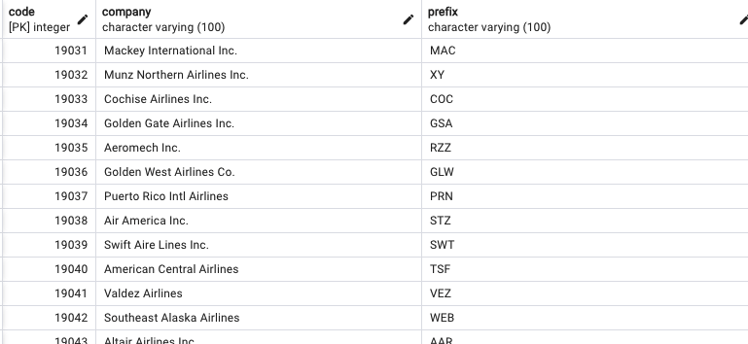
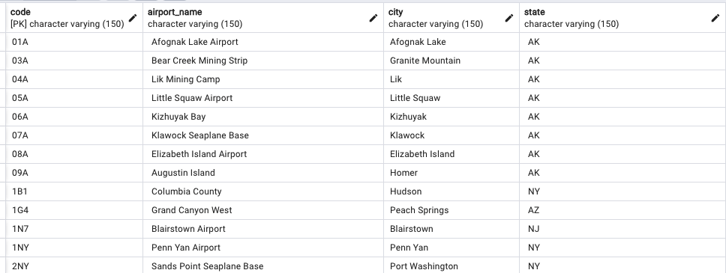
Data Engineering: Creating Table Schema
august_2018
air_carrier_data
airport_data
Notes:
PostgreSQL (pgAdmin4) serves as the SQL database utilized for storing the data obtained from the CSV files. Each CSV file was transformed into a table schema displaying all the columns contained within each CSV.
We chose SQL PostgreSQL due to its scalability, reliability, and user-friendly nature, minimizing the likelihood of encountering errors during usage.

Slide 10
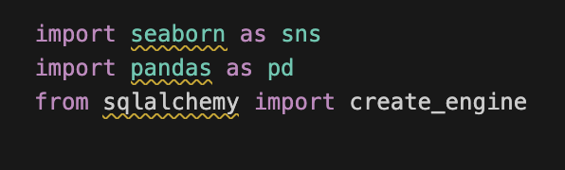
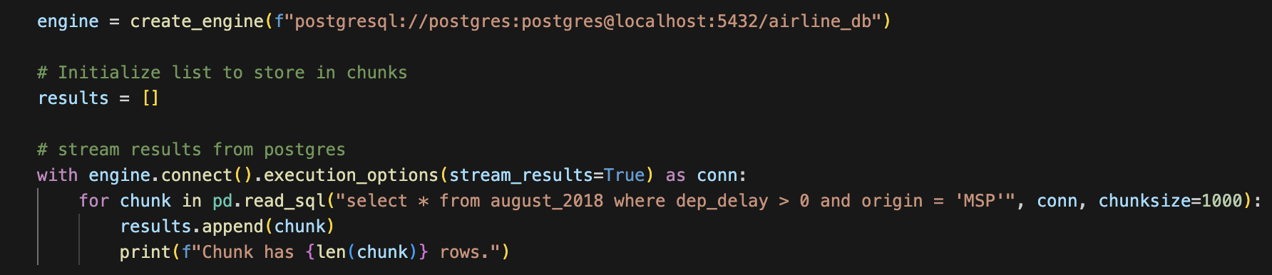
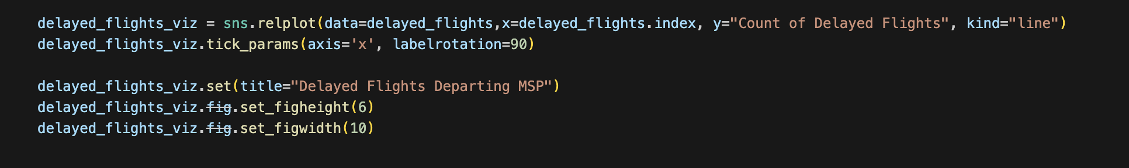
What’s Next?
Import the Seaborn library
Create connection to Postgres to make DataFrame
Create the line graph with Seaborn!

Slide 11
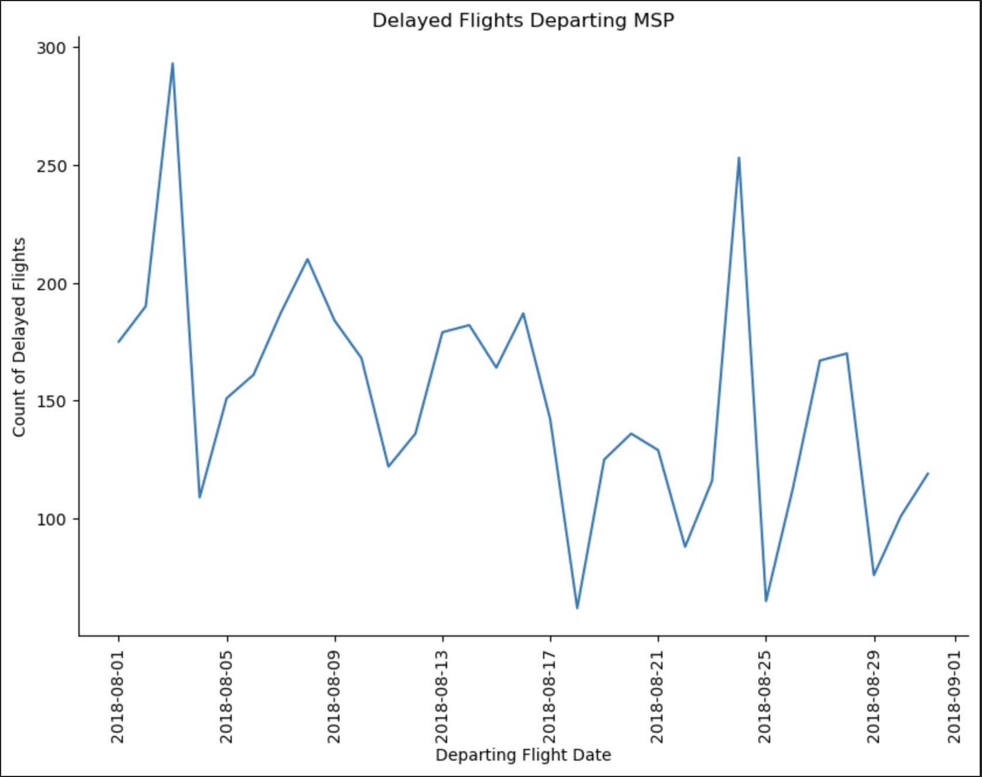
The Final Seaborn Result
Departure delays from MSP for August 2018
Delayed flights had a departure delay greater than 0
Origin was filtered to “MSP”

Slide 12
References
1. Dataset: https://data.world/dot/airline-on-time-performance-statistics
2. Dataset Definitions: https://www.transtats.bts.gov/DatabaseInfo.asp?QO_VQ=EFD&Yv0x=D
3. Downcast: https://www.educative.io/answers/what-is-the-tonumeric-function-in-pandas
4. Reset index for DataFrame: https://stackoverflow.com/questions/20167930/start-index-at-1-for-pandas-dataframe
5. Seaborn Documentation: https://pypi.org/project/seaborn/

