Slide 1





EPAM DevOps PROJECT (Spring 2021)
Simple CI\CD chain

Slide 2
Project Steps
Create and Run AWS Instances
Install Ansible, write and run roles for deploying Jenkins and Apache
Configure Jenkins for CI\CD
Put Landing page on GitHub and check result on Apache Server

Slide 3

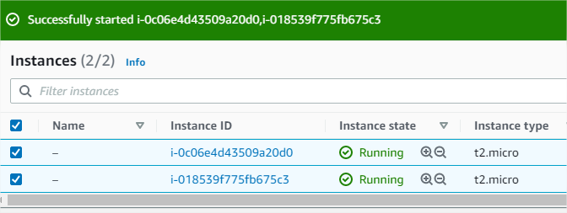
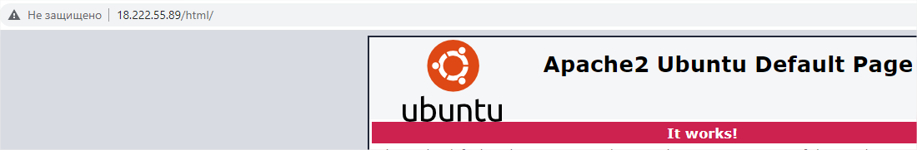
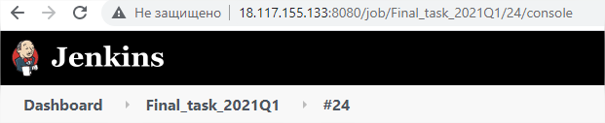
Run Instances and configure it

Slide 4
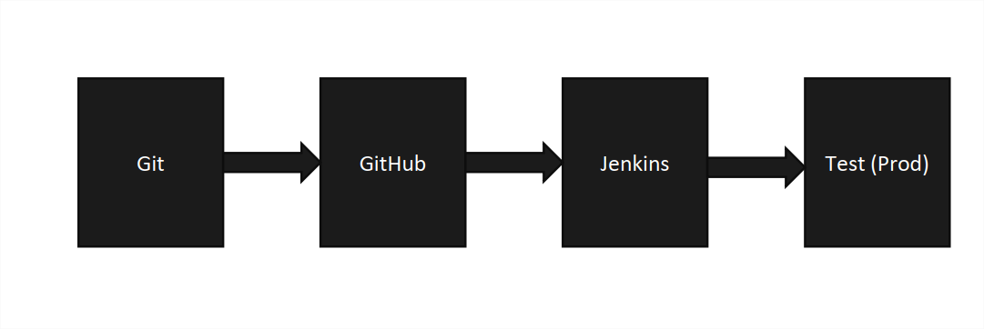
All changes done by Landing Page owner (by me) and pushed on GitHub will be seen on remote Web Server in pictures

Slide 5
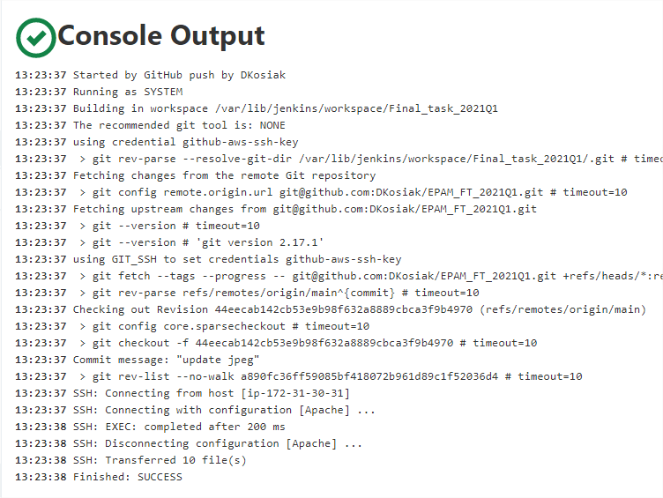
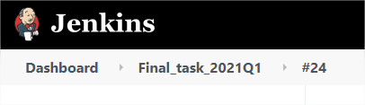
WebHook push info to Jenkins, and it made new Build and push changes on Web server

Slide 6
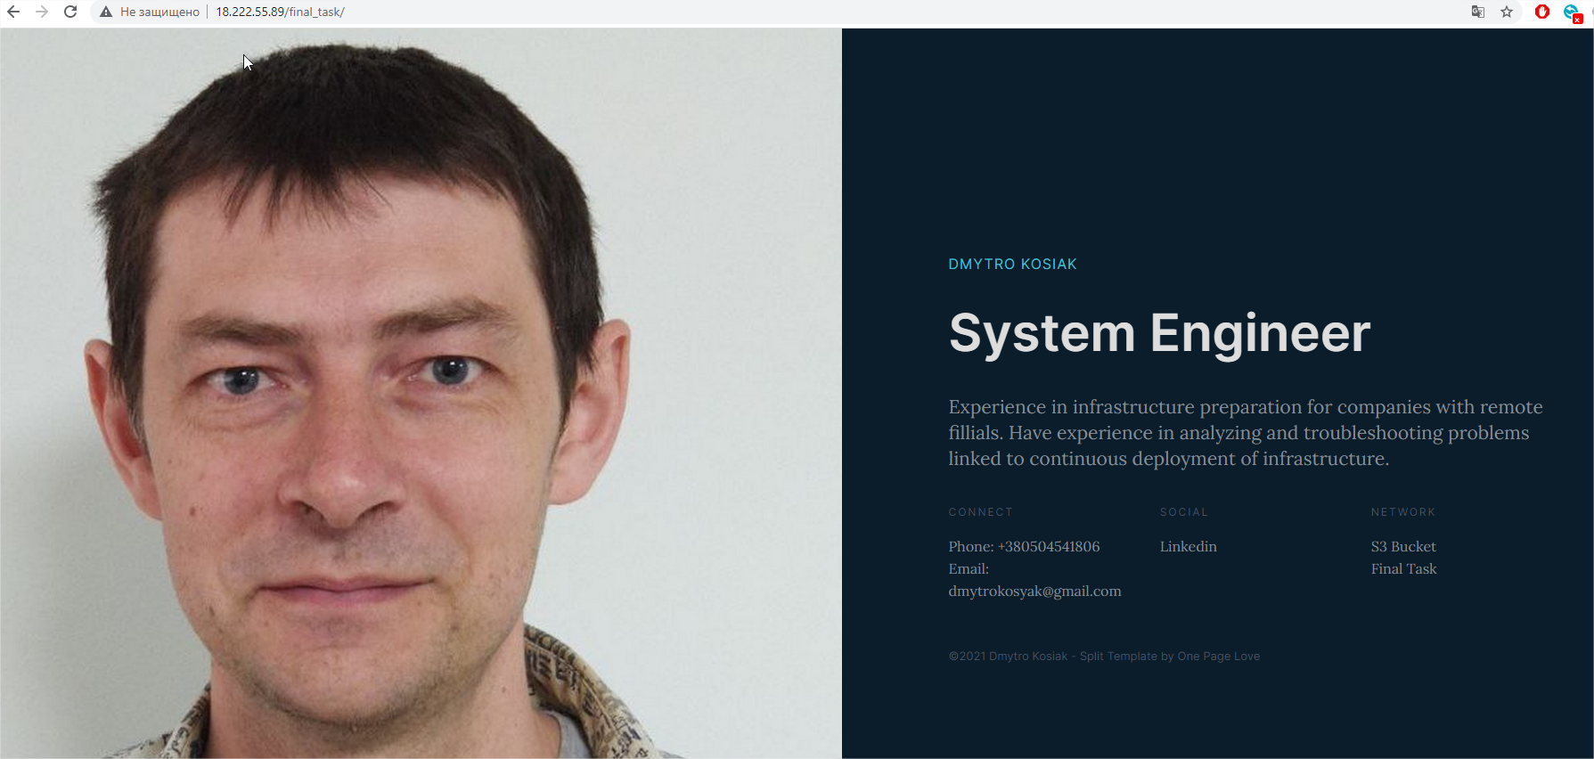
As Result we will see Landing Page

Slide 7
Thank you for your Attention
Home Tasks and Ansible configs you can see on GitHub
Repository with Landing Page you can see via Link
Presentation made by
Dmytro Kosiak
for EPAM Spring DevOps 2021

