Slide 1
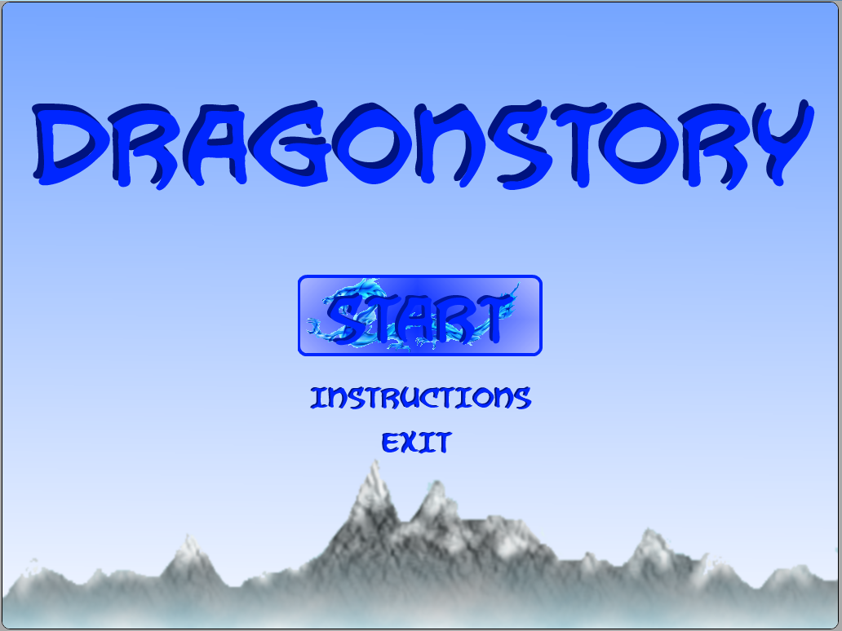

COMP397 – Web Gaming Final Project
Created by Douglas Krein, Francis Ofougwuka, Christine Cho

Slide 2




Game Overview
2D Side scroller with a dragon protagonist
Escape dragon lair with eggs
Avoid corrupted dragons
Return to lair when stronger to reclaim it

Slide 3
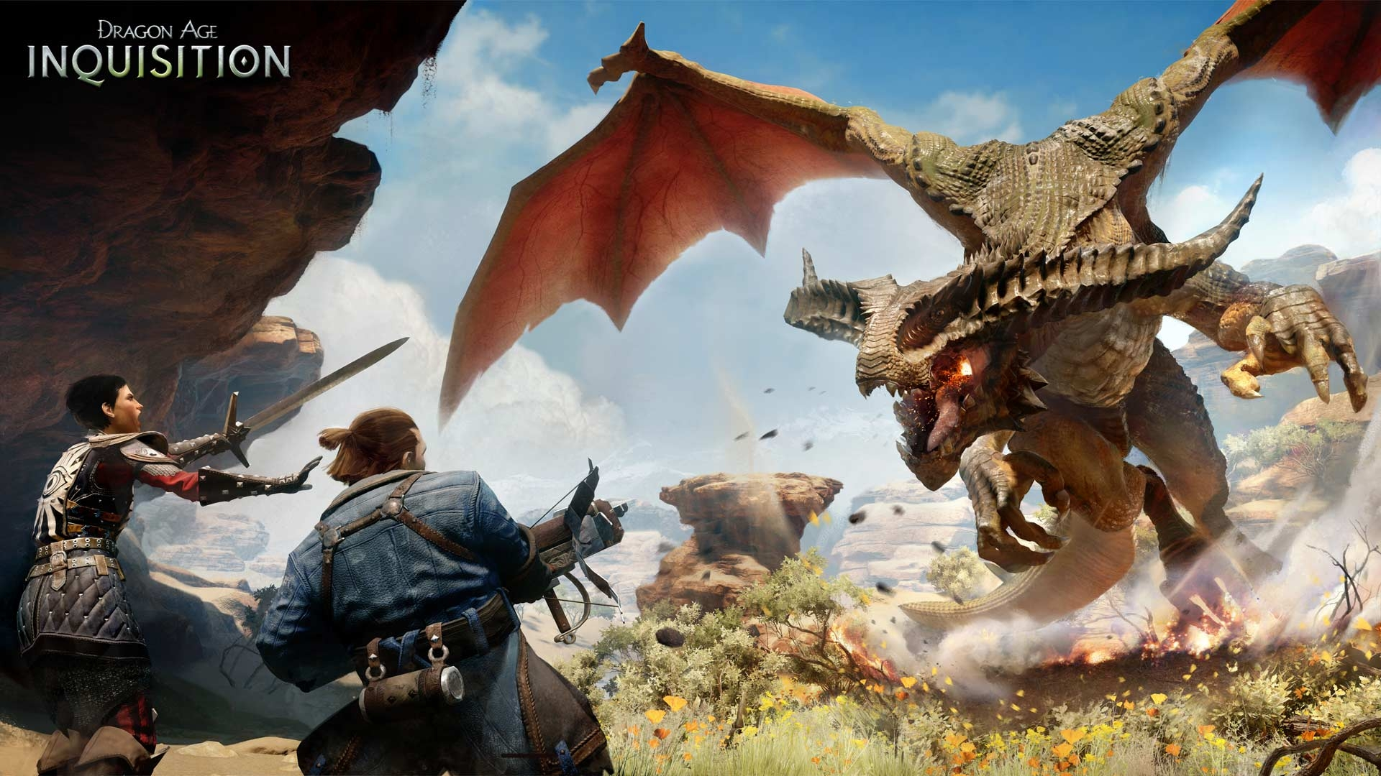
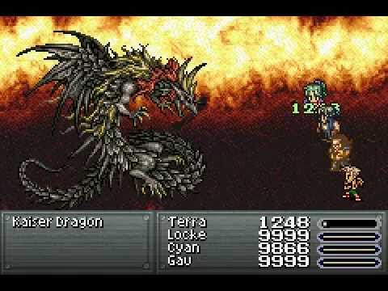
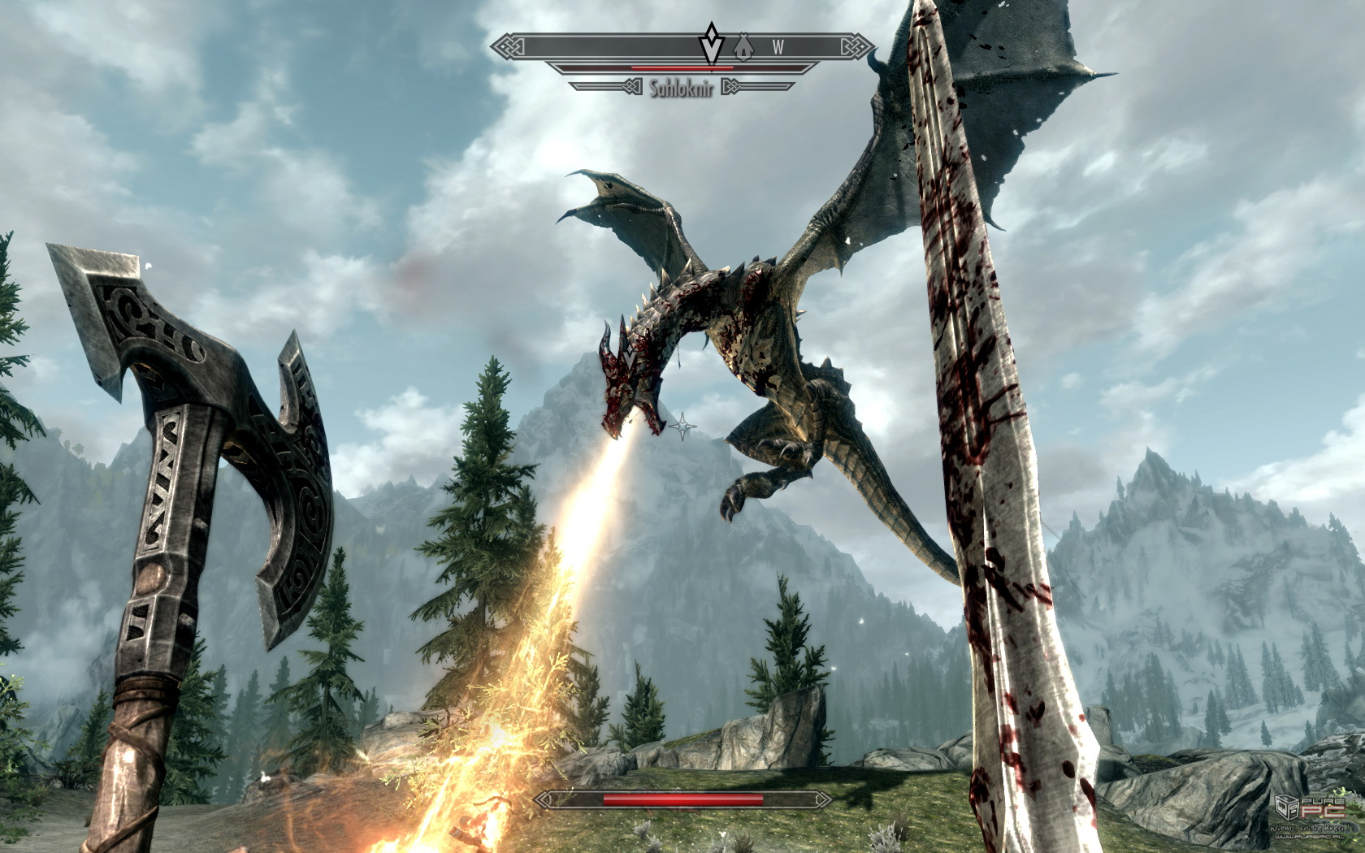
Game overview
Games these days are mostly about killing dragons
Never about the life as one though

Slide 4
Original Plan
Based off another assignment
Originally a pure survival game
Code and ideas were constructed based on level
All the basic requirements were coded into level 1
Added new difficulties per level

Slide 5
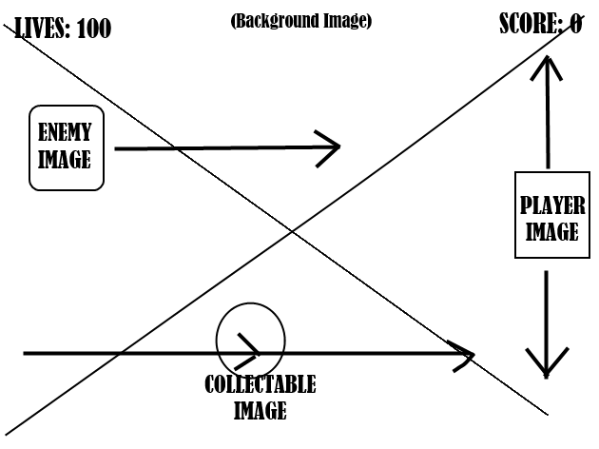
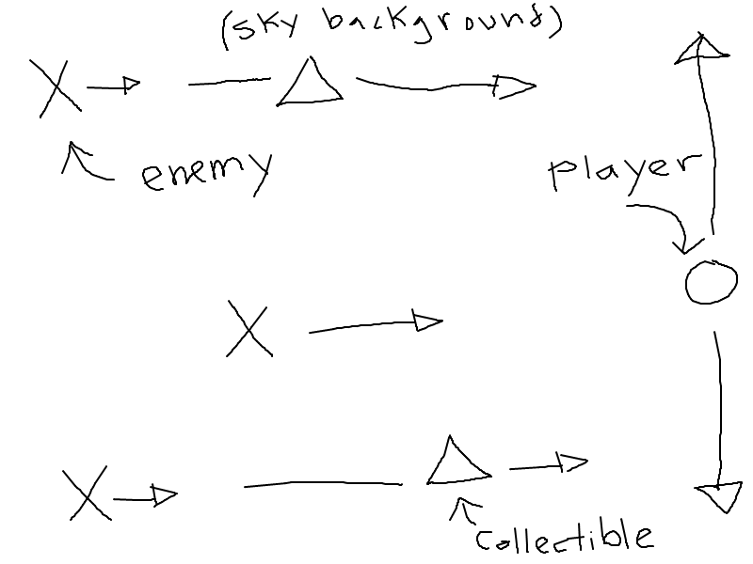
Original Plan
Level 1: Dragons that move along X or XY Axis

Slide 6
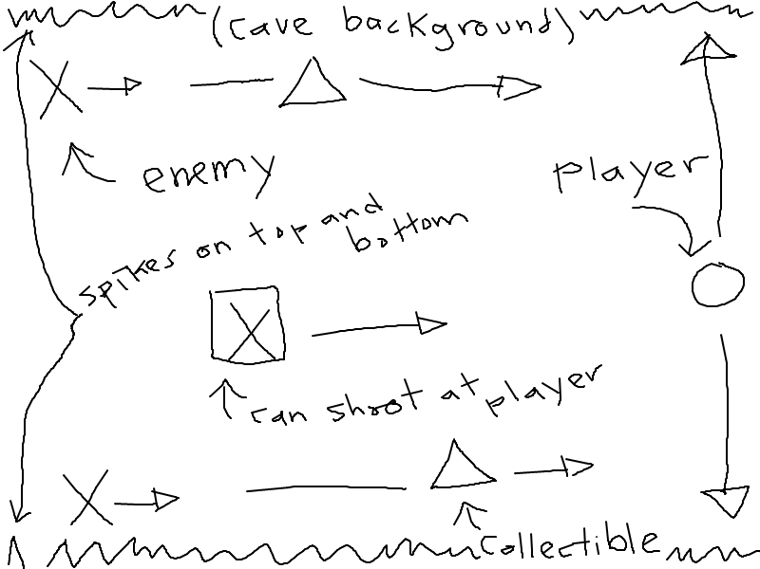
Original Plan
LEVEL 2: Fire breathing dragons
Stalagmites/stalactites on the top and bottom of the screen

Slide 7
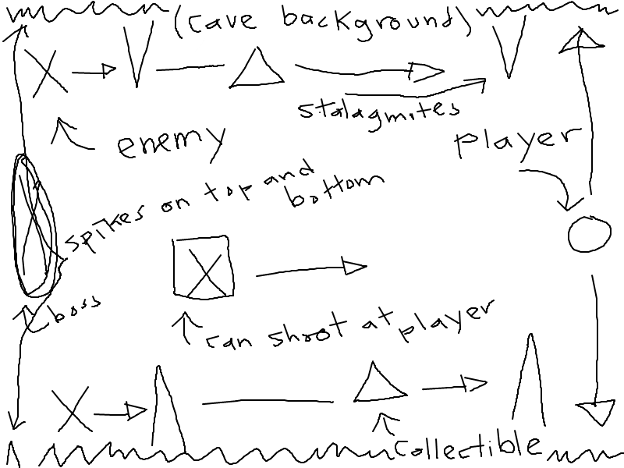
Original Plan
LEVEL 3: BOSS dragon

Slide 8



How to play?
Slide mouse up and down to move you character
Collect the following to score points:

Slide 9
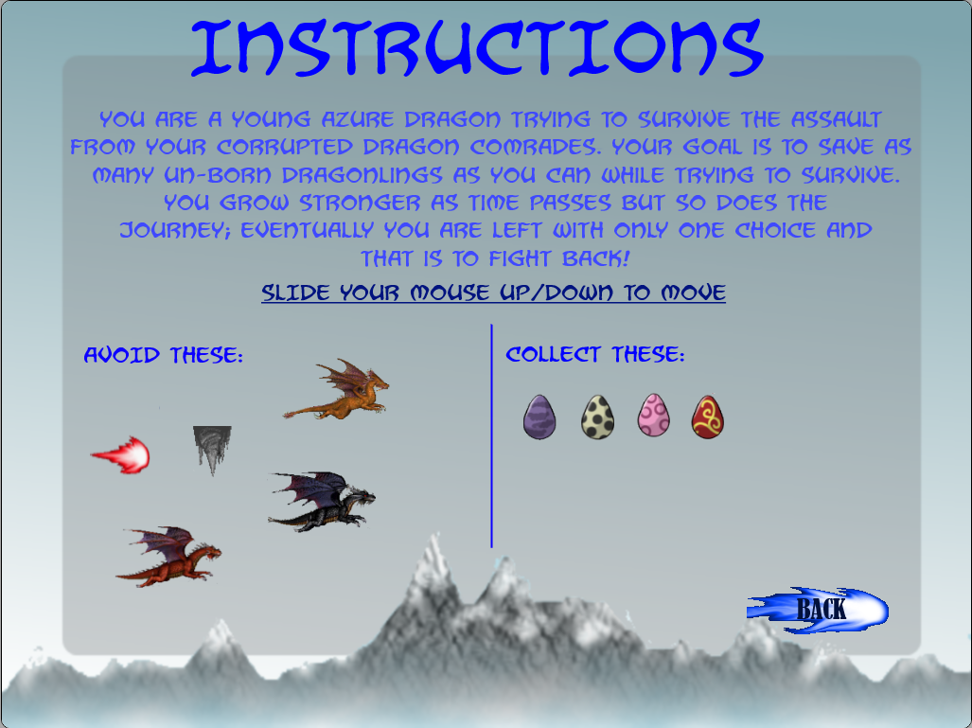
Instructions

Slide 10
~~~~Demonstration~~~~

Slide 11
Lessons learned
Fireball collision array
Create a scrolling background with continuous loop

Slide 12
Future possibilities
MORE LEVELS
Multiplayer?
PROVIDE MORE FREEDOM TO THE PLAYER
LESS MOVEMENT RESTRICTIONS
POWER UPS

