Slide 1
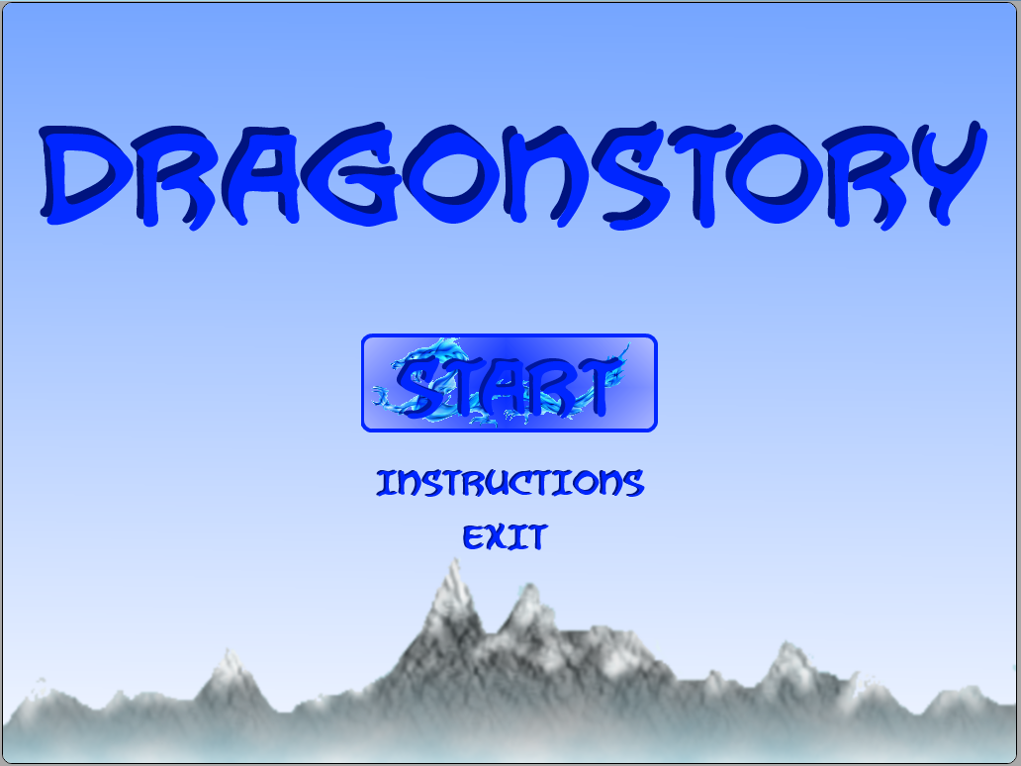

COMP397 – Web Gaming Final Project
Created by Douglas Krein, Francis Ofougwuka, Christine Cho

Slide 2




Game Overview
2D Side scroller with a dragon protagonist
Escape dragon lair with eggs
Avoid corrupted dragons
Return to lair when stronger to reclaim it

Slide 3
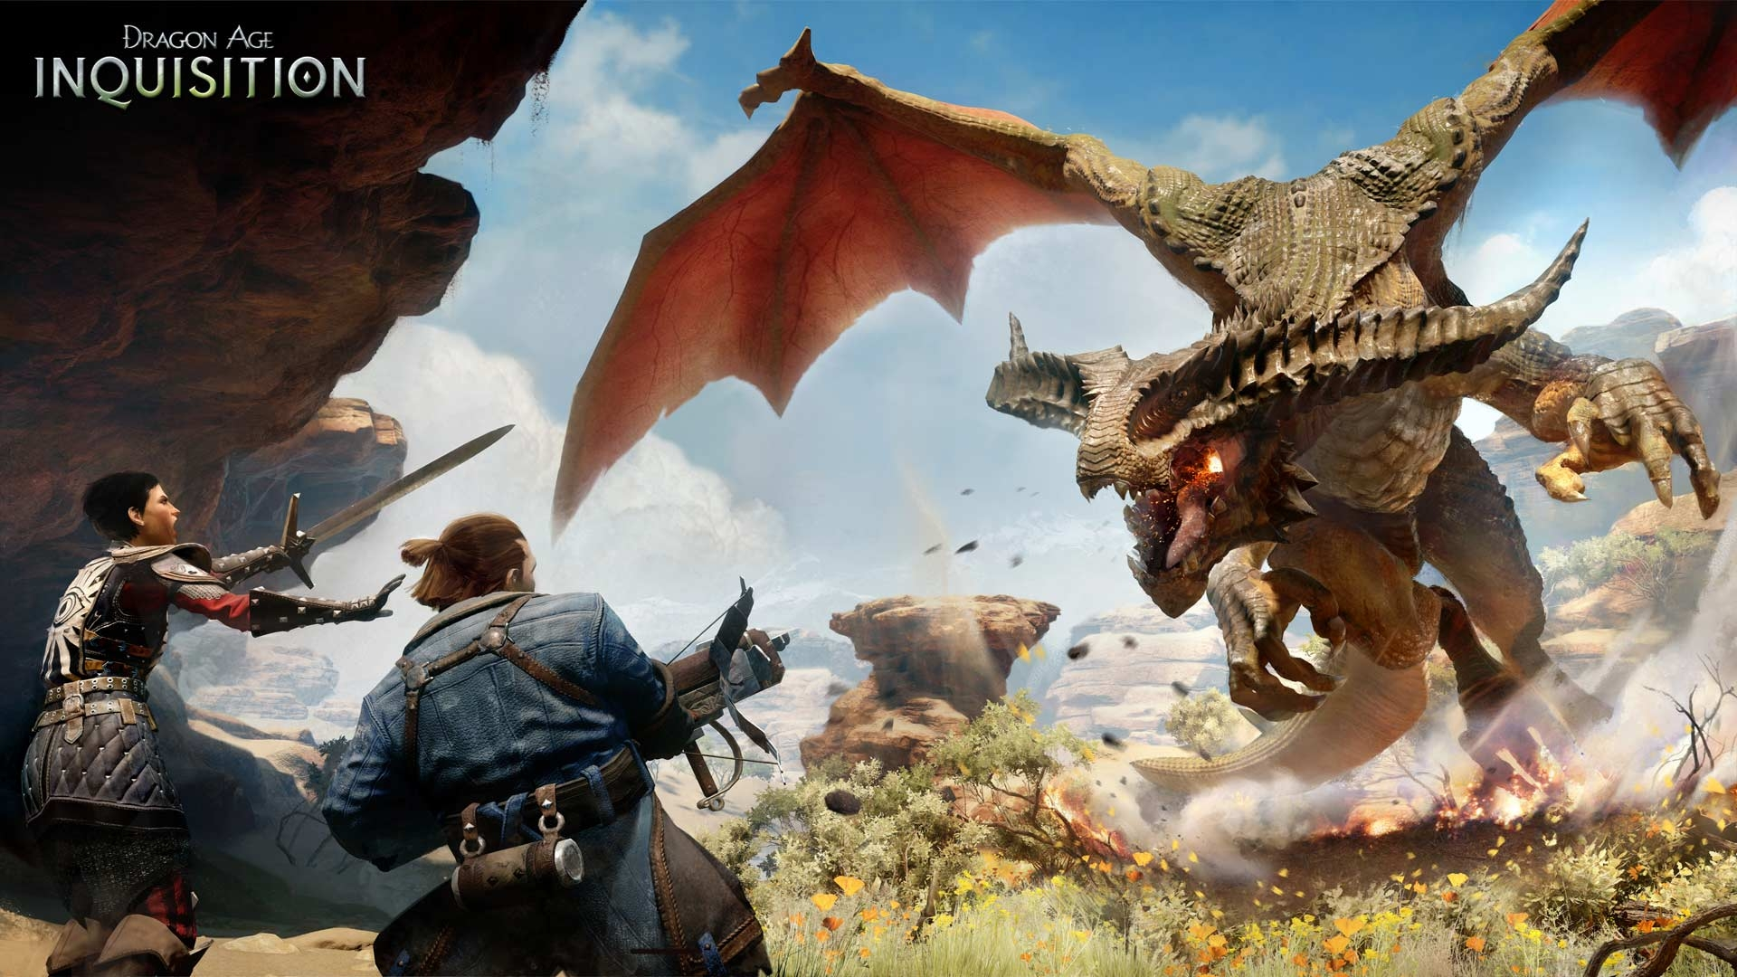
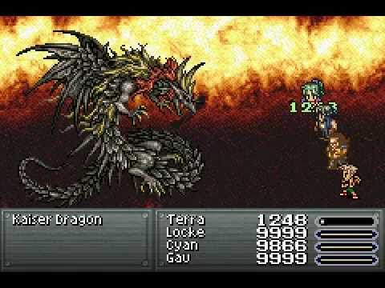
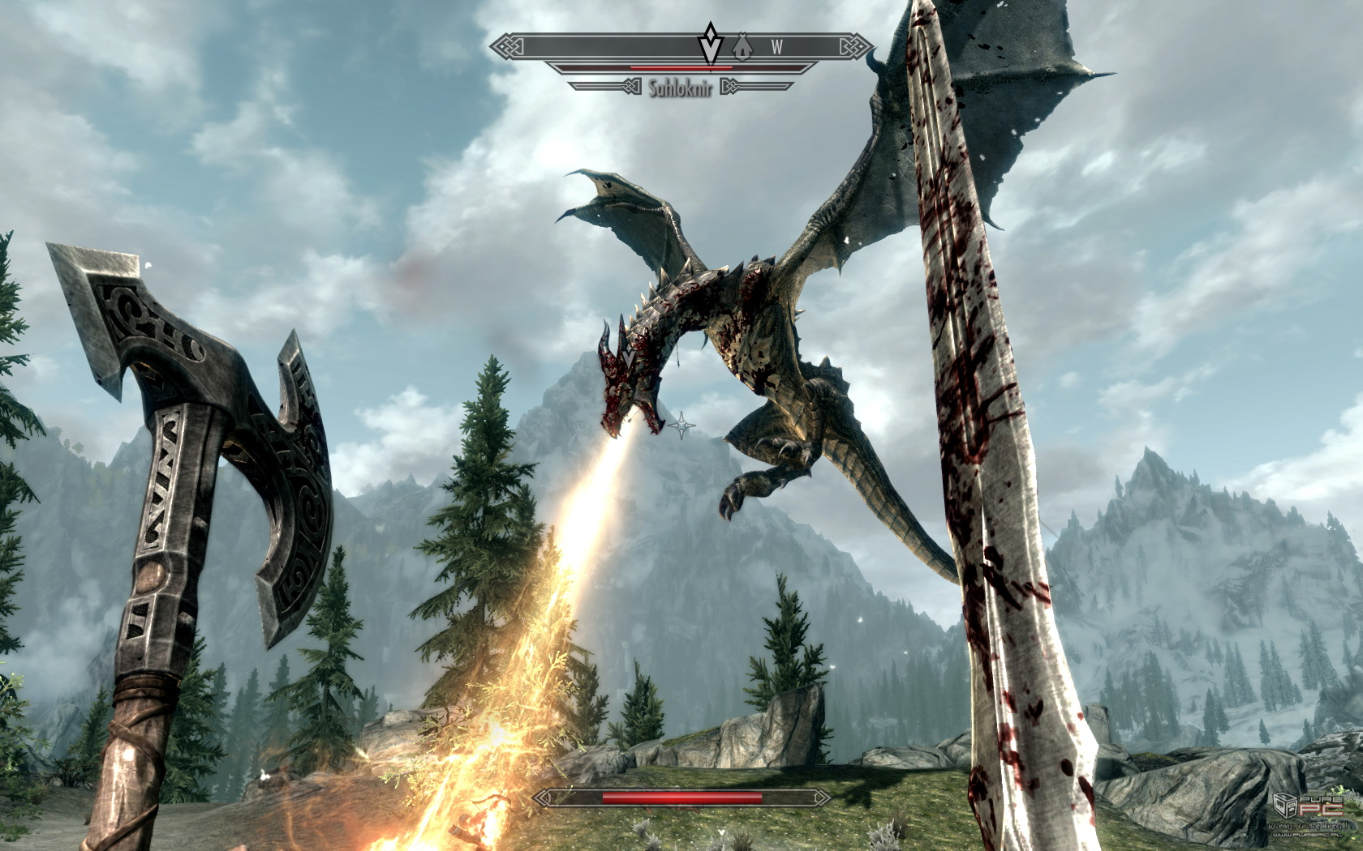
Game Overview
Games these days are mostly about killing dragons
Never about the life as one though

Slide 4
Original Plan
Based off another assignment
Originally a pure survival game
Code and ideas were constructed based on level
All the basic requirements were coded into level 1
Added new difficulties per level

Slide 5
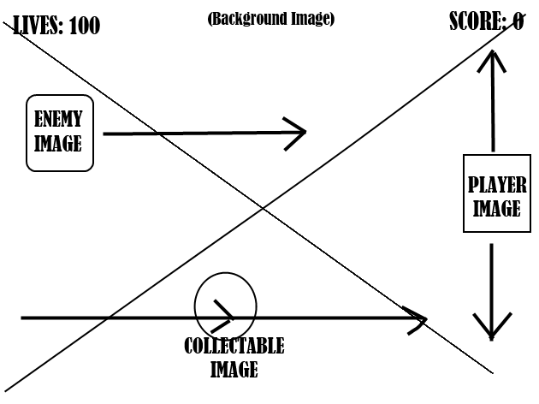
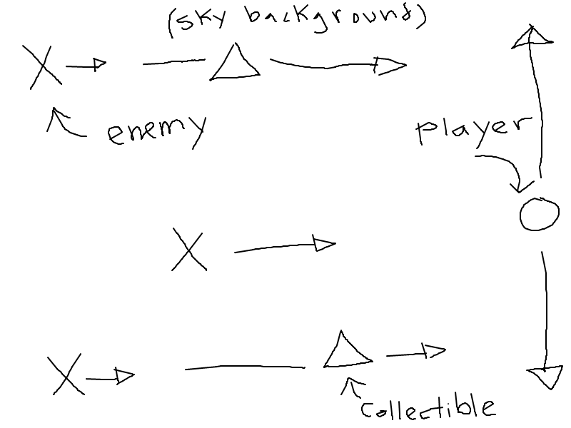
Original Plan
Level 1: Dragons that move along X or XY Axis

Slide 6
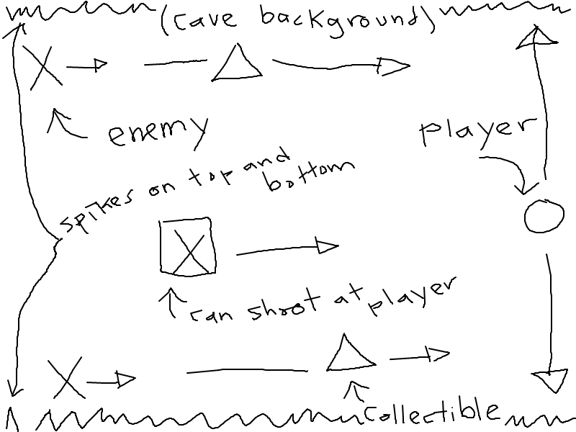
Original Plan
LEVEL 2: Fire breathing dragons
Stalagmites/stalactites on the top and bottom of the screen

Slide 7
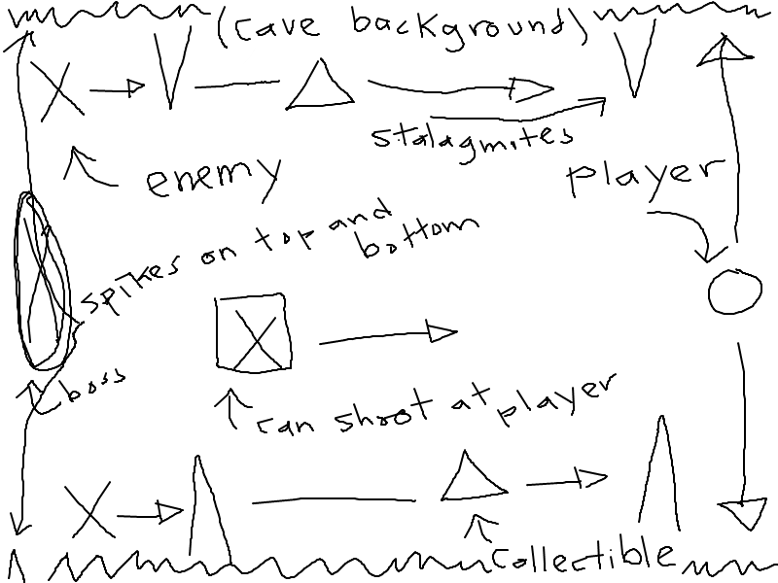
Original Plan
LEVEL 3: BOSS dragon

Slide 8



How to play?
Slide mouse up and down to move you character
Collect the following to score points:

Slide 9
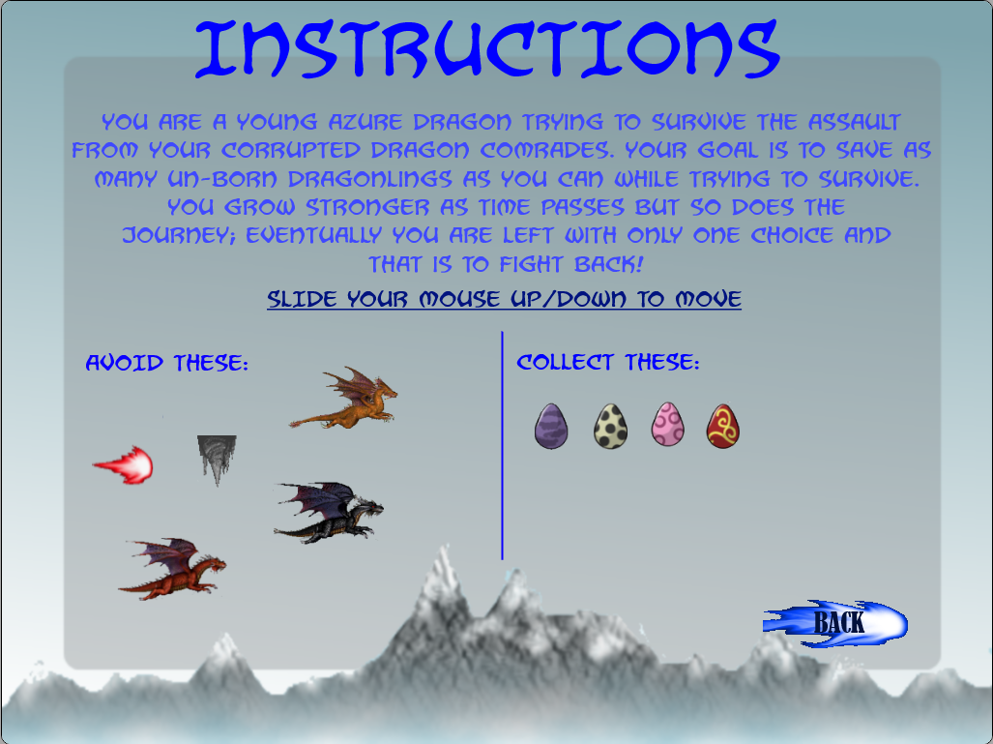
Instructions

Slide 10
~~~Demonstration~~~

Slide 11
Lessons learned
Typescript
Fireball collision array
Create a scrolling background with continuous loop

Slide 12
Future possibilities
More Levels
Multiplayer
Provide more freedom to the player
Less movement restrictions
Power ups
Animation on sprites

Slide 13
QUESTIONS?

Slide 14
THANK YOU

