Slide 1

Design and develop a robot that can navigate through a museum to provide visitors with information about the exhibits and artwork.
BY:
Shiva Sai Krishna D

Slide 2
SIMULATION
Gazebo
Differential plugin
Teleop operations
INTRODUCTION
Explanation
CONCLUSION
VISUALIZATION
RVIZ
SLAM
NAVIGATION
CAD DESIGN
Showcase of cad model

Slide 3
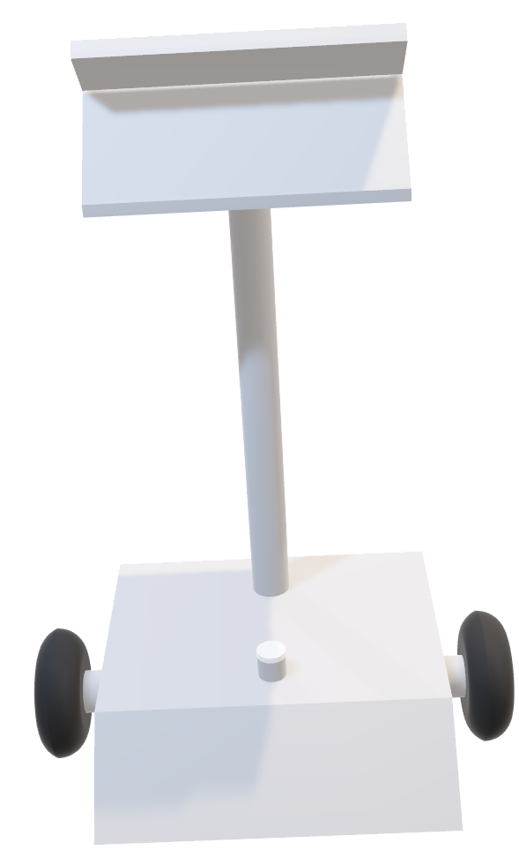

Slide 4
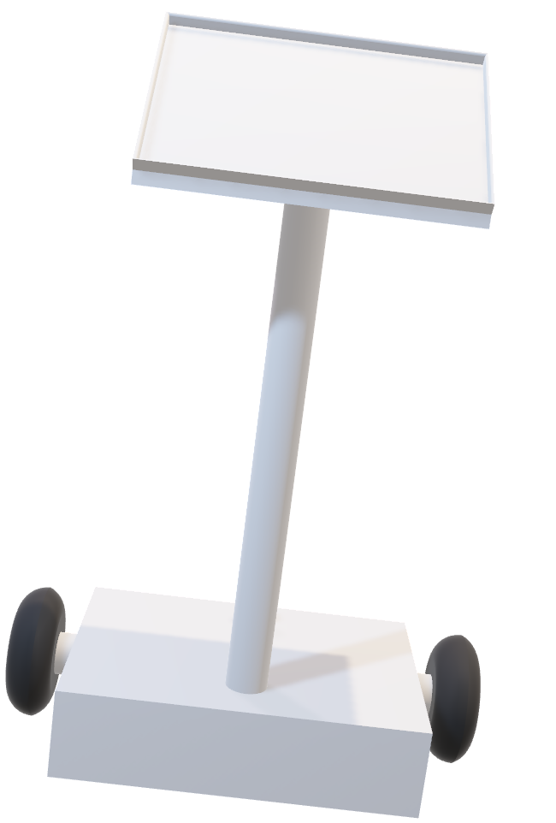

Slide 5
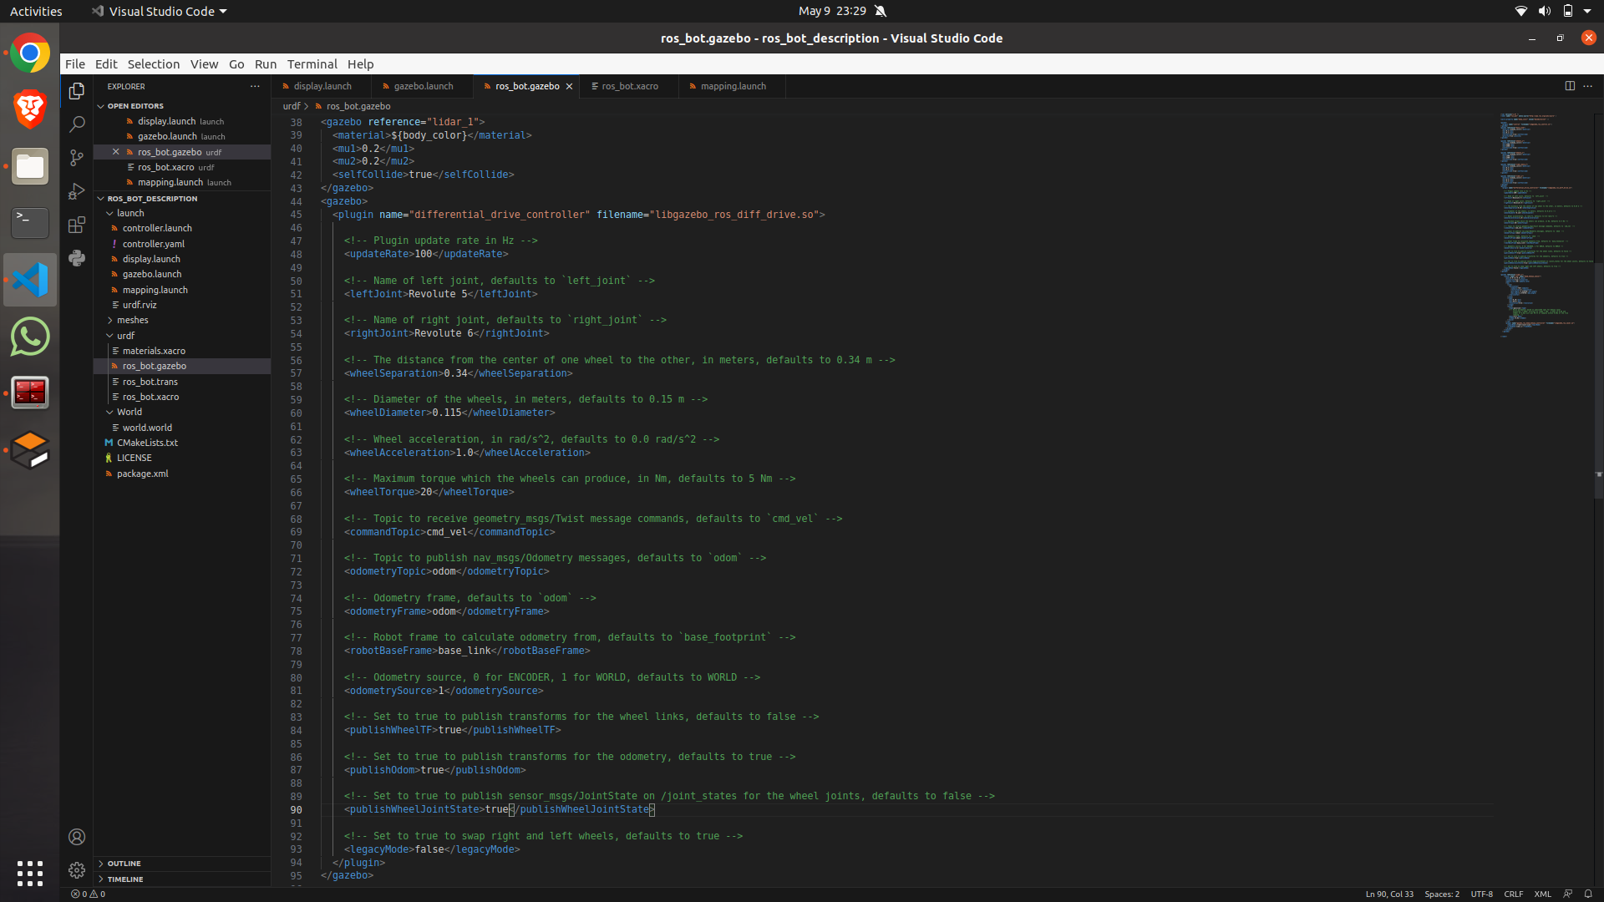

Slide 6
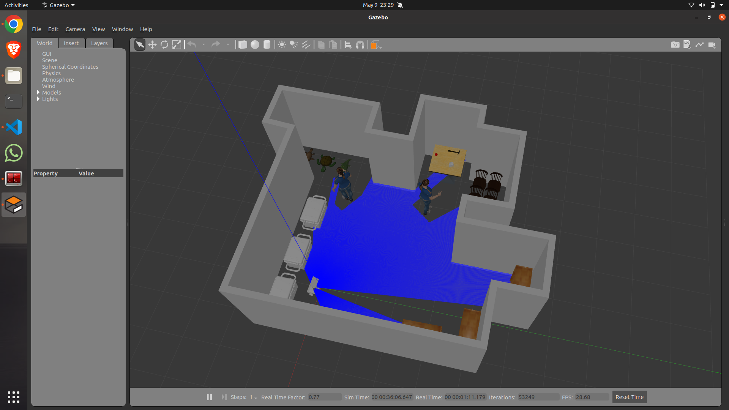

Slide 7
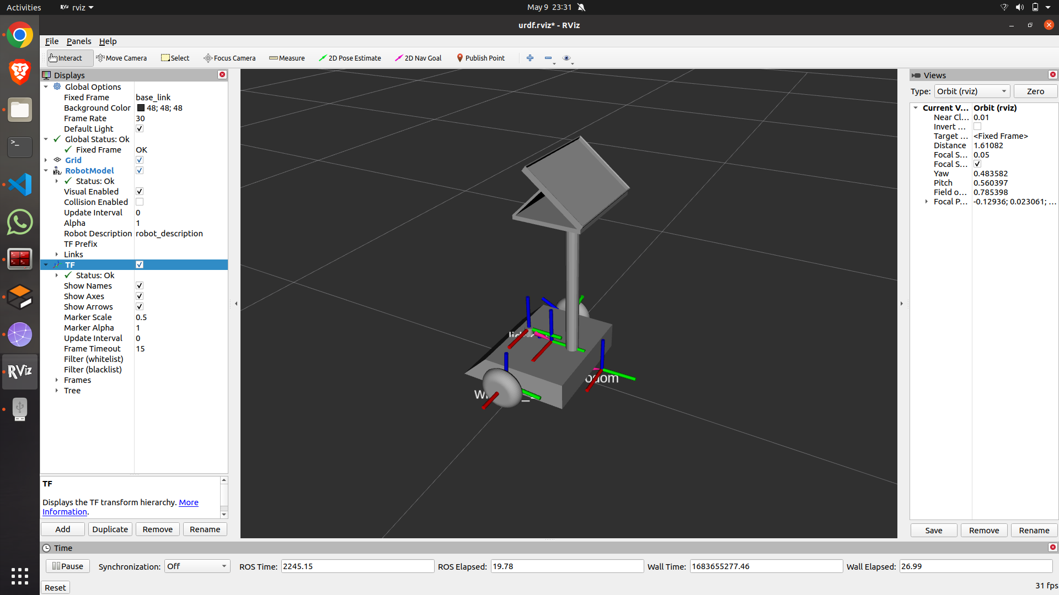

Slide 8
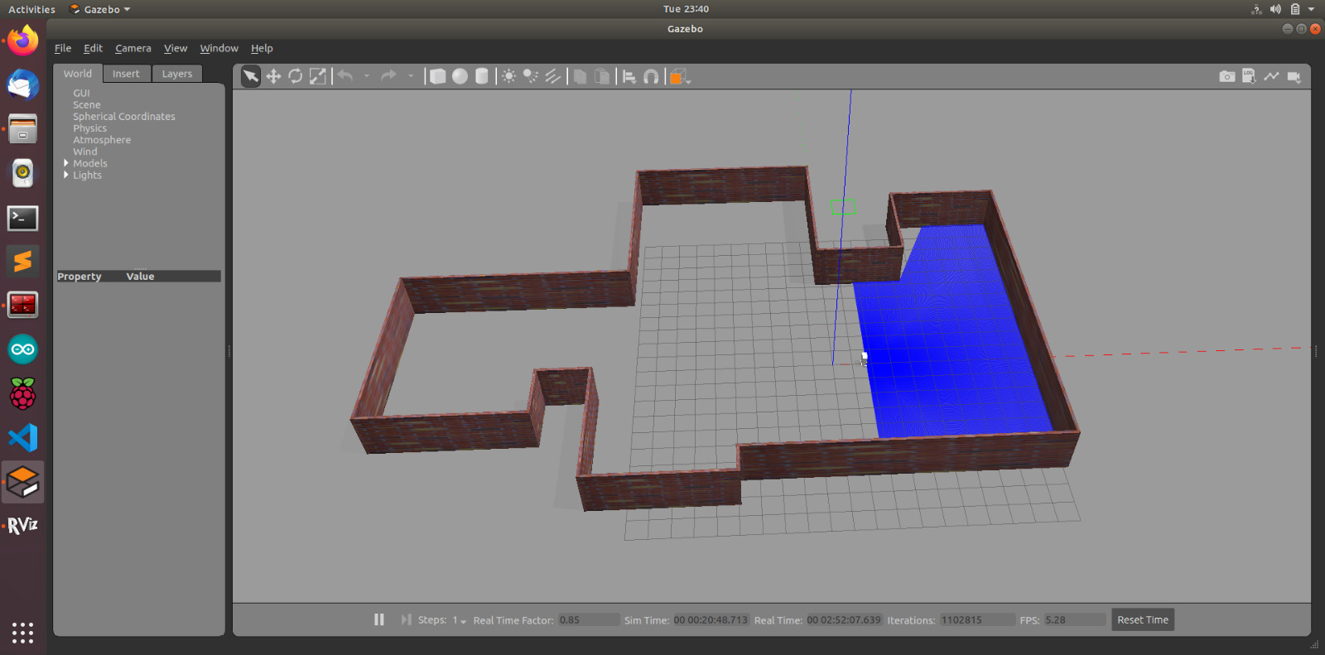

Slide 9
