Slide 1


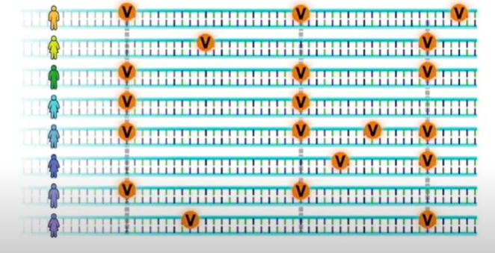


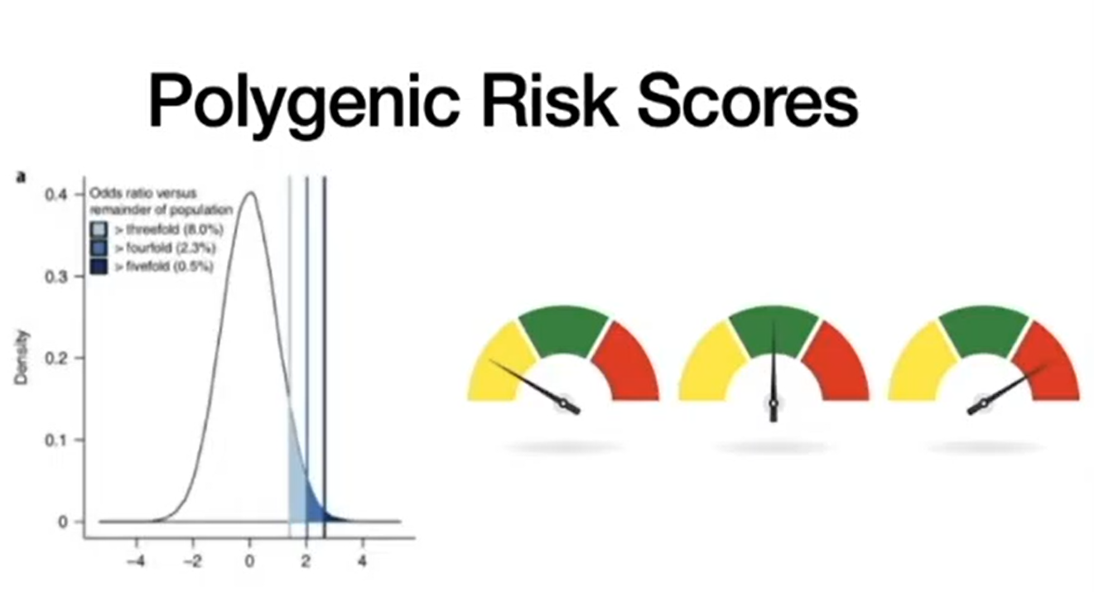
An infectious disease genetics application focused on helping you understand your susceptibility to diseases such as HIV, Hepatitis C, tuberculosis, and more!
Notes:
Mention why we chose additional studies for HepC and HIV, 1. They were missing the first paper 2. Because of chronic/undetected conditions can cause spread/outbreak and be beneficial to the person if treated early.
HIV Progression:https://pubmed.ncbi.nlm.nih.gov/21051598/
Hepatitis C: https://www.ncbi.nlm.nih.gov/pmc/articles/PMC3638215

Slide 2
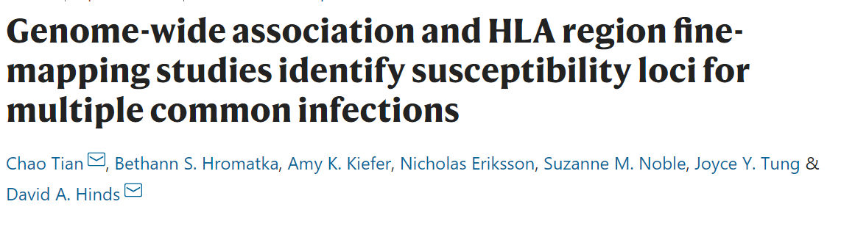
Selection of GWAS studies
23 Multiple Infections
200,000 European individuals
23andMe study
GWAS studies for 23 infections
HIV Progression
2648 individuals
Mixed ancestry
Measured through viral load (Quantitative trait)
Hepatitis C Progression
2,401 individuals
Mixed ancestry
Spontaneous resolution of Hep C
Notes:
Mention why we chose additional studies for HepC and HIV, 1. They were missing the first paper 2. Because of chronic/undetected conditions can cause spread/outbreak and be beneficial to the person if treated early.
HIV Progression:https://pubmed.ncbi.nlm.nih.gov/21051598/
Hepatitis C: https://www.ncbi.nlm.nih.gov/pmc/articles/PMC3638215

Slide 3
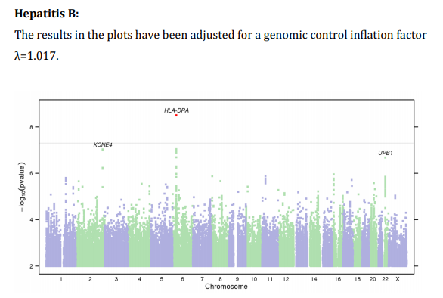
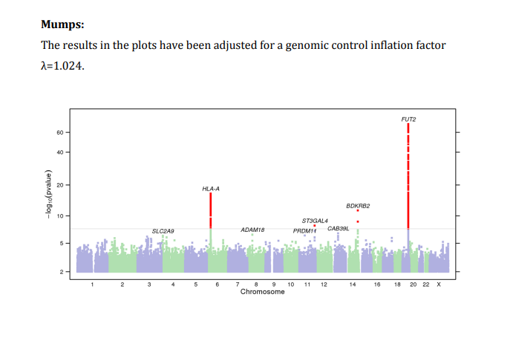
Selection of SNPs from 23 and Me Study
Summary statistics provide top 8000 SNPs for every infection
In some cases like Hep B, only few SNPS were above the significance threshold of pval<10e-8
Previously mentioned association studies found associations for SNPs pval <10e-6. So we plan to use this as a cutoff
Notes:
Mention why we chose additional studies for HepC and HIV, 1. They were missing the first paper 2. Because of chronic/undetected conditions can cause spread/outbreak and be beneficial to the person if treated early.
HIV Progression:https://pubmed.ncbi.nlm.nih.gov/21051598/
Hepatitis C: https://www.ncbi.nlm.nih.gov/pmc/articles/PMC3638215

Slide 4
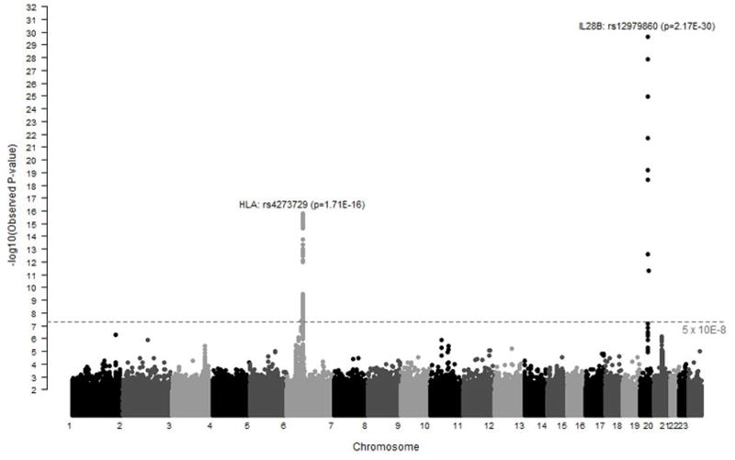
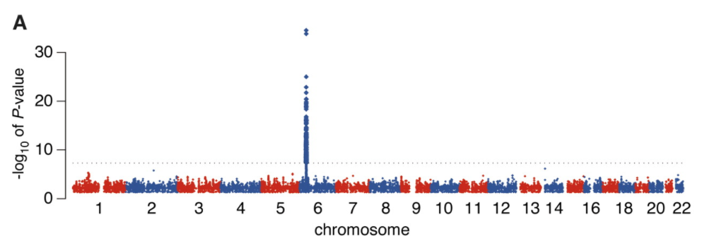
Selection of SNPs from Progression Study
Disease Progression(Hep C and HIV)
Hep C
Individuals selected from 13 study groups
Trait: Spontaneous resolution(919) vs 1482 (persistence) based on Hep C Ab/RNA
European Ancestry(1581), African American(447), Mixed(373)
9 significant SNPs from meta-analysis (p-val<10e-12)
HIV
3 Institutes in collaboration with 335 healthcare providers
Controllers(974) va Progressors(2628) based on HIV RNA copies for a 12 month period tracking
European Ancestry(1712), African American(1233), Hispanic(677)
372 significant and associated SNPs from meta-analysis(pval<10e-8)
Notes:
Mention why we chose additional studies for HepC and HIV, 1. They were missing the first paper 2. Because of chronic/undetected conditions can cause spread/outbreak and be beneficial to the person if treated early.
HIV Progression:https://pubmed.ncbi.nlm.nih.gov/21051598/
Hepatitis C: https://www.ncbi.nlm.nih.gov/pmc/articles/PMC3638215

Slide 5
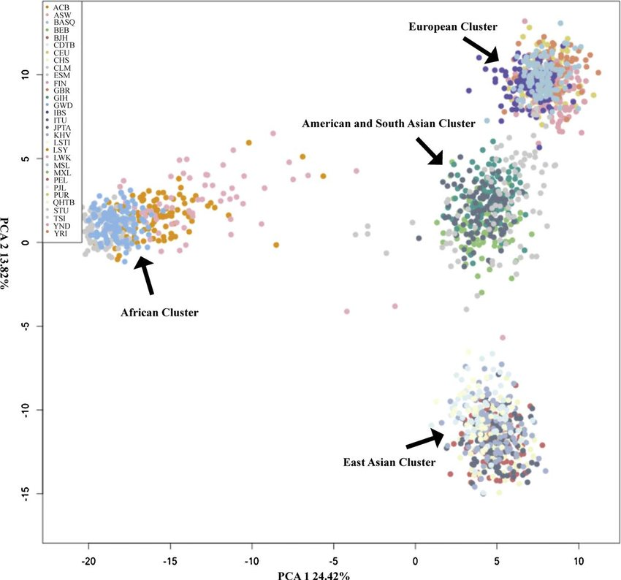
Inferring User Ancestry
PLINK
Generate PCA plots using reference populations and user genomic data
Place user in appropriate population bin to generate PRS scores
Importance of calculating ancestry
Different populations have different PRS distributions
Users perception of ancestry may not match geographic location
Notes:
Mention why we chose additional studies for HepC and HIV, 1. They were missing the first paper 2. Because of chronic/undetected conditions can cause spread/outbreak and be beneficial to the person if treated early.
HIV Progression:https://pubmed.ncbi.nlm.nih.gov/21051598/
Hepatitis C: https://www.ncbi.nlm.nih.gov/pmc/articles/PMC3638215

Slide 6
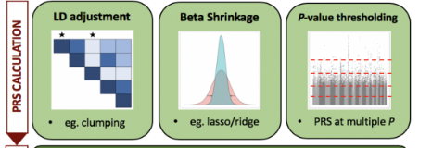
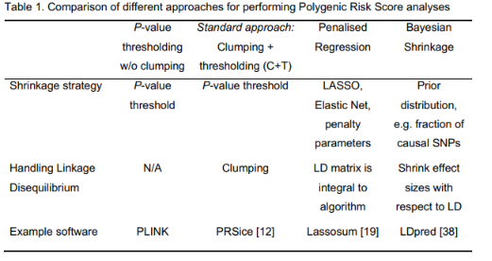
LD and PRS generation
Calculate PRS score based on summary statistics
Compare to appropriate population distribution
Tool that accounts for LD:
PRSice
Lassosum
Notes:
Mention why we chose additional studies for HepC and HIV, 1. They were missing the first paper 2. Because of chronic/undetected conditions can cause spread/outbreak and be beneficial to the person if treated early.
HIV Progression:https://pubmed.ncbi.nlm.nih.gov/21051598/
Hepatitis C: https://www.ncbi.nlm.nih.gov/pmc/articles/PMC3638215

Slide 7
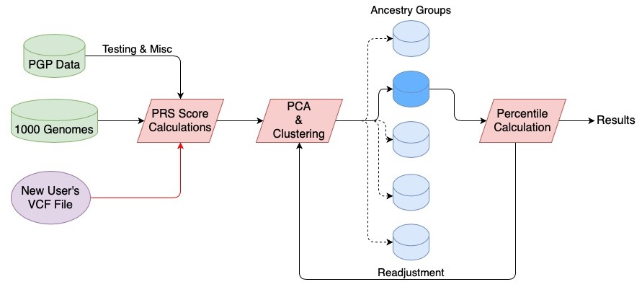
Proposed Model
Notes:
Mention why we chose additional studies for HepC and HIV, 1. They were missing the first paper 2. Because of chronic/undetected conditions can cause spread/outbreak and be beneficial to the person if treated early.
HIV Progression:https://pubmed.ncbi.nlm.nih.gov/21051598/
Hepatitis C: https://www.ncbi.nlm.nih.gov/pmc/articles/PMC3638215

Slide 8
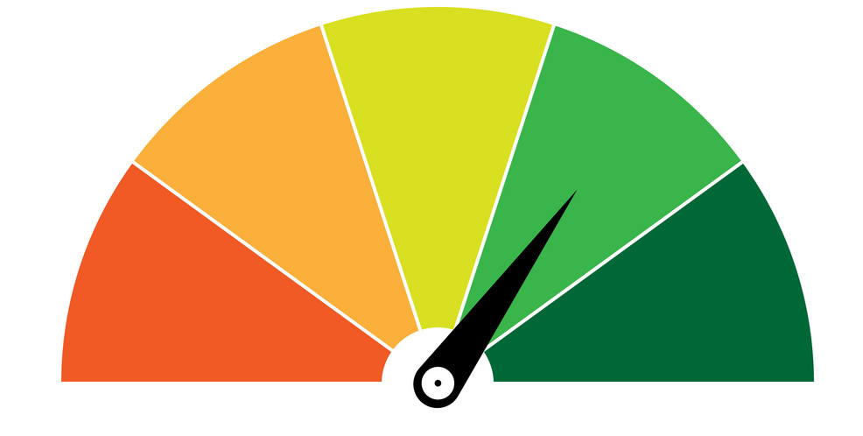
User Results
Polygenic Risk Scores: These scores are calculated for each infectious disease in our set, measuring the susceptibility or progression for that disease.
Branching: Since different SNPs might hold different significance in individuals depending upon their ancestry, we will channel the user’s input based on where the user lies on a PCA map from our reference files.
Results: In order to keep results informative, we will provide a percentile score to users, indicating their risk for susceptibility or disease progression.
Readjustment: As new data keeps coming in, we will adjust our percentile scores and PCA plots.
Notes:
Mention why we chose additional studies for HepC and HIV, 1. They were missing the first paper 2. Because of chronic/undetected conditions can cause spread/outbreak and be beneficial to the person if treated early.
HIV Progression:https://pubmed.ncbi.nlm.nih.gov/21051598/
Hepatitis C: https://www.ncbi.nlm.nih.gov/pmc/articles/PMC3638215

Slide 9
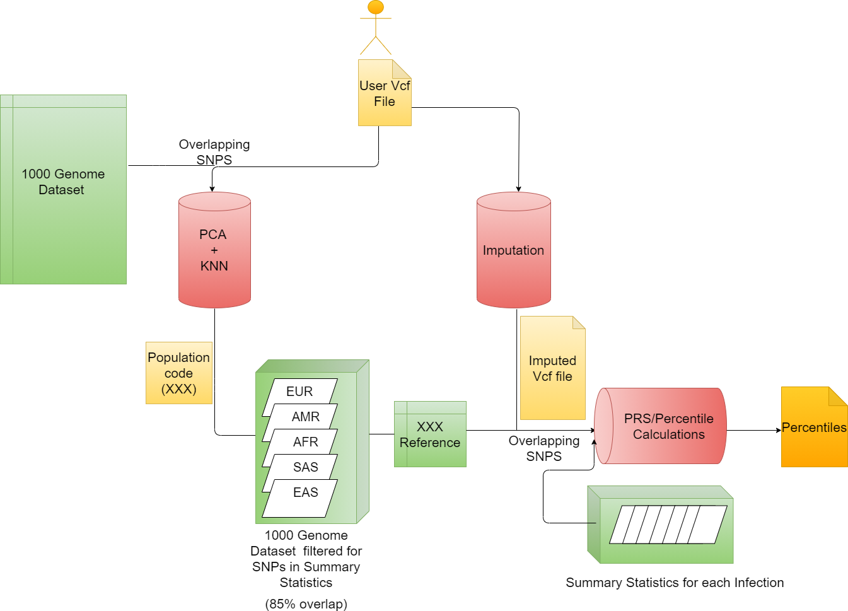
Pipeline Implementation:Phasing and Imputation
Software: Eagle2
Additional filtration of the user file:
Chromosome regions were filtered out based on 500kbp regions flanking both sides of clustered of SNPs
Number of threads: 3
Final Time for processing: 2 hours
Notes:
Mention why we chose additional studies for HepC and HIV, 1. They were missing the first paper 2. Because of chronic/undetected conditions can cause spread/outbreak and be beneficial to the person if treated early.
HIV Progression:https://pubmed.ncbi.nlm.nih.gov/21051598/
Hepatitis C: https://www.ncbi.nlm.nih.gov/pmc/articles/PMC3638215

Slide 10
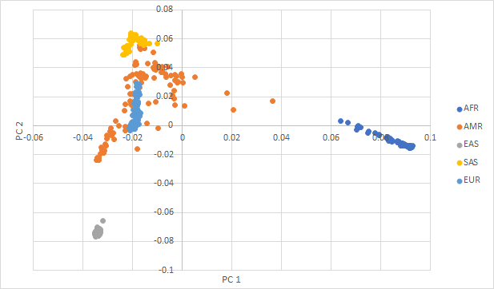
PCA and KNN clustering for Ancestry Determination
500 reference samples - 100 from each 1000 Genomes super-population
Merged rsids from reference samples with user id rsids (~500,000 SNPs )
Ran PCA with plink
Performed KNN with sci-kit learn
5 top PCs, accounts for 80% variance
5 neighbors
Notes:
Mention why we chose additional studies for HepC and HIV, 1. They were missing the first paper 2. Because of chronic/undetected conditions can cause spread/outbreak and be beneficial to the person if treated early.
HIV Progression:https://pubmed.ncbi.nlm.nih.gov/21051598/
Hepatitis C: https://www.ncbi.nlm.nih.gov/pmc/articles/PMC3638215

Slide 11
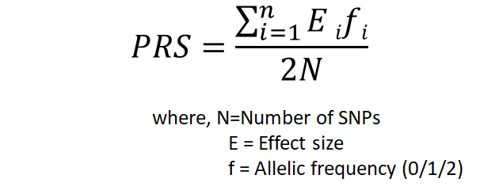
Polygenic Risk Score Calculation
Reference dataset for KNN predicted population
1000G subset of samples confirmed with PCA
Extracted variants present in the Summary Statistics (retrieved ~75% of variants)
User Inputed Vcf file
Summary Statistics for Individual Infection (rsid, Affect Allele, beta value, P Value )
Merge and get the overlapping SNP Genotype for Reference and User Vcf file
Filtered out SNPS with MAF < 0.01
Clumping SNPs having correlated P-values within 250 Kb region window
List of lead SNPs obtained after clumping is used to Calculate PRS score
python package scipy to calculate percentile PRS for the subject score
Notes:
Mention why we chose additional studies for HepC and HIV, 1. They were missing the first paper 2. Because of chronic/undetected conditions can cause spread/outbreak and be beneficial to the person if treated early.
HIV Progression:https://pubmed.ncbi.nlm.nih.gov/21051598/
Hepatitis C: https://www.ncbi.nlm.nih.gov/pmc/articles/PMC3638215

Slide 12
Final Pipeline
Notes:
Mention why we chose additional studies for HepC and HIV, 1. They were missing the first paper 2. Because of chronic/undetected conditions can cause spread/outbreak and be beneficial to the person if treated early.
HIV Progression:https://pubmed.ncbi.nlm.nih.gov/21051598/
Hepatitis C: https://www.ncbi.nlm.nih.gov/pmc/articles/PMC3638215

Slide 13
References
Multiple Common Infections: Tian, C., Hromatka, B.S., Kiefer, A.K. et al. Genome-wide association and HLA region fine-mapping studies identify susceptibility loci for multiple common infections. Nat Commun 8, 599 (2017). https://doi.org/10.1038/s41467-017-00257-5
HIV Paper: Pereyra, F., Jia, X., & McLaren, P. (2010). The Major Genetic Determinants of HIV-1 Control Affect HLA Class I Peptide Presentation. Science, 330(6010), 1551-1557. doi:10.1126/science.1195271
Hep C Paper: Duggal P, Thio CL, Wojcik GL, et al. Genome-wide association study of spontaneous resolution of hepatitis C virus infection: data from multiple cohorts. Ann Intern Med. 2013;158(4):235-245. doi:10.7326/0003-4819-158-4-201302190-00003
Notes:
Mention why we chose additional studies for HepC and HIV, 1. They were missing the first paper 2. Because of chronic/undetected conditions can cause spread/outbreak and be beneficial to the person if treated early.
HIV Progression:https://pubmed.ncbi.nlm.nih.gov/21051598/
Hepatitis C: https://www.ncbi.nlm.nih.gov/pmc/articles/PMC3638215

Slide 14
Thankyou !
Notes:
Mention why we chose additional studies for HepC and HIV, 1. They were missing the first paper 2. Because of chronic/undetected conditions can cause spread/outbreak and be beneficial to the person if treated early.
HIV Progression:https://pubmed.ncbi.nlm.nih.gov/21051598/
Hepatitis C: https://www.ncbi.nlm.nih.gov/pmc/articles/PMC3638215

