Slide 1
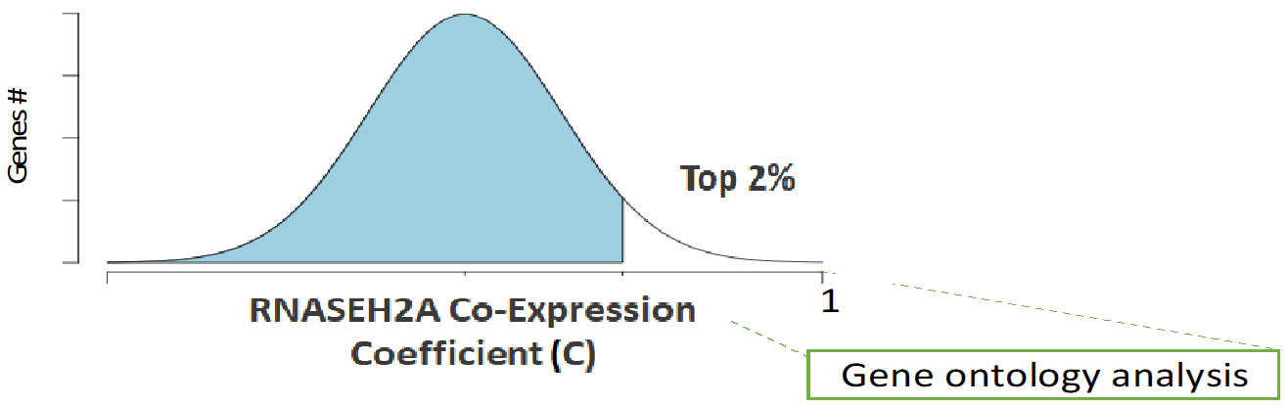
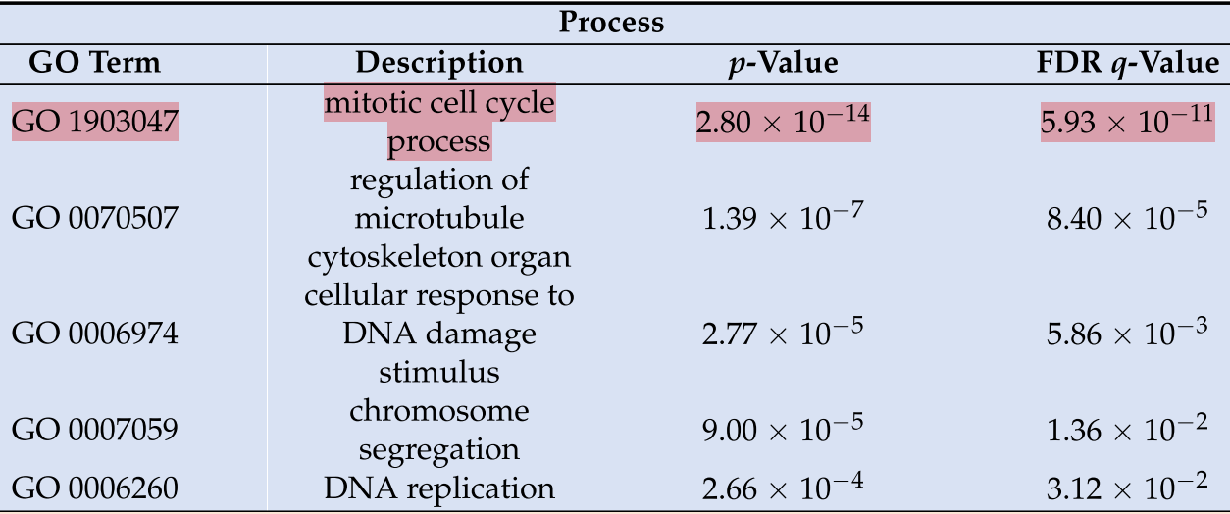
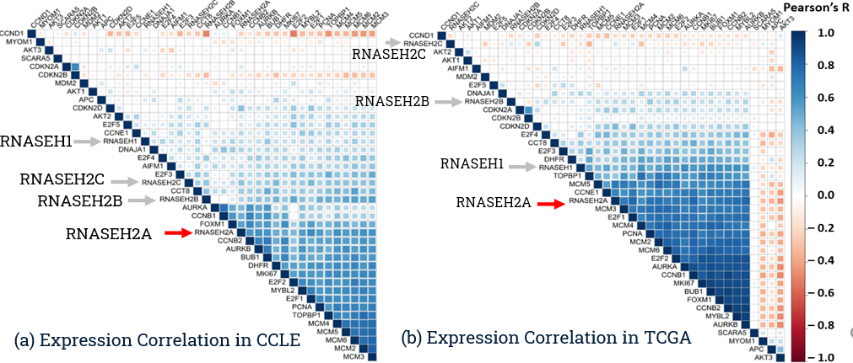

Expression Correlation and Copy Number Alteration(CNA) Prevalence of Human RNASEH2A in cancer supports a role for RNASEH2A in cancer proliferation
Gene name (s) | Function/Role
CDKN2A, CDKN2B, CCND1, | G1 Cell Cycle Phase
DHFR, CCNE1 | G1/S Cell Cycle Phase
AKT1-3, E2F4-5 | S Cell Cycle Phase
CDKN2D, MDM2 | G2 Cell Cycle Phase
CCNB2, TOPBP1 | G2/M Cell Cycle Phase
APC, BUB1 | M Cell Cycle Phase
E2F2, E2F3, CCNB1 | M/G1 Cell Cycle Phase
MYBL2, FOXM1, BUB1, AURKA, AURKB | Upregulated in cancer
SCARA5, MYOM1 | Downregulated in cancer
PCNA, MKI67(Ki67), MCM2–MCM6, E2F1 | Proliferative markers in cancer
CCNE1, CCND1, CCNB1 | Cell cycle markers associated with cancer
RNASEH2A, RNASEH2B, RNASEH2C RNASEH1 | Target genes in this study
CCT8, DNAJA1, AIFM1 | Predicted Binding partners of RNASEH2A
Gene Ontology term analysis of top 2% co-expressed genes with RNASEH2A in GTEx dataset reveals possible involvement in Mitotic Cell Cycle Process
Poster of this study was awarded US National Science Foundation Conference Award
@ The 26th Annual Meeting of the RNA Society - RNA 2021.
Correlation Plots of selected genes in CCLE(a) and TCGA Pan Cancer(b) Datasets with hierarchical clustering to reveal close association of RNASEH2A (in red) (as opposed to RNASEH2B, RNASEH2C and RNASEH1) with cancer Proliferation and G2 and M Cell cycle markers

Slide 2
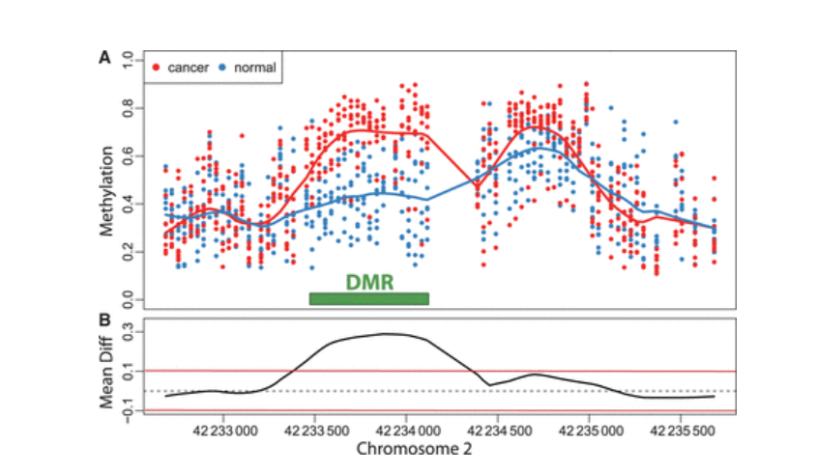
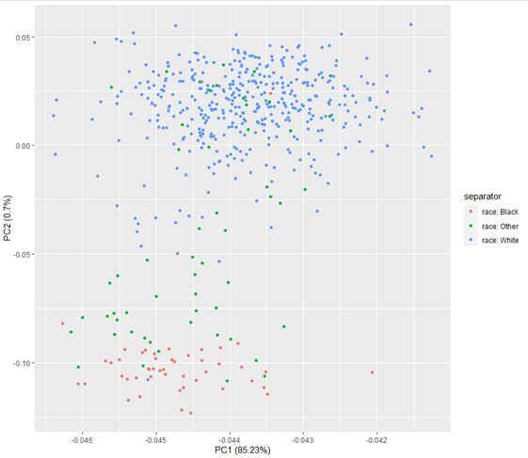
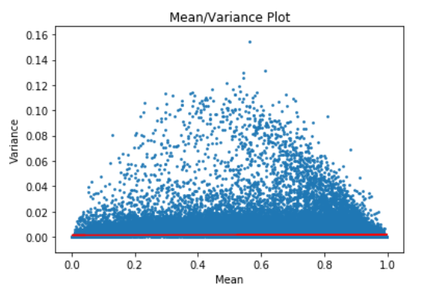
Smoking-associated Differentially Expressed Methylations (DMRs) and prognosis in HIV positive males
Hypermethylated area in Experimental condition vs Control and definition of Differentially methylated regions DMR
500 probes
1000 probes
2000 probes
PCA plot showing first two Principal Components.
The largest variation was seen based on race
Mean-Variance of beta value for ~550 HIV patient discovery cohort and thresholding to select highly variable Methylation probes to be used for prognosis using Veterans aging Cohort (VACS) index

Slide 3
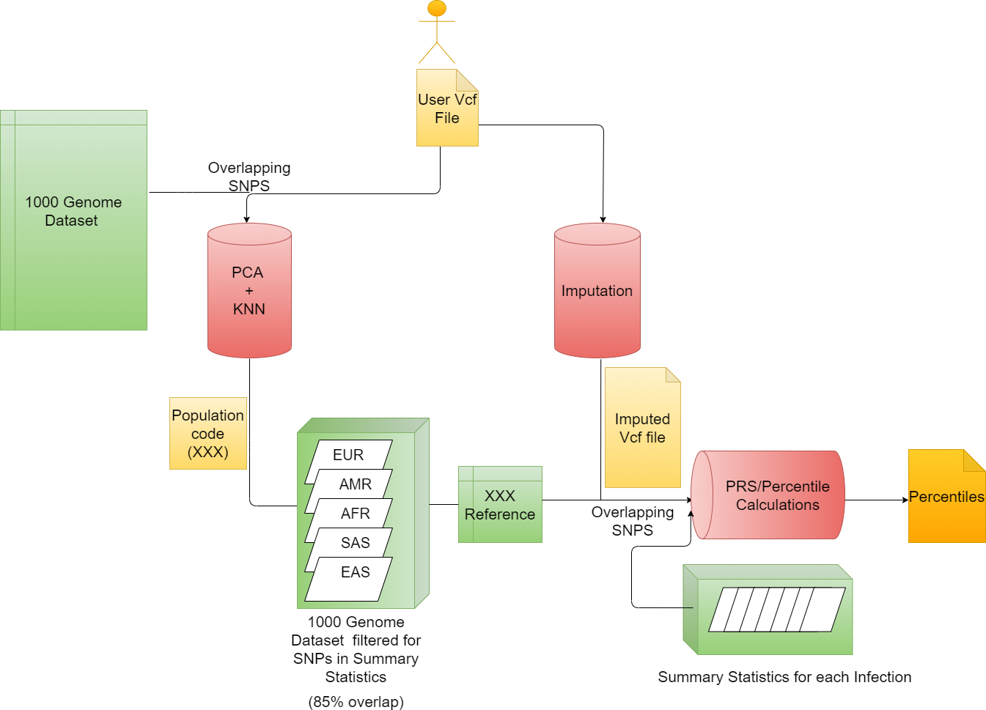


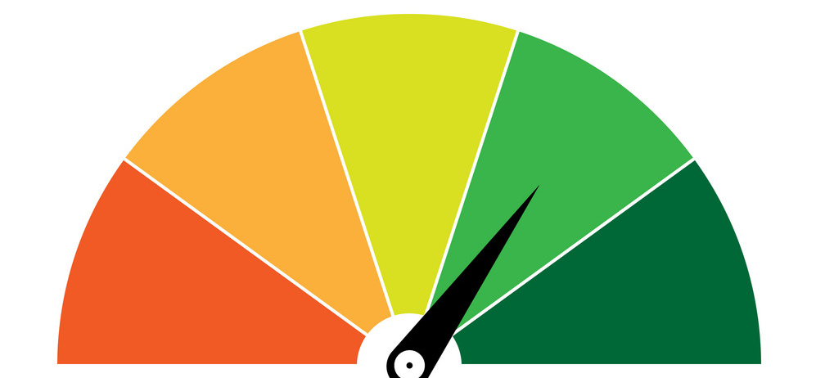
Pipeline for I-Gen: An App to predict Polygenic Risk Score (PRS) of consumer for Multiple Infections based on 23andm3 and Ancestry Genomics data
DNA sequencing data
Polygenic Risk Score Percentile
Ancestry Determination

