Slide 1

EventsHap - Uncovering events around you!!!
DARSHIT KOTHARI (20FOTCA11060)
DHRUV GAJJAR (20FOTCA11038)

Slide 2
Abstract
‘EventsHap – The Website which is designed to assist people in finding rejuvenating and fruitful activities.’ People during their leisure time usually finds it difficult to search for some events or activities to attend, Since there is no platform that can notify them about the activities happening in the nearby areas. Majority of people finds it tough to figure out what to do on the weekends. Hence , resulting in waste of time.
Whether it's a weekend or weekdays, Events like gaming tournaments, marathons, cyclothon, concerts, etc take place on regular basis, which are used to fill the empty spaces of lives. Through this website the user can easily find events happening around them.

Slide 3
Need of this system
In today’s life, people have many options to enjoy weekends but with many options comes more trouble to choose places nearby.
It is very time consuming and complex to search such events near surrounding.
For this people have to gather information as such they don’t know about the events occurring nearby.
This web application will help people to overcome from such issues and search an immediate result of events occurring nearby.

Slide 4


Presently Available Systems for the same
https://insider.in/online-events-india
https://www.whatshot.in/

Slide 5
Difference between
Our System | Existing Systems
Events are area centric in our system. | Events are not area centric in this existing systems.
Helps to discover events nearby. | Nearby events are not covered.
No payment charges on any user. | Payment charges are taken from the users.
Free of cost are shown in our system. | Free of cost events are not displayed by the existing system.
Gives opportunity to discover local events . | Local events are not covered by them.

Slide 6
Project Model
Iterative Waterfall Model
The Iterative waterfall model provides feedback paths from every phase to its preceding phases.
In the Iterative model, iterative process starts with a simple implementation of a small set of the software requirements and iteratively enhances the evolving versions until the complete system is implemented and ready to be deployed.
An iterative life cycle model starts with specifying and implementing part of the software, which is then reviewed to identify further requirements.

Slide 7
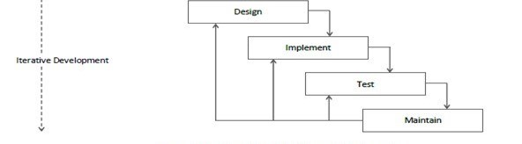
ITERATIVE WATERFALL MODEL
ITERATIVE WATERFALL MODEL

Slide 8
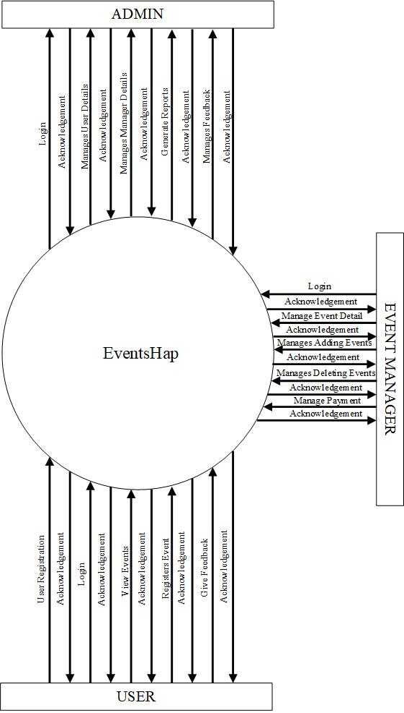
Data Flow Diagram(DFD)
LEVEL 0
LEVEL 0

Slide 9
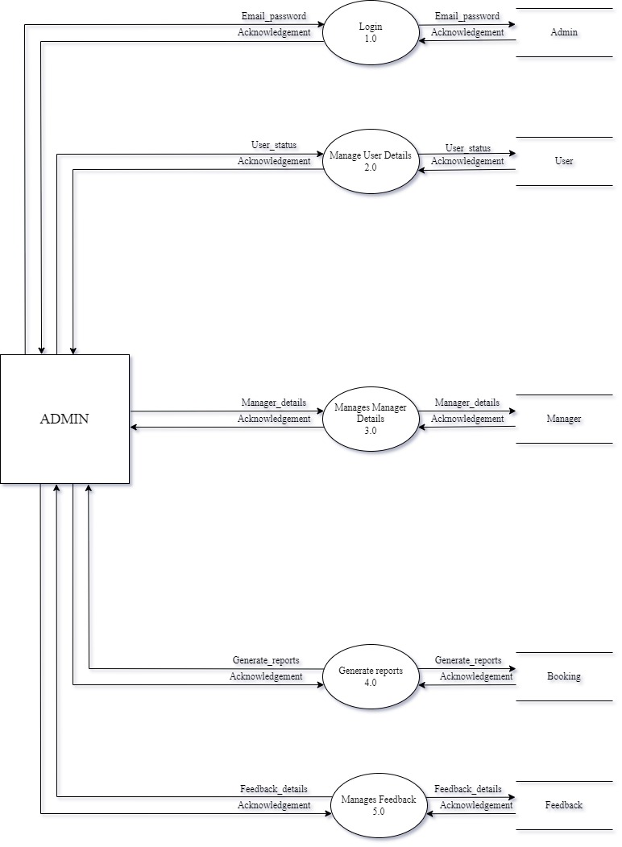
Data Flow Diagram(DFD)
LEVEL 1 ADMIN
LEVEL 1 ADMIN

Slide 10
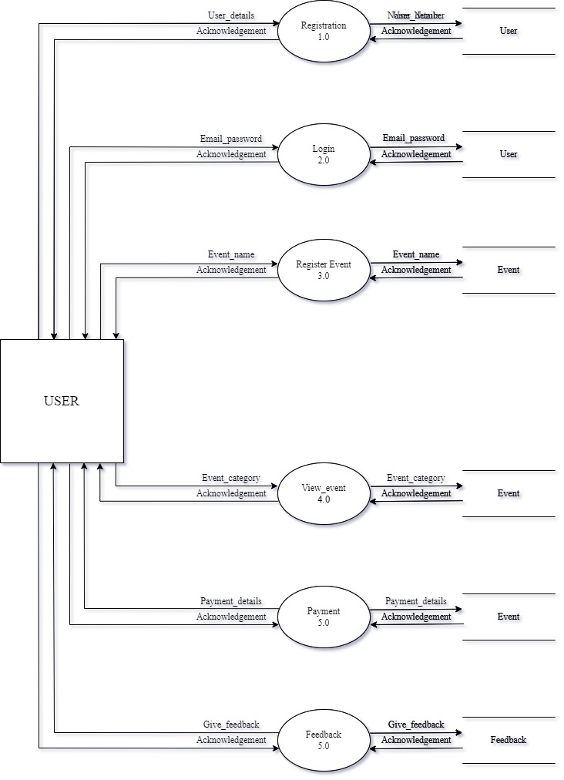
Data Flow Diagram(DFD)
LEVEL 1 USER
LEVEL 1 USER

Slide 11
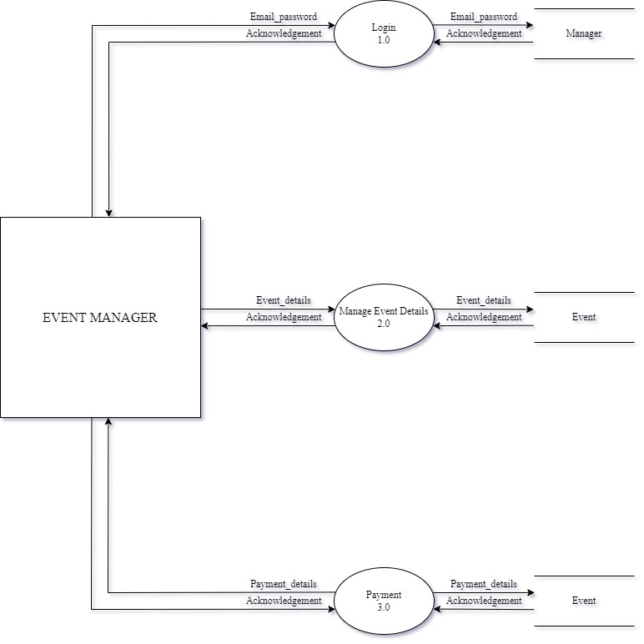
Data Flow Diagram(DFD)
LEVEL 1 EVENT MANAGER
LEVEL 1 EVENT MANAGER

Slide 12
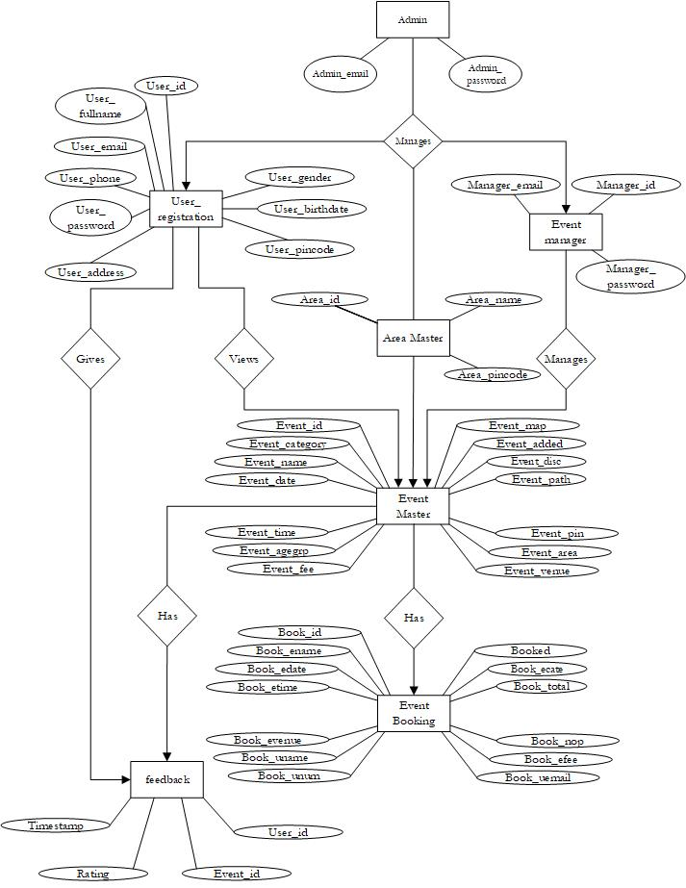
Entity Relationship(ER) Diagram

Slide 13
Black Box Testing
Black Box Testing is a software testing method in which the functionalities of software applications are tested without having knowledge of internal code structure, implementation details and internal paths.
In short, a process done by laymen from inserting the input to getting the output is known as Black Box Testing.
It is also known as Behavioral Testing.
Input
Black Box
Output

Slide 14

Steps to Black box testing:
Step 1 : Visit the website.

Slide 15

Steps to Black box testing:
Step 2 : Choose the event category you prefer to visit.

Slide 16
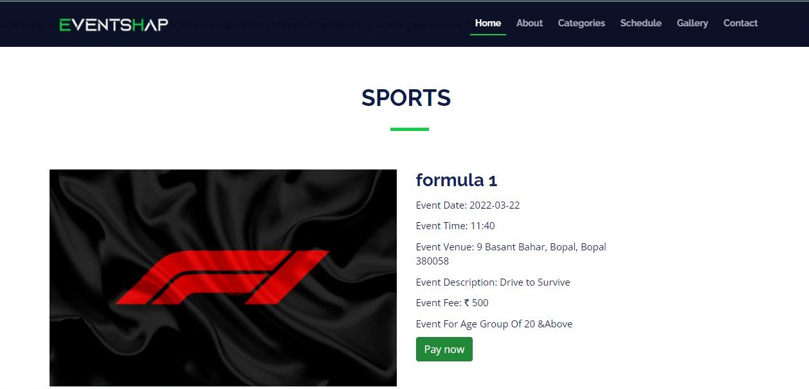
Steps to Black box testing:
Step 3 :Select the event you want to visit and Click on ‘Pay now’.

Slide 17
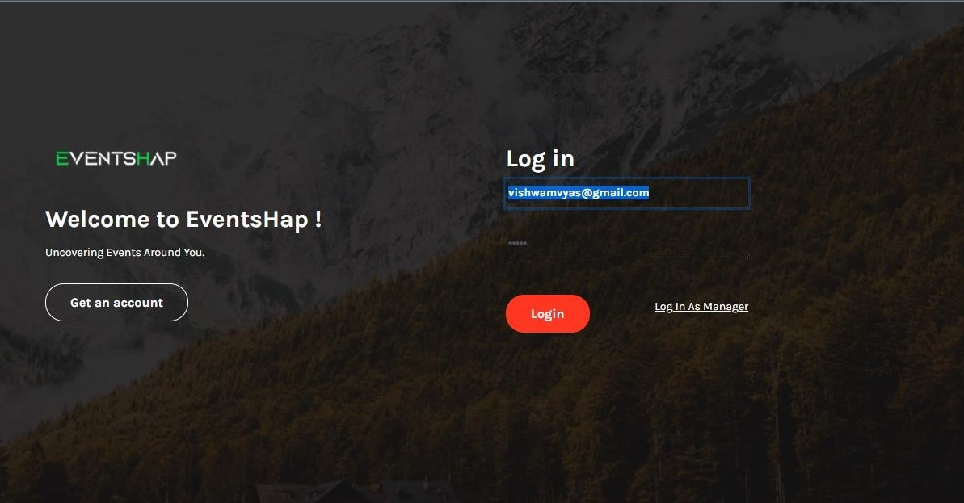
Steps to Black box testing:
Step 4 : It will redirect to log in page, where user needs to fill the login form if the user has any account.

Slide 18
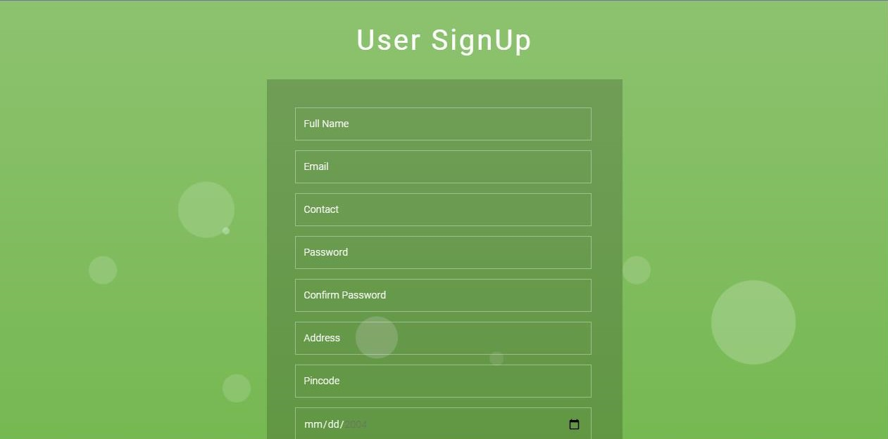
Steps to Black box testing:
Step 5 : If the user do not have an account , then click on ‘Get an account’ and fill the details to create an account and than login

Slide 19
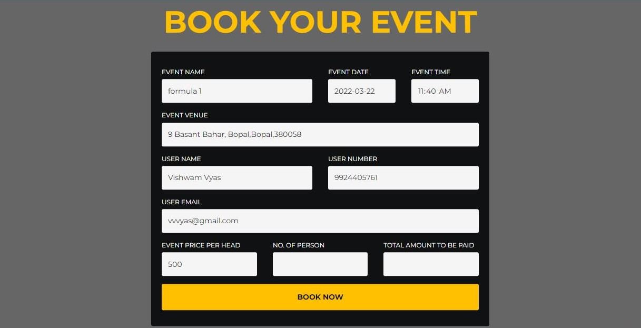
Steps to Black box testing:
Step 6 : Revisit the same event and now again click on ’Pay now’ and fill the remaining details and click on ‘Book now’.

Slide 20
Thank you

