Slide 1
Comparison of Deep Reinforcement Learning Algorithms in Partially Observable Environments
COS 703 Final Project
Daniel Lucas Thompson

Slide 2
Goals

Slide 3
Goals
Convert the Deep Q-Learning algorithm to use features instead of images
Test the Deep Q-Learning algorithm on fully observable and partially observable problems
Test the Deep Recurrent Q-Learning algorithm on fully observable and partially observable problems
Compare the results of each algorithm to determine which works best for the partially observable environment

Slide 4
Tools Used

Slide 5






Tools Used
Python
OpenAI Gym framework
Keras Deep Learning library
Jupyter Notebooks
Pandas
Matplotlib

Slide 6
Reinforcement Learning

Slide 7
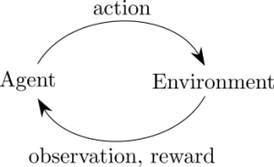
Reinforcement Learning
Agent receives a starting observation
Agent decides on an action and sends it to the environment
Agent receives a reward from the environment and a new observation
Continues until a stopping condition is met

Slide 8
Q-Learning

Slide 9

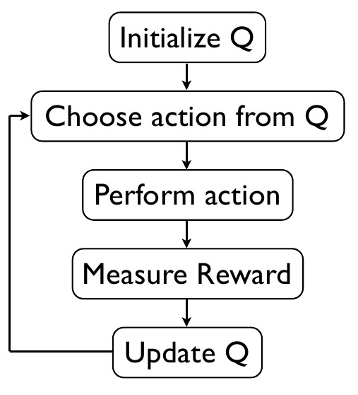
Q-Learning
Initialize the values
Choose and perform an action
Use the received reward to update the Q-Values
Repeat until convergence

Slide 10
Problem and Data

Slide 11
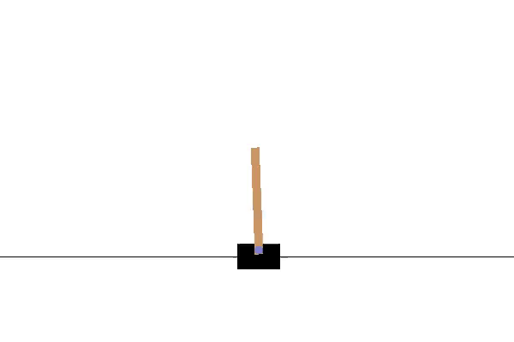
Cart Pole Problem

Slide 12
Cart Pole Problem

Slide 13
Cart Pole Fully Observable Problem
Observation | Min | Max
Cart Position | -2.4 | 2.4
Cart Velocity | -Inf | Inf
Pole Angle | -41.8° | 41.8°
Pole Velocity at Tip | -Inf | Inf
Action
Push cart left
Push cart right

Slide 14
Cart Pole Partially Observable Problem
Observation | Min | Max
Cart Position | -2.4 | 2.4
Pole Angle | -41.8° | 41.8°
Action
Push cart left
Push cart right

Slide 15
Deep Q-Learning (DQN)

Slide 16
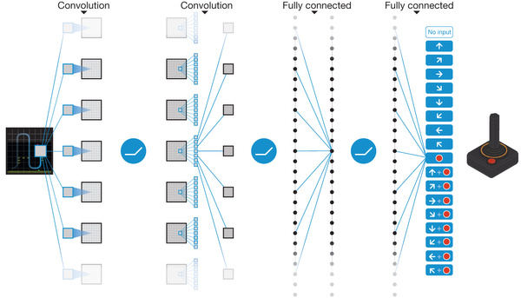
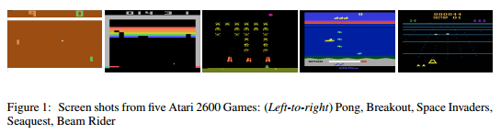
Deep Q-Learning (DQN)
Created by Google Deep Mind
Learns to play Atari games with only image inputs using Convolutional Networks
Plays at or above human level on 29 out of 49 tested Atari games

Slide 17
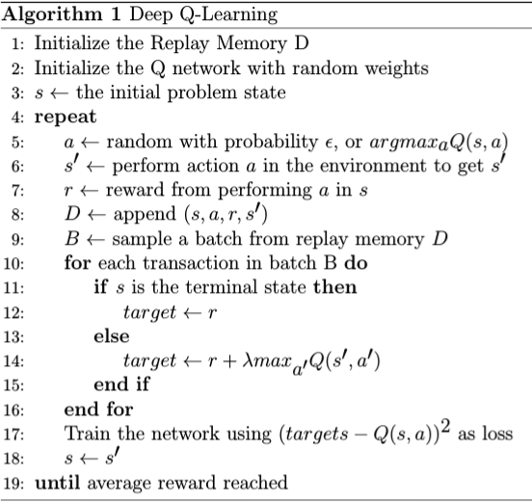
Deep Q-Learning (DQN)
Uses a deep neural network to approximate the Q function
Uses replay memory to simplify training, but trains in an online fashion
Uses target networks to aid in training stability
Uses ε-greedy exploration to aid in fully exploring the environment

Slide 18
Deep Recurrent Q-Learning (DRQN)

Slide 19
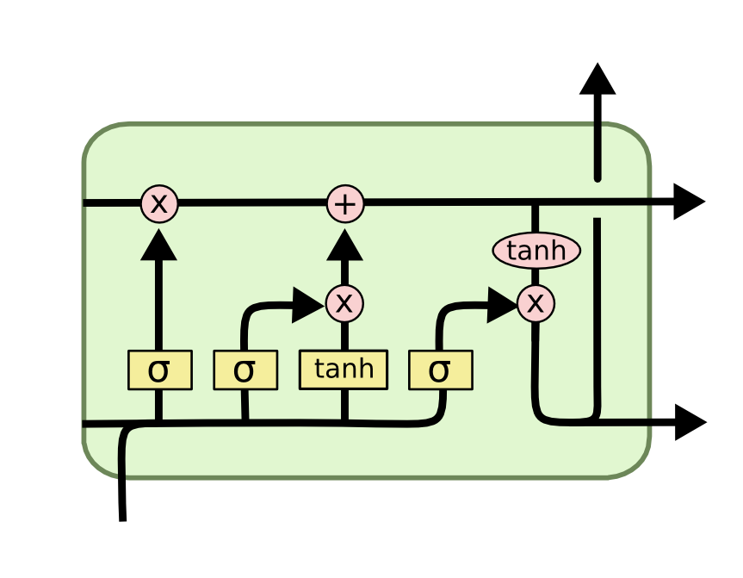
Deep Recurrent Q-Learning (DRQN)
Identical to DQN with two exceptions
Replaces the last feed forward neural network layer with a Long Short Term Memory (LSTM) layer
Modification of Replay Memory to use transactions in sequential order
LSTM Memory Cell

Slide 20
Results

Slide 21
Results Overview
For Each Algorithm and Problem
10 Training Runs
10 Testing Runs
Algorithm and Problem
DQN Fully Observable
DRQN Fully Observable
DQN Partially Observable
DRQN Partially Observable

Slide 22
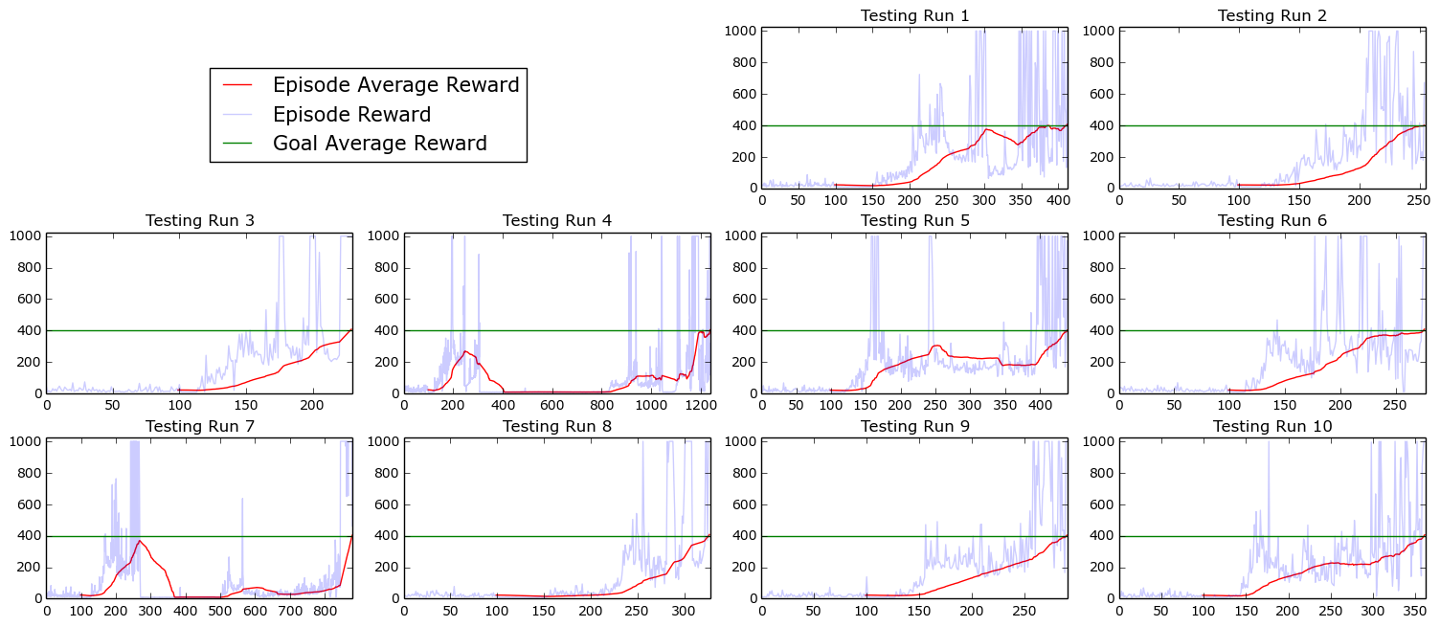
DQN Fully Observable Training

Slide 23
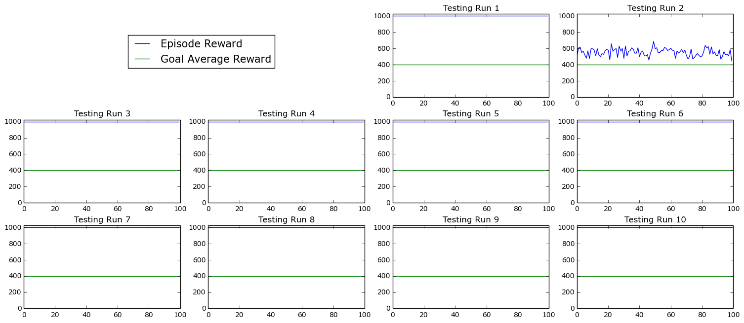
DQN Fully Observable Testing

Slide 24
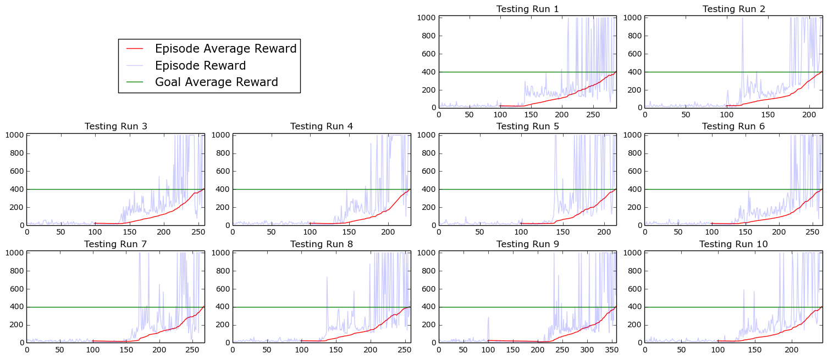
DRQN Fully Observable Training

Slide 25
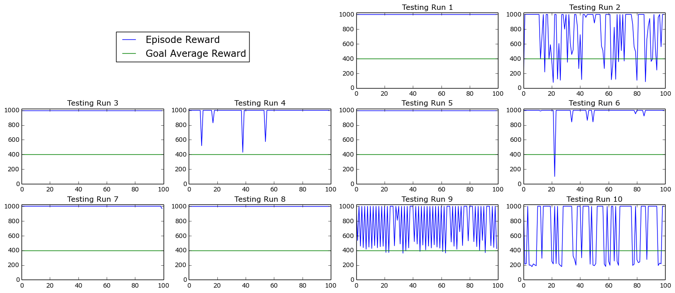
DRQN Fully Observable Testing

Slide 26
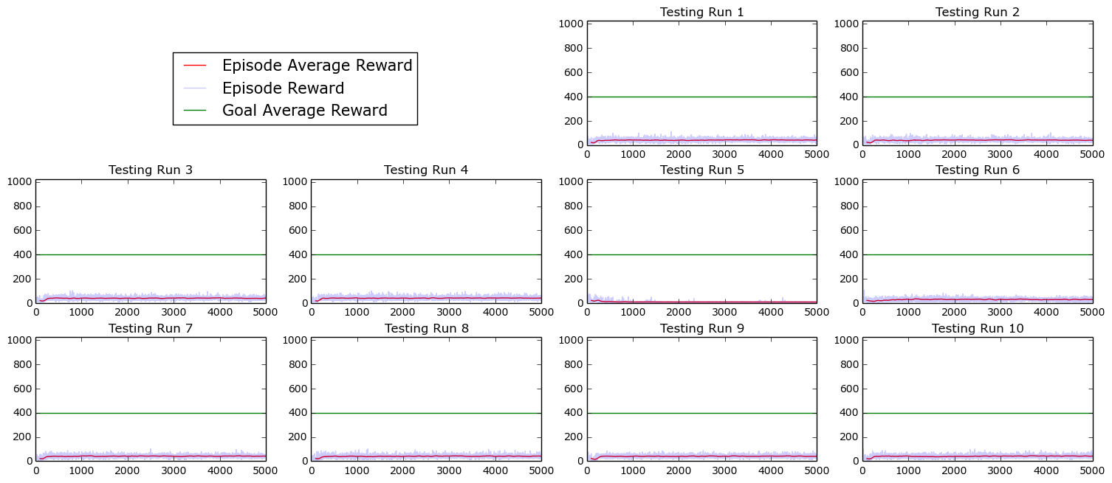
DQN Partially Observable Training

Slide 27
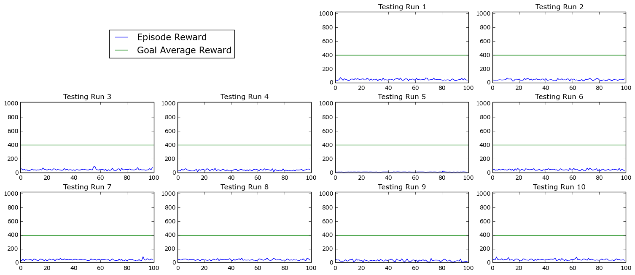
DQN Partially Observable Testing

Slide 28
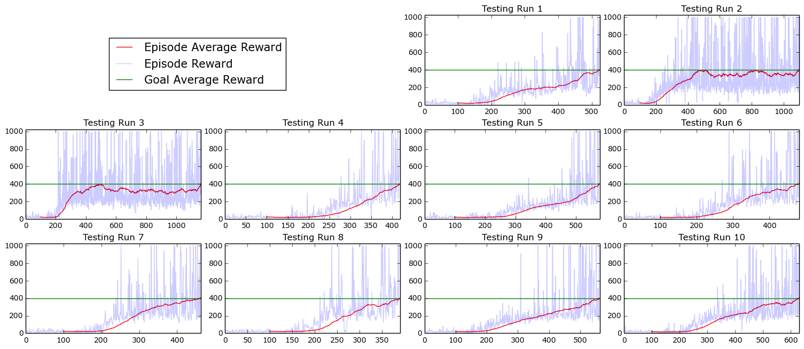
DRQN Partially Observable Training

Slide 29
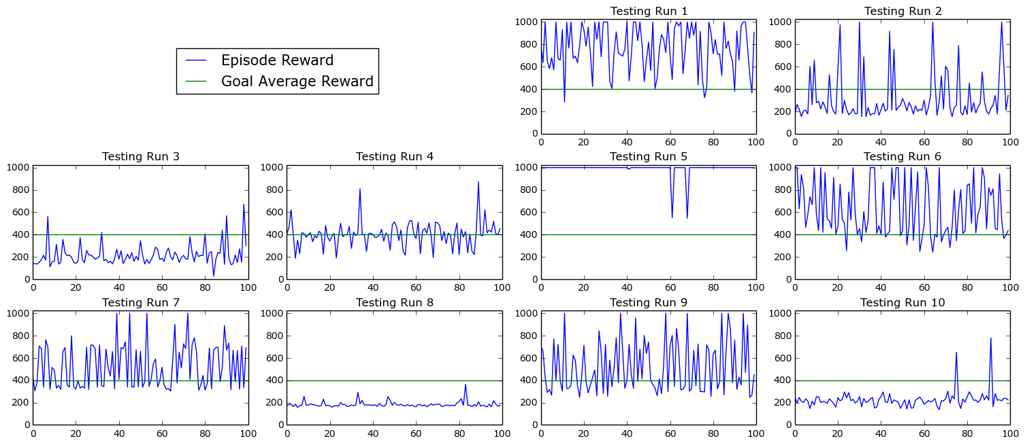
DRQN Partially Observable Testing

Slide 30
Analysis

Slide 31
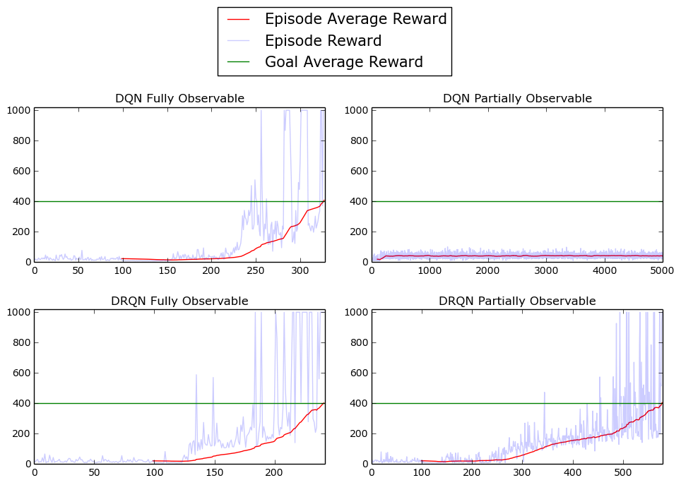
DQN vs DRQN Training

Slide 32
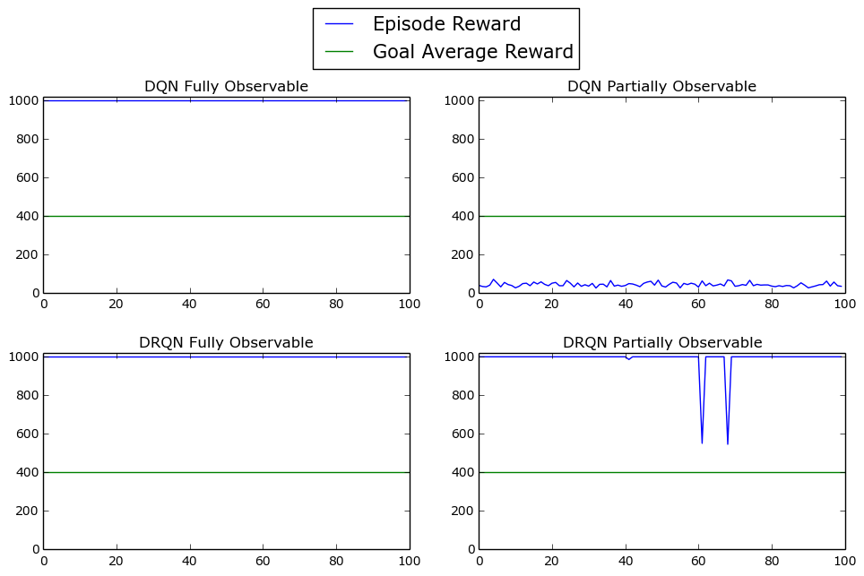
DQN vs DRQN Testing

Slide 33
Conclusion

Slide 34
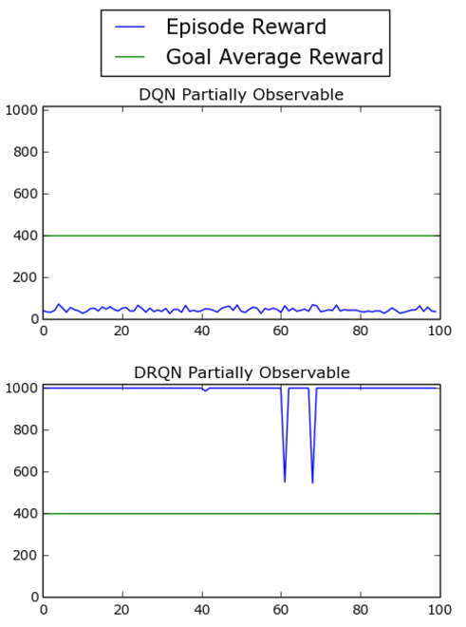
Conclusion
DQN performs poorly in partially observable environments
DRQN can obtain the goal in partially observable environments
DRQN is much harder to train and find correct parameters

Slide 35
Future Work

Slide 36
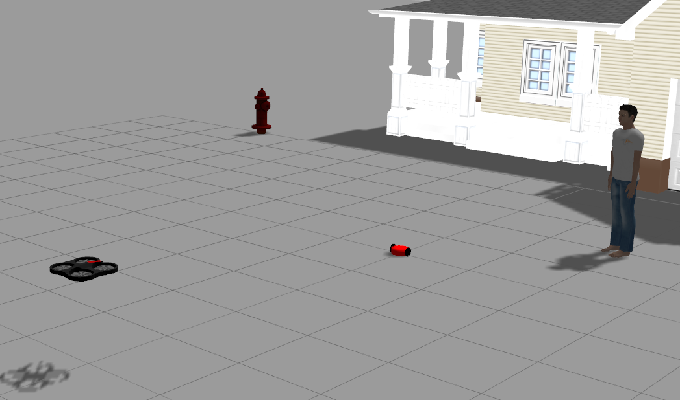
Future Work
Drone Target Tracking - using the DQN and DRQN algorithms, train drones in a simulator to follow a moving target
Convolutional Neural Networks - modify the drone target tracking to use convolutional neural networks when appropriate hardware is available for training

Slide 37
References
[1] Volodymyr Mnih, Koray Kavukcuoglu, David Silver, Alex Graves, IoannisAntonoglou, Daan Wierstra, and Martin A. Riedmiller. Playing atari withdeep reinforcement learning. CoRR, abs/1312.5602, 2013.
[2] Matthew J. Hausknecht and Peter Stone. Deep recurrent q-learning forpartially observable mdps. CoRR, abs/1507.06527, 2015.
[3] Greg Brockman, Vicki Cheung, Ludwig Pettersson, Jonas Schneider,John Schulman, Jie Tang, and Wojciech Zaremba. Openai gym. CoRR,abs/1606.01540, 2016.

