Slide 1
揭秘HTML5和CSS3

Slide 2
网站标准的简单历史
XHTML 1
CSS2.1
Content
Presentation
2001-2006

Slide 3
网站标准的简单历史
WHATWG?
  Web Hypertext Application Technology Working Group
W3C
  Word Wide Web Consortium
2004-Present

Slide 4
网站标准的简单历史
HTML5
CSS3
Content
Presentation
2007-Present

Slide 5
HTML5
HTML5 DEMO

Slide 6
HTML发展历史
HTML4.0
XHTML1
XHTML2
WHATG
HTML5
1998
2000
2002
2004
2007

Slide 7


支持HTML5的浏览器
Opera 9.5+
  Cross-document messaging
  Server-sent events
  Web Forms 2.0
  Canvas and video
Safari 3.1+
  <video> and <audio> tags
  Offline data storage API
  Webkit(Iphone/Chrome/Android/
  Nokia s60/Palm's WebOS)

Slide 8


支持HTML5的浏览器
FireFox 3.1+
  offline storage and canvas
  Geolocation/Web Workers/
  ContentEditable
  Gecko(more HTML5 APIS)
Internet Explorer 8.0+
  embed element and
  contentEditable attribute
  cross-document messaging

Slide 9
HTML5技术概览
HTML5新增和移除的元素
HTML5基本布局
HTML5对表单的支持
HTML5 DOM变化
HTML5的Javascript APIs
  Canvas
  Video/Audio
  Drag&Drop
  Geolocation
  Application Cache
  Database Storage
  X-Document Messaging

Slide 10
HTML5新增的元素
多媒体及交互式元素
  video, audio...
  details, menu, command...
结构元素
  header, footer, section, article, nav...
块级语义及行内元素
  aside, figure, dialog...
  time, meter, mark, progress...
表单控件
  email, url, datetime, number, range, color...
HTML5新增的属性
  contenteditable, contextmenu, data-*, hidden, item, itemprop, subject, role, aria-*, spellcheck, draggable, irrelevant, template, placeholder, autofocus, required, async, manifest...
HTML5新增的事件
  onabort, onbeforeunload, oncontextmenu, ondrag, ondragend, ondragenter, ondragleave, ondragover, ondragstart, ondrop, onerror, onmessage, onmousewheel, onresize, onscroll, onunload...

Slide 11
HTML5移除的元素
移除的元素
  font, center, strike, big, s, u, acronym, applet, dir...
移除的属性
  如link和a元素的rev属性, link元素的target属性, td的scope属性，script元素的language属性, body元素的alink，link，text和vlink属性...

Slide 12
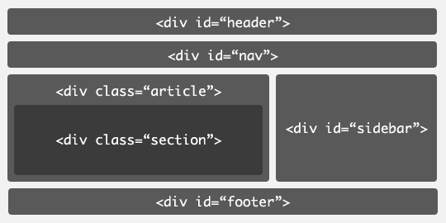
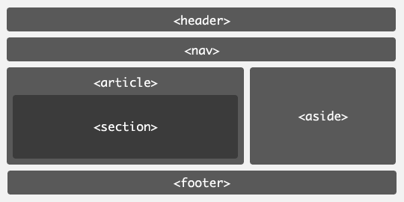
HTML5基本布局
<!DOCTYPE html>
<htmlang = "en">
<head>
<meta charset = "utf-8">
<title>HTML5 Demo</title>
<body>
<header><h1></h1><h2></h2></header>
<nav><ul><li></li><li></li></ul></nav>
<section>
<article></article>
<article></article>
</section>
<aside></aside>
<footer></footer>
</body>
</html>
HTML4
HTML5

Slide 13
HTML5对表单的支持
新的控件类型
  <input type="url|email|date|tel|search|datetime|date|month|week|datetime-local|number|range|color">, <select data="http://domain/getoptions"></select>
文件上传控件
  <input type="file" accept = "image/png" />
重复的模型
  add, remove, move-up, move-down
内建表单验证
  <input type="email" required />, <input type="number" min=10 max=100 />
XML Submission
  application/x-www-form+xml

Slide 14
<form action='/register' enctype="application/x-www-form+xml" method="post">
<p>
<label for='name'>ID(请使用Email注册)</label>
<input name='name' required type='email' />
<p>
<label for='password'>密码</label>
<input name='password' required type='password' />
<p>
<label for='birthday'>出生日期</label>
<input type='date' name='birthday' />
<p>
<label for='gender'>国籍</label>
<select name='country' data='countries.xml'></select>
<p>
<label for='photo'>个性头像</label>
<input type='file' name='photo' accept='image/*' />
<table>
<thead>
<td><button type="add" template="questionId">+</button> 保密问题</td>
<td>答案</td>
<td></td>
</thead>
<tr id="questionId" repeat="template" repeat-start="1" repeat-min="1" repeat-max="3">
<td><input type="text" name="questions[questionId].q" /></td>
<td><input type="text" name="questions[questionId].a" /></td>
<td><button type="remove">删除</button></td>
</tr>
</table>
<p><input type='submit' value='send' class='submit' /></p>
</form>

Slide 15
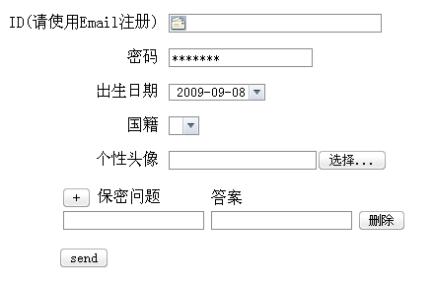
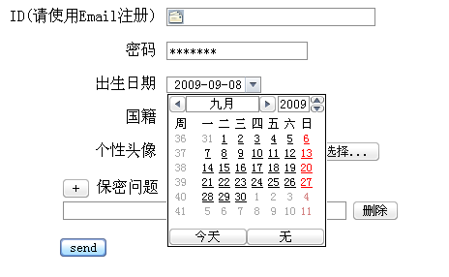
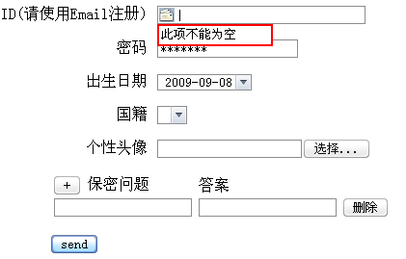
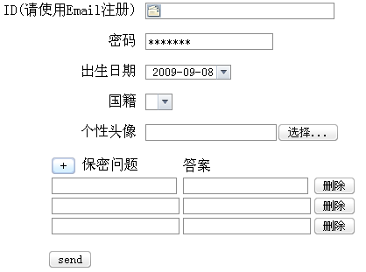
http://adamlu.com/Demo/Speech/Demo/form-html5.html

Slide 16
HTML5 DOM变化
getElementsByClassName
Selector API
  document.querySelector()
  document.querySelectorAll()
Traversal API
  .nextElementSibling
  .previousElementSibling
  .firstElementChild
  .lastElementChild
  .children

Slide 17
HTML5的Javascript APIs
History API
Video&Audio
Offline Applications
Messaging
Web Forms2.0
Storage
Drag&Drop
Undo
Geolocation
X-Domain
Canvas
Editable
Local Database

Slide 18
Video&Audio
<video height="280" width="498" poster="border.png" id="video">
<source src="coldplay.mp4">
</video>
<audio src="music.oga" controls>
<a href="music.oga">Download song</a>
</audio>

Slide 19
Canvas
<canvas>是一个新的HTML元素，这个元素可以被Script语言(通常是JavaScript)用来绘制图形。例如可以用它来画图、合成图象、或做简单的(和不那么简单的)动画。
var canvas = document.getElementById("canvas"), context = canvas.getContext("2d");
context.fillStyle="rgb(0,0,200)";
context.fillRect(10, 10, 50, 50);
context.save();
context.restore();
context.scale(x, y);
context.rotate(angle);
context.translate(x, y);
......

Slide 20
Drag&Drop
拖拽事件: dragstart, dragend, dragenter, dragleave, dragover, drag, drop
<div draggable="true" ondragstart="dragstartHandler(event)"></div>
function dragstartHandler(e){
  alert('dragstart');
  }

Slide 21
Web Workers
让Javascript多线程，可以在后台做很多工作而不会阻断当前的浏览器
var w = new Worker('worker.js');
w.onmessage = function(event){
alert(event.data);
}
w.postMessage('run');

Slide 22
Web Workers
//worker.js
importScripts('xhr.js', 'db.js');
onmessage = function(event){
if(event.data == 'run'){
run();
}
}
function run(){
var data = doCrazyNumberCrunch();
postMessage(data);
}

Slide 23
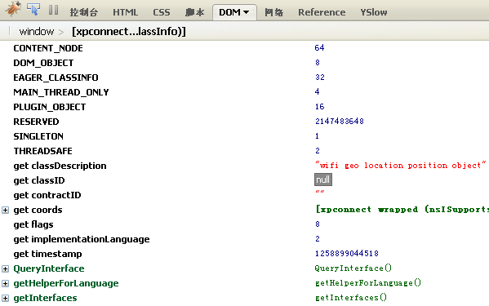
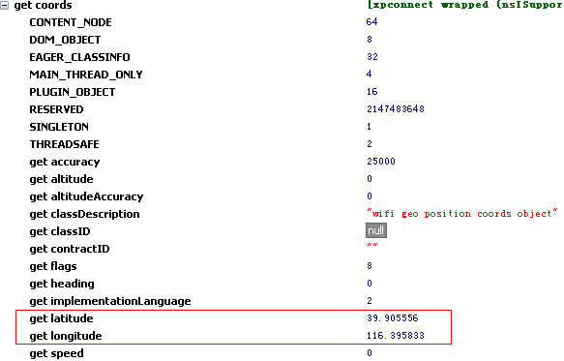
Geolocation
navigator
.geolocation
.getCurrentPosition(
success,
error);

Slide 24
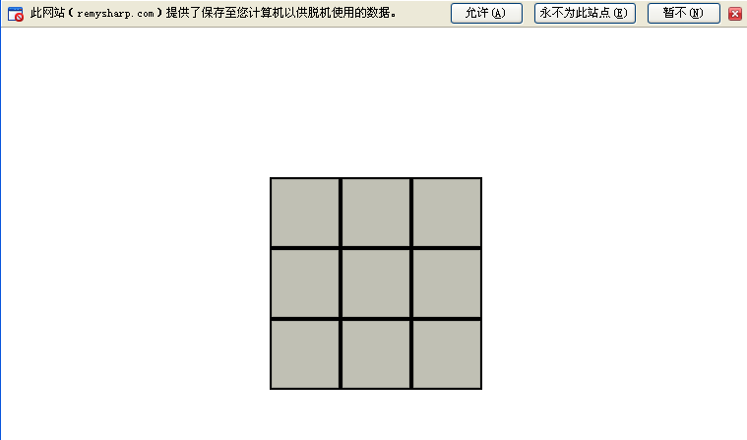
Application Cache
<html manifest = "rubiks.manifest">
rubiks.manifest
  CACHE MANIFEST
  /demo/rubiks/style.css
  /demo/rubiks/jquery.min.js
  /demo/rubiks/rubiks.js
  #version 15
http://remysharp.com/demo/rubiks

Slide 25
Storage
database storage(客户端数据库SQLite)
WebKit中已经实现
var database = openDatabase('db', '1.0');
database.executeSql('SELECT * FROM test', function(result){
database.executeSql('DROP TABLE test');
});

Slide 26
Storage
key/val存储()
  sessionStorage(window based)
  localStorage(domain based)
WebKit/IE8/Firefox 3.5已经实现
.setItem(key, value)
.getItem(key)

Slide 27
Cross-Document Messaging
.postMessage(message, targetOrigin)
.onMessage(event)
  event.data == message
document.getElementById('iframe').contentWindow.postMessage('my message', 'http://adamlu2.com');
window.addEventListener('message',
function(e){
if(e.origion !== 'http://adamlu1.com'){
return;
}
alert(e.origion+' said: '+e.data);
}, false);

Slide 28
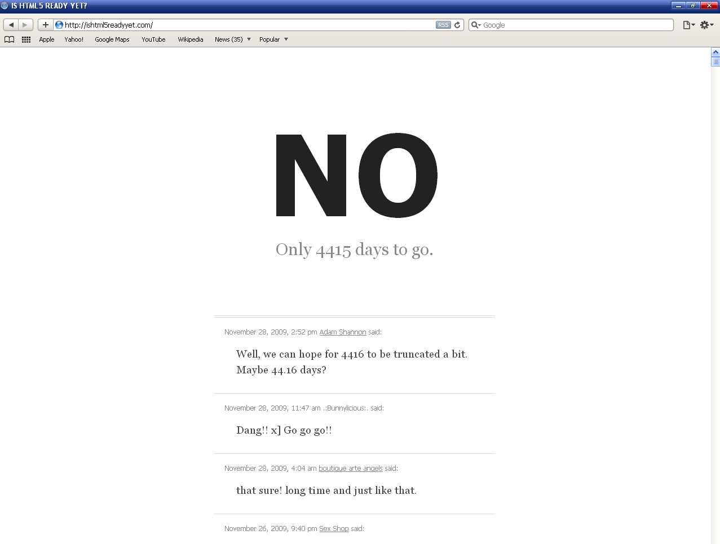
2022?
http://ishtml5readyyet.com/

Slide 29
CSS3
CSS3 DEMO

Slide 30
CSS的发展历史
CSS1.0
CSS2.0
CSS3.0
1996
1998
2001
Cascading Style Sheets

Slide 31
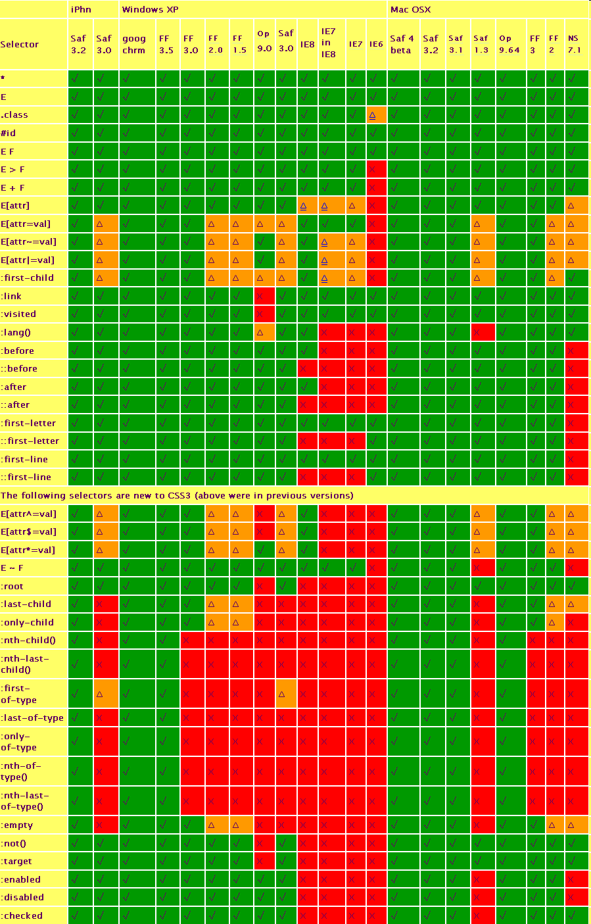
支持CSS3的浏览器
http://adamlu.com/Demo/Speech/Demo/CSS-Browser-Support.png

Slide 32
CSS3技术概况
选择器
布局
样式
动画
其它

Slide 33
CSS3-选择器
属性选择器
  a[href$='.pdf'], a[href^='mailto'], a[class*=‘item’]
兄弟选择器
  Div~img
伪类选择器
  :nth-child(n), :nth-last-child(n), :last-child, :checked, :empty, :only-child, :nth-of-type(odd), :nth-of-type(even)

Slide 34
CSS3-样式
圆角
  border-radius: 3px
  -moz-border-radius-topleft
  -webkit-border-top-left-radius
阴影
  box-shadow: 5px 5px 5px rgba(0, 0, 0, 0.5)
  text-shadow: 2px 2px #444, 3px 3px #555
自定义字体
  @font-face{
  font-family: Adam, src:url(adam.ttf);
  }
  p{font-family:Adam, serif;}
文本换行
  word-wrap: normal|break-word

Slide 35
CSS3-样式
边框背景
  border-image: url(border.png) 27 27 27 27 round round;
渐变
  background: -moz-linear-gradient(20%, center, 30%, center, from(blue), to(yellow)) no-repeat;
背景
  background-size: 100px 50px;
  background-origin: content-box|border-box|padding-box;
  background-clip: border-box|padding-box

Slide 36
CSS3-样式
透明
  opacity: 0.5;
RGBA
  color: rgba(0, 255, 0, 0.5);
HSL/A
  color: hsl(240, 50%, 50%); hsla(240, 50%, 50%, 0.5)
调整元素尺寸
  resize: both|horizontal|vertical

Slide 37
CSS3-布局
盒模型
  box-sizing: content-box|border-box;
网格模型
  column-count: 3; column-width: 13em; column-gap: 1em; column-rule: 1px solid black;
CSS Table Display
  #content{display: table;}
  #main{display: table-cell; width:620px; padding-right: 22px;}
  #side{display: table-cell; width: 300px;}
Outline
  outline-offset

Slide 38
CSS3-动画
变换
  transform: rotate(30deg);
  transform: scale(0.5, 2.0);
  transform: skew(-30deg);
  transform: translate(30px, 0);
过渡
  transition: all 1s ease-out ;
动画
  animation: greenPulse infinite ease-in-out 3s;

Slide 39
CSS3-其它
媒体查询
  .entry{color: red;}
  @media all and {min-width: 100em}{
  .entry{color: black;}
  }
语音支持
  voice-volume, voice-balance, voice-family

Slide 40
浏览器前缀
Firefox: -moz-box-shadow
Safari: -webkit-box-shadow
Opera: -o-box-shadow
IE: -ms-box-shadow

Slide 41
CSS3应用原则
优雅降级
对于不支持CSS3的浏览器可以使用Javascript来实现
  如ie7.js, ie8.js对CSS选择符的优化
  如对于不支持:hover的ie6使用JS
在向用户或老板推广新技术的同时也要关注他们的目标与可行性，不能为了技术而技术

Slide 42
参考资源
http://zh.wikipedia.org/wiki/HTML_5
http://www.whatwg.org/html5/
http://dev.w3.org/html5/spec/Overview.html
http://html5demos.com/
http://www.w3.org/TR/html5-diff/
http://www.alistapart.com/articles/previewofhtml5
https://developer.mozilla.org/cn/DOM/Storage
http://www.w3.org/TR/css3-roadmap/
http://dev.w3.org/html5/
http://dev.w3.org/csswg/
http://www.css3.info/modules/

Slide 43
Thanks!
Q&A
Gtalk: luchaowu@gmail.com
MSN: luchaowu@hotmail.com

