Slide 1
Final Project: What, how, and when
Shai Bagon

Slide 2
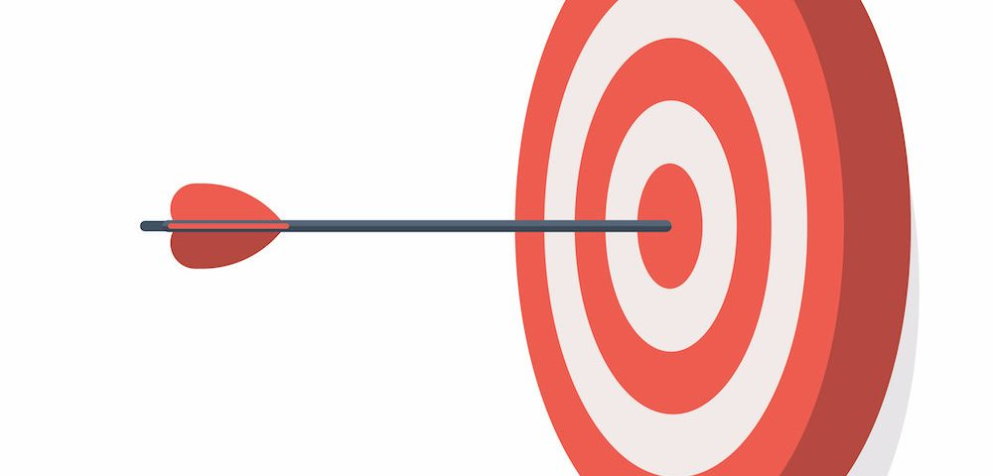
Final Project
Goal: Explore concepts taught in class
Fairly open-ended: vision-related. Be creative ;)
Work in groups of 2-3 students

Slide 3
A Good Project
Problem statement/Motivation
Related work
Method
Data
Experiments
Conclusion

Slide 4
Tracks
Application:
Apply DL+CV concepts to new data at your lab
Method:
Propose new architecture/loss/training scheme/algorithm and apply it to existing CV problem

Slide 5
Does my project meet expectations?
Your project does
Need to show significant effort
Need to demonstrate insights
Your project does not
Need not be strictly novel (although we encourage)
Need not beat state-of-the-art
Ask yourself
Are you interpreting the results, or merely stating them?
Are you evaluating results from different perspectives?

Slide 6
Picking a Project Idea
Do what is important or interesting to you, not what seems easiest
Practical considerations:
Data: is there existing and available data?
Code/framework: do you need to implement everything from scratch?
Compute resources: How much compute power/time it requires?

Slide 7
Inspiration
Papers from leading conferences: CVPR, ICCV, ECCV, ICLR, NeurIPS, ICML
Additional sources:
Papers with code, Kaggle

Slide 8
Timeline
June 17th: Proposal
July 1st: Milestone
Aug 5th: Submission
TBD: Presentation

Slide 9
Timeline
June 17th: Proposal
July 1st: Milestone
Aug 5th: Submission
TBD: Presentation
A PDF document:
Abstract
Data
Resources
Challenges

Slide 10
Timeline
June 17th: Proposal
July 1st: Milestone
Aug 5th: Submission
TBD: Presentation
A PDF document:
Abstract
Data
Method
Preliminary Results
Rising Flags

Slide 11
Timeline
June 17th: Proposal
July 1st: Milestone
Aug 5th: Submission
TBD: Presentation
PPTX presentation + 5min video:
Introduction
Related work
method
Results
Conclusions/take home message

Slide 12
Default Projects

Slide 13

Spot the Fake
Problem statement/Motivation
Related work
Method
Data
Experiments
Conclusion

Slide 14
Spot the Fake
Problem statement/Motivation
Related work
Method
Data
Experiments
Conclusion
Identify “source” of fake faces
Understand different generative models
What makes a “fake” face?
…

Slide 15
Spot the Fake
Problem statement/Motivation
Related work
Method
Data
Experiments
Conclusion
Different generative models
Other “fake” classification works

Slide 16
Spot the Fake
Problem statement/Motivation
Related work
Method
Data
Experiments
Conclusion
Classification
Open ended classification (?)
Interpretability
Data generation
…

Slide 17
Spot the Fake
Problem statement/Motivation
Related work
Method
Data
Experiments
Conclusion
Real faces from FFHQ
Fakes from 4(+) different generative methods
…

Slide 18
Spot the Fake
Problem statement/Motivation
Related work
Method
Data
Experiments
Conclusion
Binary classification
Multi-way classification
Open ended
In depth analysis

Slide 19
Spot the Fake
Problem statement/Motivation
Related work
Method
Data
Experiments
Conclusion

Slide 20

InstaRepeat
Problem statement
Related work
Method
Data
Experiments
Conclusion

Slide 21

InstaRepeat
Problem statement
Related work
Method
Data
Experiments
Conclusion
Clustering
Metric learning

Slide 22
InstaRepeat
Problem statement
Related work
Method
Data
Experiments
Conclusion
Face identification
…

Slide 23
InstaRepeat
Problem statement
Related work
Method
Data
Experiments
Conclusion
Siamese networks
Contrastive loss
Learn embeddings
…

Slide 24
InstaRepeat
Problem statement
Related work
Method
Data
Experiments
Conclusion
Binary classification
Multi-way classification
Open ended
In depth analysis

Slide 25
InstaRepeat
Problem statement
Related work
Method
Data
Experiments
Conclusion
InstaRepeat data

Slide 26
InstaRepeat
Problem statement
Related work
Method
Data
Experiments
Conclusion
Cluster test set
Explore the feature space

Slide 27
InstaRepeat
Problem statement
Related work
Method
Data
Experiments
Conclusion

Slide 28
Default Projects
They are not a “closed project” – there is room for creativity (mandatory!)

Slide 29
Questions?
More details: dl4cv.github.io/final_project.html

