Slide 1

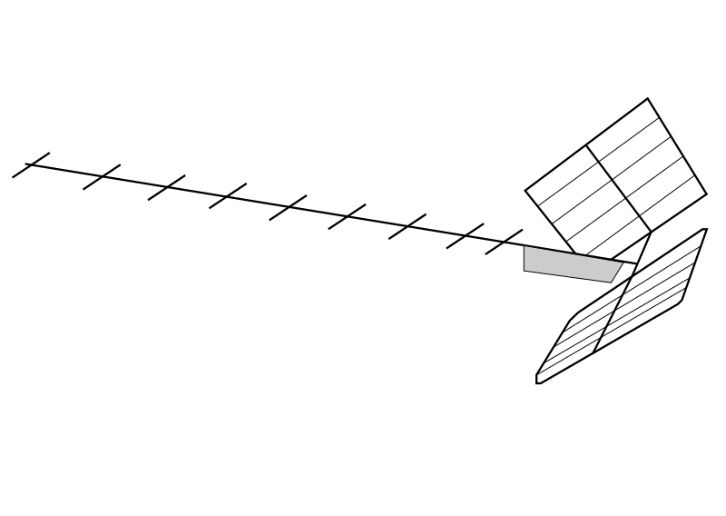
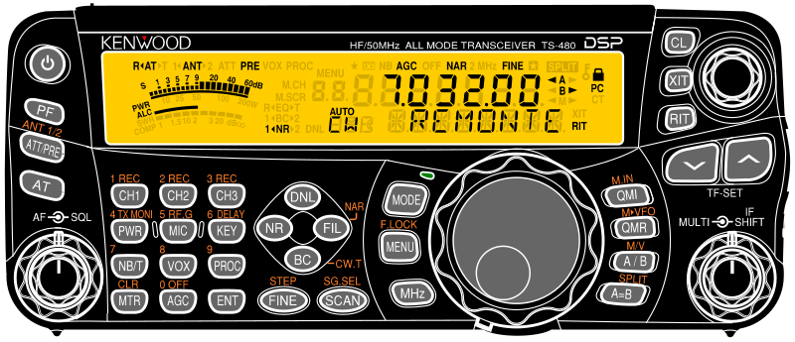
Central Control Software (Logging software, custom GUI, ...)
more software
...
HTTP calls
^{Raspberry Pi Zero}
REST API for hamlib
rigctld@1
rigctld@2
rigctld@3
...
rotctld@1
rotctld@2
...
...
USB
serial
network
USB
serial
network
USB
serial
network
USB
serial
network
USB
serial
network
TRX #1
TRX #2
TRX #3
antenna #1
antenna #2

