Slide 1
Nature
Start the era of data governance
Top-level business architecture visualization Nature is “making history”
Xuebin Li

Slide 2
目录
Pain spot
Concepts
Significance

Slide 3
Pain spot

Slide 4


data consistency under distribute system
Unreliable communication
service A
service B
Retries and idempotent are hard work

Slide 5


The data is hidden and protected under the service
Hardly to change
Building a global view is difficult
make data dirty
easy to form historical burden
nearsightedness

Slide 6
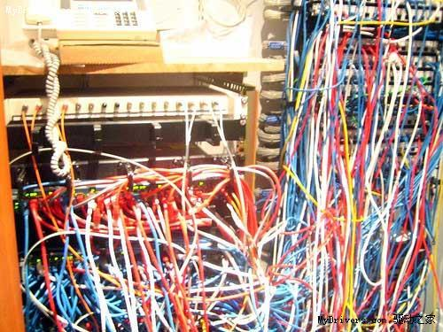
Large business systems are very difficult to manage
Goals behind the system!
We just want data, systems are only tools
Out of Control
by Kevin Kelly

Slide 7
Nature concepts

Slide 8
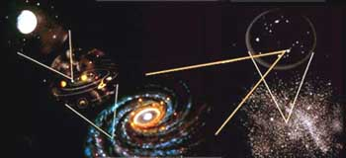

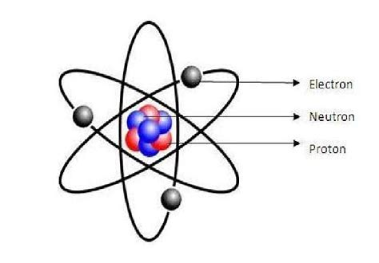

Three top level abstractions
static
Hierarchy devide things
Points make up things
Relations between points make things running
Instantaneous

Slide 9
Point with hierarchy（Administrative Simplification）
Human management is more flexible
/webShop/sales/order
/webShop/warehouse/order
/webShop/warehouse/in
/webShop/warehouse/out
Point
=
thing
self-organizing
self-described
Reduce system complexity
Notes:
简化管理

Slide 10

Relation(release data from instance)(1)
spatial correlation
input data instance out of Nature
?
/.../sales/order
/.../warehouse/order
call a converter out of Nature to generate target data instance
temporal correlation
Notes:
接口只是个点，并不能说明谁和谁有关系

Slide 11
Relation(release data from instance)(2)
convertor
downstream data
upstream data
y = f ( x )
y = f (f (f (…))
Notes:
接口只是个点，并不能说明谁和谁有关系

Slide 12

Relation(release data from instance)(3)
independent choice
easy to develop
more effective
Short process
deserialize
Service decoupling
Notes:
传统方式：独立分析是好的，用于实现就不好了。但全面综合分析是有缺陷的（不容易发现和提取复用单元）
父母包办：主动下传
一对多，实现方式复杂，效率低、易出问题！
整体(不是整体)上下线,
缺少全局观不能洞见问题和复用项
运行时的可见性和跟踪性
自主选择人生：我只关心我的需要（上游），到我这里就结束了；下游的我不管，由他们独立完成。
多对一，实现方式简单。效率高、可靠。
易于并行和异步处理。模块化思维。
前者像前spring时代，后者像spring时代。

Slide 13
Nature is “making history”(Ensure data consistency)
But you can have multiple data instances of states
No modification
{
Allows Nature aotomatic retry
where: /webShop/sales/order
data instance
(Primary key)
when: operate time
{
“orderID”:1223,
...,
”goods”:[...],
...
}
event: digest of Json object
No deletion

Slide 14
Significance

Slide 15
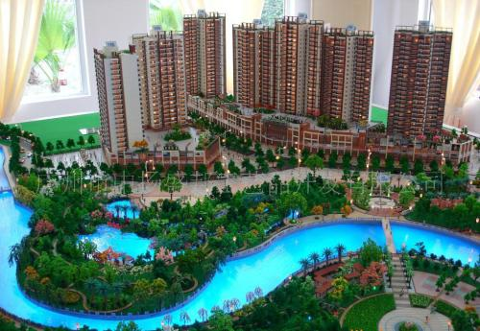
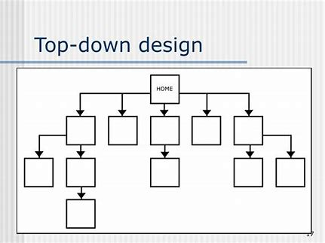
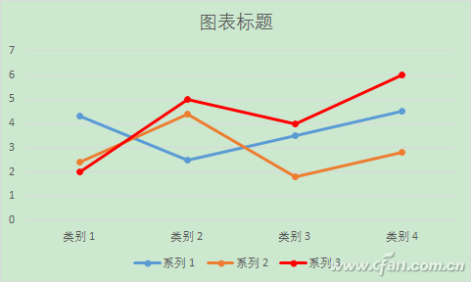
Business oriented
global modeling and purl business
Completely decoupled and break the limitations from technology
Insight into the business
Top-down Business Process Choreographer
Technology reuse
real-time vitualization for design-time and run-time
Notes:
TOGAF Enterprise Architecture

Slide 16

Strong restraint
Before Nature: truth obeys reality
IT Service Management
Don't compromise on technology
Data Governance
Data is the soul of business
After Nature: reality obeys truth
Notes:
TOGAF Enterprise Architecture

Slide 17
Simplified programming
Only one goal
Nature use multiple convertors for different goals
Convertor is just a function
only called by Nature and will retry when environment error occured
hot plug
Nature can retry
easy business update
Only one input and one output
“Thing” can have version and different version can has independent orchestration
Input and output “Thing”s are defined in nature
Notes:
TOGAF Enterprise Architecture

Slide 18
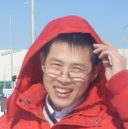
Thank you!
李学斌
llxxbb@yeah.com
Notes:
绑架数据之上的各种协议
容易整合现有系统
合久必分分久必合（新单体应用）

