Slide 1
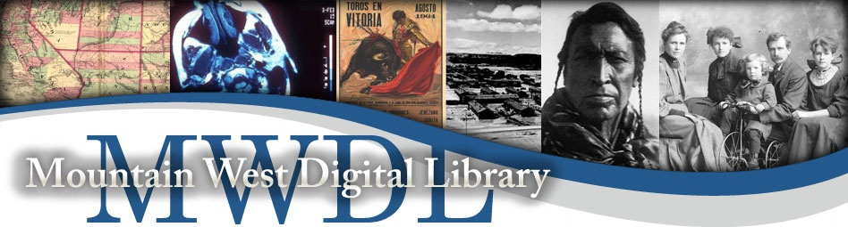
Teresa Hebron
Digital Metadata Librarian
Notes:
Hi, I’m Teresa Hebron, the Digital Metadata Librarian at Mountain West Digital Library.

Slide 2
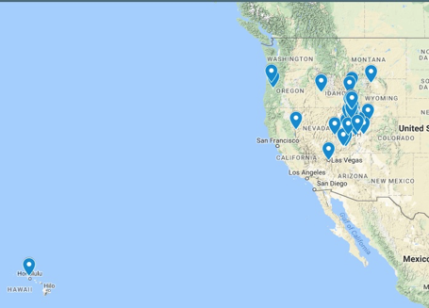
Background
MWDL founded 2001
16 members; harvesting 17 repositories
990K+ records in MWDL portal
Notes:
Mountain West was founded in 2001 and has grown from a project of the Utah Academic Library Consortium to be a multi-state regional platform ingesting content from 17 repositories at 16 institutions in Idaho, Nevada, Wyoming, Oregon, Utah, and Hawaii. Like DPLA, we’re on a hub/sub-hub model where some of our members manage digital collections for other, smaller institutions. (Hawaii is included because Brigham Young University has a campus in Hawaii and their digital special collections are hosted by the main campus in Provo, UT.) States like Arizona & Montana have joined & left over the years, causing our record counts to fluctuate, but current record count is 990K - just shy of 1M records! We’re ready to go platinum! Of those, ~98% are contributed to DPLA.
Key point: We AGGREGATE records from our members via OAI-PMH harvesting. Our members are metadata PROVIDERS and we, MWDL, are the HARVESTER. Because our members are diverse, this involves making a local copy of metadata in our platform in accordance with our…

Slide 3
MWDL Metadata Application Profile (MAP; 2011)
Required Fields
Title
Subject
Description
Date
Format
Type
Rights
Identifier
Additional Fields
Mandatory-if-applicable: Conversion specs, Creator
Recommended: Language, Spatial
Notes:
Adopted in 2011, the MWDL Metadata Application Profile requires 8 fields, and recommends 4 others. We are currently in the process of re-doing our MAP so these may change.

Slide 4
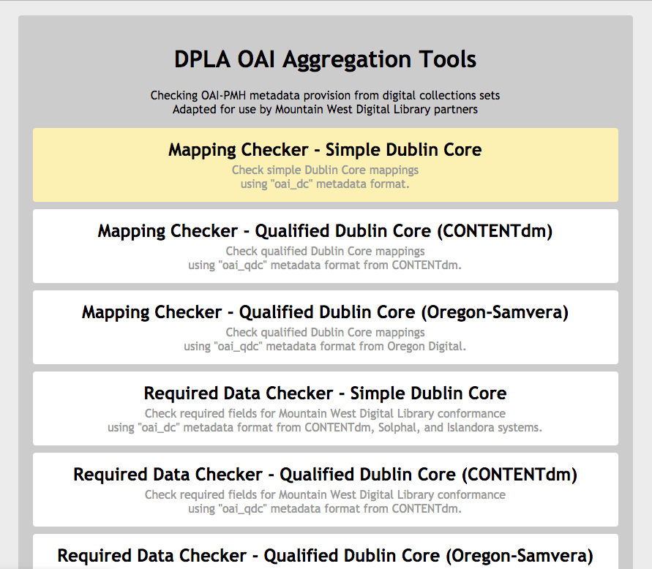
Auditing https://mwdlmetadata.tools.lib.utah.edu
https://mwdlmetadata.tools.lib.utah.edu
Notes:
Because of the nature of our aggregation tools, we choose to focus primarily on the pre-harvest metadata auditing rather than post-harvest transformations/enhancements. Since 2015, we use a web-based, public facing tool check for completeness and conformance with the MAP before harvesting and recontribution to DPLA.
Summary of problem: How do you accurately and efficiently QA tens of thousands of records being harvested via OAI to ensure MAP compliance and DPLA interoperability, deliver actionable feedback to repository & collection managers? And do it with a permanent staff of 2 plus student workers?
Tool intro: 2015 adaptation of NCDHC’s DPLA OAI aggregation tool, available on GitHub. Previous MWDL director adapted and launched in late 2015, I updated/relaunched this spring with modifications. We’re not alone -- American Theological Library Association launched their own version based on the MWDL adaptation this spring, and Empire State also uses a version (albeit a non public-facing one). This tool uses standard OAI-PMH verbs behind the scenes to give a visual representation of metadata in collections.

Slide 5
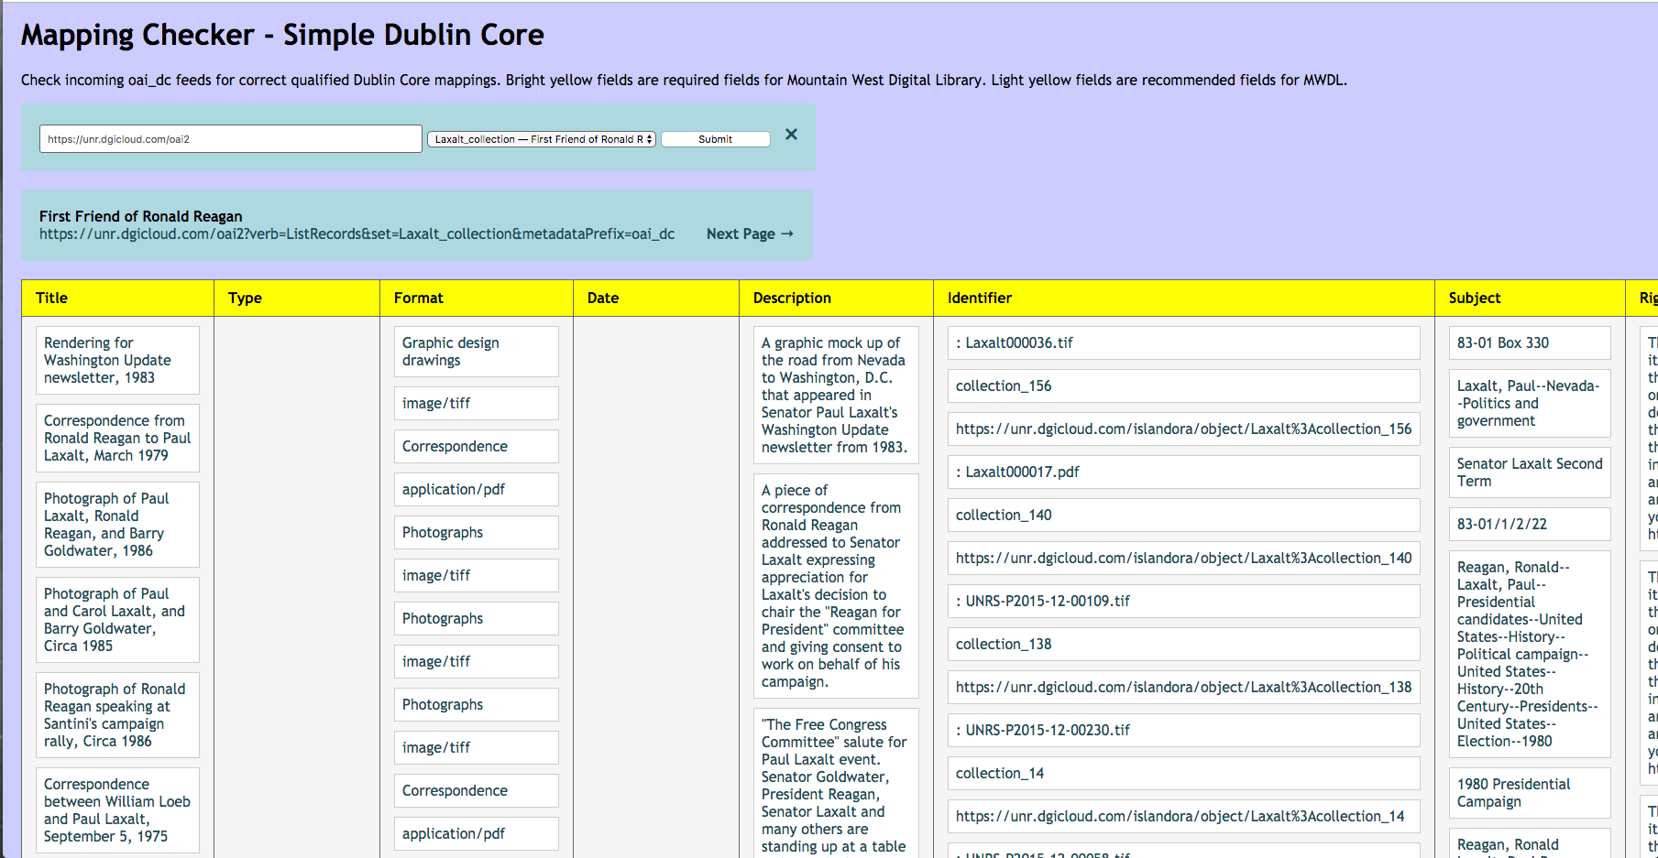
Mapping Checker
Notes:
Mapping Checker: useful for a visual once-over of data, making sure content looks good in required fields; are any columns blank, or is there odd data in columns? Ex Type & Date are blank here - is the data missing altogether or are those fields not mapped properly to OAI? Identifier column has file names in addition to item identifiers. Subject looks to have shelving/box inventory information mapped to it.

Slide 6
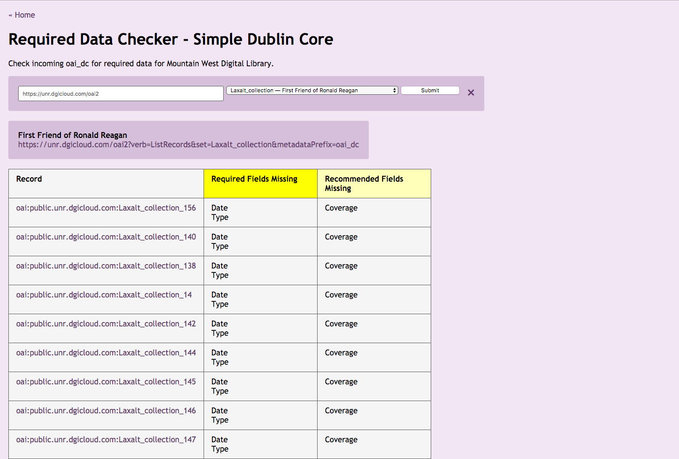
Required Data Checker
Notes:
Required Data Checker: are any required fields missing data? Tool flags records and prints field name in Required/recommended columns. This is just XSL tests with styling applied.

Slide 7
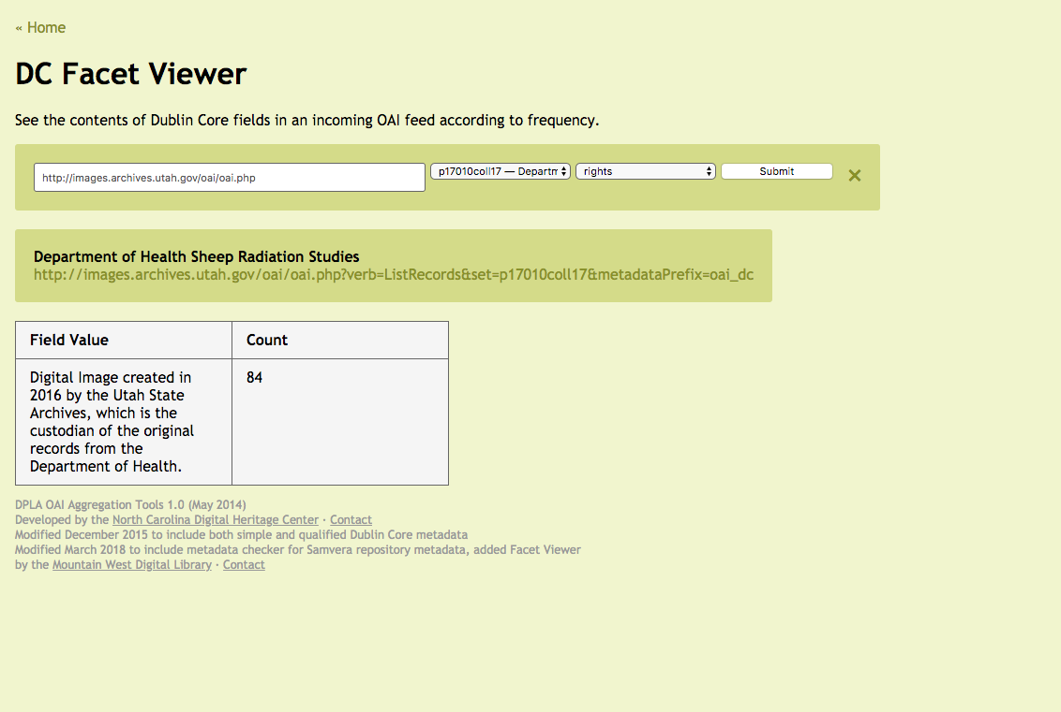
Facet Viewer
Notes:
Facet Viewer: See the frequency & formatting of terms used in various fields. Useful for checking consistency/application visually. UT State Archives Rights example - the same value was used consistently across the entire set.

Slide 8
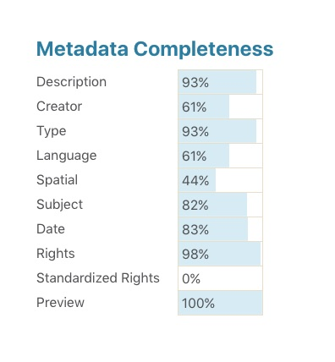
MWDL Metadata completeness in DPLA
Notes:
DPLA recently launched an analytics dashboard for hubs, and this is a screenshot of MWDL’s completeness for most-searched fields in DPLA. As we can see, a number of the required MWDL fields are at a high level of completeness, such as description, type, subject, date, and rights. More metadata = better searching!

Slide 9
Questions?
Teresa Hebron
teresa.hebron@mwdl.org
@EndivesArchives
Notes:
This is me - please get in touch if you have any questions!

