Slide 1

Teresa Hebron
Digital Metadata Librarian

Slide 2
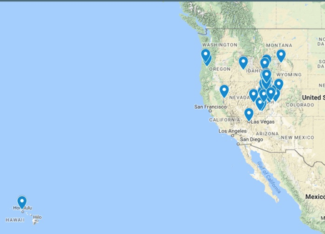
Background
MWDL founded 2001
16 members; harvesting 17 repositories
990K+ records in MWDL portal

Slide 3
MWDL Metadata Application Profile (MAP; 2011)
Required Fields
Title
Subject
Description
Date
Format
Type
Rights
Identifier
Additional Fields
Mandatory-if-applicable: Conversion specs, Creator
Recommended: Language, Spatial

Slide 4
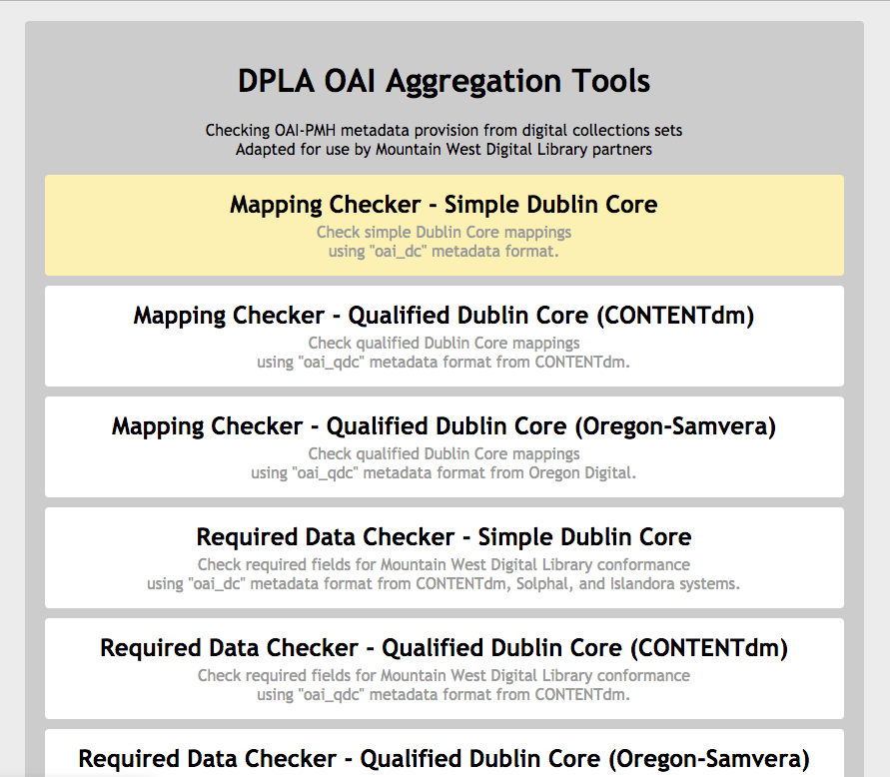
Auditing https://mwdlmetadata.tools.lib.utah.edu
https://mwdlmetadata.tools.lib.utah.edu

Slide 5
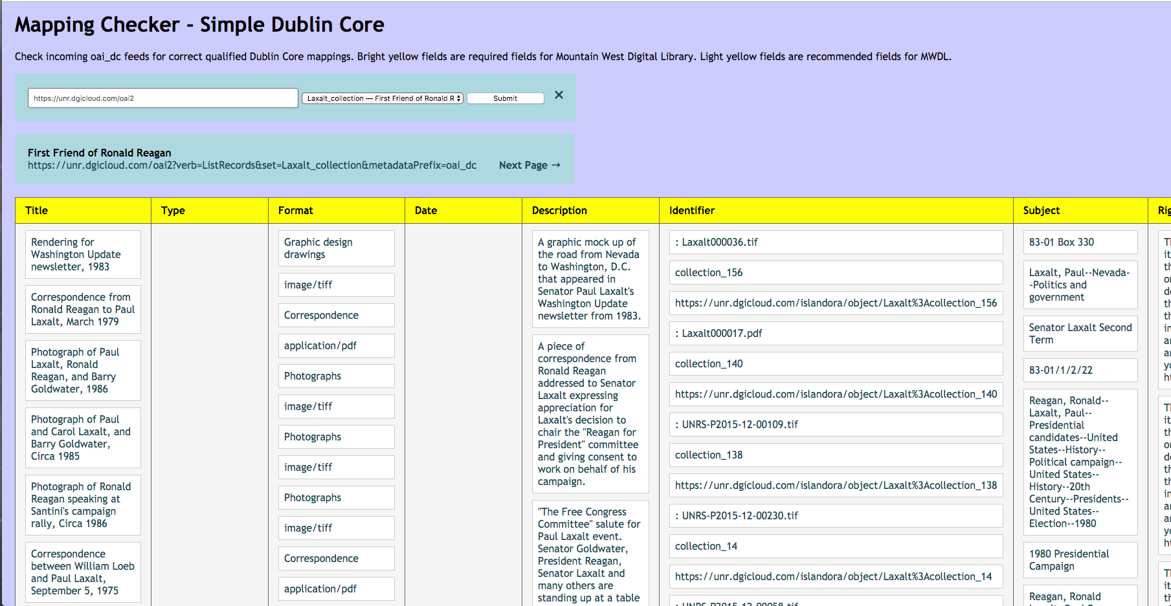
Mapping Checker

Slide 6
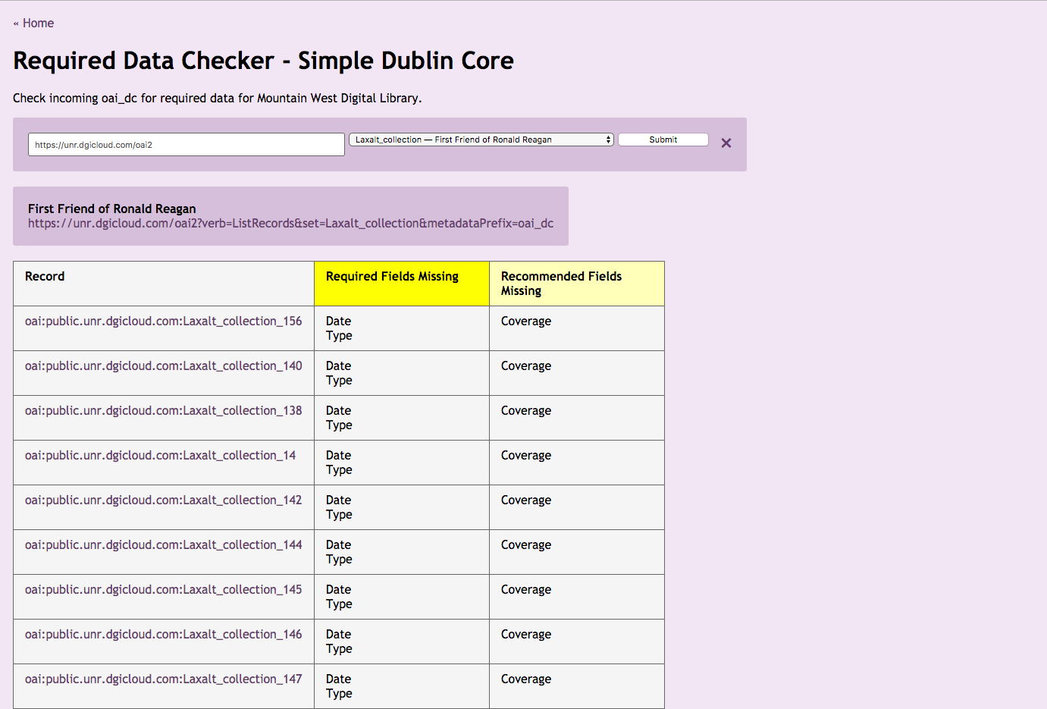
Required Data Checker

Slide 7
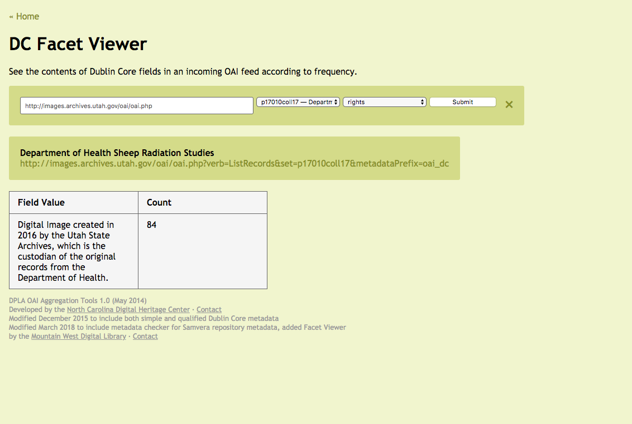
Facet Viewer

Slide 8
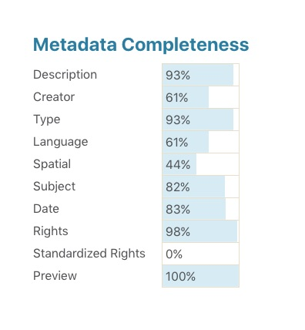
MWDL Metadata completeness in DPLA

Slide 9
Questions?
Teresa Hebron
teresa.hebron@mwdl.org
@EndivesArchives

