Slide 1

OpenRefine
October 14, 2017

Slide 2
Goals of This Module
Introduce OpenRefine & its Interface
Basic Data Assessment
Data Remediation
Data Validation
Data Enhancement (time allowing)

Slide 3
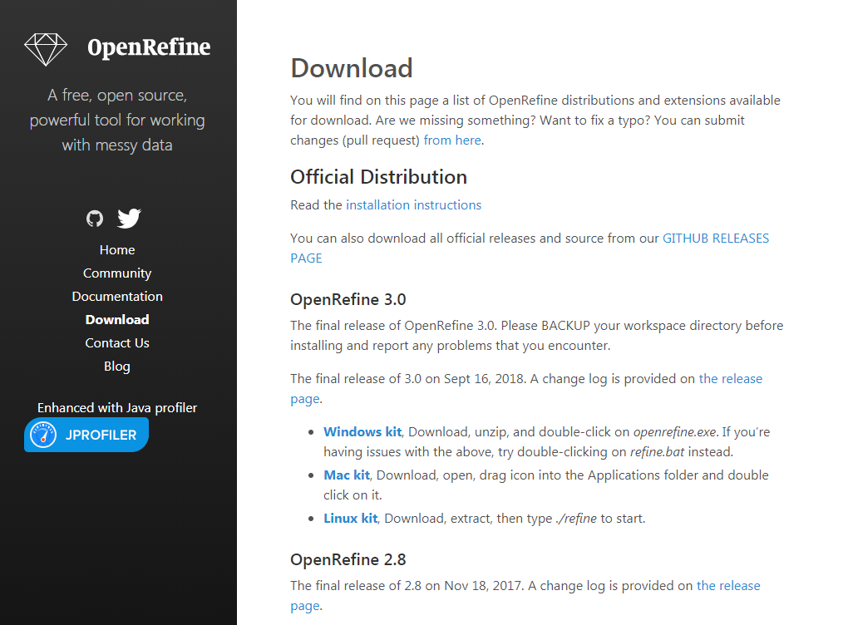

Slide 4
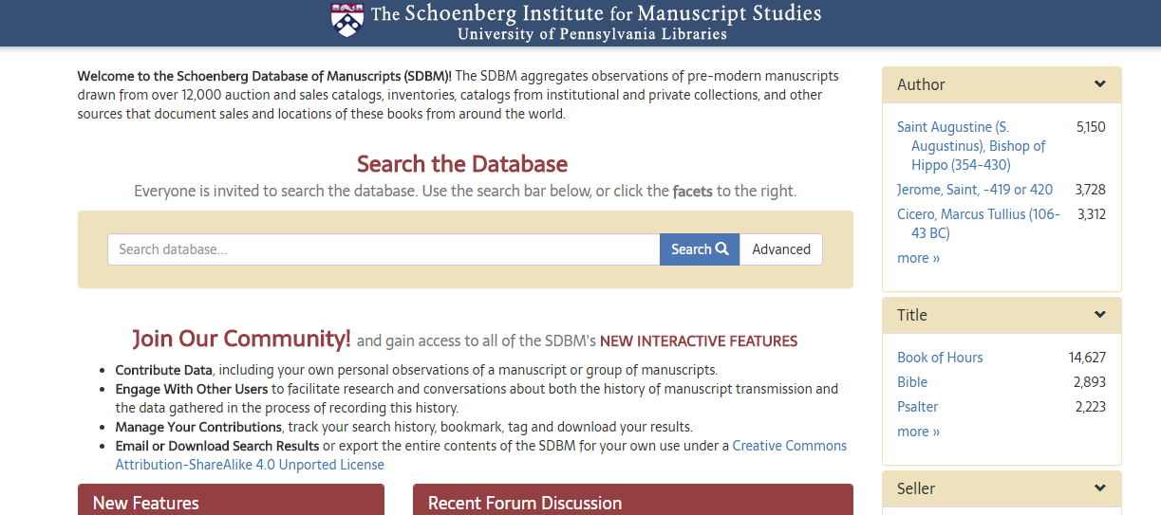
Sample data: Schoenberg Database of Manuscripts

Slide 5
Common Transformation | GREL Expression
Convert string to uppercase text | value.toUppercase()
Convert string to lowercase text | value.toLowercase()
Convert string to title-case text | value.toTitlecase()
Trim leading and trailing whitespace | value.trim()
Collapse consecutive whitespace | value.replace(/\s+/,' ')
Convert the value to a number | value.toNumber()
Convert the value to a date | value.toDate()
Convert the value to a string of text | value.toString()

Slide 6
Further Information
OpenRefine manual at GitHub: https://github.com/OpenRefine/OpenRefine/wiki
Free Your Metadata tutorials: http://freeyourmetadata.org/
OpenRefine 101 at at Cognitive Class: https://cognitiveclass.ai/courses/introduction-to-openrefine

