Slide 1
Introduction to Metadata Analysis Using the DLF Metadata Framework
Kate Flynn, Chicago Collections; University of Illinois at Chicago

Slide 2
The Basics
Baseline
Glossary: http://bit.ly/2gIzY6W
Types of metadata
Descriptive metadata
Technical metadata
Preservation metadata
What people might be working with when assessing
Databases
Character delimited value formats
XML
JSON
Spreadsheets (XLS, XSLX)
Notes:
Both

Slide 3
The Basics
http://bit.ly/MdFramework
A high-level framework for assessing descriptive metadata in digital collections
Many thanks to:
Sara Rubinow
Maggie Dickson
Kathryn Gronsbell
Anna Neatrour
Bethany Scott
Metadata Assessment Framework
Notes:
Kate

Slide 4
Why do we assess?

Slide 5
Why do we assess?
Migrations
Before or after (or both!)
Data sharing
Aggregation (exposing data)
Shareability
Interoperability
Migrations or Data Sharing

Slide 6
Why do we assess?
Standards
Application profile or guidelines
Schema
Other pre-defined structures
Validation

Slide 7
Why do we assess?
What change would have the most impact?
Enhancement for a specific user community
To address specific problems
Consider resources available
Targeted Enhancement

Slide 8
Why do we assess?
Lets users (internal & external) know what is expected for metadata
Profile Generation

Slide 9
Why do we assess?
Staff changeovers may mean internal knowledge loss
Systems & contexts can change over time
These can be internally generated or from external sources
Standards & Best Practices

Slide 10
Why do we assess?
Exhibits
Text analysis
Other digital humanities use
Handling Emerging Object Types

Slide 11
Why do we assess?
Usability
Staff changeovers and internal knowledge
External access and aggregation
Impact of Metadata Work

Slide 12
What are you assessing?

Slide 13
What are you assessing?
Prioritizing assessment
Baseline compliance
Vocabulary compliance
Repository migration
Usability
Building a scope + Parameters

Slide 14
What are you assessing?
Use practices and policies for efficiency & effectiveness
Guidelines
Data dictionaries
Application profiles
Building a scope + Parameters

Slide 15
What are you assessing?
Keep it simple
Use an approach that allows you to meet your objectives
Having multiple phases/steps can help
Building a scope + Parameters

Slide 16
What measures do we use to assess?

Slide 17
What measures do we use to assess?
The element/property/attribute is present
Completeness
Notes:
Required vs. recommended. Something doesn’t have to be “empty” to not be complete.

Slide 18
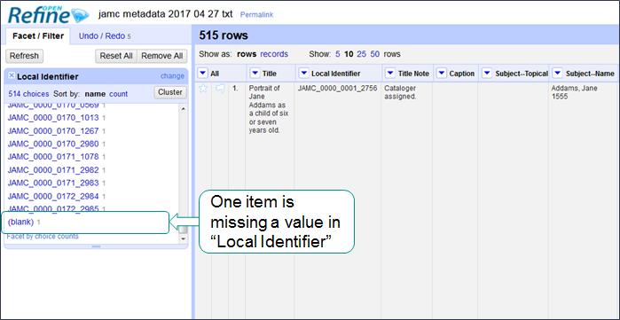
Completeness

Slide 19
Completeness
Description: This is an audio interview with Jane Smith at her home in Niles, Illinois. It took place on August 7, 2011.
Notes:
Something can be considered to be not “complete” even if there is a value there.

Slide 20
What measures do we use to assess?
Values are consistent within your domain. Semantic and structural values and elements are represented in a consistent manner across records
Consistency
Notes:
What does not having consistency mean?

Slide 21
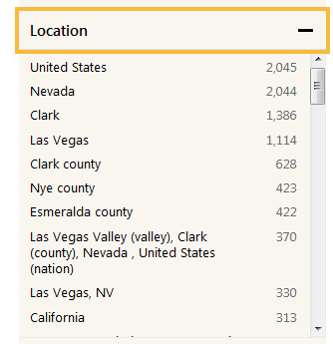
Consistency

Slide 22
What measures do we use to assess?
Information is correct and factual both semantically and syntactically
Accuracy
Notes:
Kate

Slide 23
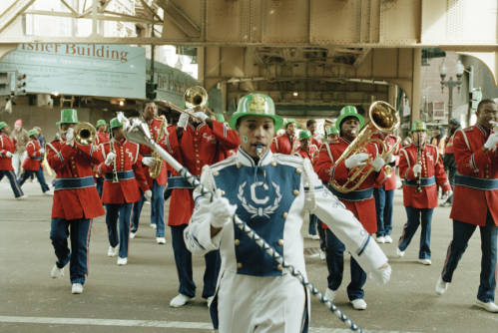
Accuracy
Example
Project Location: Beverly (Chicago, Ill.)
Project Location: Loop (Chicago, Ill.)
Notes:
Kate

Slide 24
What measures do we use to assess?
Metadata can be read by a human and/or a machine
Accessibility
Notes:
Kate

Slide 25
Accessibility
Names: Eacutecole nationale supeacuterieure des beaux-arts (France)

Slide 26
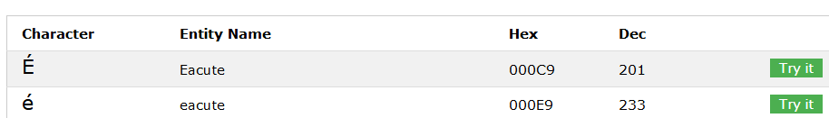
Accessibility
https://www.w3schools.com/charsets/ref_html_entities_e.asp

Slide 27
Accessibility
Names: École nationale supérieure des beaux-arts (France)

Slide 28
What measures do we use to assess?
Values adhere to the expectations of your user communities (both internal and external)
Example
Consortium requirements
Aggregator requirements
Best practices
Conformance to Expectations
Notes:
Kate

Slide 29
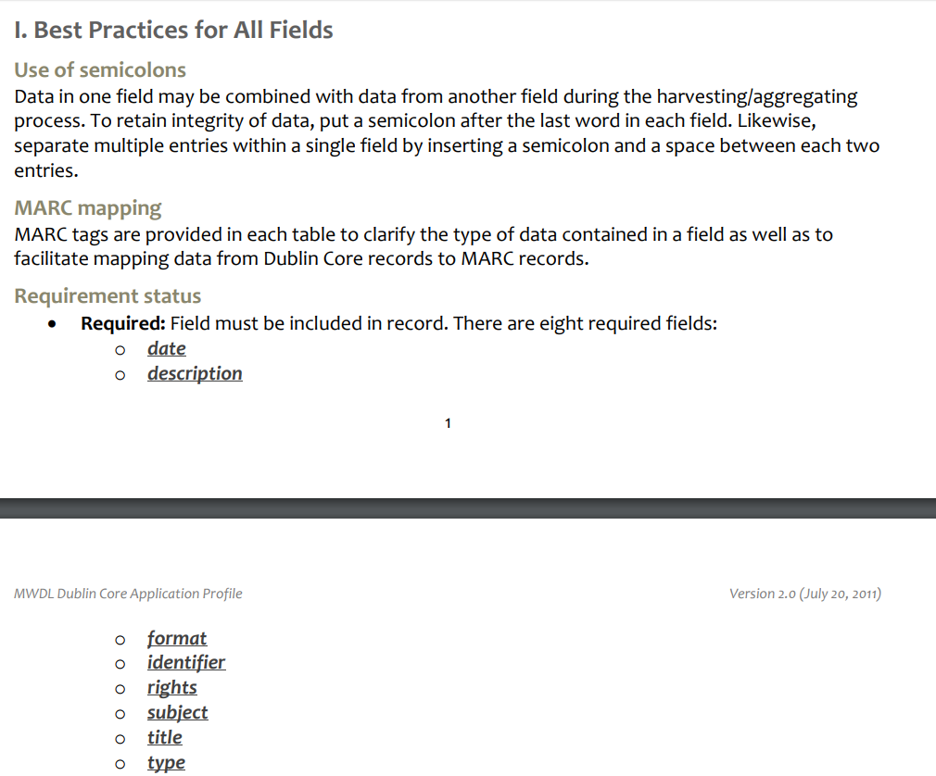
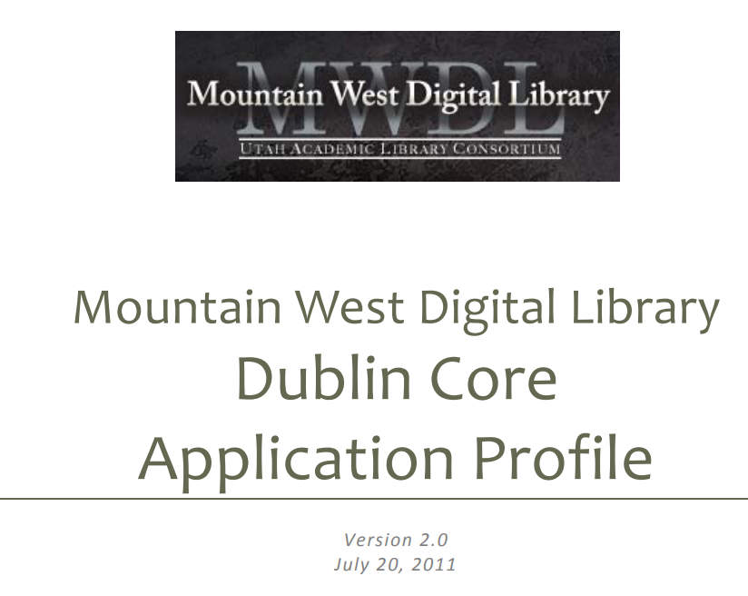
Conformance to Expectations
Notes:
Kate

Slide 30
What measures do we use to assess?
When the resource changes, the metadata is updated accordingly. When additional metadata becomes available or when metadata standards change, the metadata associated with the resource also changes.
Timeliness
Notes:
Kate

Slide 31
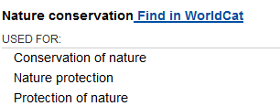
Timeliness
http://experimental.worldcat.org/fast/1034632/
Notes:
Kate – LOC standards changes. New Example?

Slide 32
What measures do we use to assess?
You can track metadata transformations back to the original form. You have information about the source of the original metadata.
Provenance
Notes:
Kate

Slide 33
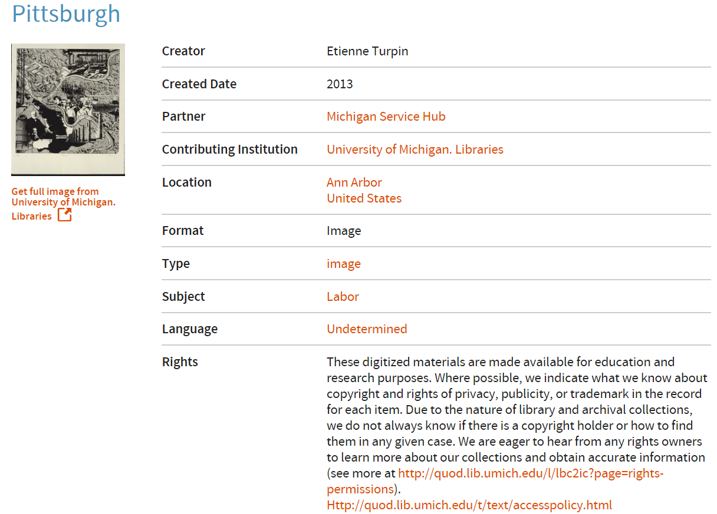
Provenance
Notes:
Kate

Slide 34
Documenting assessment
Why?
Advocacy
Demystification
Sustainability
Compliance
How / Potential outputs
Best Practices / Guidelines
Clean-up plans
Application profile
Reports
Other
Notes:
Kate

Slide 35
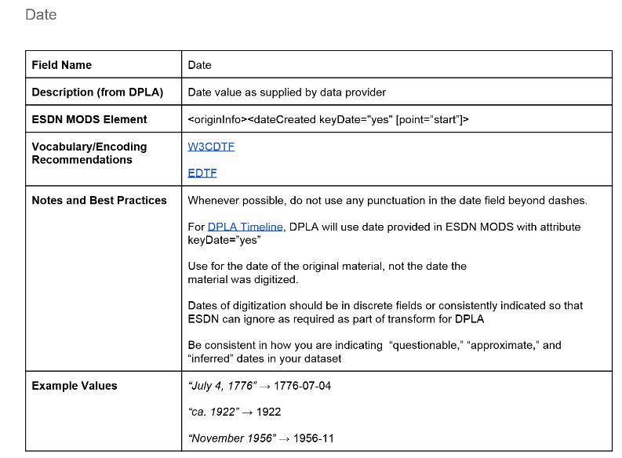
Example Metadata Guidelines
Empire State Digital Network Best Practices & Guidelines: http://bit.ly/edsnmap

Slide 36
An example clean-up plan
Edit the following fields
Local Identifier should be Identifier
Delete the following fields
Genre
Add the following fields
Creator
Caption
Convert values in Subject from LCSH to FAST
Transcribe information written on the image into the new Caption field

Slide 37
Resources
DLF Assessment Interest Group Metadata Working Group Toolkit
http://bit.ly/mdassessment
Metadata Application Profile Clearinghouse
https://tinyurl.com/MAPclearinghouse
Glossary of Terms http://bit.ly/2gIzY6W
Metadata Assessment Framework
http://bit.ly/MdFramework

