Slide 1

#r2b: Metadata management with ExifTool and MDQC
Amy Rudersdorf, AVP | @WeAreAVP | amy@WeAreAVP.com

Slide 2
information management consulting & software dev
WeAreAVP.com

Slide 3
Fixity
Exactly
MDQC
Cost of Inaction Calc
Free digital preservation tools https://www.weareavp.com/products/
WeAreAVP.com

Slide 4
Overview: Why use these tools?
Notes:
This presentation outlines the types of assessments we performed, the characteristics of the organizations with which we engaged, and the findings.
From this, we can extrapolate the sort of gaps that are shared across many organizations to provide some guidance as institutions look to build or shore up their own digital preservation programs. This presentation is intended to provide a basis for assessing and addressing gaps in an org’s own digital preservation practice, policies, and strategies, and, ideally, for the community as a whole to consider when determining where to devote collective resources.

Slide 5
Perform basic embedded metadata review
Automate embedded metadata review
Notes:
As a company that works with such diverse clients, AVP has unique insights into how digital preservation is happening in organizations of all types. This presentation uses our perspective to identify trends in our assessment findings and explain why those findings matter.
We feel that reporting back to the communities we serve will help to foster conversation and bring about further progress in this area. It should be noted that I will not -- purposefully -- delve deeply into the root causes behind these trends, however, because, unlike the findings themselves, the root causes are as varied as the organizations themselves.

Slide 6
Download
http://bit.ly/exiftool
ExifTool

Slide 7
Download & unzip this:
http://bit.ly/r2b-images
Notes:
Put files in “downloads” - leave them in the TIFS folder.

Slide 8
Developed by Phil Harvey
Supports images and many AV formats
Why use it?
Analyse embedded metadata and file system metadata --> technical and administrative metadata that may be used to recreate files in the future.
You can view the MD or save it before you package up your files for long-term storage.
Notes:
AVP performs digital preservation assessments for institutions in order help them better understand the maturity of their digital preservation practice, and to identify gaps and risks in their program. Digital preservation assessments can take several forms, but typically fall into one of three categories:
“Lite” assessments — These involve performing a gap analysis of an organization through onsite interviews with a variety of relevant stakeholders as defined by the client, documentation and policy review, demonstrations of technologies, storage analysis, and shadowing clients as they work. We use ISO 16363, ISO 14721, and the NDSA Levels of Digital Preservation as reference points to form the basis of our assessments.

Slide 9
Open terminal window
Type “exiftool”
Take a quick look at help file
Type “q” to get out of help file
Notes:
Once you’ve installed ExifTool, follow these steps.

Slide 10
Let’s do something with a file.

Slide 11
First, Let’s use “Get Info” (on a Mac) to take a look at the properties of bridge_01.jpg. What do you see?
Notes:
General section has file system information
Location
Size
Date file was created
Date file was last modified

Slide 12
“More Info” section has further file information taken from the file itself
Includes:
Image information
Dimensions
Color space
Alpha channel

Slide 13
Now let’s look at the file using ExifTool
$ cd /Users/rudeamy/Downloads/images
$ exiftool bridge_01.jpg
Notes:
You should see some of the same information that you saw in the Properties dialog, but you should see much much more info now, including, in this case, specific information about the color profile of the image.

Slide 14
Let’s add some options from the help file to format the output a little more and make it more thorough
$ exiftool -G1 bridge_01.jpg (group by source of metadata - includes system tags)
$ exiftool -G1 -D -a -e bridge_01.jpg (composite tags are removed)
$ exiftool -G1 -D -a -ee bridge_01.jpg
(extract information from any embedded files, if they exist)
Notes:
How does this differ from what we saw using the operating system?
What is the resolution of this image?
What is the color components description? Why is it important to know this?
Color Components is a meta information mostly found in image files. This includes raw camera files such as NEF or CR2, but also compressed image files like JPG. Even PDF files can contain information about Color Components if an image with such information is embedded in the document.
But what does Color Component say about your image? Any photo or picture stores information about the colors used in the image. This includes the Color Components that make up the color scheme of an image.
The value of the color components is typically either 3 or 1. 3 indicates that there are three Color Components available, e.g. hue, saturation and brightness or R, B and B. 1, however, may indicate that the image is saved in grayscale.

Slide 15
Exiftool users can export data in text, CSV, JSON, or XML formats.
$ exiftool -G1 -D -a -ee bridge_01.jpg > out.txt
$ open out.txt
You should see your text document open now and it should include the standard exiftool output as raw text.

Slide 16
We can do that with XML and CSV, too.
$ exiftool -G1 -D -a -ee -X bridge_01.jpg > out.xml
$ open out.xml
$ exiftool -G1 -D -a -ee -csv bridge_01.jpg > out.csv
$ open out.csv
Notes:
Depending on your computer’s default program for .xml and .cxv files, this may or may not function properly. You may have to use the finder to open the file to look at it. Once you have opened it, you’ll see the same information as before except now it’s wrapped in XML RDF for your use if that is your preferred output.

Slide 17
Now let’s create a CSV and XML of data from all the files in the images folder.
$ exiftool -G1 -D -a -ee -r -csv ./ > out_all.csv
$ open out_all.csv
$ exiftool -G1 -D -a -ee -r -X ./ > out_all.xml
$ open out_all.xml
Notes:
What’s the big difference here, in terms of how the data is organized?
How might you use this information?

Slide 18
Download
https://www.weareavp.com/products/mdqc/
MDQC

Slide 19
MDQC stands for Metadata Quality Control. MDQC allows users to create rules on embedded metadata, scan a set of files, and report on the conformance of each file against the user-defined rules.

Slide 20
We’re going to test our files to see if they conform to our rules.

Slide 21
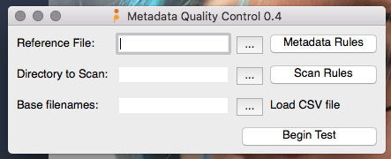
Notes:
What’s the big difference here, in terms of how the data is organized?
How might you use this information?

Slide 22
SET UP YOUR REPORT DIRECTORY
File > Report Directory
Notes:
What’s the big difference here, in terms of how the data is organized?
How might you use this information?

Slide 23
CHOOSE YOUR REFERENCE FILE
Notes:
What’s the big difference here, in terms of how the data is organized?
How might you use this information?

Slide 24
IDENTIFY YOUR DIRECTORY
Notes:
What’s the big difference here, in terms of how the data is organized?
How might you use this information?

Slide 25
SET SOME RULES
All files should have the creator “AVP”
All files should have a copyright statement
All files should be horizontal
All files should be the same dimensions
All files should have a title
Notes:
What’s the big difference here, in terms of how the data is organized?
How might you use this information?

Slide 26
CAUTION
IF YOU SET THE RULES WRONG, YOU HAVE START ALL OVER AT THE BEGINNING
Notes:
What’s the big difference here, in terms of how the data is organized?
How might you use this information?

Slide 27
RUN THE TEST

Slide 28
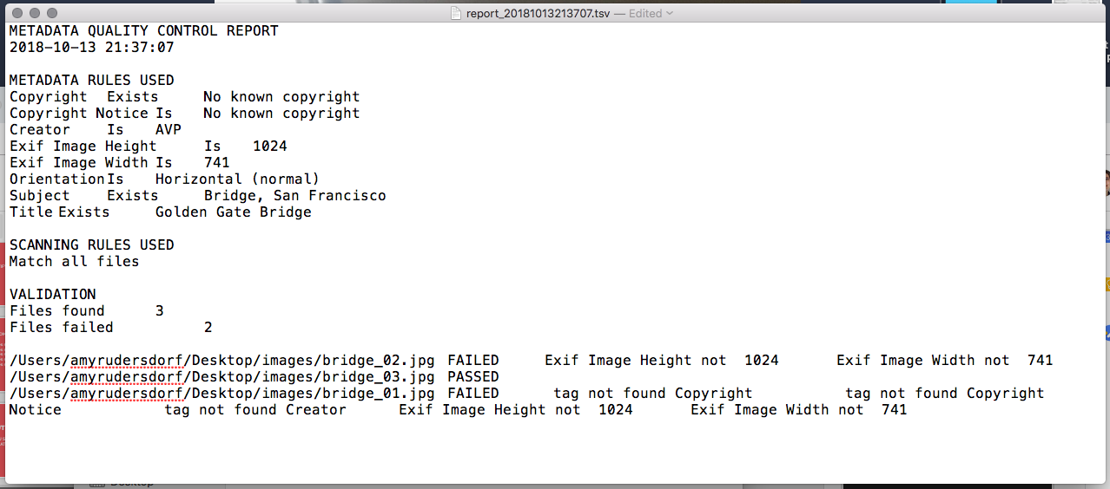

Slide 29
TRY IT YOURSELF

Slide 30
QUESTIONS?
Free digital preservation tools https://www.weareavp.com/products/
WeAreAVP.com

