Slide 1
Deep learning

Slide 2
Neural Networks: NN
Basic structure of biological neuron
TURINGS simple theoretical model of a neuron
How memory is created and stored(short term/long term)
Progression of NN through history and what are the leading edge research topics on it now?
Where NN fits within the world of machine learning?
What kinds of problems are best suited for NN?
What the best platforms to try and work at this point for the NN?
What the minimal must have’s to run a NN?
Different types of NN?
What is Deep learning?
How to prepare the data for the NN?
What is Hyperparameter Optimization?
What all of this has to do with AI? Or me?
D
E
M
O
Notes:
Time constraint, 18 – 50 min = 2.77 min / slide
1: No formulas.
2: if you are carrying the handouts you are surely taking something out of this discussion even if you have to leave in the middle of the talk.
2

Slide 3
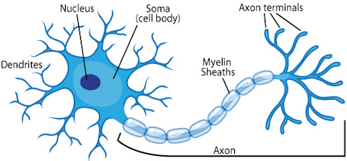
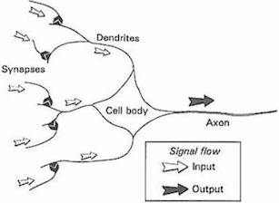
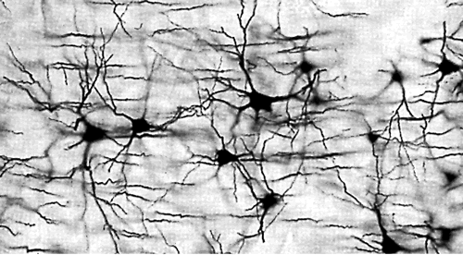
Neural Networks: NN
Basic structure of biological neuron
Notes:
The first step toward artificial neural networks came in 1943 when Warren McCulloch, a neurophysiologist, and a young mathematician, Walter Pitts, wrote a paper on how neurons might work. They modeled a simple neural network with electrical circuits.
3

Slide 4
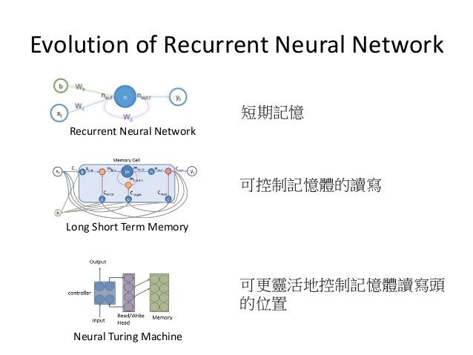
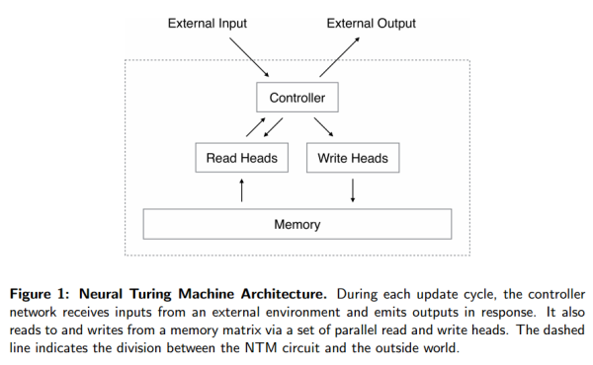


Neural Networks: NN
TURINGS simple theoretical model of a neuron
<-------------- This guy is not this guy --------------->

Slide 5
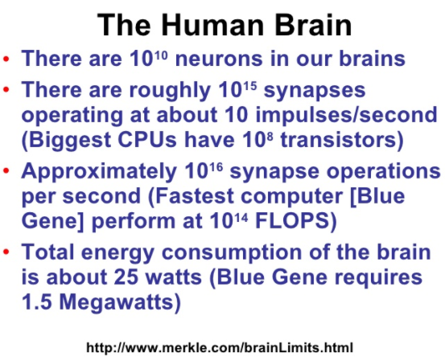
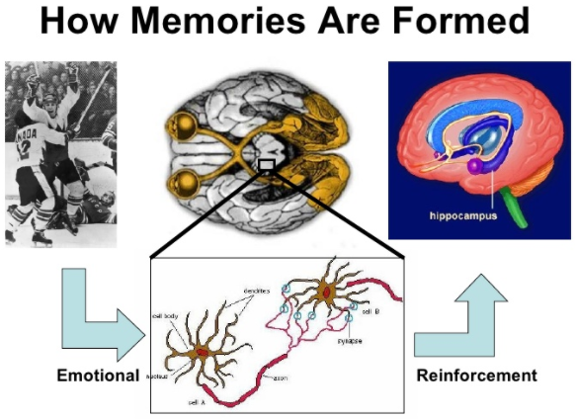
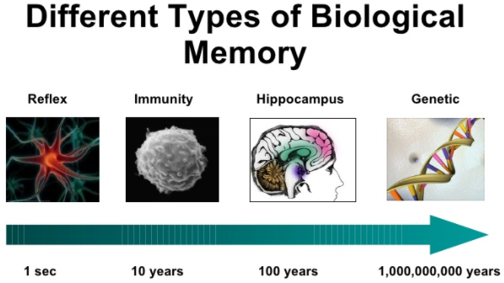
Neural Networks: NN
How memory is created and stored(short term/long term)
Notes:
Major Components of an Artificial Neuron
Component 1. Weighting Factors:
Component 2. Summation Function:
Component 3. Transfer Function:
Component 4. Scaling and Limiting:
Component 5. Output Function (Competition):
Component 6. Error Function and Back-Propagated Value:
Component 7. Learning Function:
Teaching an Artificial Neural Network
Supervised Learning.
Unsupervised Learning.
Learning Rates.
Learning Laws.
Hebb's Rule:
Hopfield Law:
The Delta Rule:
The Gradient Descent Rule:
Kohonen's Learning Law:
5

Slide 6
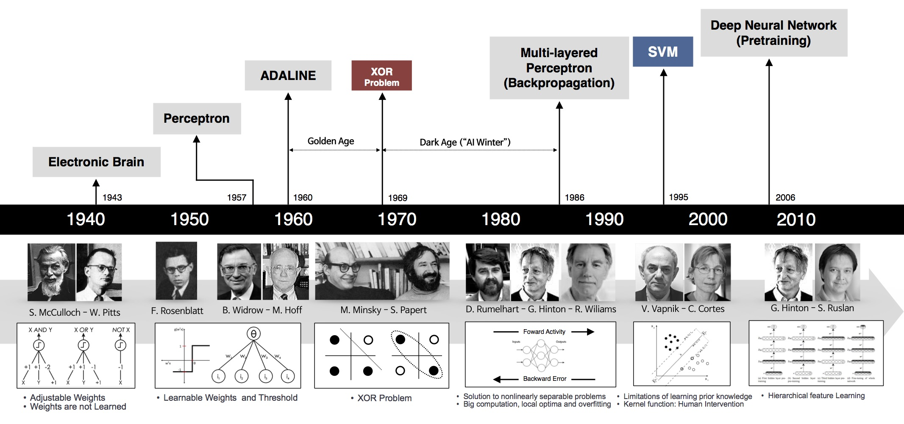
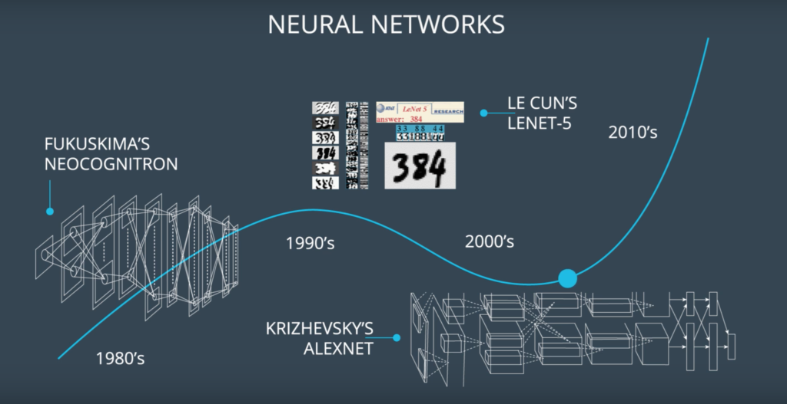
Neural Networks: NN
Progression of NN through history and what are the leading edge research topics on it now?
Latest: Fei-Fei Li proposed a concept of One-Shot Learning.
Notes:
http://fortune.com/ai-artificial-intelligence-deep-machine-learning/
http://irrigation.rid.go.th/rid15/ppn/Knowledge/Artificial%20Neuron%20Networks%20Technology/3.0%20History%20of%20Neural%20Networks.htm
The first step toward artificial neural networks came in 1943 when Warren McCulloch, a neurophysiologist, and a young mathematician, Walter Pitts, wrote a paper on how neurons might work. They modeled a simple neural network with electrical circuits.
Reinforcing this concept of neurons and how they work was a book written by Donald Hebb. The Organization of Behavior was written in 1949. It pointed out that neural pathways are strengthened each time that they are used.
1950s, it became possible to begin to model the rudiments of these theories concerning human thought. Nathanial Rochester from the IBM research laboratories led the first effort to simulate a neural network. That first attempt failed. But later attempts were successful.
1956 the Dartmouth Summer Research Project on Artificial Intelligence provided a boost to both artificial intelligence and neural networks.
John von Neumann suggested imitating simple neuron functions by using telegraph relays or vacuum tubes. Also, Frank Rosenblatt, a neuro-biologist of Cornell, began work on the Perceptron. He was intrigued with the operation of the eye of a fly. Much of the processing which tells a fly to flee is done in its eye. The Perceptron, which resulted from this research, was built in hardware and is the oldest neural network still in use today. A single-layer perceptron was found to be useful in classifying a continuous-valued set of inputs into one of two classes. Unfortunately, the perceptron is limited and was proven as such.
In 1959, Bernard Widrow and Marcian Hoff of Stanford developed models they called ADALINE and MADALINE. These models were named for their use of Multiple ADAptive LINear Elements. MADALINE was the first neural network to be applied to a real world problem. It is an adaptive filter which eliminates echoes on phone lines. This neural network is still in commercial use.
Unfortunately, these earlier successes caused people to exaggerate the potential of neural networks, particularly in light of the limitation in the electronics then available.
In 1982 several events caused a renewed interest. John Hopfield of Caltech presented a paper to the national Academy of Sciences. Hopfield's approach was not to simply model brains but to create useful devices. With clarity and mathematical analysis, he showed
how such networks could work and what they could do.
At the same time, a conference was held in Kyoto, Japan. This conference was the US-Japan Joint Conference on Cooperative/Competitive Neural Networks. Japan subsequently announced their Fifth Generation effort. US periodicals picked up that story, generating a worry that the US could be left behind. Soon funding was flowing once again.
By 1985 the American Institute of Physics began what has become an annual meeting - Neural Networks for Computing. By 1987, the Institute of Electrical and Electronic Engineer's (IEEE) first International Conference on Neural Networks drew more than 1,800 attendees.
6

Slide 7
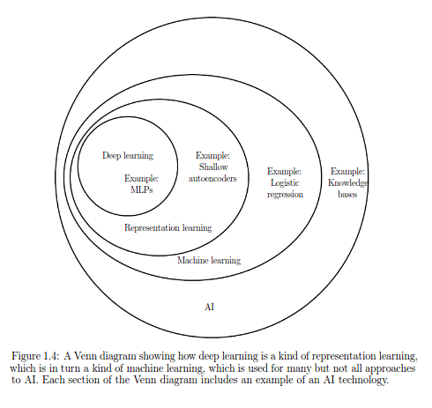
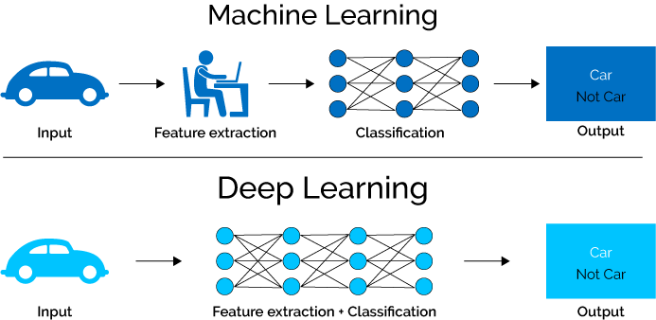
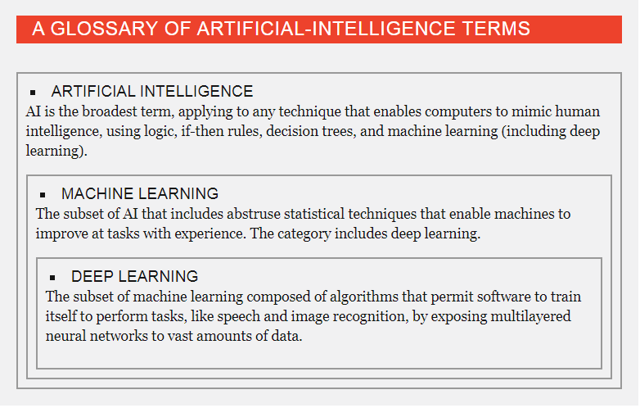
Neural Networks: NN
Where NN fits within the world of machine learning?

Slide 8
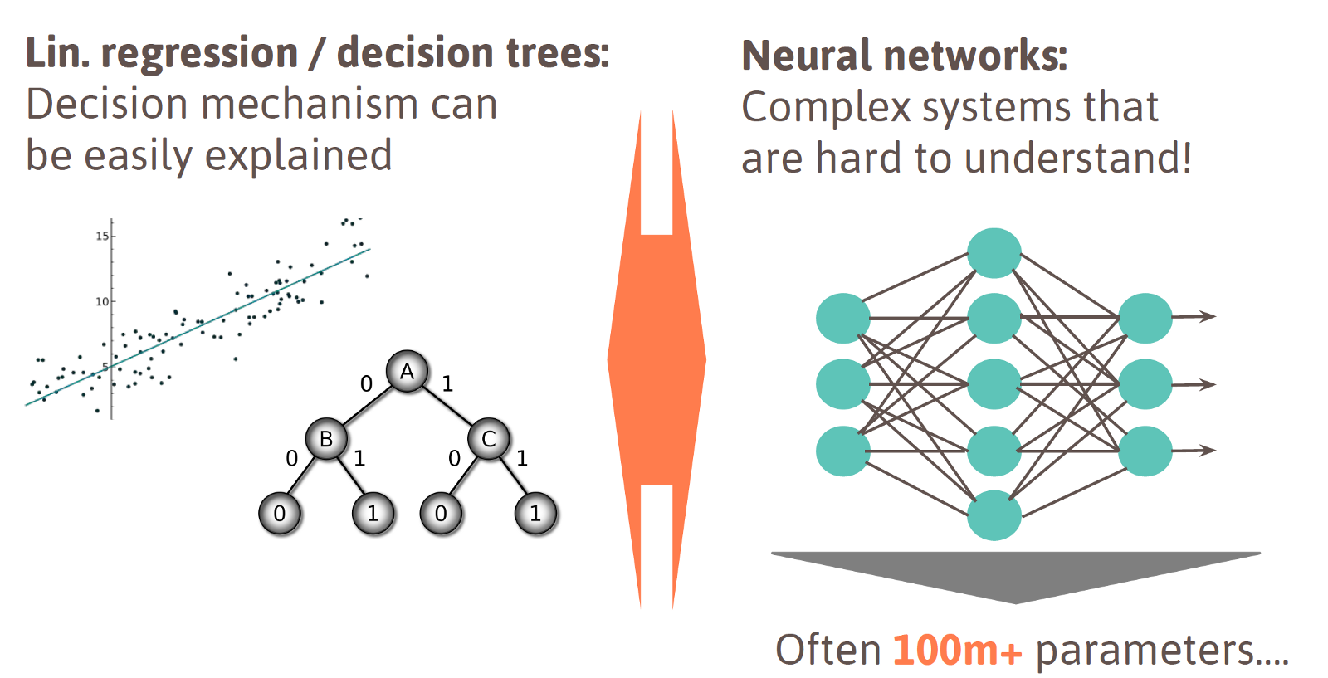
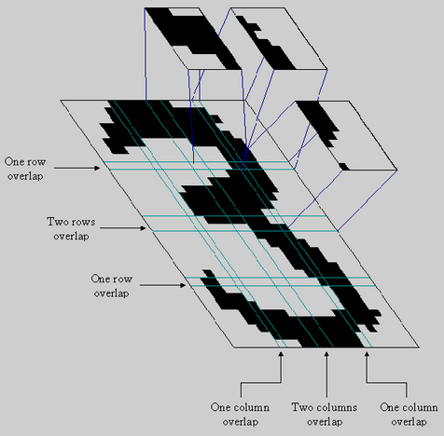
Neural Networks: NN
What kinds of problems are best suited for NN?
Notes:
http://irrigation.rid.go.th/rid15/ppn/Knowledge/Artificial%20Neuron%20Networks%20Technology/5.0%20Network%20Selection.htm
Basically, most applications of neural networks fall into the following five categories:
prediction
classification
data association
data conceptualization
data filtering
8

Slide 9
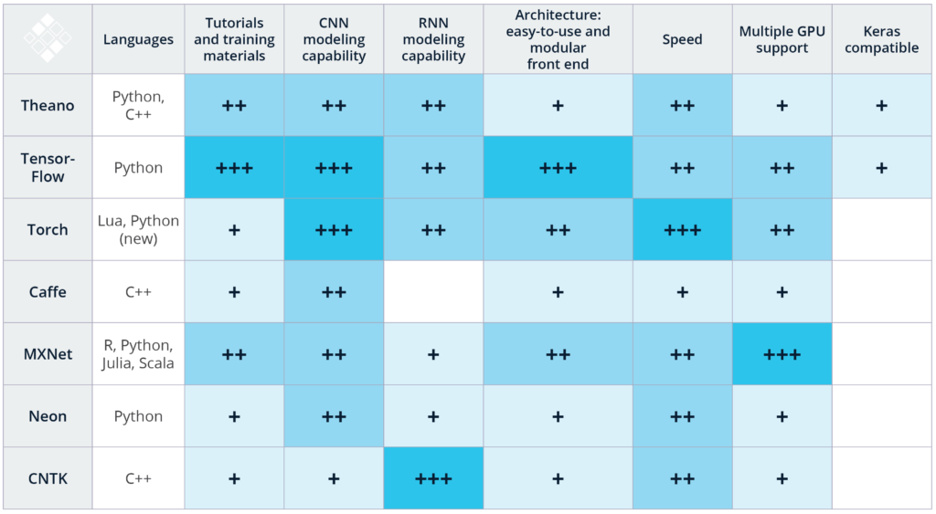
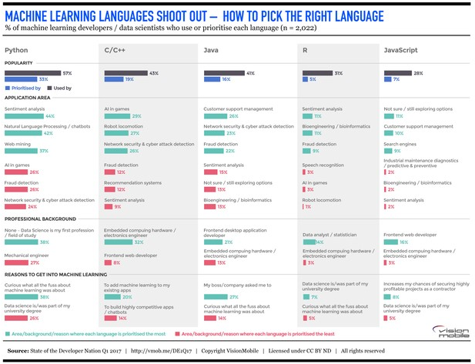
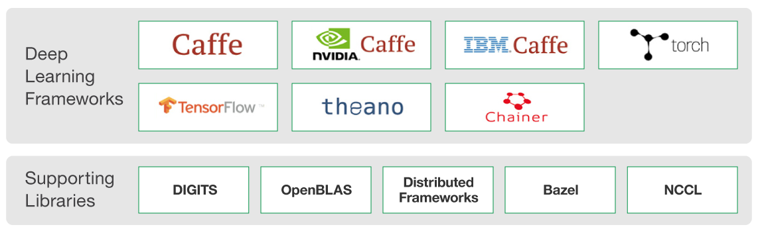
Neural Networks: NN
What the best platforms to try and work at this point for the NN?

Slide 10
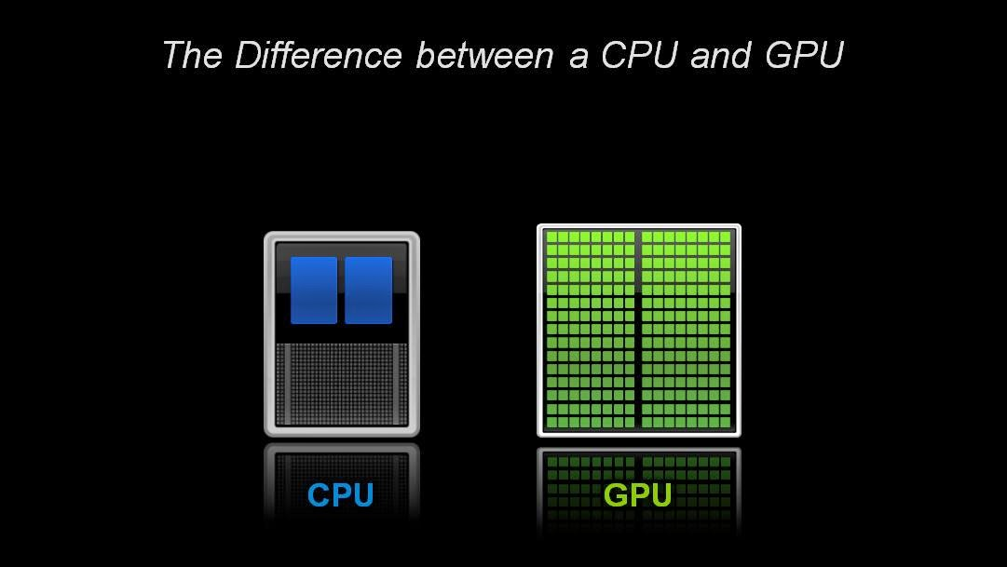
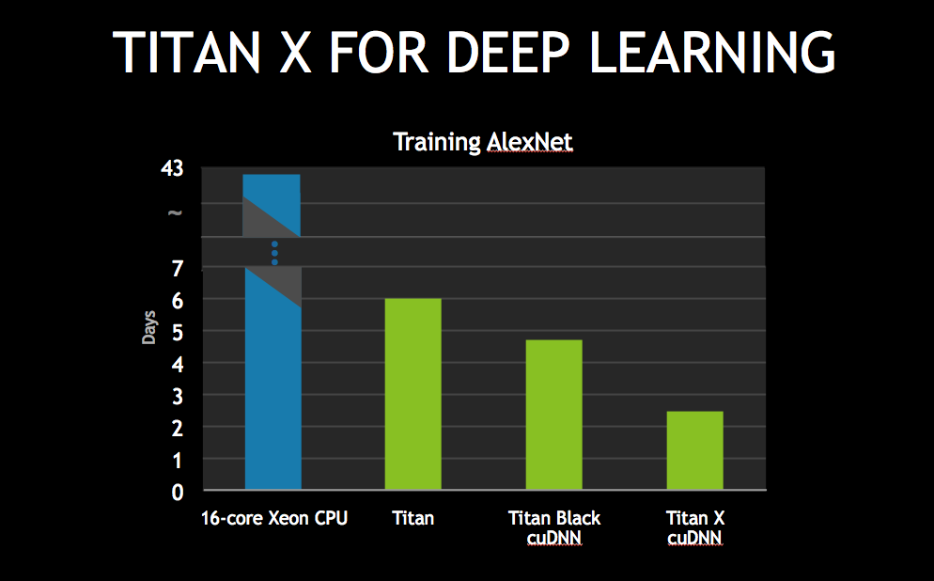
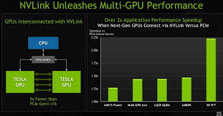




Neural Networks: NN
What the minimal must have’s to run a NN?
Notes:
My personal favorite for the beginners:
R(Data preparation) +-> Python 3.5(base programming language) +-> Tensorflow(Google’s NN library) + Keras(Simplifier package built on top of Tensorflow[Can work with theano or torch]) + Hyperas(based on hyperopt, for hyperparameter optimizer)
10

Slide 11
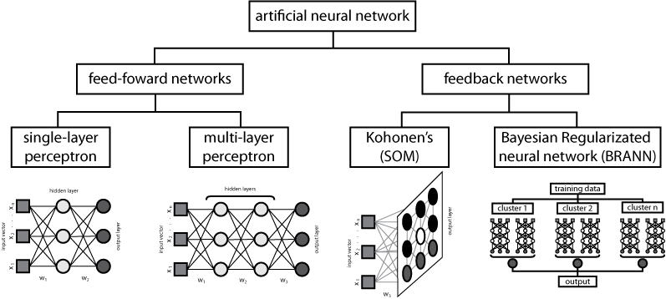
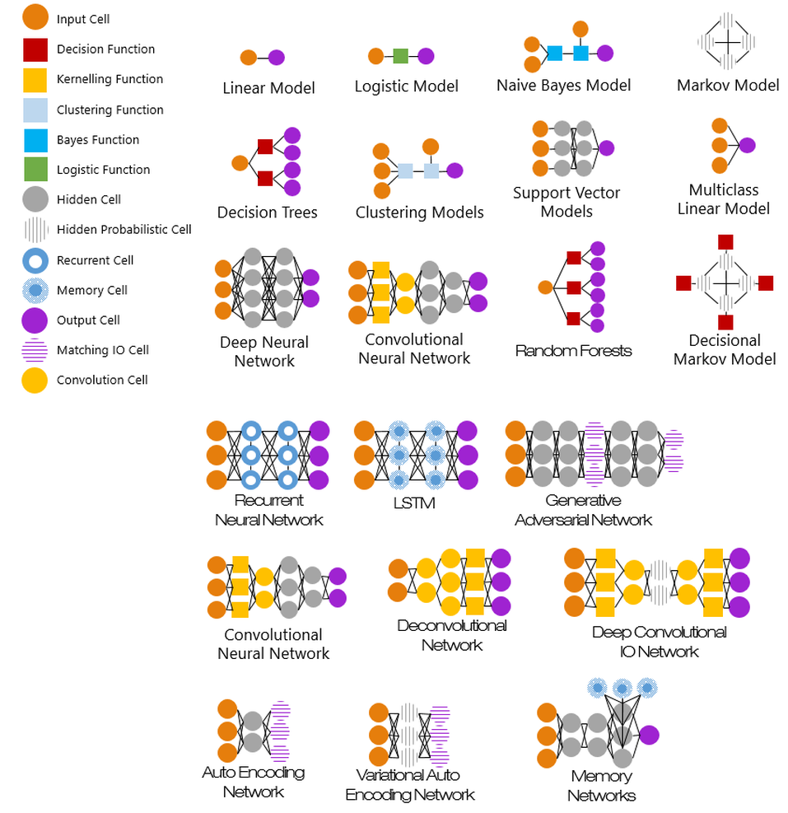
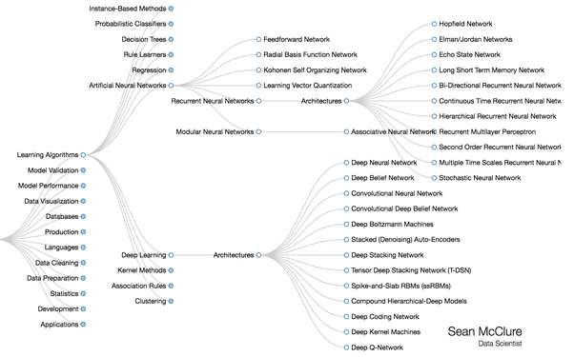
Neural Networks: NN
Different types of NN?
Notes:
http://www.asimovinstitute.org/neural-network-zoo/
11

Slide 12
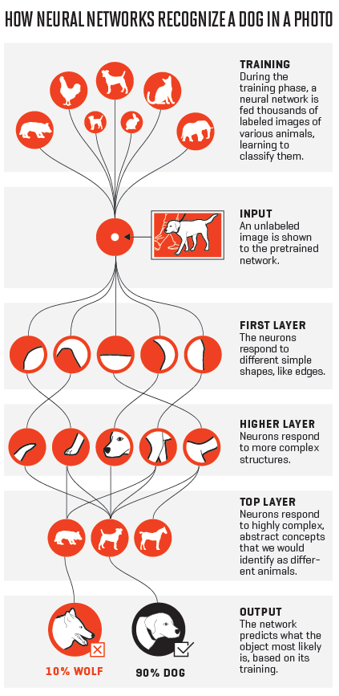
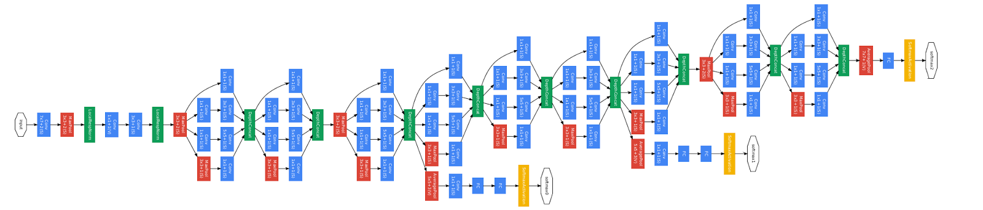
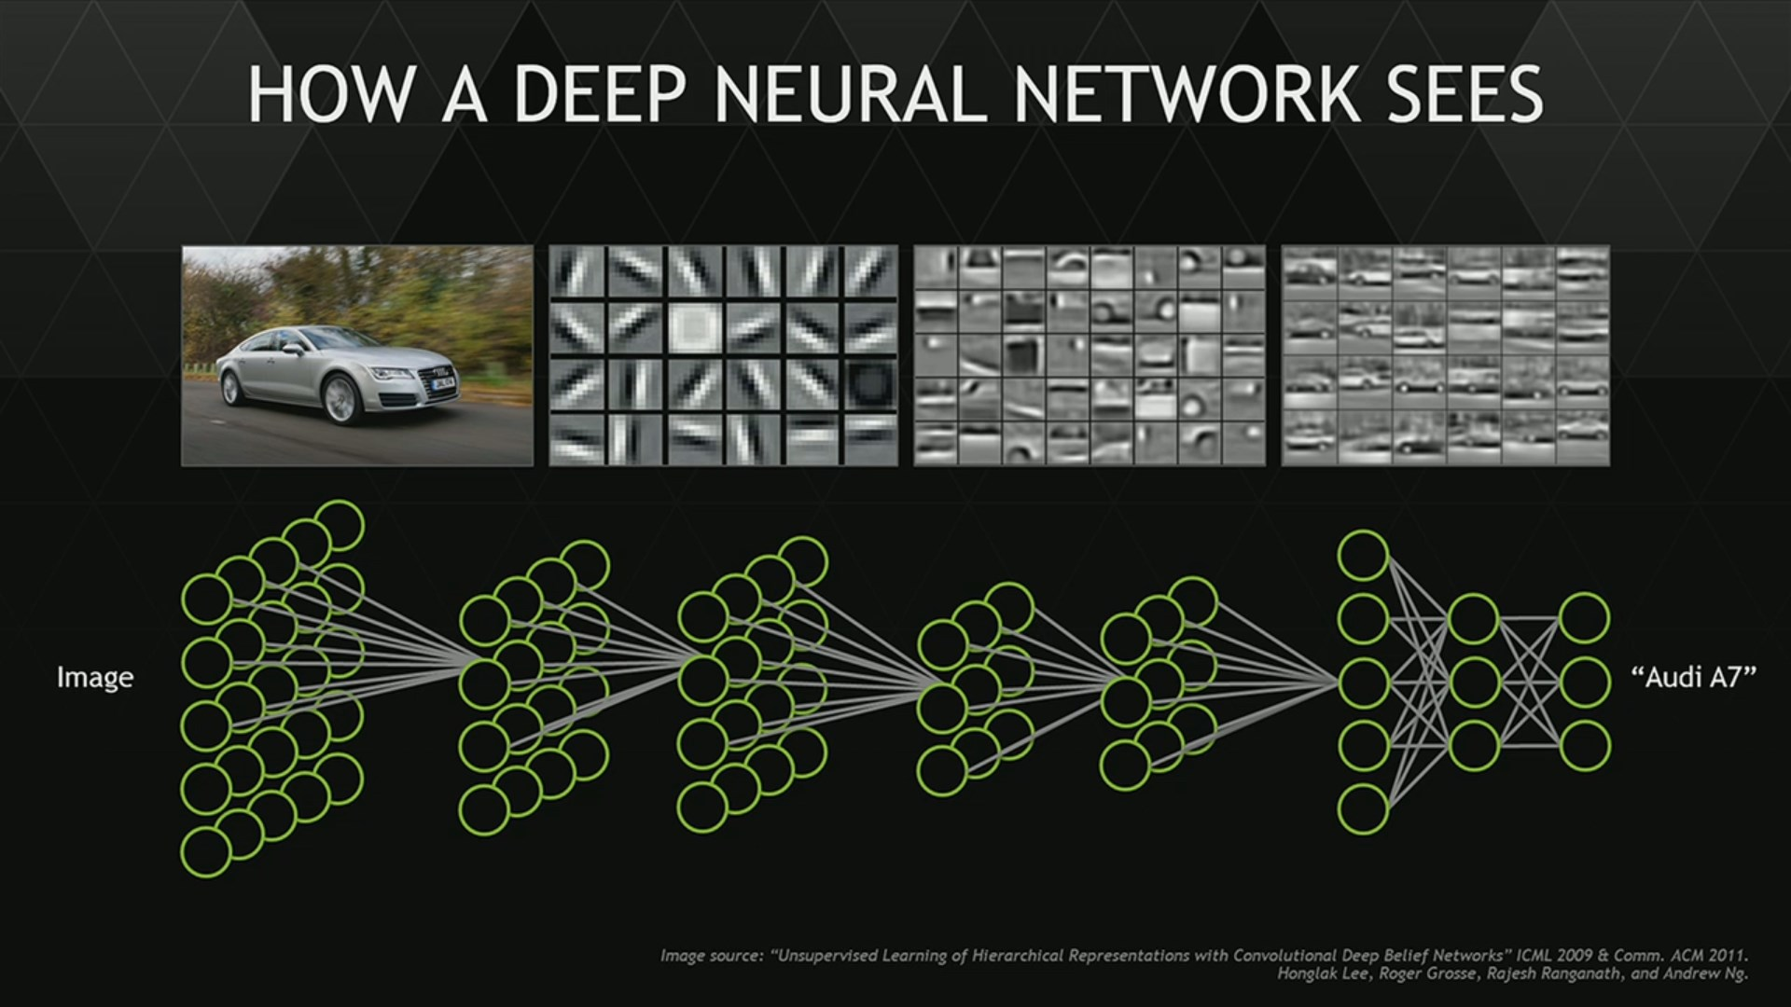
Neural Networks: NN
What is Deep learning?

Slide 13
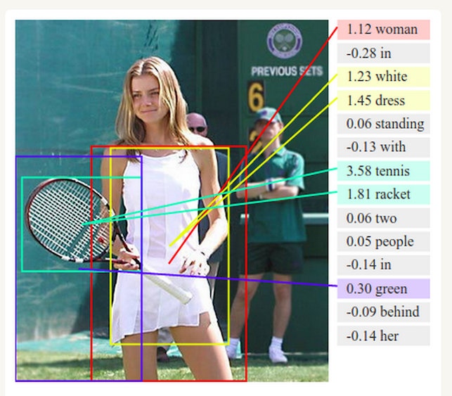
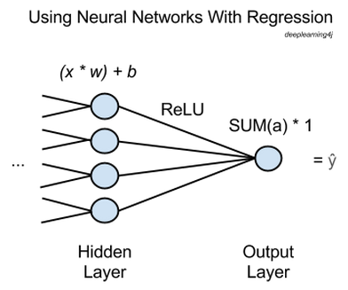
Neural Networks: NN
How to prepare the data for the NN?
Neural Network in action
Overall Data*
}
Training_X
Training_Y
R
A
N
D
O
M
I
Z
E
Binary X data: use -1.0 or +1.0 encoding.
Categorical X data: use effects encoding such as [0.0, 0.0, 1.0] or [-1.0, -1.0, -1.0].
Numeric X data: use (x - mean) / stddev normalization.
Binary Y data: use 0.0 or 1.0 encoding.
Categorical Y data: use dummy encoding such as [0.0, 0.0, 1.0] or [1.0, 0.0, 0.0].
Numeric Y data: do not normalize.
Classification Problems
Test_X
Test_Y
3 Personal rules of data preparation:
Get rid of outliers.(Only the obvious crazy one’s.)
Convert/normalize each column to numeric data. Maintain lookup tables to know what those number meant.
Randomize/shuffle well within your test data.
Split into training_x/training_y , test_x/test_y.
a neural network performing regression will have one output node, and that node will just multiply the sum of the previous layer’s activations by 1. The result will be ŷ, “y hat”, the network’s estimate, the dependent variable that all your x’s map to.
To perform backpropagation and make the network learn, you simply compare ŷ to the ground-truth value of y and adjust the weights and biases of the network until error is minimized, much as you would with a classifier. Root-means-squared-error (RMSE) could be the loss function.
In this way, you can use a neural network to get the function relating an arbitrary number of independent variables x to a dependent variable y that you’re trying to predict.
Regression Problems
*Dr. James McCaffrey works for Microsoft Research in Redmond, WA
Notes:
neural networks are used for the purpose of unsupervised learning, classification, or regression.
a neural network performing regression will have one output node, and that node will just multiply the sum of the previous layer’s activations by 1. The result will be ŷ, “y hat”, the network’s estimate, the dependent variable that all your x’s map to.
To perform backpropagation and make the network learn, you simply compare ŷ to the ground-truth value of y and adjust the weights and biases of the network until error is minimized, much as you would with a classifier. Root-means-squared-error (RMSE) could be the loss function.
In this way, you can use a neural network to get the function relating an arbitrary number of independent variables x to a dependent variable y that you’re trying to predict.
13

Slide 14
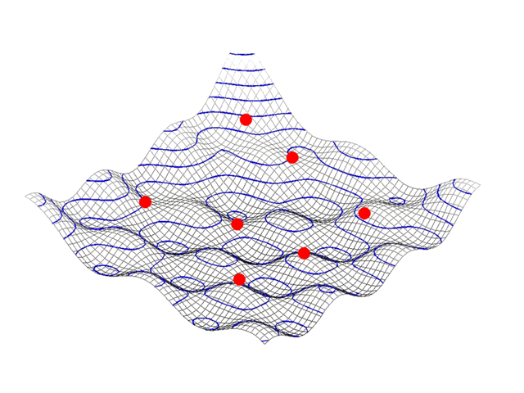
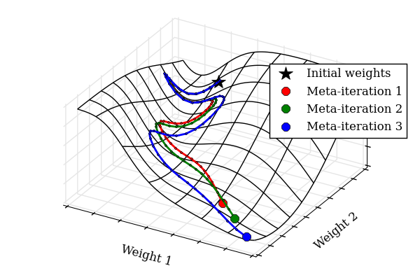
Neural Networks: NN
What is Hyperparameter Optimization?
Notes:
https://github.com/hyperopt/hyperopt
https://github.com/maxpumperla/hyperas
14

Slide 15
Lets get our hands dirty……..
Install R 3.3(+R studio) & Python 3.5(+ Pycharm community edition) in windows environment.
Make sure python paths(python folder and scripts folder) are included in the windows %Path%.
Install some basic standard packages using PIP
  “Numpy – MKL”
  “Scipy – MKL”
  “Matplotlib”
  “Tensorflow”
  “Keras”
  “Hyperas”
  “Pillow” (I know.. Why such a stupid name… right? Well we in the community like to keep it simple and fun I guess)

Slide 16
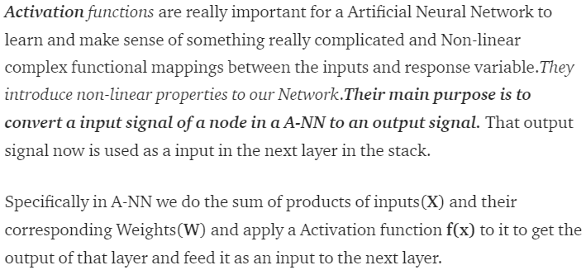
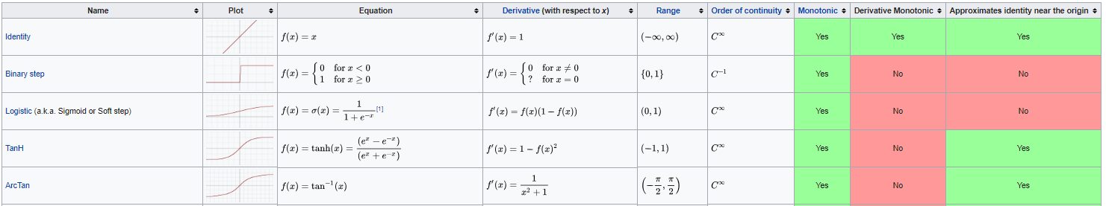
  Activation functions
“Input times weights , add Bias and Activate”

Slide 17
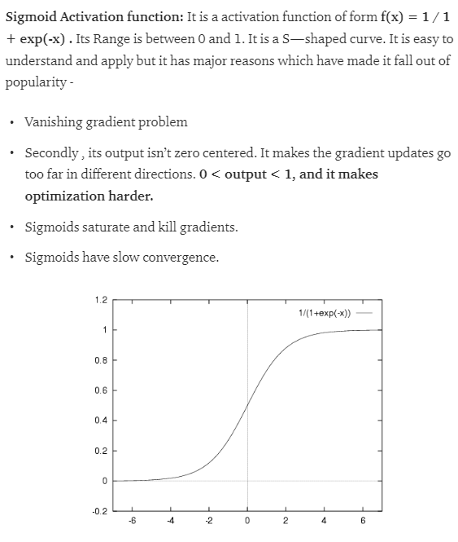
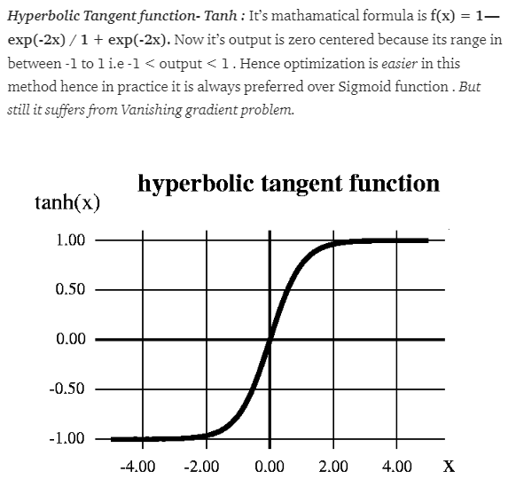
  Activation functions

Slide 18
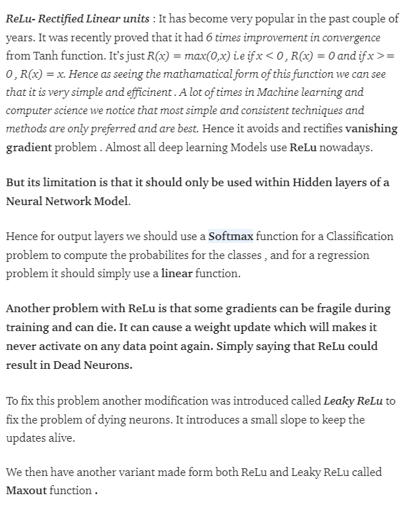
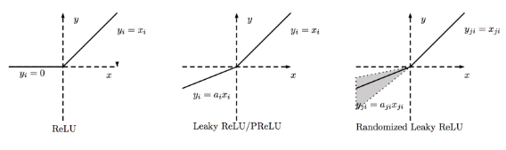
  Activation functions

Slide 19
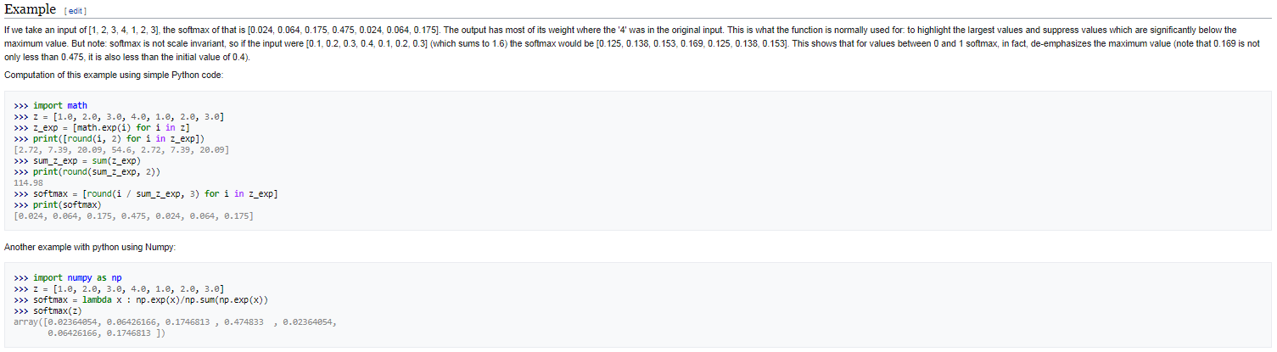
  Softmax functions – for the outermost layer

Slide 20
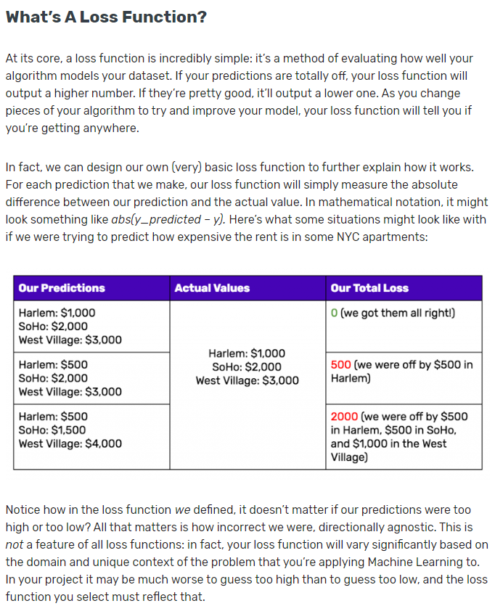
  Loss functions / cost function

Slide 21
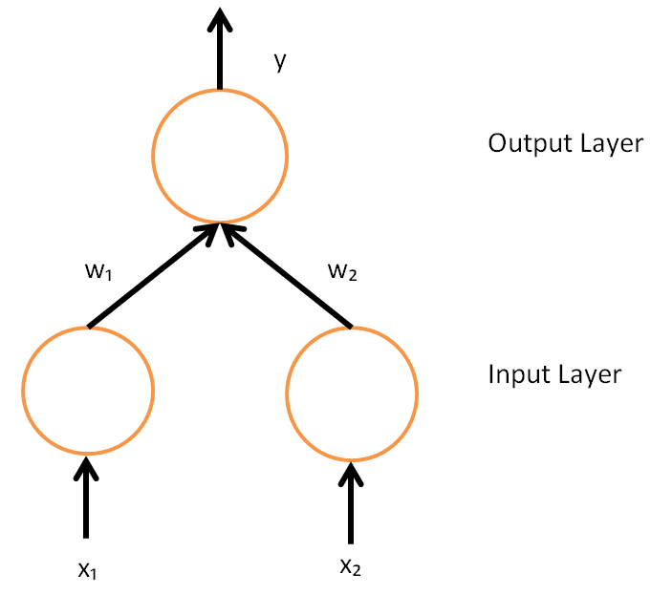
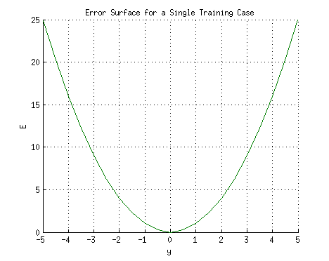
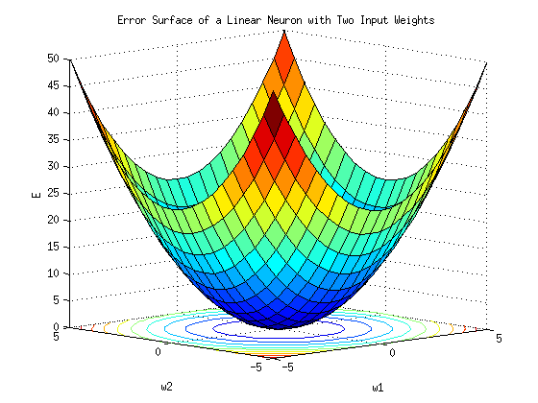
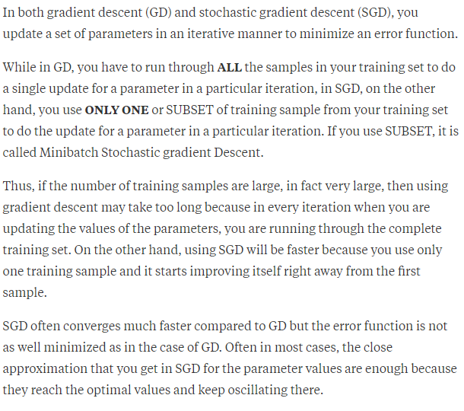
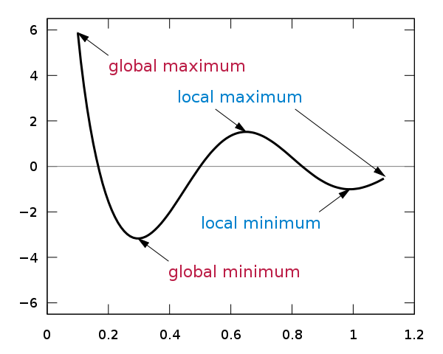
  Back propagation / optimization

Slide 22
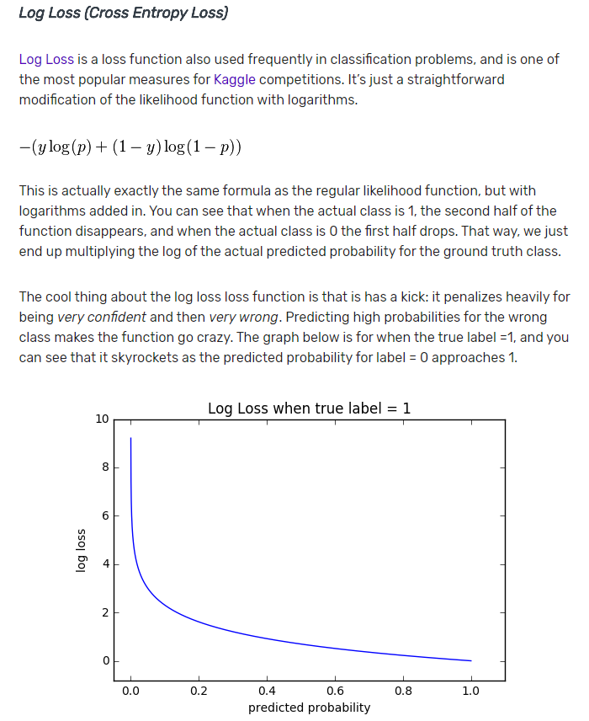
  Cross entropy

Slide 23
  Guide
http://neuralnetworksanddeeplearning.com/chap1.html
https://medium.com/data-science-group-iitr/loss-functions-and-optimization-algorithms-demystified-bb92daff331c

Slide 24
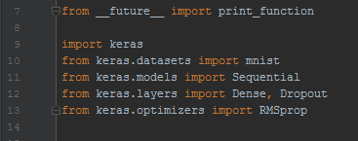

On your marks…
Import packages to work with
2. Declare variables to work with
How to build lookup’s
{
{
}
num_classes = 3,
Lunch menu =
{1: Rajma-Chawal; 2: Biriyani;
3:Dal-Rice; 4:Roti-curry}
Weather =
{1: too-sunny; 2.Perfect; 3:Raining;
4:Cold}
Amount of traffic =
{1:Super heavy; 2:Light; 3:Moderate; 4:Heavy}
Boss not coming to office =
{1:y; 2:N}
Calls =
{1:W.F.H; 2:Going to office; Sick Leave}
X |  | Y
FAM | VIC | CALLS
0.1102 | 2.3425 | HOM_FAM
1.5944 | 1.4899 | HET
3.2144 | 0.1234 | HOM_VIC
num_classes = 3,
Calls = {1:HOM_FAM;
2:HET;
3:HOM_VIC}
X |  |  | Y
Engine HP | No. Of Door | No. Of Wheels | Vehicle Type
400 | 4 | 4 | CAR
150 | 0 | 2 | Motorcycle
10000 | 2 | 16 | Truck
0 | 0 | 2 | Cycle
{
}
num_classes = 4,
Vehicle Type = {1:CAR;
2:Motorcycle;
3:Truck;
4:Cycle}
}
X |  |  |  |  |  | Y
Lunch Menu | No of meetings | Weather | Amount of traffic | Boss not coming to office | No of pending work | Calls
Rajma-Chawal | 4 | Too sunny | Super heavy | Y | 4 | W.F.H
Biriyani | 0 | Perfect | Light | N | 2 | Going to office
Dal-Rice | 2 | Raining | Moderate | Y | 16 | Sick leave
Roti-curry | 0 | Cold | Heavy | N | 2 | Going to office

Slide 25
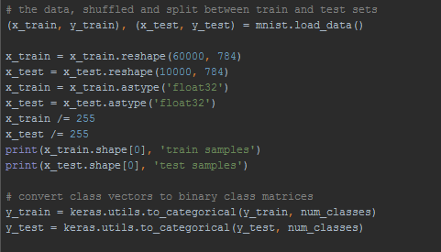
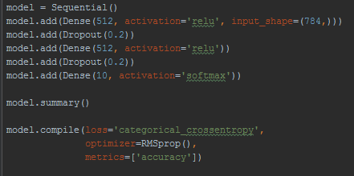
Get…
3. Build/Split(Prepare) dataset
4. Define your model structure
0 | 0 | … | 0
0 | 253 | … | 0
… | … | … | …
0 | 255 | 0 | 0
0 | 0 | … | 0
0 | 253 | … | 0
… | … | … | …
0 | 255 | 0 | 0
0 | 0 | … | 0
0 | 253 | … | 0
… | … | … | …
0 | 255 | 0 | 0
0, 0, …, 0 | 0, 253, …, 0 | ……… | 0, 255, 0, 0
0, 0, …, 0 | 0, 253, …, 0 | ……… | 0, 255, 0, 0
0, 0, …, 0 | 0, 253, …, 0 | ……… | 0, 255, 0, 0
X |  |  |  | Y
0, 0, …, 0 | 0, 0.9912, …, 0 | ……… | 0, 1, 0, 0 | 6
X |  |  |  | Y
0, 0, …, 0 | 0, 0.7712, …, 0 | ……… | 0, 0, 1, 0 | 2
X |  |  |  | Y
0, 0, …, 0 | 0, 0.9912, …, 0 | ……… | 0, 1, 0, 0 | 6

Slide 26


Set…
5. Train your model
6. Test/Score your model

Slide 27
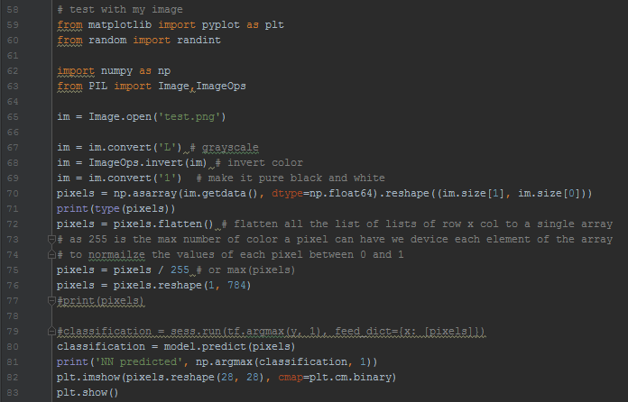


Go…
7. Test with actual(real world) data
28 pixel
Invert color
28 pixel
28 Cols
0 | 0 | … | 0
0 | 253 | … | 0
. . . | . . . | … … … | . . .
0 | 0 | … | 0
Convert to a pixel value Metrix
28 Rows
Divide by 255,Bring the values btwn 0~1
0 | 0 | … | 0
0 | 0.99215 | … | 0
. . . | . . . | … … … | . . .
0 | 0 | … | 0
0, 1, 2, … 784 (28*28) : X |  |  |  | Y
0, 0, …, 0 | 0,.99215, …, 0 | …,…,… | 0, 0, …, 0 | 6

Slide 28
Assignment
Run mnist dataset against a RNN type neural network model using keras
  Run the same model for 1 epoch and 20 epoch and note the difference in performance.
  Run the same model for 128 and 256 minibatch and note the difference
  Test the model with a 28 pixel by 28 pixel data generated by you.
Train the mnist dataset on a CNN type neural network model using keras
  Run the same model for 1 epoch and 20 epoch and note the difference in performance.
  Run the same model for 128 and 256 minibatch and note the difference
  Test the model with a 28 pixel by 28 pixel data generated by you.
Develop a image repository, lookup table and mapping table for CNN.
  Train CNN with your own data
  Test CNN with your own data
  Save the model.
  Optimize parameter.

