Slide 1

FINDING THE BEST LOCATION FOR A TUITION CENTRE IN MELBOURNE, AUSTRALIA
Daniel levy

Slide 2
DATA SOURCES
Postcode data, sorted by latitude and longitude
01
School data, sorted by postcode
02
Enrolment data, sorted by school
03
Socio-Economic Index for Area (SEIFA) scores, sorted by postcode
04
Tuition centre locations in close proximity to each postcode
05

Slide 3
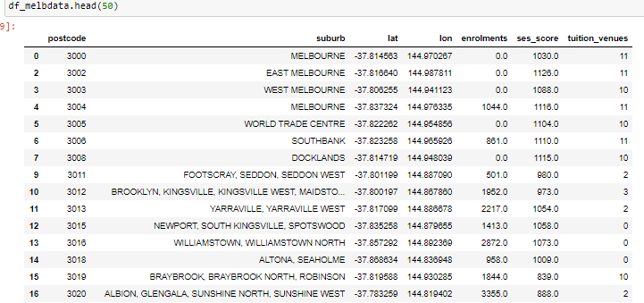
Data: wrangled, cleaned and pre-processed into features

Slide 4
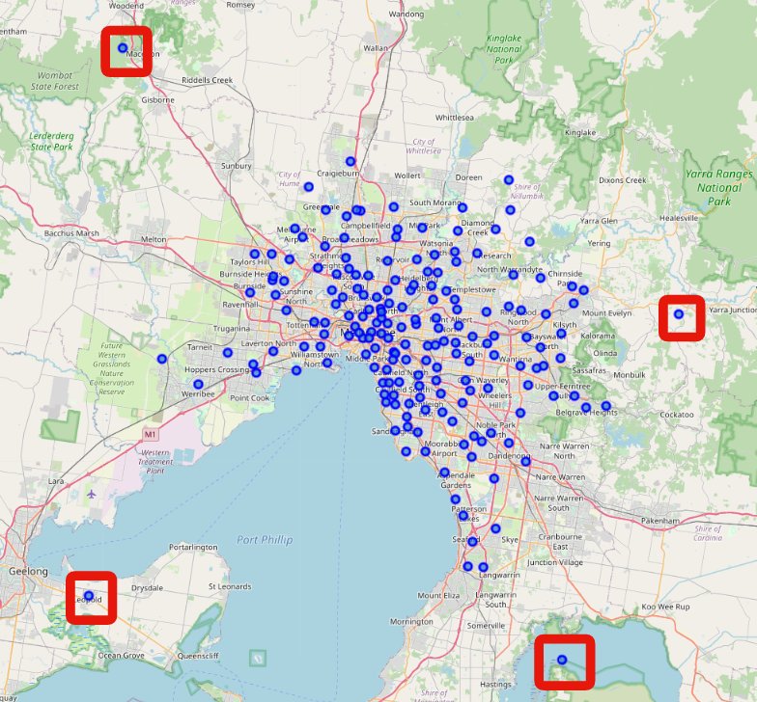
Melbourne’s postcodes, visualized TAKEAWAY: CLUSTERING ALGORITHM SENSITIVE TO OUTLIERS is REQUIRED

Slide 5
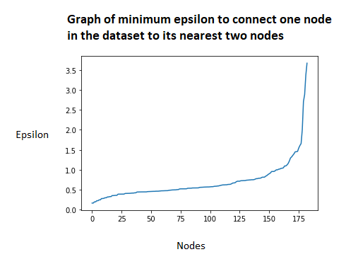
DBSCAN CLUSTERING ALGORITHM: PARAMETER SELECTION
Minimum number of nodes (postcodes) in a cluster chosen to be k = 3, based on geographic intuition
Epsilon chosen to be 0.6 at “elbow”,
The elbow is the point where the curve begins to change rapidly

Slide 6
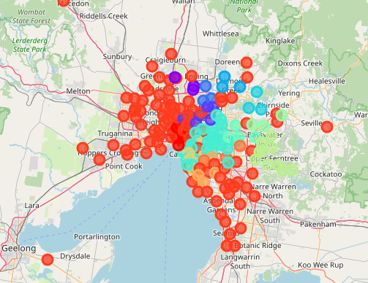
DBSCAN Clustering algorithm results
Each dot represents a different postcode
Each colour represents a different cluster

Slide 7
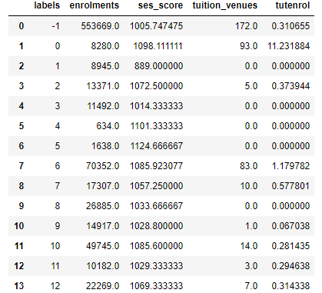
Summary data of each cluster
Each label ID represents a different cluster (-1 is outliers)
Total enrolments
Average SEIFA score
Total number of tuition centres in close proximity
Number of tuition centres per 1000 students

Slide 8
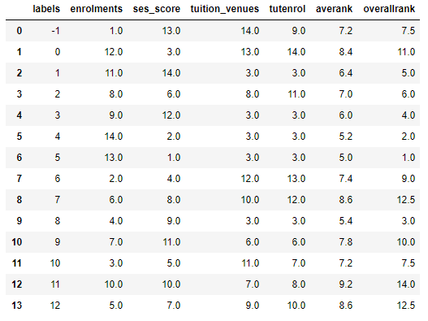
Ranking data of each cluster
Each column ranked from 1 to 14
Average rank of all column metrics
Overall rank of average rank
Clusters labelled 4, 5 and 8 best overall rank
Cluster 4 and 5 only have 2000 total enrolments between them however (per previous slide)
Cluster label 8 chosen as having best mix of features for new tuition centre
Cluster label 1 chosen as being most underserved location for education

Slide 9
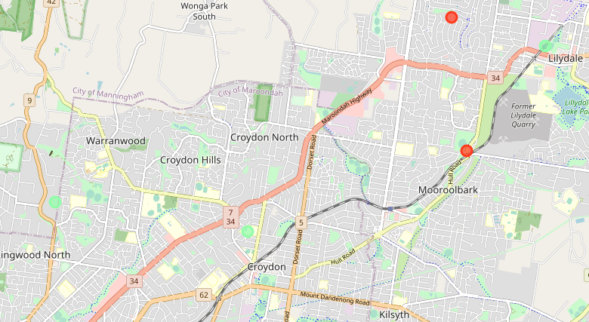
BEST LOCATION IN METROPOLITAN MELBOURNE FOR NEW TUTORING LOCATION
Pale green dots correspond to the postcodes of Ringwood North, Croydon and Lilydale
26,885 total student enrolments
1033 average SEIFA score (1000 nationwide average)
0 tuition centres in close proximity

Slide 10
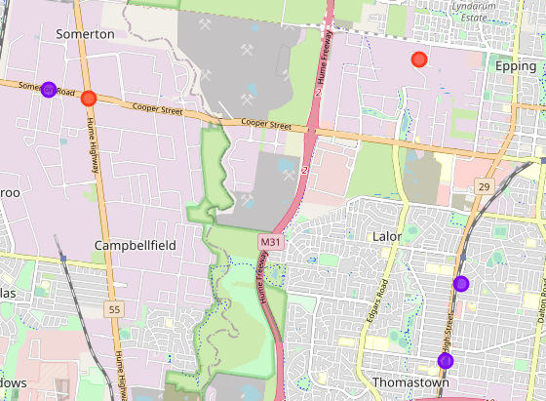
MOST UNDERSERVED AND UNDERPRIVILEGED LOCATION FOR EDUCATION SERVICES IN MELBOURNE
Purple dots correspond to the postcodes of Lalor, Thomastown and Somerton
8,945 total student enrolments
889 SEIFA score (1000 nationwide average)
0 tuition centres in close proximity

Slide 11
improvements
Curate more comprehensive list of tuition centre data
1
Do more considered analytical work on the relationship between features
2

