Slide 1
Examination Script Management System
Put You Name #Index0000
Put You Name #Index0000

Slide 2
Background Of Study
The rapid advancement of Information and Communication Technology (ICT) has transformed how educational institutions manage academic records. Cloud computing provides secure, scalable, and centralized storage that improves data accessibility, backup, and disaster recovery (Sharma & Singh, 2020; Rahman & Islam, 2023). However, many institutions, including Koforidua Technical University (KTU), still rely on manual and localized storage of examination papers, making document management inefficient. This study therefore proposes a cloud-based examination script management system to improve document security, accessibility, and long-term preservation.

Slide 3
Problem Statement
The Computing Sciences Department of Koforidua Technical University (KTU) currently stores examination scripts manually in physical examination rooms. This approach consumes valuable office space, makes document retrieval slow and difficult, and exposes important academic records to risks such as fire, flooding, theft, and unauthorized access. The absence of a centralized digital storage and retrieval system also affects efficiency and security. Therefore, there is a need for a cloud-based examination script management system to securely store, manage, and retrieve examination records while supporting the university's digital transformation.

Slide 4
Objective of study
Main Objective
To design and develop examination scripts management system for Computer Sciences Department.
Specific Objectives
1. To design and implement a file compression model that reduces the size of scanned PDF examination documents before uploading to the cloud.
2. To develop a cloud-based storage system that enables secure scanning, uploading, storage, and retrieval of examination papers.
3. To design and implement an automated alert system that notifies lecturers to upload examination papers after marking and recording.
4. To develop an access control model that allows administrators to grant access to authorized users within defined time periods.

Slide 5
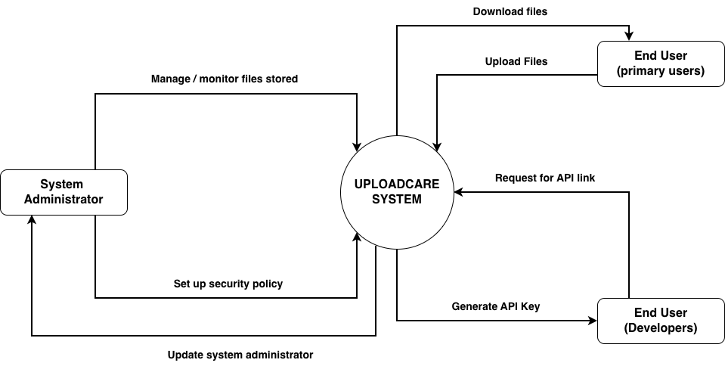
Literature Review
Context Diagram for Uploadcare

Slide 6
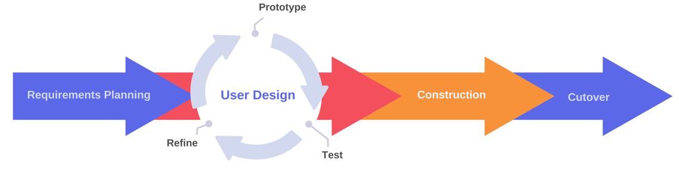
Methodology
Rapid Application Development (RAD)
Construction
This phase involved building and coding the system using the selected technologies. All major features were developed and tested.
Requirements Planning
This phase identified what the system should do and who would use it. It also gathered the requirements needed to develop the system.
Cutover
This phase involved testing the completed system and deploying it for use. Minor issues were fixed, and future improvements were identified.
User Design
This phase focused on designing the database, user interface, and system structure. The design was improved based on user feedback.

Slide 7
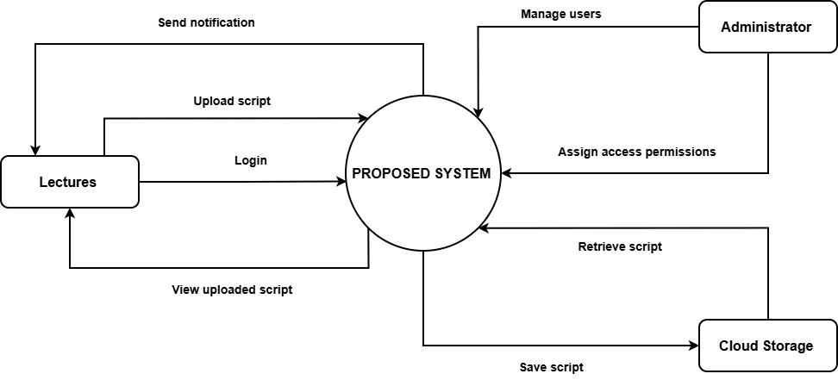
Methodology
Context Model Diagram

Slide 8
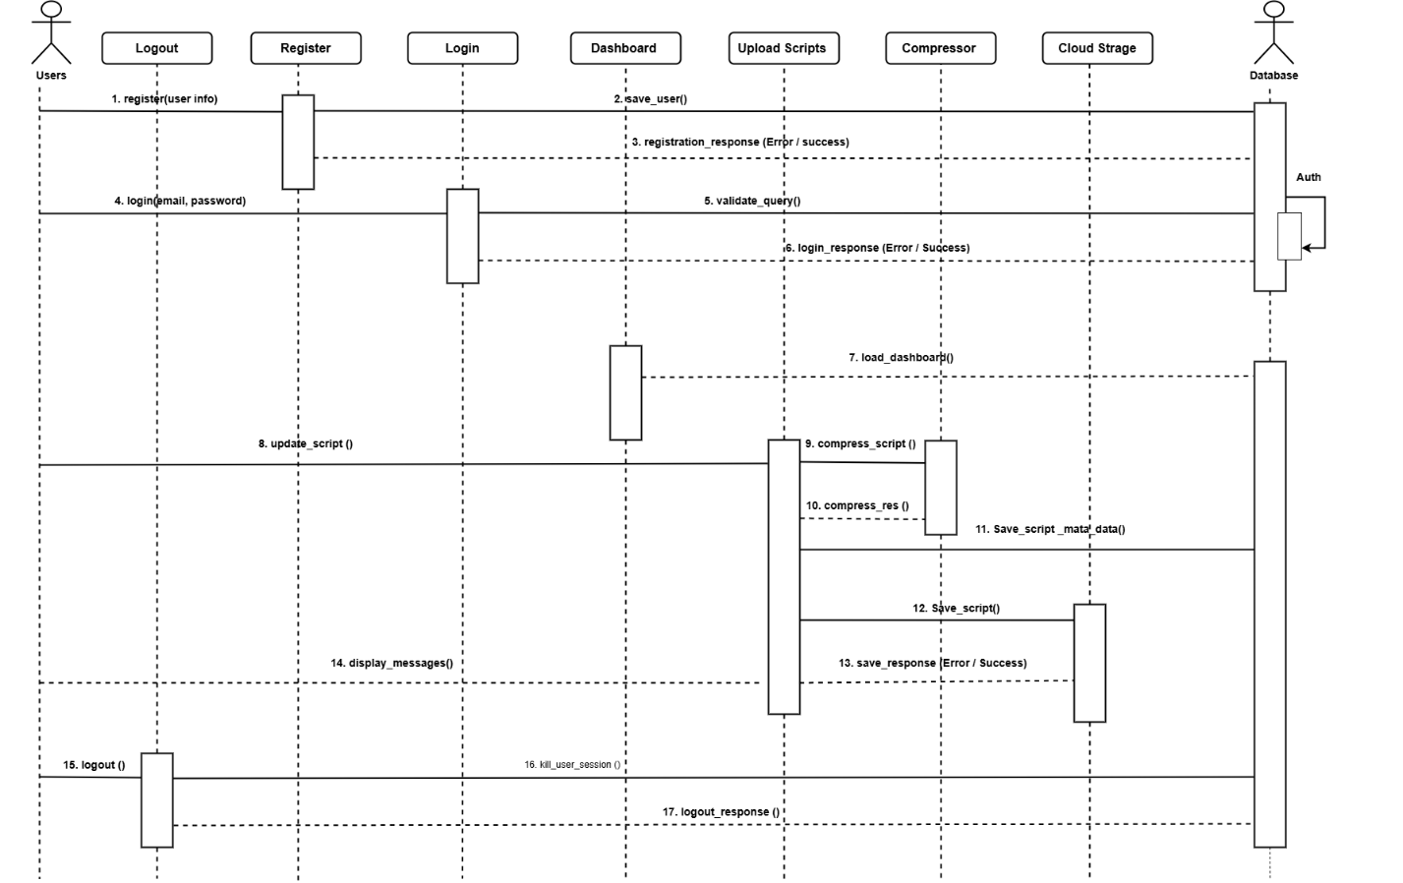
Methodology
Sequence
Model
Diagram

Slide 9
References
Adeyemi, T., Salami, K., & Yusuf, A. (2024). Cloud‑based academic record systems in developing countries. International Journal of Educational Technology, 21(2), 45–60.
Alshamaila, Y., Papagiannidis, S., & Li, F. (2021). Cloud computing adoption in higher education. Journal of Enterprise Information Management, 34(3), 789–806.
Hasan, M., & Khan, S. (2022). Digital transformation in universities through cloud computing. Education and Information Technologies, 27(4), 5231–5250.
Khan, A., & Rahman, M. (2021). Security challenges in cloud‑based education systems. IEEE Access, 9, 112345–112359.
Rahman, M., & Islam, R. (2023). Secure document management systems using cloud technology. Journal of Cloud Computing, 12(1), 88–101.

