Slide 1
Financial Mobile Platform For Student
Gilbert Offei B203230057
Supervisor: Prof. S Okyere Dankwa

Slide 2
Background Of Study
The rapid growth of ICT has transformed financial transactions through secure and efficient mobile payment systems (Dahlberg, Guo, & Ondrus, 2025). Although mobile money has improved financial inclusion in Ghana (Aker & Mbiti, 2022), Koforidua Technical University (KTU) still relies on manual fee payment and verification processes that cause delays and inconvenience. This study therefore proposes a Student Pay Mobile Application to simplify fee payments, provide instant digital receipts, and improve financial management.

Slide 3
Problem Statement
Despite the widespread adoption of mobile payment systems in Ghana, Koforidua Technical University (KTU) still relies largely on traditional fee payment methods that require students to visit banks. This process results in long queues, delays in registration, and risks associated with carrying cash and handling paper receipts. Although USSD-based payment options exist, they offer limited functionality and user convenience. Therefore, there is a need for a secure and user-friendly mobile payment application that provides real-time payment confirmation, digital receipts, and efficient transaction management to improve the university's fee payment process.

Slide 4
Objective of study
Main
Design and development of financial mobile platform for students in Koforidua Technical University (KTU).
Specific Objectives
Design and develop a module that will integrate multiple digital payment options.
Design and develop a module that will ensure real-time payment processing with instant confirmation notifications.
Design and develop a module that will provide transaction histories with downloadable PDF receipts.

Slide 5
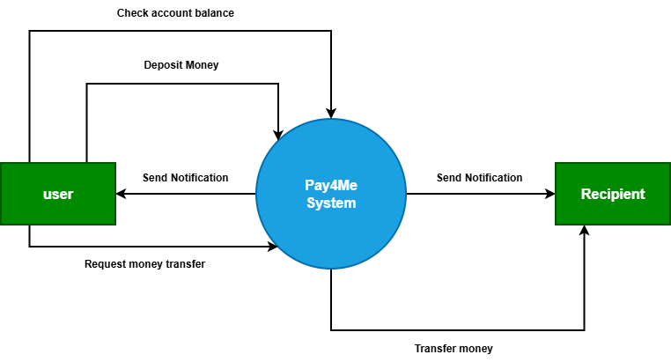
Literature Review
Context Diagram For Pay4Me

Slide 6
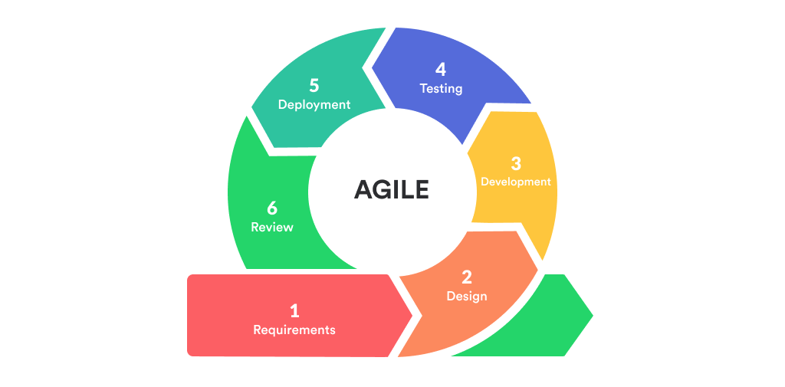
Methodology
Tools and Technologies
React Native for Mobile app
PHP for backend API
MySQL database
WebStorm and PHPStorm development environment

Slide 7
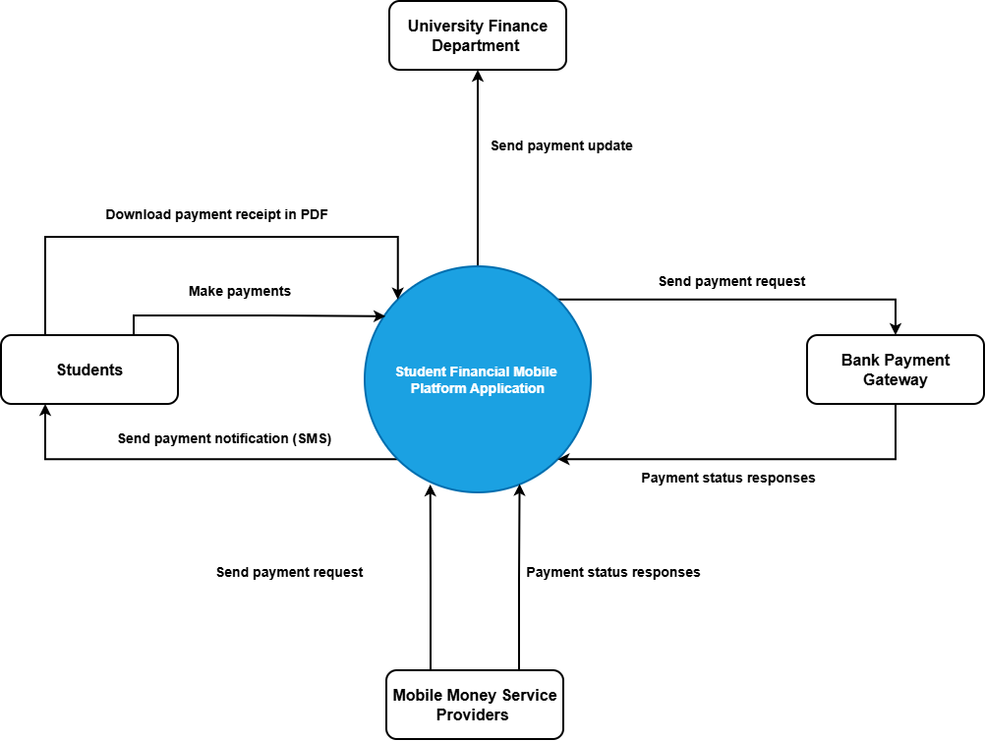
Methodology
Context Diagram For Proposed System

Slide 8
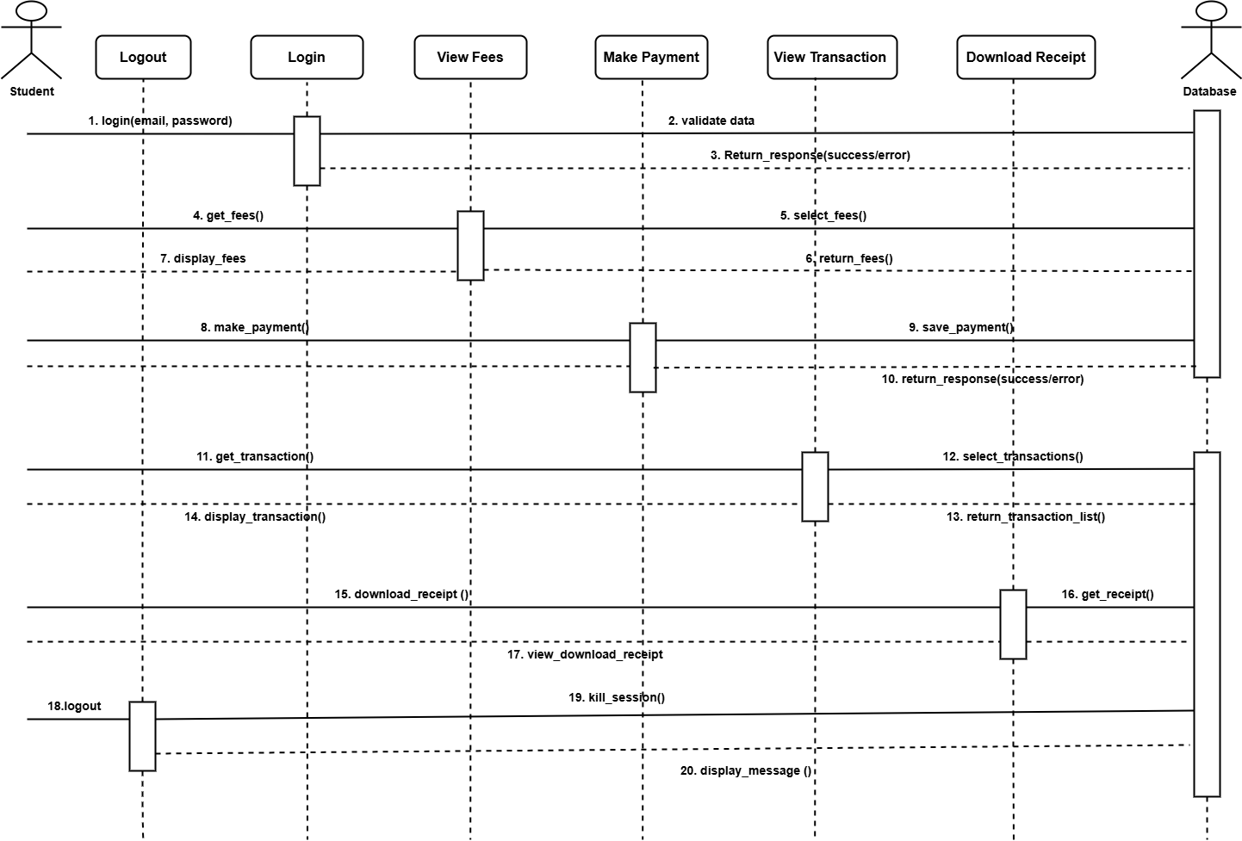
Methodology
Sequence Diagram For Proposed System

Slide 9
References
Dahlberg, T., Guo, J., & Ondrus, J. (2015). A critical review of mobile payment research. Electronic Commerce Research and Applications, 14(5), 265–284.
Oliveira, T., Thomas, M., Baptista, G., & Campos, F. (2016). Mobile payment: Understanding the determinants of customer adoption and intention to recommend the technology. Computers in Human Behavior, 61, 404–414.
Slade, E. L., Williams, M. D., & Dwivedi, Y. K. (2013). Mobile payment adoption: Classification and review of the extant literature. Marketing Review, 13(2), 167–190.
Donner, J., & Tellez, C. A. (2008). Mobile banking and economic development: Linking adoption, impact, and use. Asian Journal of Communication, 18(4), 318–332.
Boateng, R., & Molla, A. (2006). Developing e-banking capabilities in a Ghanaian bank: Preliminary lessons. Journal of Internet Banking and Commerce, 11(2).

