Slide 1

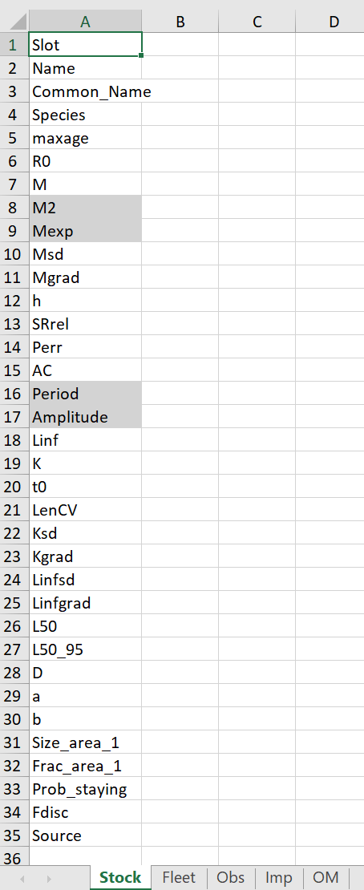
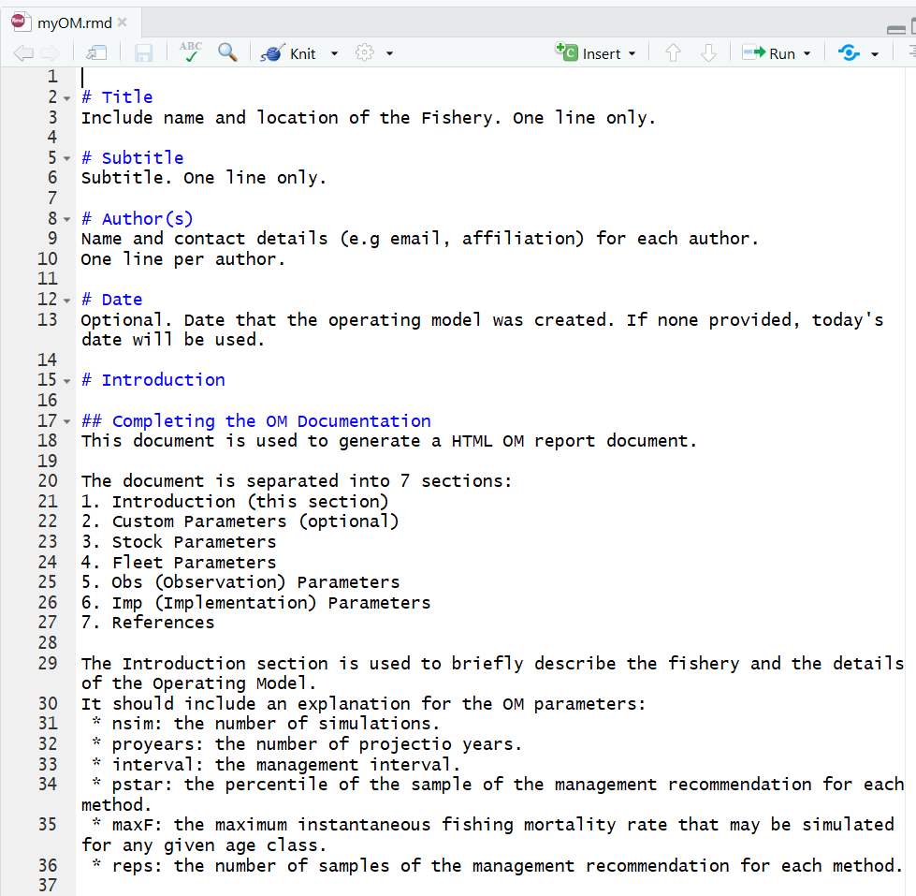
DLMtool CHEAT SHEET 1
Getting Started
Create New OM
OM Excel: myOM.xlsx
OM Report: myOM.rmd
Install package: install.packages('DLMtool')
User Guide: userguide()
Cheat Sheets: cheatsheets()
Website: http://datalimitedtoolkit.org
Report Issues: https://github.com/DLMtool/DLMtool/issues
Blank OM: OM <- new('OM')
New OM from available objects: OM <- new('OM', 'Stock', 'Fleet', 'Obs', 'Imp')
e.g. OM <- new('OM', Albacore, Generic_Fleet, Generic_Obs, Perfect_Imp)
Initialize Excel OM and OM Report: OMinit('myOM')
Import OM from Excel: OM <- XL2OM('myOM')
Generate OM Report: OMdoc()
Acronyms
DLMtool | Data-Limited Methods Toolkit
MP | Management Procedure
MSE | Management Strategy Evaluation
OM | Operating Model
PM | Performance Metrics
Customize OM
Sketch Historical Fishing: Fleet/OM <- ChooseEffort(Fleet/OM)
Sketch Selectivity: Fleet <- ChooseSelect(Fleet, FstYr = …)
Sketch Age Specific M: OM <- ChooseM(OM)
Sketch Length Specific M: OM <- ChooseM(OM, 'Length')
Predicting Life-History Parameters:
e.g. OM <- new('OM')
OM@Species <- 'Scomber japonicus'
OM <- LH2OM(OM)
Custom Parameters:
e.g. OM <- new('OM', Albacore, Generic_Fleet, Generic_Obs, Perfect_Imp)
OM@cpars$M <- rlnorm(OM@nsim, log(0.2), 0.05)
Remove Process and Observation Error: OM <- tinyErr(OM)
Replace OM Component: OM <- Replace(OM, Blue_shark)
Management Procedures
MP Type | Returns
Output | TAC (total allowable catch)
Input | TAE, SL, Spatial (total allowable effort, size limit, spatial closure)
Mixed | Combination of Output and Input
Reference | TAC (assuming perfect data)
Main Object Classes
Class | Contents
Stock | Biological Properties
Fleet | Exploitation Properties
Obs | Observation Error
Imp | Implementation Error
OM | Operating Model
MSE | Management Strategy Evaluation Results
MP | Management Procedure
Find MP type: MPtype()
e.g. MPtype(c('AvC', 'curE', 'matlenlim', 'FMSYref'))
OM = Stock + Fleet
+ Obs + Imp
Find MPs using Data slot: Uses()
e.g. Uses('Mort')
Examine OM
Run MSE
Plot OM Components:
e.g. plot(Albacore)
plot(Generic_Fleet)
Plot OM: plot(OM)
Plot Existing MPA: plotMPA(OM)
Plot M: plotM(OM)
Plot Selectivity: plotSelect(OM)
Run MSE: runMSE()
e.g. MSE <- runMSE(OM,
MPs=c('AvC', 'curE', 'matlenlim', 'FMSYref'))
Run MSE in parallel: runMSE(parallel=TRUE)
e.g. MSE <- runMSE(OM,
MPs=c('AvC', 'curE', 'matlenlim', 'FMSYref'),
parallel=TRUE)
Check Convergence: Converge(MSE)
Run Historical Simulations:
Hist <- runMSE(OM, Hist=TRUE)
Find Available Objects: avail('Object Class')
e.g. avail('Stock')
avail('Fleet')
avail('Obs')
…
avail('MP')
More Objects: DLMextra()
Slot Names: slotNames('Object Class')
e.g. slotNames('Stock')
. CC BY SA Adrian Hordyk • a.hordyk@oceans.ubc.ca • http://datalimitedtoolkit.org • DLMtool version 5.3 • Updated: January 2019

Slide 2
DLMtool CHEAT SHEET 2
Performance Metrics
Subset MSE
Custom MPs
Available PM Functions: avail('PM')
Calculate PM:
e.g. MSE <- runMSE()
P50(MSE)
Subset by MP: MSE2 <- Sub(MSE, MPs= …)
e.g. MSE <- runMSE()
stats <- summary(MSE)
accept <- which(stats$P50 > 0.7)
acceptMPs <- stats[accept, 'MP')
subMSE <- Sub(MSE, MPs=acceptMPs)
Subset by Simulation: MSE2 <- Sub(MSE, sims= …)
e.g. below <- MSE@OM$M < median(MSE@OM$M)
subMSE <- Sub(MSE, sims=below)
Averaging MPs: myMP <- makeMeanMP(MP Names)
e.g. avgMP <- makeMeanMP(c('BK', 'DBSRA', 'Fadapt', 'Rcontrol')
MSE <- runMSE(DLMtool::testOM, MPs=c ('BK', 'DBSRA', 'Fadapt', 'Rcontrol', 'avgMP')
Tplot(MSE)
Example Custom PM:
Calculate Probability F < 2 x FMSY in first 5 years:
myPM <- function(MSEobj=NULL, Ref=2, Yrs=5) {
Yrs <- ChkYrs(Yrs, MSEobj) # validate years
PMobj <- new('PMobj') # create empty PM object
PMobj@Name <- paste0('Probability F/FMSY < ', Ref) # name of PM
PMobj@Caption <- paste0('Probability F/FMSY < ', Ref) # caption
PMobj@Stat <- MSEobj@F_FMSY[, , Yrs[1]:Yrs[2]] # statistic
PMobj@Ref <- Ref # save Reference
PMobj@Prob <- calcProb(PMobj@Stat < PMobj@Ref, MSEobj) # prob.
PMobj@Mean <- calcMean(PMobj@Prob) # average prob.
PMobj@MPs <- MSEobj@MPs # record MPs
PMobj # return PM object
}
class(myPM) <- 'PM' # assign to class 'PM'
summary(MSE, 'myPM') # calculate performance
TradePlot(MSE, 'myPM', 'P50') # trade-off plot with new PM
Pseudo-Code to create new MP:
AvCatchMP <- function(x, Data, reps=100, plot=FALSE) {
AvC <- Data@AvC[x] # access element x from Data object slot
…
Rec <- new('Rec') # create object of class Rec
# slotNames("Rec")
Rec@TAC <- AvC # populate one or more Rec slots
Rec # return Rec object
}
class('AvCatchMP') <- 'MP'
Fishery Data Object
Example Data: avail('Data')
Blank Data: Data <- new('Data')
Initialize Data Excel: DataInit()
Import Data from Excel: Data <- XL2Data()
Plot Data: summary(Data)
Write Data: Data2csv(Data, ‘Data.csv’)
Apply MPs
Apply MP: runMP(Data, 'MP Name')
e.g. All Available MPs: runMP(Atlantic_mackerel)
TAC <- runMP(Atlantic_mackerel, 'AvC')@TAC
Plot TACs:
e.g. Atlantic_mackerel <- runMP(Atlantic_mackerel)
boxplot(Atlantic_mackerel)
Examine MSE Results
Evaluating OM
Summary Results: summary(MSE)
Trade-Off Plots: TradePlot(MSE, PMs)
e.g. TradePlot(MSE, 'P50', 'AAVY')
Tplot(MSE)
Tplot2(MSE)
NOAA_plot(MSE)
Projection Plots:
Pplot(MSE)
Pplot2(MSE)
Kobe Plot: Kplot(MSE)
Value of Information:
VOI(MSE) VOI2(MSE)
VOIplot(MSE)
VOIplot2(MSE)
Other Plots:
COSEWIC_Hplot(MSE)
Cplot(MSE)
DFO_plot(MSE)
DFO_plot2(MSE)
DFO_proj(MSE)
IOTC_plot(MSE)
PWhisker(MSE)
wormplot(MSE)
Compare Simulated and Actual Data:
Turing(OM, Data)
Management Procedures
Posterior Predicted Data
Available MPs: Can(Data)
Unavailable MPs: Cant(Data)
Feasible MPs: ?Fease
e.g. All Management Options: Fease(Data) = Can(Data)
TAC Only: Fease(Data, TAE=FALSE,
SL=FALSE, Spatial=FALSE)
Size Reg. Only: Fease(Data, TAC=FALSE,
TAE=FALSE, Spatial=FALSE)
Generate Predicted Data from MP application:
e.g. MSE <- runMSE(MPs="DCAC", PPD=TRUE)
Predicted_Ind <- MSE@Misc$Data[[1]]@Ind
matplot(t(Predicted_Ind), type='l',
xlab='Projected Year', ylab='Index value')
. CC BY SA Adrian Hordyk • a.hordyk@oceans.ubc.ca • http://datalimitedtoolkit.org • DLMtool version 5.3 • Updated: January 2019

