Slide 1

EMBASSY GUARD

Slide 2
TABLE OF CONTENTS
01.The problem
02.The solution
03.The product
This section is about the problem I’m trying to solve
This section is about the solution to the specified problem
This section shows the product core features
04.Mind map
05.Technologies
06.Project plan
This section shows our target audience
This section shows the technologies that will be used
This section will show our project plan.

Slide 3

01.
THE PROBLEM

Slide 4

01.The problem
The Nigeria Embassy Kigali faces a real communication hurdle - you can't just reach out to them when needed. Visits are a must, making it tough to share or get crucial updates unless you're physically there. Even worse, there's no system in place to keep the public in the loop about emergencies or crises. This lack of info leaves everyone in the dark about urgent situations

Slide 5



02.
THE SOLUTION

Slide 6
02.The Solution
By implementing this system, we aim to address the challenges of inaccessibility and the lack of real-time communication, enabling individuals to connect with the embassy seamlessly, anytime, anywhere.
our solution includes an advanced alert system designed to disseminate real-time updates on emergencies and crises. This revolutionary system not only enhances public awareness but also fosters a proactive approach to crisis management.

Slide 7
03.
THE PRODUCT

Slide 8


03.The Product
This EMBASSY GUARD is a new system that Will allow users to access it at anytime.

Slide 9


Core Features
Communication
Emergency Alert
Evacaution
User will be able to
communicate with
embassy
User will be able to
received Alert
Users will be able to
see guide during crises
Reports
Resource Allocation
Update News
Users will received
recent updates news
It will display report
Users will be able to see the
equipment's and suppliers

Slide 10
Core Features
Create Account
Assembly point
Members
Users will be able
to create account
User’s are allow to have
access to assembly during crises
Users can communicate
with other members
View Analysis
GPs tracker
Users will be able to
View analysis in dashboard
The GPs will tracking
the location upon login

Slide 11
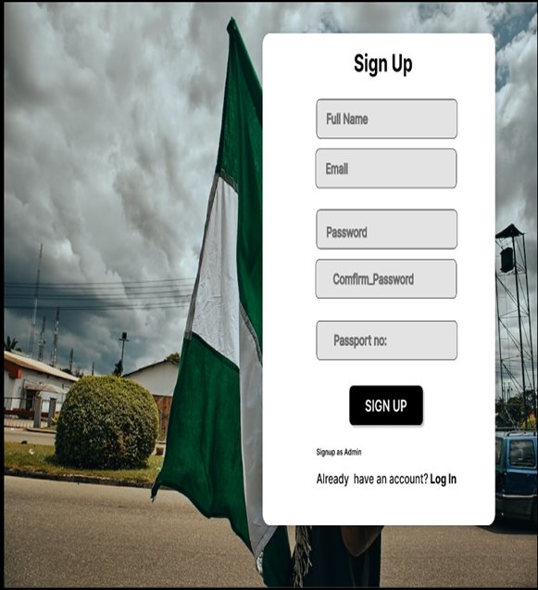
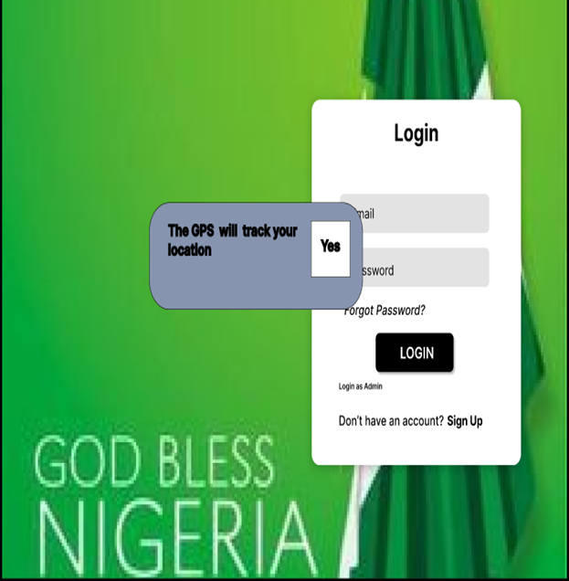
APP Design

Slide 12
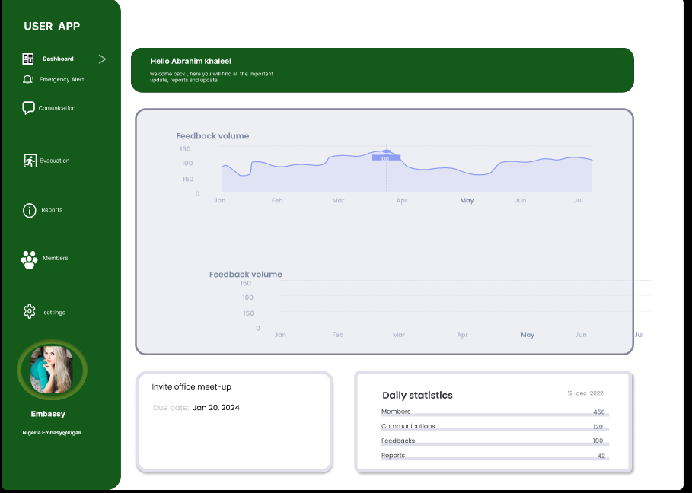
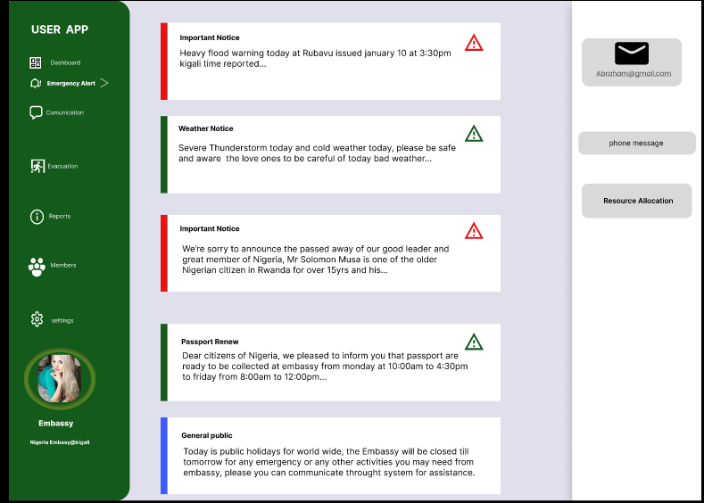
APP Design

Slide 13
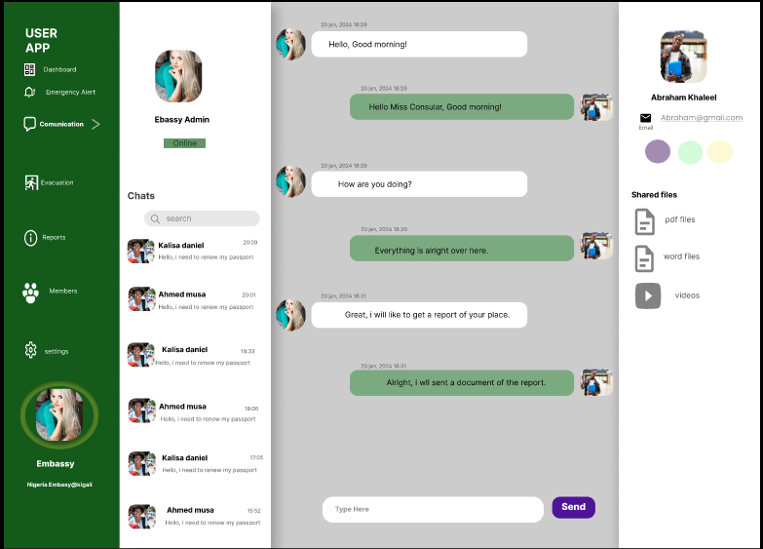
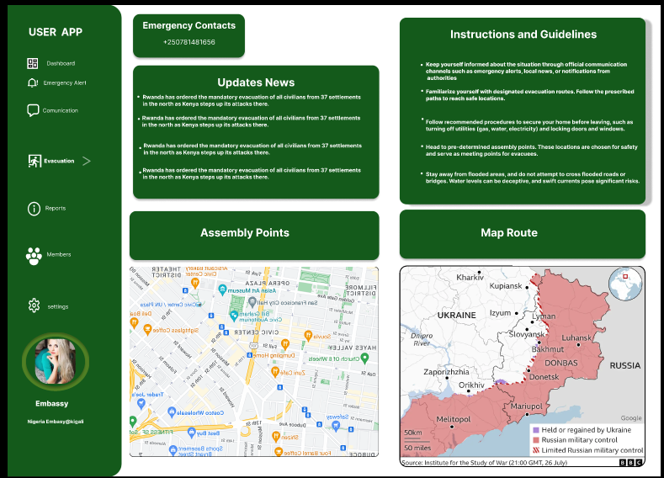
APP Design

Slide 14
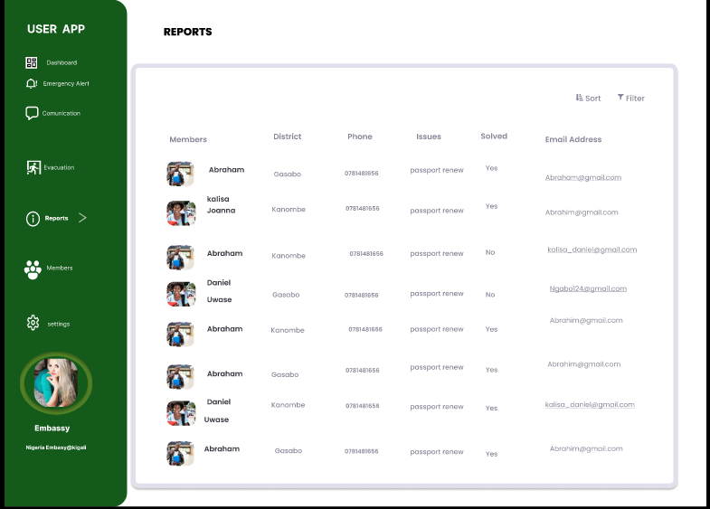
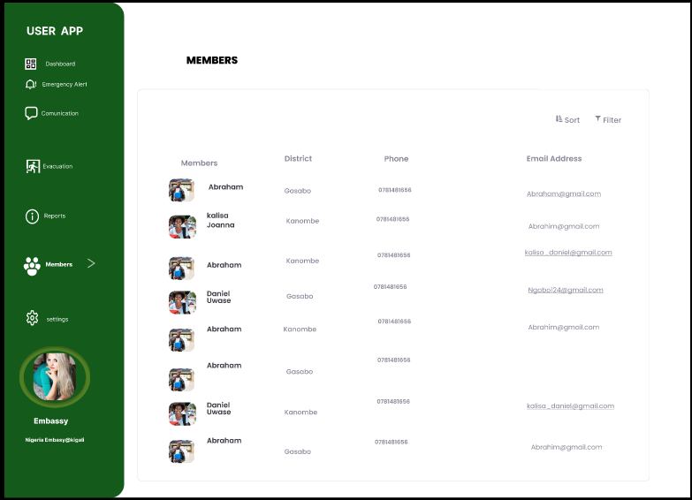
APP Design

Slide 15
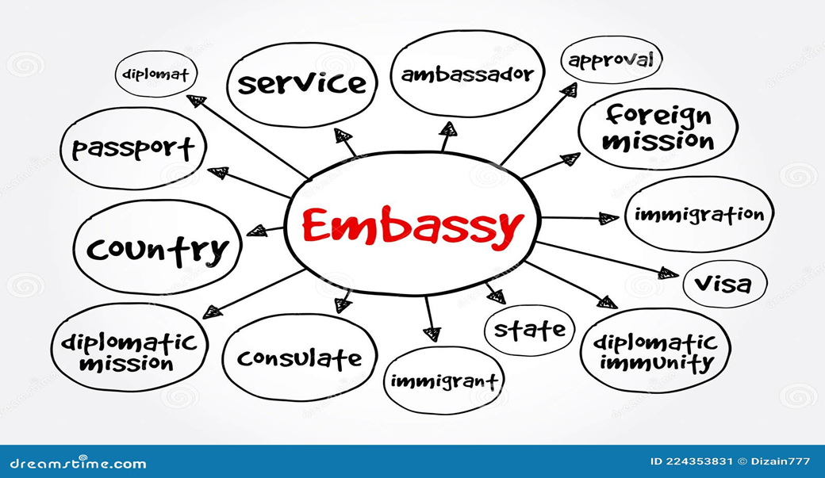
Mind Map

Slide 16
05.
TECHNOLOGY

Slide 17
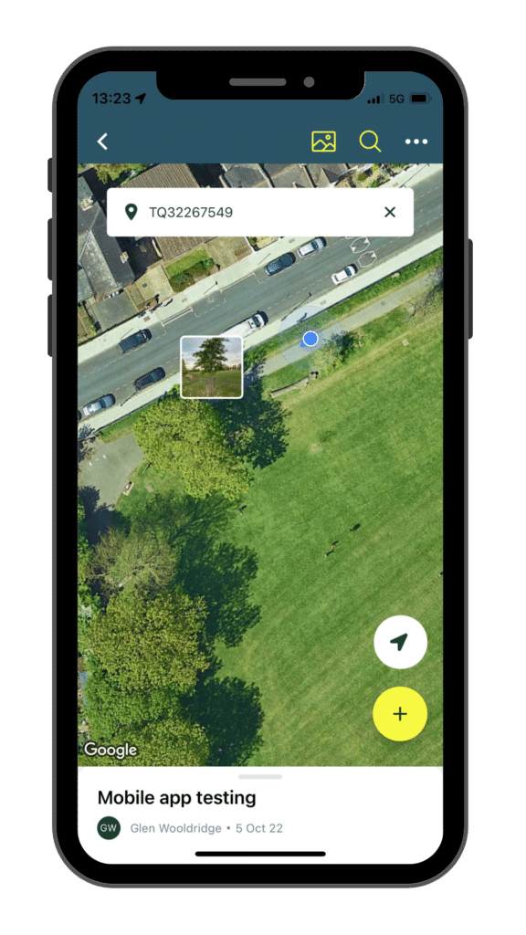
Technologies that will be used are:
Front end
1. HTML5
2. CSS
3. JavaScript
Back end
1. Python(Django)
2. MySQL

Slide 18









Project Goals
BRANCH VISITS
FAST RESPONSE
Reduce the number
of citizens visit
To be fastest response thant meeting
COMMUNICATION CHANNELS
SAVE COST AND TIME
Users will not spent on cost of transport
Multiples ways of communication

Slide 19







Project Stages
Gather requirements
Design & Prototyping
Implementation/Coding
Planning
Testing
Deployment
Maintenance

Slide 20


THANK YOU FOR LISTENING !
By: IBRAHIM KHALIL IBRAHIM
Software Engineering
ID:23330
Email: Ibrahim.khalil.ibrahim90.com

