Slide 1

Optimal Design of Dual Band Band pass Filter using Stepped-Impedance Resonators
Project Batch No. 25
TEAM MEMBERS:
BH .V.L.S.D.N.JYOTHI 17B01A0410
D. SATYASRI V L PRASANNA 17B01A0427
B. SAI SRILEKHA 17B01A0413
D. LALITHA PRASANNA 17B01A0461
PROJECT GUIDE
MR. G. CHALLA RAM
Assistant Professor , M.Tech(Ph.D)
DEPARTMENT OF ELECTRONICS AND COMMUNICATION ENGINEERING
SHRI VISHNU ENGINEERING COLLEGE FOR WOMEN :: BHIMAVARAM
(AUTONOMOUS)

Slide 2
OUTLINE
MOTIVATION
OBJECTIVE
BACKGROUND
LITERATURE SURVEY
PROBLEM IDENTIFICATION AND PROPOSED SOLUTION
MATHEMATICAL FOUNDATIONS OF THE PROJECT
PROJECT IMPLEMENTATION DETAILS
FLOW CHART
SIMULATION RESULTS
TOOLS REQUIRED
CONCLUSION
TIMELINE
REFERENCES

Slide 3
MOTIVATION
As tremendous demand for Multi-band bandpass filters (BPFs) with excellent performance and compact size is need of an hour .Due to the distinct properties of multiband BPFs, such as wide rejection band, deep transmission zeros, high selectivity, sharp roll-off rate, and tunable behavior, they have a specific place in the RF receivers.
Therefore, this method demonstrates good dual-pass band performance with sharpened out-of-band rejection skirts and deepened mutual band isolation.

Slide 4
OBJECTIVES
To design a Dual-band band pass filter using Quarter wavelength SIR with pass bands at 5.8GHz and 1.8GHz .
To improve the characteristics, SIR's are sequentially cascaded by alternative J and K inverters.

Slide 5
BACKGROUND
This project provides a generalized synthesis method for the design of novel dual-band band pass filter using microstrip-line topology.
It is an essential component for integration of miniaturized Dual-band systems.
DUAL-BAND BANDPASS FILTER:
Dual-band band pass filters (BPFs) provide the functionality of two separate filters, but in the size of a single filter.

Slide 6
QUATER-WAVELENGTH STEPPED-IMPEDANCE RESONATORS(SIRS):
Fundamental resonant elements that can operate from RF to millimeter-wave frequencies and can be used in many kinds of filters, oscillators and mixers.
Quarter wave SIRs features a large central frequency ratio and small circuit size compared to others.
J AND K INVERTERS:
Impedance and Admittance.
Inverters are two-port networks used in many RF and microwave filters.
They are used to convert a series element into a shunt element.
It is much easier to realize shunt elements in distributed circuits than series elements.

Slide 7
LITERATURE SURVEY
Title | Dual-band micro strip band pass filter using stepped-impedance resonators with new coupling scheme
Author | Y. P. Zhang and M. Sun
Journal Name | IEEE Trans. Microw. Theory Techn., vol. 54, no. 10, pp. 3779–3785, Oct. 2006
Type of filter | Dual band band pass filter
Type of structure | stepped-impedance resonators
Observation | A micro strip band pass filter using stepped-impedance resonators with two new coupling schemes was designed, fabricated, and tested in LTCC technology for dual-band applications at 2.4 and 5.2 GHz. It was shown that the measured and simulated performances are in good agreement.

Slide 8
LITERATURE SURVEY
Title | Synthesis method for even-order symmetrical Chebyshev band pass filters with alternative J/K inverters and λ/4 resonators
Author | S. Zhang and L. Zhu
Journal Name | IEEE Trans. Microw. Theory Techn., vol. 61, no. 2, pp. 808–816, Feb. 2013.
Type of filter | Chebyshev band pass filter
Type of structure | J/K inverters and λ/4 resonators
Observation | In this project, they proposed about a detail synthesis method for the even-order Chebyshev band pass filter based on the λ/4 micro strip line resonators and alternatives J/K inverters. Two groups of Chebyshev band pass filters with the fourth- and sixth-order number are designed and fabricated.

Slide 9
LITERATURE SURVEY
Title | Synthesis Design of Dual-Band Band pass Filters With λ/4 Stepped-Impedance Resonators
Author | Songbai Zhang and Lei Zhu
Journal Name | IEEE transactions on microwave theory and techniques, vol. 61, no. 5, May 2013.
Type of filter | Dual-Band Band pass Filters
Type of structure | λ/4 Stepped-Impedance Resonators
Observation | It demonstrates good dual-pass band performance with sharpened out-of-band rejection skirts and deepened mutual band isolation as highly desired in filter design.

Slide 10
PROBLEM IDENTIFICATION AND PROPOSED SOLUTION
The challenges faced while designing dual-band BPF are pass band selectivity, compact size and simple design procedures.
To overcome this a pair of quarter-wave stepped-Impedance resonators are used due to advantage of their harmonic frequency behavior, simple structure and simple established design methodology.

Slide 11
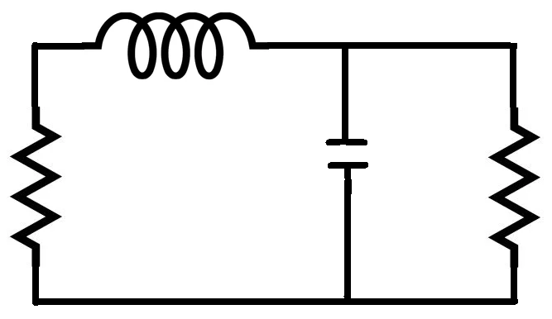
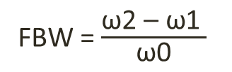
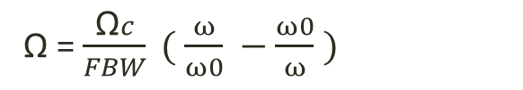

MATHEMATICAL FOUNDATIONS OF THE PROJECT
Our design of dual band band pass filter will start at with a simple low pass filter with resonant frequency of 1.8 GHz and 5.8 GHz.
FREQUENCY AND ELEMENT TRANSFORMATIONS
A low pass prototype response is to be transformed to a band pass response having a pass band ω2 − ω1, where ω1 and ω2 indicate the pass band-edge angular frequency. The required frequency transformation is
Where ω0 denotes the center angular frequency and FBW is defined as the fractional bandwidth.
g1
g0
g2
g3
Fig.1 : Prototype low pass filter for n=2
Ω = $\frac{\text{Ω}c}{FBW} ( \frac{ω}{ω0} −\frac{ω0}{ω} )$
FBW = $\frac{\text{ω}\text{2 – }\text{ω}\text{1} }{\text{ω}\text{0}}$
$\text{ω}\text{0}$ = $\sqrt{\text{ω}\text{1}\text{∗}\text{ω}\text{2}}$

Slide 12


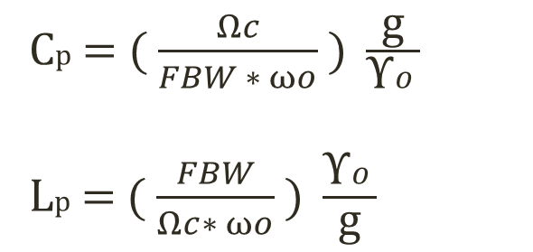
On applying the frequency transformation to reactive element g of the low pass prototype, is given by
which implies that an inductive/capacitive element g in the low pass prototype will transform to a series/parallel LC resonant circuit in the band pass filter.
The elements for the series LC resonator in the band pass filter are
(Where g representing the inductance)
The elements for the parallel LC resonator in the band pass filter are
(where g representing the capacitance)
jΩg jω$\frac{\text{g}\text{∗}\text{Ω}c}{FBW∗ ω0}$ + $\frac{1}{\text{j}\text{ω}}$ $\frac{ω0\text{ ∗}\text{g}\text{∗}\text{Ω}c}{FBW}$
Ls = ( $\frac{Ωc}{FBW ∗ ωo} )$ϒ0 *g
Cs = ( $\frac{FBW}{Ωc∗ ωo} ) \frac{1}{\text{ϒ}\text{o}\text{ ∗}\text{g} }$
Cp = ( $\frac{Ωc}{FBW ∗ ωo} ) \frac{\text{g}}{\text{ϒ}o}$
Lp = ( $\frac{FBW}{Ωc∗ ωo} ) \frac{\text{ϒ}o}{\text{g}}$

Slide 13
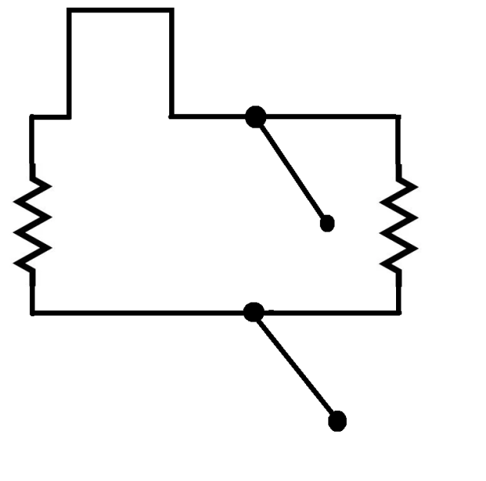
RICHARDS’ TRANSFORMATION
Richards transformation allows us to replace lumped inductors with short circuit stubs and capacitors with open circuit stubs of characteristic impedance Z0= 1/C.
Z’1
Z’A = g0
Z’B = 1/g3
Y’2
Fig.2 : After applying Richards transformation.

Slide 14

STEPPED IMPEDANCE RESONATOR
W1
W2
ϴ2
ϴ1
Fig.3 : STEPPED IMPEDANCE RESONATOR
The impedance values of open circuit stubs and short circuit stubs are represented in the micro strip line format.
Where w1,w2 are widths of micro strip line and ϴ1, ϴ2 are the electrical lengths

Slide 15

PROJECT IMPLEMENTATION DETAILS
The physical dimensions are l1= 2.15mm , w1 = 8.35mm; l2 = 0.5mm, w2 = 7.825mm; l3 = 7.85mm, w3 = 0.45mm; l4 = 2mm, w4 = 9mm; l5 = 1.1mm, w5 = 6.4mm; l6 = 2mm, w6 = 9mm; l7 = 7.85mm, w7 = 0.45mm; l8 = 0.5mm , w8 = 7.85mm; l9 = 2.15mm, w9 = 8.35mm; l10 = 1mm, w10 = 0.6mm.
w1
w2
w8
w9
l9
l1
l3
l7
Port 1
w4
w5
w6
Port 2
l4
l6
l10
w10
Fig.4 : Second-order dual-band band-pass filter type 1 at 1.8 and 5.8 GHz.

Slide 16



Impedance Transformer
The dual-band impedance transformer, as shown in Fig. 5,feeds the λ/4 SIRs to meet the specified dual-band external coupling degrees.
lt
$\text{Z}\text{0 }$= 50Ω
Dual Band Impedance Transformer
lt
l3
$$\text{Z}\text{L}$$
$$jB$$
l1
l2
Fig.5 :Schematic of a dual-band impedance transformer attached to a λ/4 SIR.

Slide 17

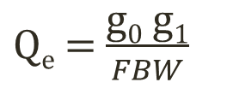
The required external quality factor of the singly loaded resonator is expressed as Qe
FBW means Fractional Band Width
The external impedance seen from the SIR can be expressed as
A dual-band impedance transformer is introduced so that I/O ports’ 50-Ω impedance can match well with external impedance ZL at two central frequencies.
$\text{Q}\text{e}$ = $\frac{\text{g}\text{0} \text{g}\text{1}}{FBW}$
$$\text{Z}\text{L}\text{ =}{\left.\text{Qe}{\left(\frac{f}{2}\frac{dB}{df}\right)}^{−1}\right|}_{\text{f}\text{ = }\text{f}\text{′}\text{0,} \text{f}\text{′′}\text{0}}$$

Slide 18
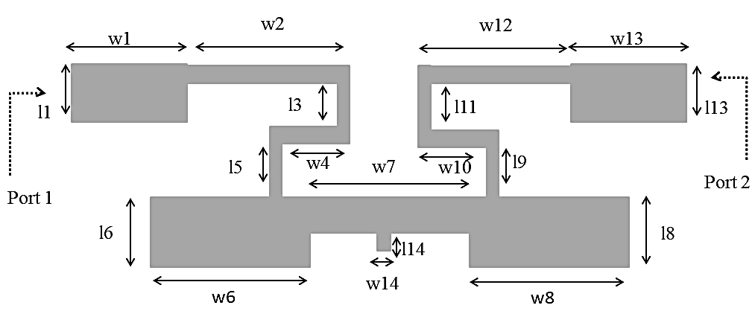
The physical dimensions of Type-II are l1 = 11.75mm, w1 = 2.15 mm; l2 = 0.5 mm, w2 = 7.825 mm; l3 = 2.775 mm, w3 = 0.45 mm; l4 = 0.45 mm, w4 = 3.65 mm; l5 = 2.525 mm, w5 = 0.45 mm; l6 = 2 mm, w6 = 9.2 mm; l7 = 1.1 mm, w7 = 6 mm; l8 = 2 mm, w8 = 9.2 mm; l9 = 2.525 mm, w9 = 0.45 mm; l10 = 0.45 mm, w10 = 3.65 mm; l11 = 2.775 mm, w11 = 0.45 mm; l12 = 0.5 mm, w12 = 7.825 mm; l13 = 11.75 mm, w13 = 2.15 mm; l14 = 1 mm, w14 = 0.6 mm.
Fig.6 : Second-order dual-band band-pass filter type 2 at 1.8 and 5.8 GHz.

Slide 19
The design is a dual-band band pass filter based on miniaturized λ/4 SIRs. Where λ /4 is coupled by alternative j and k invertors.
While designing dual band pass filter we are designing 2 SIR’s in their first 2 resonant modes in 2 specified bands.
Quarter wavelength SIR in application point of view is widely used in designing band pass filter than half wavelength SIR. Quarter wavelength SIR’s have large central frequency and small circuit size compared to half-wavelength SIR.
Main advantage of SIR is that resonance frequency can tuned by adjusting impedance ratio of high z and low z.

Slide 20
Design Layout
1.27 mm
Copper
1.27 mm
Rogers RT/duroid 6010/6010LM (tm)
8 mm
Vacuum
Fig.7 : Side view of three dimensional model of dual band band pass filter`
SOLIDS
Box Substrate : It is in the form of cube using material Rogers RT/duroid 6010/6010LM (tm) of lengths 20 mm, 40 mm, 1.27 mm.
Box Vacuum: It is in the form of cube using material Vacuum of lengths 40 mm, 60 mm, 8 mm.
Cylinder : It is in the form of cylinder using material copper of radius 0.2 mm, height -1.27 mm.

Slide 21
SHEETS (for Type 1)
Lumped Ports : Here we use two lumped ports in the form of rectangles of lengths 2.15 mm, -1.27 mm. In this the two lumped ports will have same lengths.
Perfect E : In this we use total of 11 rectangles
Ground Plane : It is in the form of rectangle of lengths 20 mm, 40 mm.
L1 : It is in the form of rectangle of lengths 2.15 mm, 8.35 mm.
L2 : It is in the form of rectangle of lengths 0.5 mm, 7.825 mm.
L3 : It is in the form of rectangle of lengths 7.85 mm, 0.45 mm.
L4 : It is in the form of rectangle of lengths 2 mm, 9 mm.
L5 : It is in the form of rectangle of lengths 1.1 mm, 6.4 mm.
L6 : It is in the form of rectangle of lengths 2 mm, 9 mm.
L7 : It is in the form of rectangle of lengths -7.85 mm, 0.45 mm.
L8 : It is in the form of rectangle of lengths 0.5 mm, 7.825 mm.
L9 : It is in the form of rectangle of lengths 1 mm, 0.6 mm.
L10 : It is in the form of rectangle of lengths 2.15 mm, 8.35 mm.
From L1 to L10 we will consider as 50 ohm line.

Slide 22
SHEETS (for Type 2)
Lumped Ports : Here we use two lumped ports in the form of rectangles of lengths 2.15 mm, -1.27 mm. In this the two lumped ports will have same lengths.
Perfect E : In this we use total of 14 rectangles
Ground Plane : It is in the form of rectangle of lengths 20 mm, 40 mm.
L1 : It is in the form of rectangle of lengths 11.75mm, 2.15 mm.
L2 : It is in the form of rectangle of lengths 0.5 mm, 7.825 mm.
L3 : It is in the form of rectangle of lengths 2.775 mm, 0.45 mm.
L4 : It is in the form of rectangle of lengths 0.45 mm, 3.65 mm.
L5 : It is in the form of rectangle of lengths 2.525 mm, 0.45 mm.
L6 : It is in the form of rectangle of lengths 2 mm, 9.2 mm.
L7 : It is in the form of rectangle of lengths 1.1 mm, 6 mm.
L8 : It is in the form of rectangle of lengths 2 mm, 9.2 mm.
L9 : It is in the form of rectangle of lengths 2.525 mm, 0.45 mm.
L10 : It is in the form of rectangle of lengths 0.45 mm, 3.65 mm.
L11 : It is in the form of rectangle of lengths 2.775 mm, 0.45 mm.
L12 : It is in the form of rectangle of lengths 0.5 mm, 7.825 mm.
L13 : It is in the form of rectangle of lengths11.75 mm, 2.15 mm.
L14 : It is in the form of rectangle of lengths 1 mm, 0.6 mm.
From L1 to L14 we will consider as 50 ohm line_1.

Slide 23
FLOW CHART
Start
Select Resonant Frequency
Mathematical Analysis
Design of Proposed model
Obtain Micro-strip line Dimensions
No
Assign excitations and boundary
Verify design model and its parameters
Yes
HFSS Simulation
Results
End

Slide 24
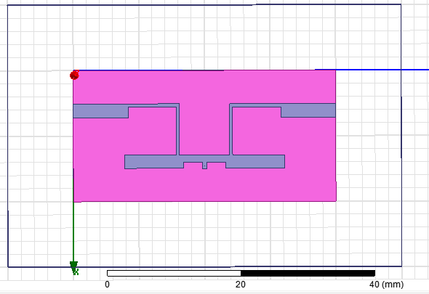
SIMULATION RESULTS
Fig.8 : Proposed layout of Second Order Dual Band Band Pass Filter of Type I at 1.8 and 5.8 GHz.

Slide 25
Fig.10 : Simulated results of Second Order Dual Band Band Pass Filter of Type I at S(1,1) parameter

Slide 26
Pass Band 1
Pass Band
2
TZ1
Fig.9 : Simulated results of Second Order Dual Band Band Pass Filter of Type I at S(2,1) parameter

Slide 27
Pass Band 1
Pass Band
2
TZ1
Fig.11 : Simulated results of band pass filter Type I at both S(1,1) & S(2,1) parameter
The resonant frequencies for the first and second pass bands are 1.8GHz and 5.8GHz respectively.
A transmission zero has been observed at 2.7GHz for the Type I design.

Slide 28
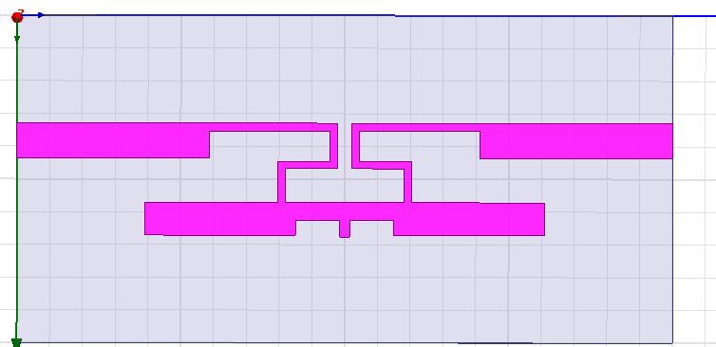
Fig.12 : Proposed layout of Second Order Dual Band Band Pass Filter Type II at 1.8 and 5.8 GHz.

Slide 29
Fig.13 : Simulated results of Second Order Dual Band Band Pass Filter Type II at S(1,1) parameter

Slide 30
Pass Band 1
Pass Band 2
TZ3
TZ1
TZ2
Fig.14 : Simulated results of Second Order Dual Band Band Pass Filter Type II at S(2,1) parameter

Slide 31
Pass Band 1
Pass Band 2
TZ3
TZ1
TZ2
Fig.15 : Simulated results of Second Order Dual Band Band Pass Filter Type II at both S(1,1) & S(2,1) parameter
The resonant frequencies for the first and second pass bands are 1.8GHz and 5.8GHz respectively.
A transmission zeroes has been observed are 2.7GHz, 4.7GHz and 6.3GHz for the type II design.

Slide 32

TOOLS REQUIRED
HFSS Software (HFSS.15)

Slide 33
CONCLUSION
A synthesis method for Dual-Band micro-strip Band pass filter at central frequencies of 1.8GHz and 5.8GHz has been designed using λ/4 SIRs. Further the design has been modified by the fusion of J and K inverters. In proposed design with inverters the transmission lines are placed close to each other, which leads to reduction in overall circuit size. This improved design has also produced two transmission zeros at 4.7 and 6.3GHz. The inclusion of these transmission zeros have shown good out-of-band rejection which is highly desirable in filter design.

Slide 34
TIMELINE
ACTIVITY/TIMELINE | April |  | May |  | June | July
Literature Survey
Problem Identification
Design & Simulation
Documentation

Slide 35
REFERENCES
S. Zhang and L. Zhu, “Synthesis method for even-order symmetrical Chebyshev bandpass filters with alternative J/K inverters and λ/4 resonators,” IEEE Trans. Microw. Theory Techn., vol. 61, no. 2, pp. 808–816, Feb. 2013.
J. Ha, S. Lee, B. W. Min, and Y. Lee, “Application of stepped-impedance technique for bandwidth control of dual-band filters,” IEEE Trans. Microw. Theory Techn., vol. 60, no. 7, pp. 2106–2114, Jul. 2012.
S. Zhang, L. Zhu, and R. Li, “Compact quadruplet bandpass filter based on alternative J/K inverters and λ/4 resonators,” IEEE, Microw. Wireless Compon. Lett., vol. 22, no. 5, pp. 224–226, May 2012.
Songbai Zhang and Lei Zhu " Synthesis Design of Dual-Band Band pass Filters With λ/4 Stepped-Impedance Resonators" IEEE transactions on microwave theory and techniques, vol. 61, no. 5, May 2013.
Y. P. Zhang and M. Sun, “Dual-band micro strip band pass filter using stepped-impedance resonators with new coupling scheme,” IEEE Trans. Microw. Theory Techn., vol. 54, no. 10, pp. 3779–3785, Oct. 2006.

Slide 36

ANY QUERIES or SUGGESTIONS ?

