Slide 1
Introduction
Working principle
Design Innovations
Selection and Significance of Materials
Analysis and Interpretation

Slide 2
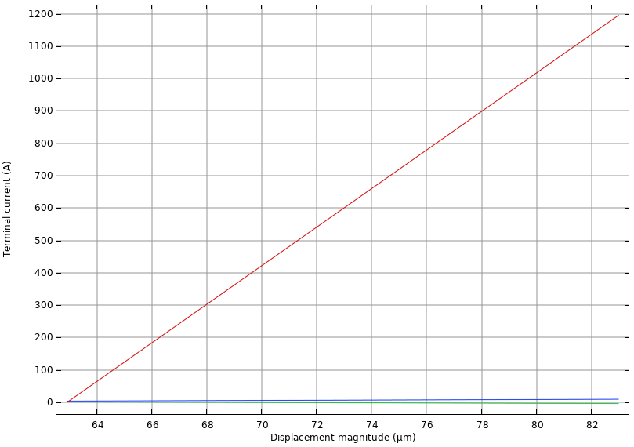


Slide 3


Slide 4
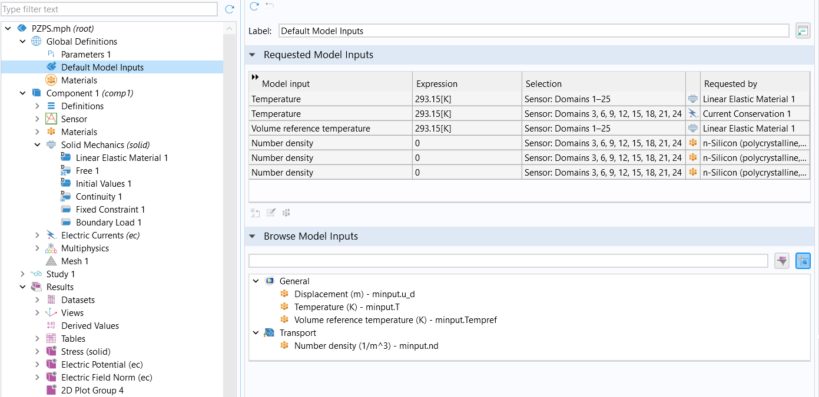

Slide 5
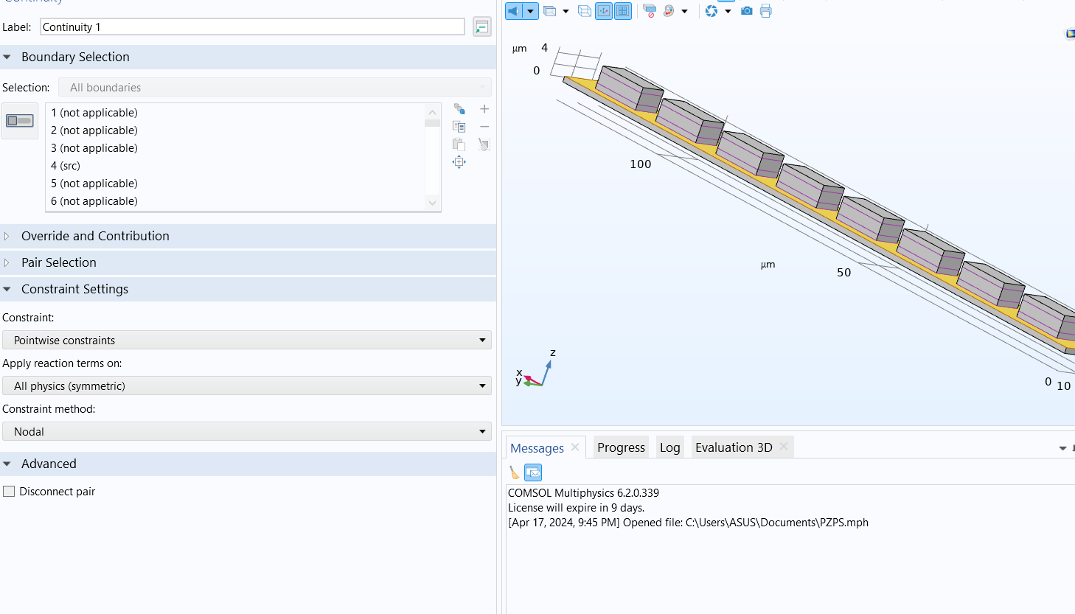

Slide 6
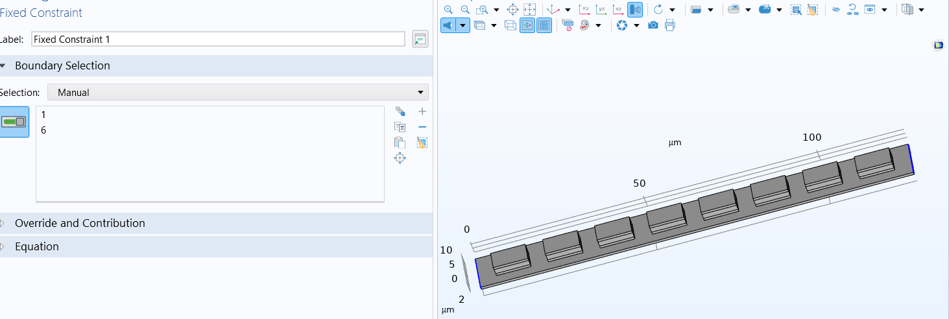

Slide 7
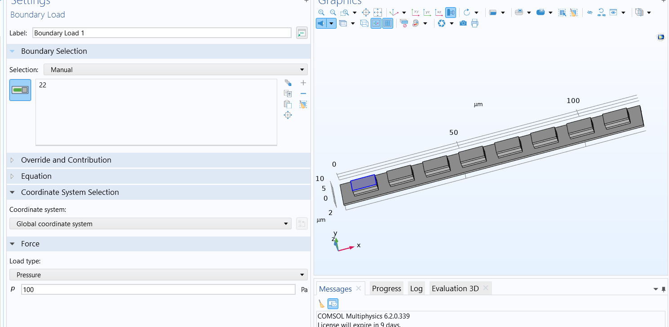

Slide 8
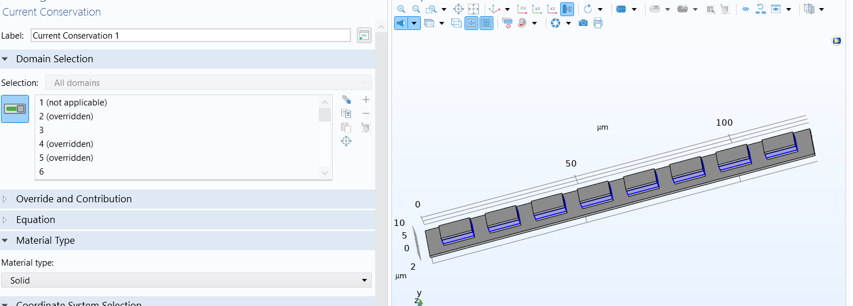

Slide 9
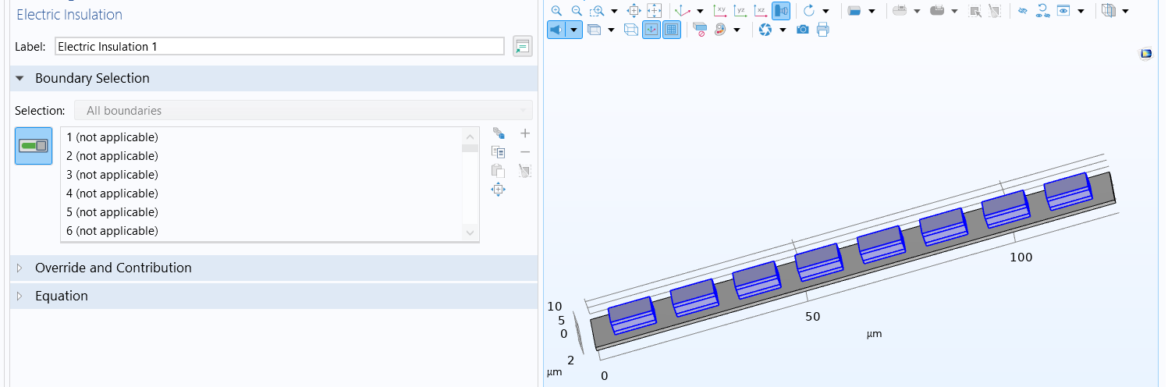

Slide 10
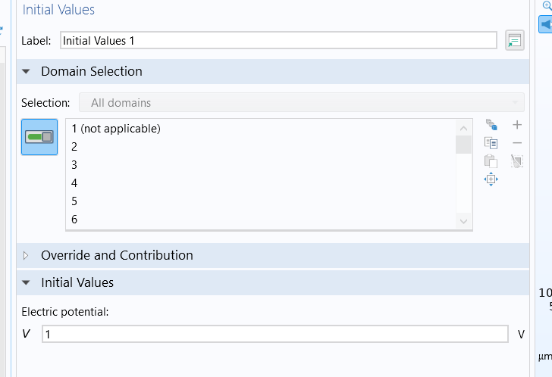

Slide 11
Micrometer | Substrate | E1 | P1 | E1_1 | E2 | P2 | E2_1 | E3 | P3 | E3_1 | E4 | P4 | E4_1 | E5 | P5 | E5_1 | E6 | P6 | E6_1 | E7 | P7 | E7_1 | E8 | P8 | E8_1
Width | 125 | 10 | 10 | 10 | 10 | 10 | 10 | 10 | 10 | 10 | 10 | 10 | 10 | 10 | 10 | 10 | 10 | 10 | 10 | 10 | 10 | 10 | 10 | 10 | 10
Depth | 10 | 5 | 5 | 5 | 5 | 5 | 5 | 5 | 5 | 5 | 5 | 5 | 5 | 5 | 5 | 5 | 5 | 5 | 5 | 5 | 5 | 5 | 5 | 5 | 5
Height | 1 | 1 | 1 | 1 | 1 | 1 | 1 | 1 | 1 | 1 | 1 | 1 | 1 | 1 | 1 | 1 | 1 | 1 | 1 | 1 | 1 | 1 | 1 | 1 | 1
position
X | 0 | 5 | 5 | 5 | 20 | 20 | 20 | 35 | 35 | 35 | 50 | 50 | 50 | 65 | 65 | 65 | 80 | 80 | 80 | 95 | 95 | 95 | 110 | 110 | 110
Y | 0 | 2.5 | 2.5 | 2.5 | 2.5 | 2.5 | 2.5 | 2.5 | 2.5 | 2.5 | 2.5 | 2.5 | 2.5 | 2.5 | 2.5 | 2.5 | 2.5 | 2.5 | 2.5 | 2.5 | 2.5 | 2.5 | 2.5 | 2.5 | 2.5
Z | 0 | 1 | 2 | 4 | 1 | 2 | 4 | 1 | 2 | 4 | 1 | 2 | 4 | 1 | 2 | 4 | 1 | 2 | 4 | 1 | 2 | 4 | 1 | 2 | 4
All are in µm

Slide 12
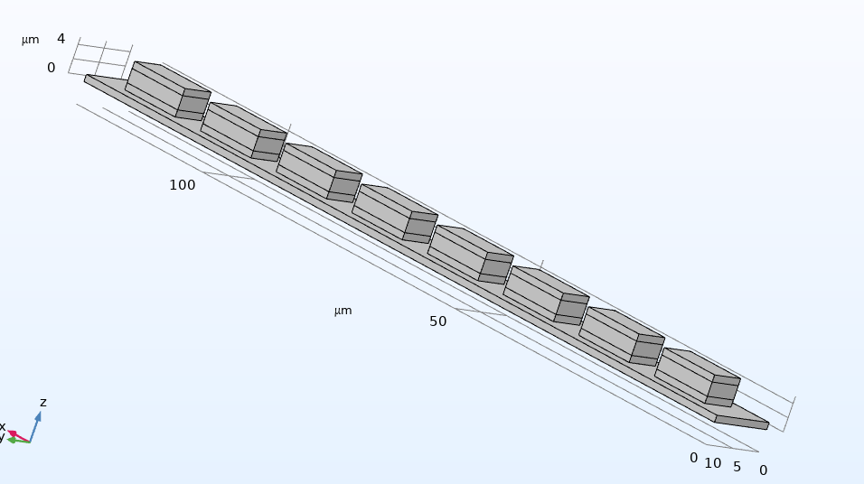
Design

Slide 14
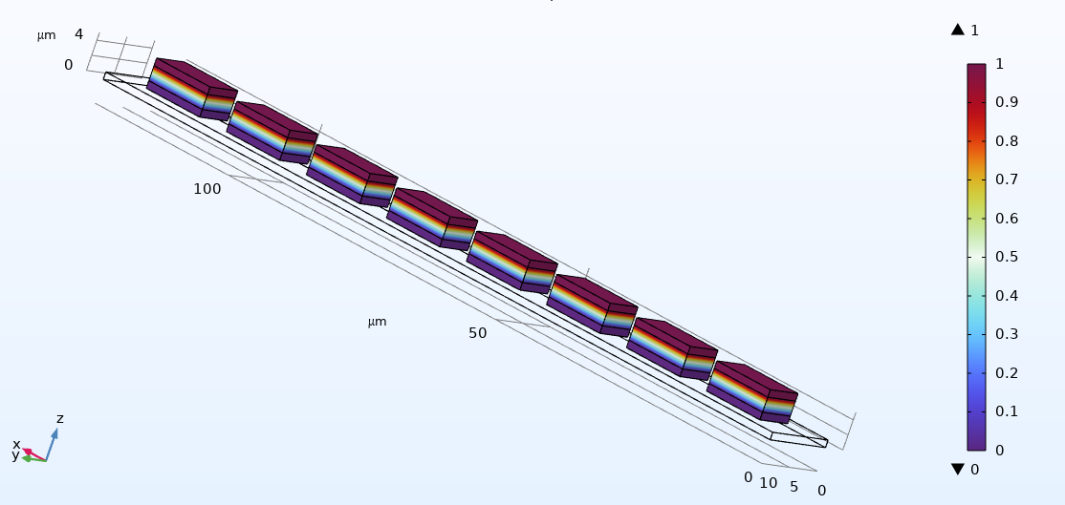
Electric Potential

Slide 15
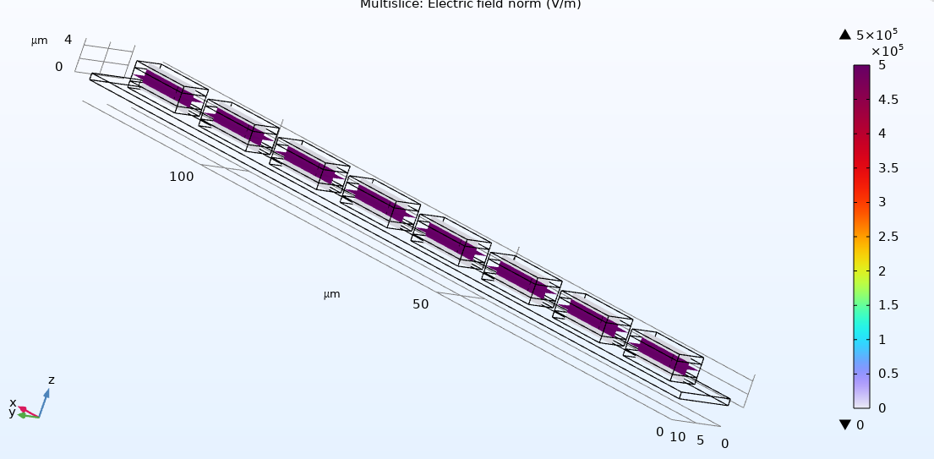
Electric Field Norm

Slide 16
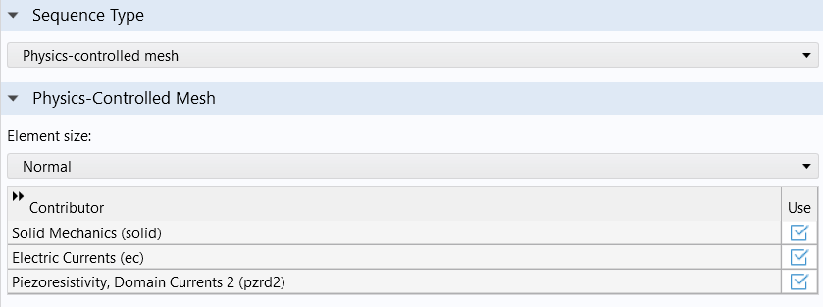
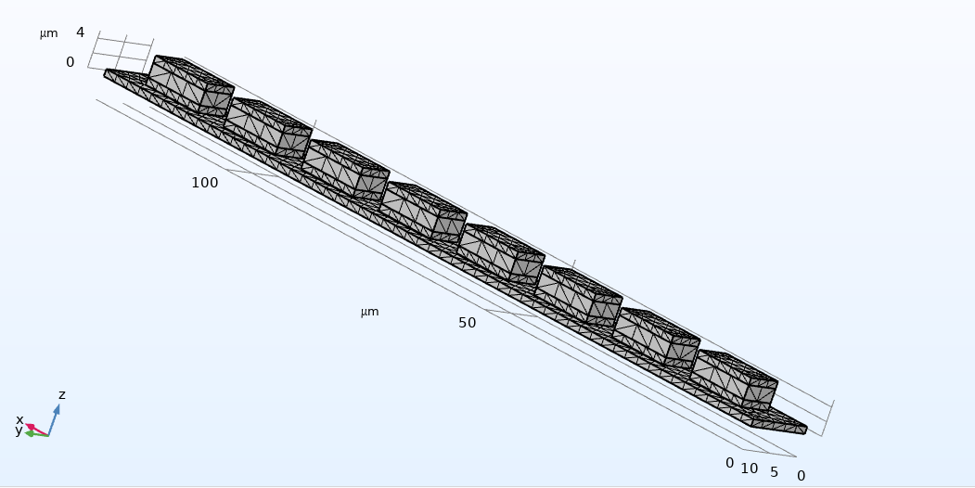
Mesh

Slide 17
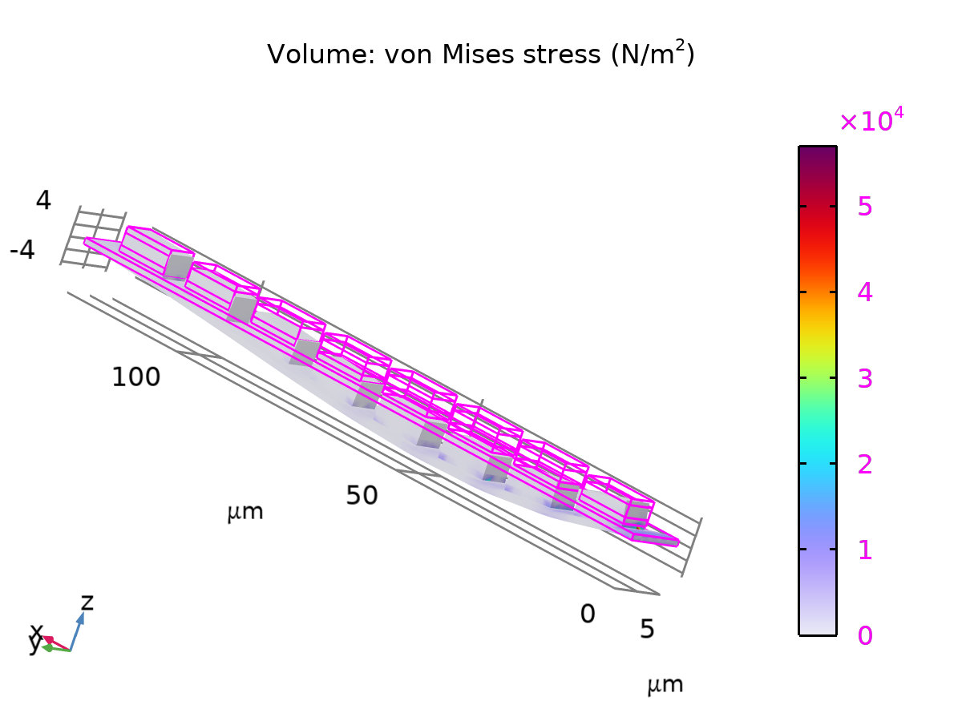
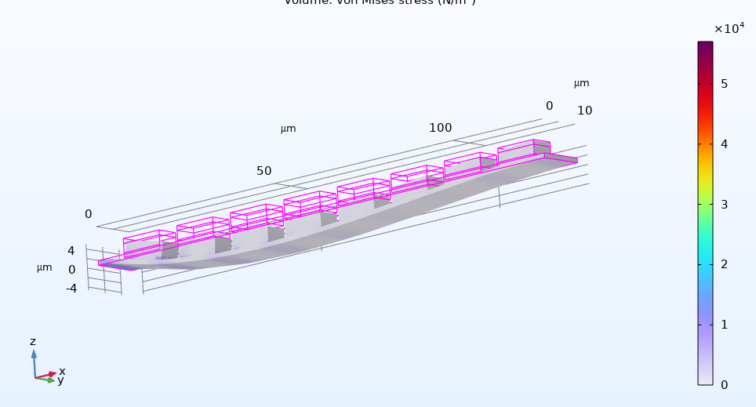
Stress 100pa

Slide 18
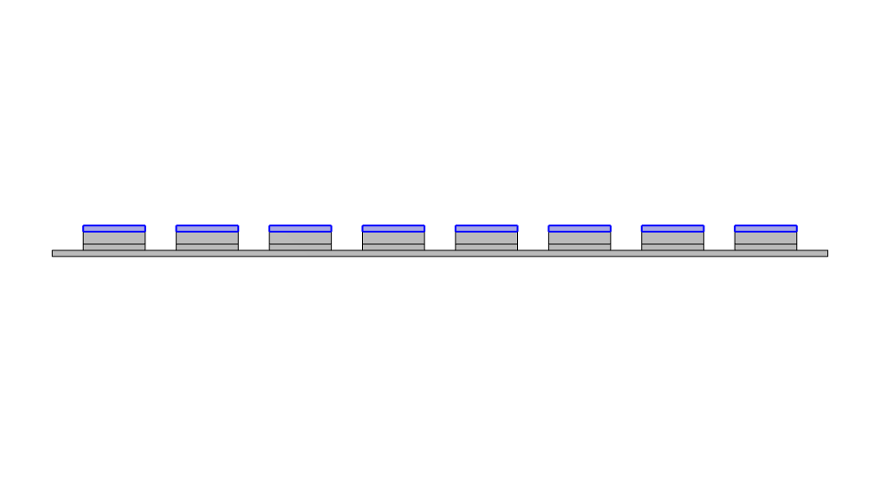
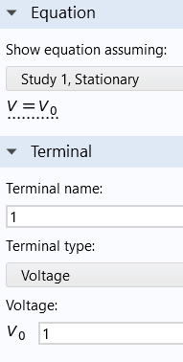
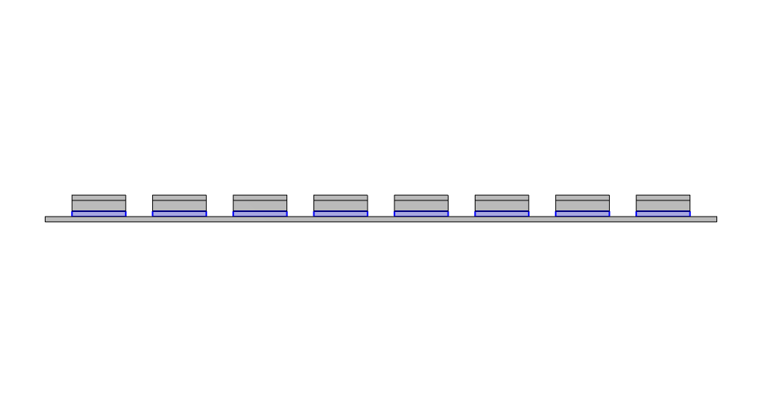
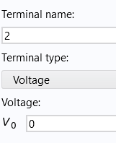
Terminals
Terminal 1
Terminal 2

Slide 19
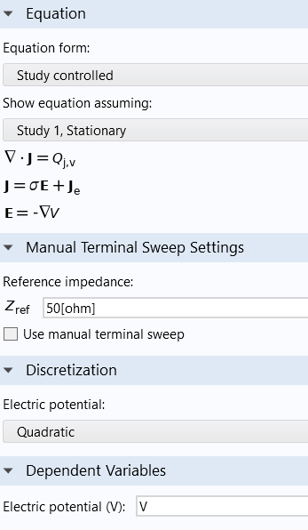
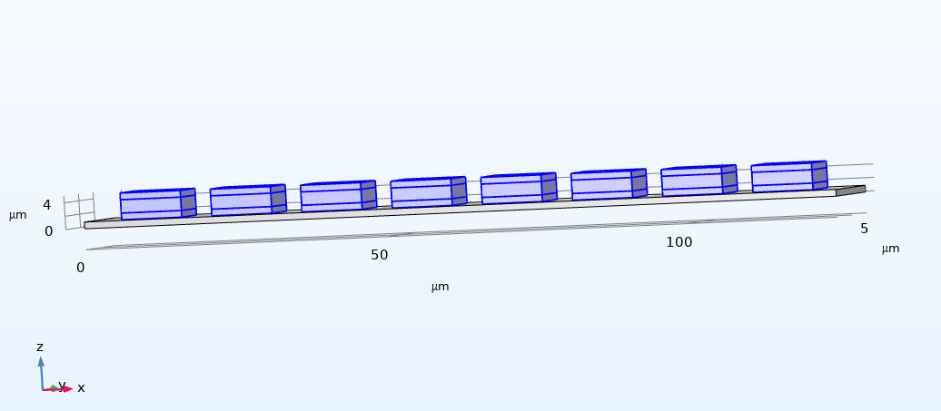
Electric currents

Slide 20
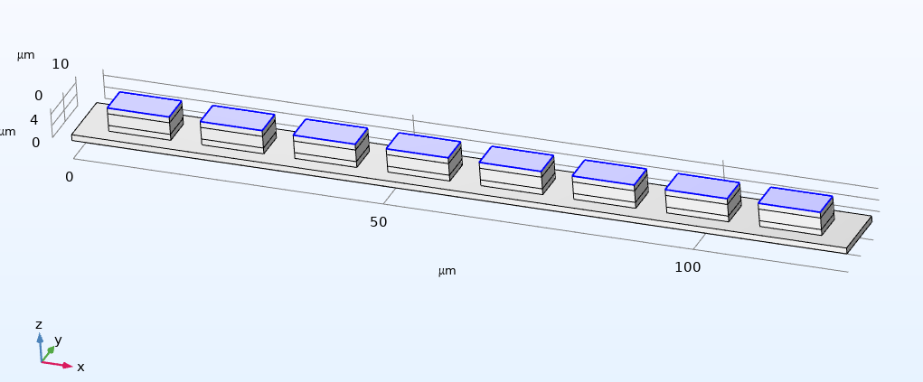
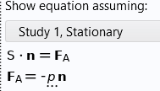
Boundary Loads

Slide 21
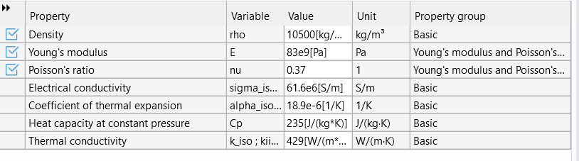
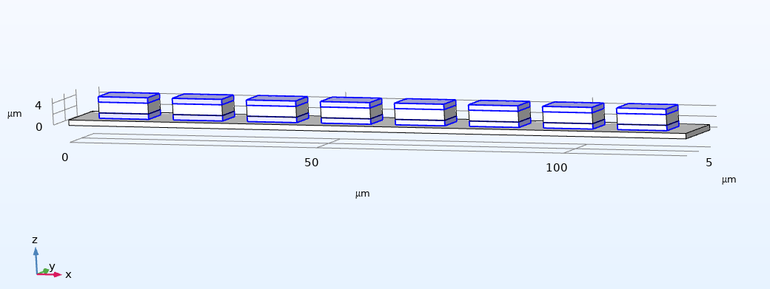
Silver

Slide 22
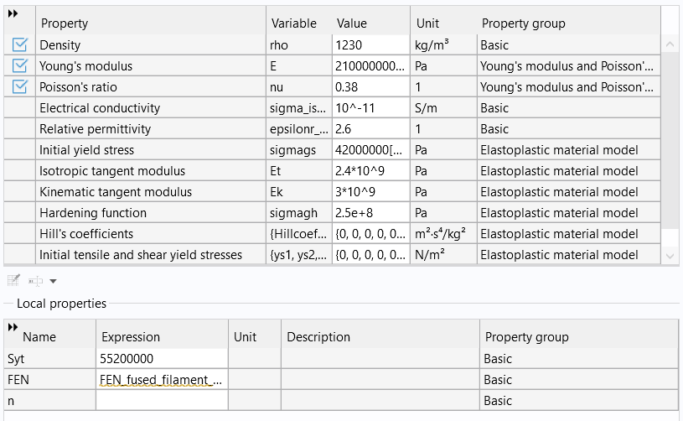
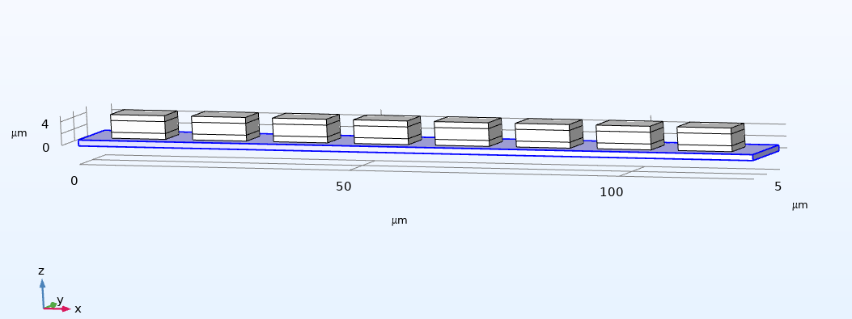
PET-G (polyethylene terephthalate glycol) [fused filament fabrication,tested at 20 °C (293 K), R = 0.1, axial, elastic strain amplitude]

Slide 23
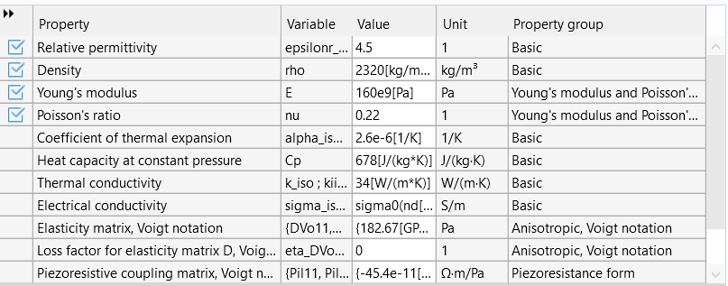
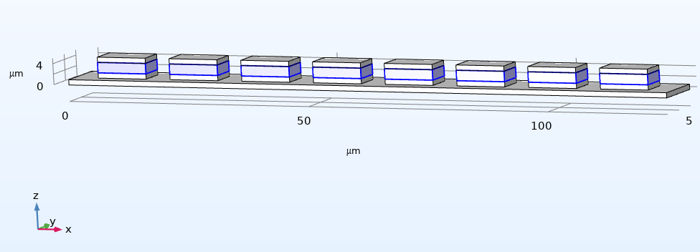
n-Silicon (polycrystalline, lightly doped)

Slide 24
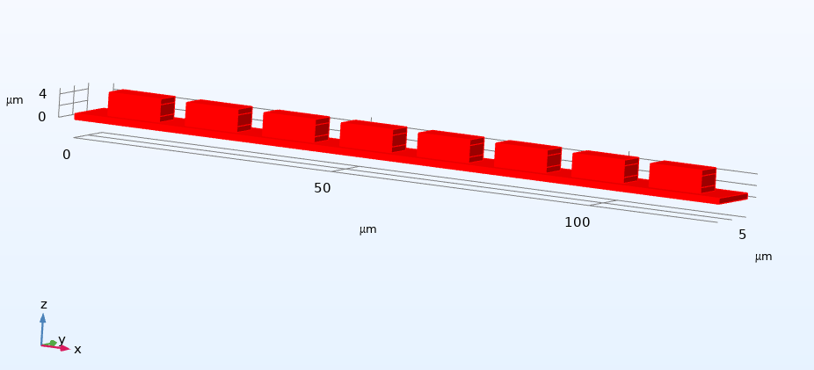
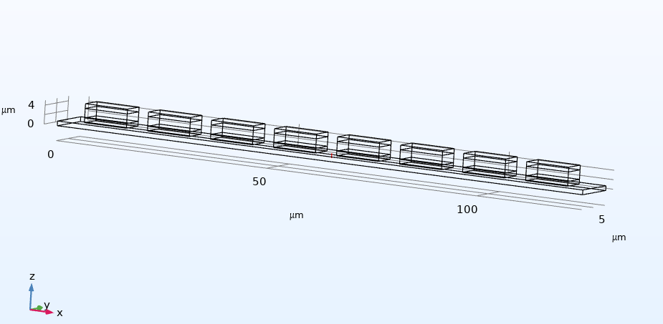
Study 1/Solution 1
Cut Line 3D 1

