Slide 1
FAIR Sensor Health Monitoring of Flight Test Data

Slide 2
Contents
Intro
Theory/Literature Review (mittelfeine Darstellung)
Problem statement
Methods
(Implementation)
Results
Discussion
Conclusion

Slide 3
Intro

Slide 4
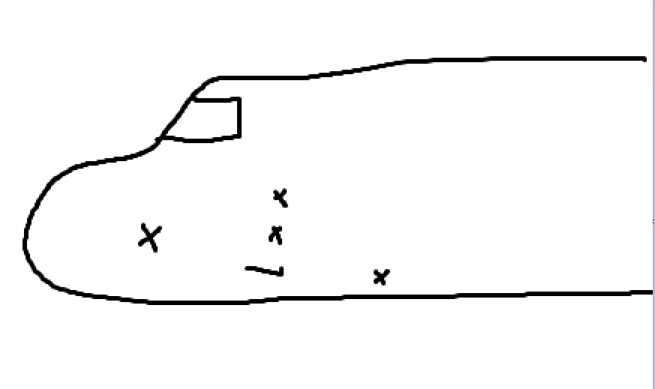
Theory
Possible Sensor Errors (Flugführung,
ISTAR Image with sensors

Slide 5
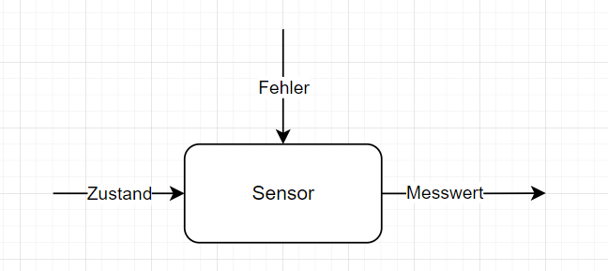
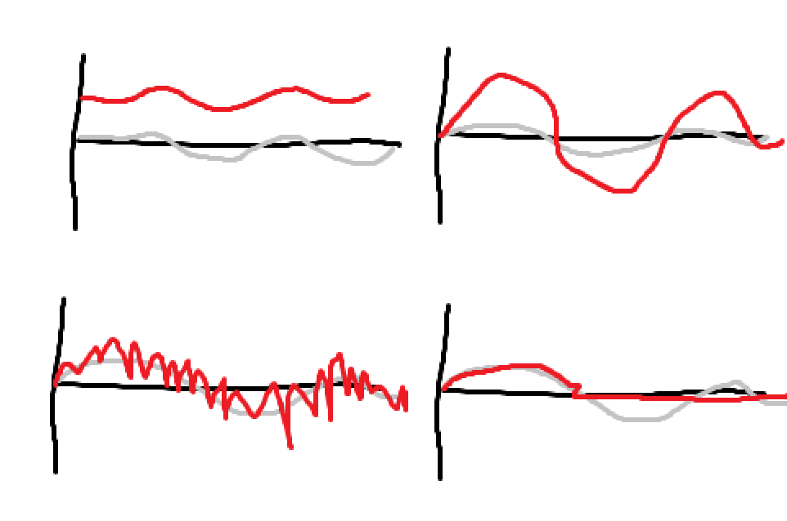
Problem Statement
Luenberger Beobachter
Grey: state, red: sensor value

