Slide 1
FAIR Sensor Health Monitoring of Flight Test Data

Slide 2
Strukturierung der Arbeit
Kapitel 1 (Intro)
What?
Kapitel 2 (Stand Technik, Theorie)
What is SHM?
Kapitel 3 (Problem statement)
Precise detection of malfunctions and perturbances
Reporting tool that displays relevant info and generates metrics
Why?
Origin?
How?
Context?
Check ISTAR Data
Costly mistakes/faults
Better overview
Quicker reaction time
Fulfillment FAIR (quick overview)
Safety critical errors may be reported
ISTAR DAQ
Different sensors
Different formats/sources
Proposal SHM
Detect errors and report them
Holistic system view
SHM as part of an ecosystem
Plug and play of single components
interoperability
Wer hat sowas schonmal gemacht
How did they do it?
How have they structured it/How do you ideally structure it (data Handling)
Wie macht man dann sowas
Wie funktionieren die einzelnen Komponenten im Detail
Wie leitet man es her?
Umfang
Anforderungen
[….]
optional
Isermann
GPS
Todo
Statistik
PCA
PTF
FAIR (tief eingehen)
Beispiele
Skystash
Optimale datenstruktur
SOIL
Statistik
PCA
PTF
STFT
Plug and play philosophy
Kapitel 4 (Methoden/Implementierung)
Kapitel 5 (Results and Discussion)
Kapitel 6 ( Conclusion and Outlook)
Stacked V-Model
Basics: Metadata Collection, formatting into SOIL
Parsing of ISTAR Data
Parsing and assignment of ISTAR data config
Check 1 Implementation
Check 2 Implementation
No signal (value)
movement too high
movement too low
Out of range
Todo
Check 3 Implementation:
Physical
GNSS
Baro
Basics: Report structure
1: list
3:Single sensor: mean value, residual, stdev
3:whole flight: occurences
2: notable occurences
Implementation Report
Download of sensors
Local checking
Upload of JSON to stash
Analysis Report
Check for errors
Adapt sensitivity and algorithms (balance false positives)
Metadata structure (filled)
Check testing 1,2,3 (test with real data)
Plots and comparisons
Check with faulty data
ARE RESULTS GOOD?
Comparison with previously developed FMEAs
Rate check quality with parameters
Implementation ecosystem
Toolchain FTI-tool
What has been done and accomplished in this work
What modular interfaces were built that can be extended in the future
API
GNSS (RAIMS)
Barohöhe
Notwendig
All Parameters present?
Innovation and exploration turbine

Slide 3
Strukturierung der Arbeit
Kapitel 1 (Intro)
Kapitel 2
What is SHM?
Kapitel
Methodology
FMEA
Data structures/handling
Kapitel 4 (Methoden/Implementierung)
Kapitel 5 (Results and Discussion)
Kapitel 6 ( Conclusion and Outlook)
Stacked V-Model
Introduction
Metadata structure
What has been done and accomplished in this work
What modular interfaces were built that can be extended in the future
Innovation and exploration turbine
Data Parsing/Provision
Configuration Metadata
Data Processing
Report visualization
Conclusion
Check testing 1,2,3
Implementation ecosystem
Discussion/Potential
Conclusion
Problem Statement

Slide 4
Contents
Intro
Theory/Literature Review (mittelfeine Darstellung)
Problem statement
Methods
(Implementation)
Results
Discussion
Conclusion

Slide 5
Intro
Semiotics
Pragmatics
Semantics
Syntactics

Slide 6
Sensor Health Monitoring between each step. Function fuses Sensors
Element
Function
Components
Component 1
Components
Tag 1
Function
Tag 2
Tag 1
Reference
Function

Slide 7
Sensor Health Monitoring (Flight)
Missing Parameters
Single Sensor Behavior
List of missing parameters
Physical values out of bounds
Amplitude out of bounds
Sampling anomalous
Level 3
Level 3 hierarchy
Parameter 1
Occurrences
Tag 1
Parameter 1
Parameter 2
Parameter 2
Parameter 3
Limits

Slide 8
SHM (Parameter)
Checking range
Offset
Tag
Suspicious values
Timestamp
Deviation [%σ]

Slide 9








F
A
I
R

Slide 10
Findable
F1. (Meta)data are assigned a globally unique and persistent identifier
F2. Data are described with rich metadata (defined by R1 below)
F3. Metadata clearly and explicitly include the identifier of the data they describe
F4. (Meta)data are registered or indexed in a searchable resource
Accessible
A1. (Meta)data are retrievable by their identifier using a standardised communications protocol
A1.1 The protocol is open, free, and universally implementable
A1.2 The protocol allows for an authentication and authorisation procedure, where necessary
A2. Metadata are accessible, even when the data are no longer available
Interoperable
I1. (Meta)data use a formal, accessible, shared, and broadly applicable language for knowledge representation.
I2. (Meta)data use vocabularies that follow FAIR principles
I3. (Meta)data include qualified references to other (meta)data
Reusable
R1. (Meta)data are richly described with a plurality of accurate and relevant attributes
R1.1 (Meta)data are released with a clear and accessible data usage license
R1.2 (Meta)data are associated with detailed provenance
R1.3 (Meta)data meet domain-relevant community standards

Slide 11
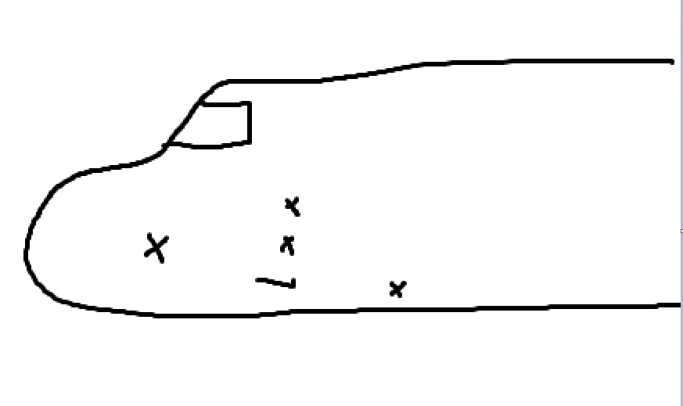
Theory
Possible Sensor Errors (Flugführung,
ISTAR Image with sensors

Slide 12
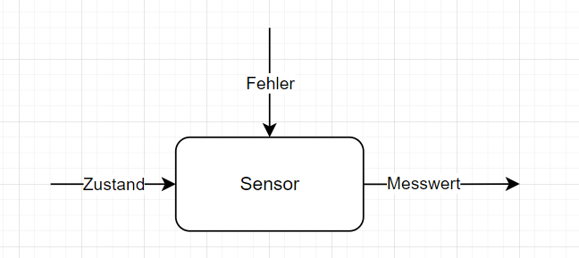
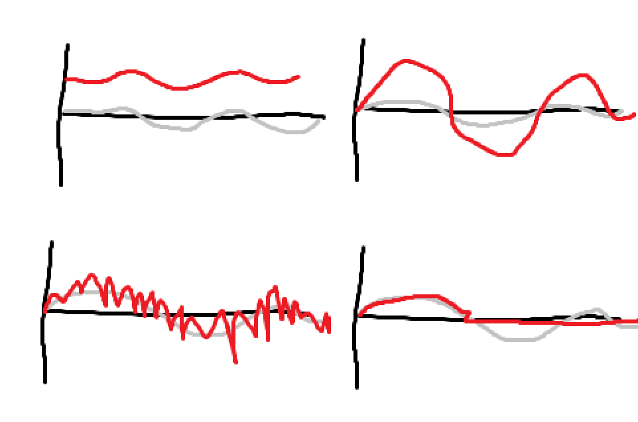
Problem Statement
Luenberger Beobachter
Grey: state, red: sensor value

Slide 13
ISTAR Digital Twin
Aircraft Internal Data
DLR Internal Data
DLR External Data
Surrounding Traffic (ADS-B)
Weather (ECMWF, Metar)
CAMO
3D Scan (Cabin & Aircraft)
Manufacturing Data (CAD)
Flight Test Plans
Basic Measurement Equipment (AC Data Bus)
Nose Boom
Aerolastic Sensor System

