Slide 1
RAG-sphere Project
Onur Koc

Slide 2
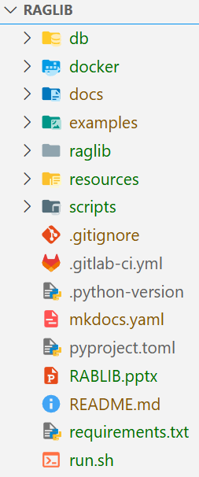
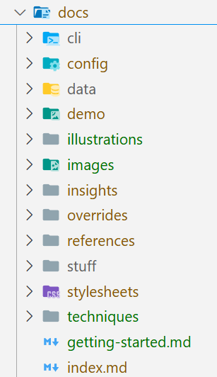
Project Structure
all files related to the pages of the documentation site and the design
all configurations regarding the creation of the documentation page and additional plug-ins

Slide 3
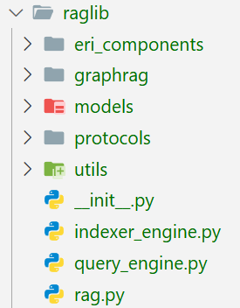
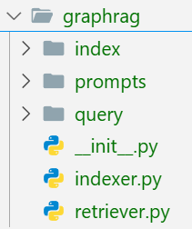
Project Structure
All files regarding the implementation of the rag techniques
contain data models (dataclasses, schemas, settings, structs).
contain abstract classes (contracts for behavior, Base classes)
File parser, loader and clients: i.e. LLM Client, ArangoDB Client
Handles the indexing process (see slide 9)
Handles the full query → retrieve → prompt → answer flow
Orchestration class for the available RAG techniques (user-api)
Graph-based indexing & retrieval techniques
Code regarding the graph construction (indexing phase)
LLM Prompt templates and output formats
Code regarding KG retrieval to generate an answer (query phase)
Indexing classes for each technique
Retriever classes for each technique

Slide 4
Project Structure
This folder will be used, when running the docker compose setup (../docker-compose.yml). 2 folders will be created in here:
1. db/arango_data
This folder is used by ArangoDB to store the generated KnowledgeGraph and CommunityGraph. It will further be used on user query.
2. db/elastic_data
This folder is used by ElasticSearch to store the generated Embeddings of document contents and community summaries. It will further be used on user query.
db/data
This folder contains the corpus

Slide 5
Project Structure
Jupyter notebook demo files
Configuration files e.g. regarding graph construction and retrieval (LLM config, Arango config ..)
Scripts for executing the indexing and retrieval techniques

Slide 6
RAGLib Framewok Design
Flexible Indexing & Querying Pipelines for Knowledge-Driven QA
RAGLib should support:
Multiple indexing & retrieval strategies
Configurable pipelines
Maintainability & extensibility
Goal: Design a reusable RAG framework for graph/vector techniques
Design Principles
Modular design (Easily add/remove/change indexing/retrieval techniques)
Separation of Indexing & Querying
Support for multiple RAG techniques
High-level usability (plug-and-play)
Low-level control (advanced tuning)

Slide 7
High-Level Architecture
RAG
Top-level Orchestrator:
user-friendly wrapper with .index() &.query()
Mid-level Orchestrator:
Handles the indexing process (Pipeline)
Mid-level Orchestrator:
Handles query → retrieve → prompt → answer
IndexerEngine
NaiveGraphRAGIndexer
GARAGIndexer
QueryEngine
GraphRAGRetriever
VectorRAGIndexer
GraphRAGIndexer
NaiveGraphRAGRetriever
GARAGRetriever
VectorRAGRetriever
Design Principles
Modular design
Separation of Indexing & Querying
Support for multiple RAG techniques
High-level usability (plug-and-play)
Low-level control (advanced tuning)

Slide 8
Indexer & Query Engines
Engine
Role
IndexerEngine | Handles the indexing process, Orchestrates logic with mid-level config
QueryEngine | Orchestrates full query-retrieve-generate flow, mid-level config
Each engine can:
Accept string identifiers (‘garag’, ‘naiverag’)
Accept full custom class instances (GARAGIndexer(**config))
And a combination of both
Easily add new techniques trough Indexer & Retriever classes
QueryEngine
IndexerEngine
Pluggable retriever by name („graphrag", „garag" etc.)
Central control over retrieval logic inside the engine

Slide 9
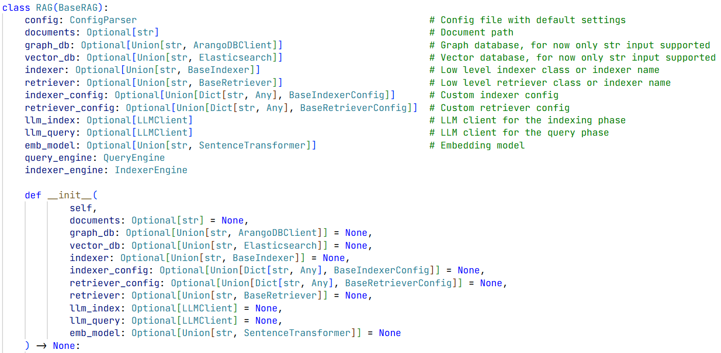
Minimal API
Orchestrates/Delegates logic to engine classes
Some pre/post processing and input validation
High-Level Orchestrator
Notes:
RAG class handles default values and input validation
GraphDB und VectorDB input validation auslagern zu den low level indexer und retriever Klassen
Damit für jede Klasse eigene Default Database settings geschrieben werden können

Slide 10
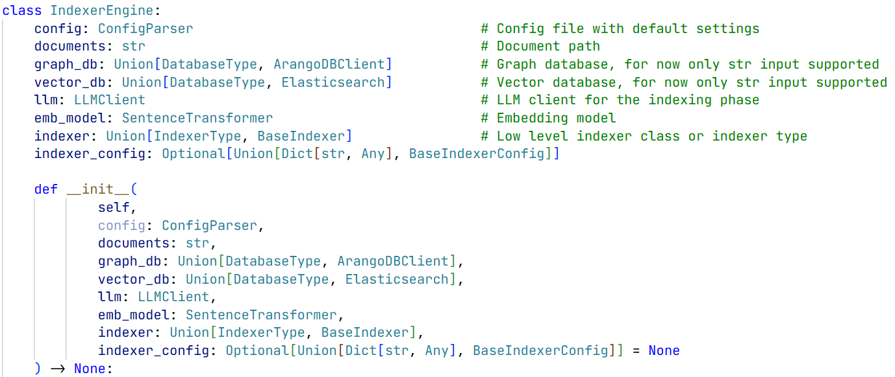
Minimal API
Orchestrates/Delegates logic to Indexer classes
Some pre/post processing and input validation
Mid-Level Orchestrator
Responsibile for:
Selecting the correct Indexer implementation
Setting up the custom indexer config
Chunking, embedding, and storing
Indexing related pre- and postprocessing
e.g. graph config (edge strategy, thresholds, etc.)

Slide 11
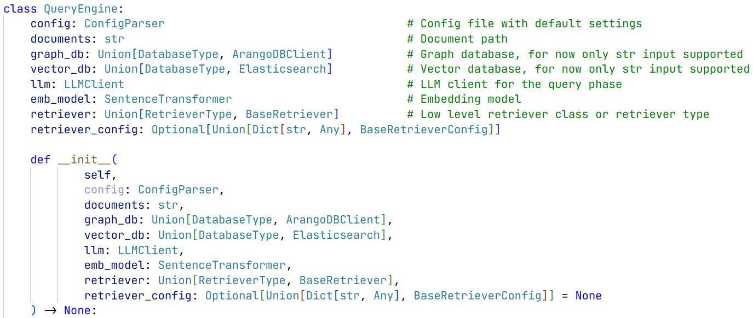
Minimal API
Orchestrates/Delegates logic to Retriever classes
Some pre/post processing and input validation
Mid-Level Orchestrator
Selecting the correct retrieval implementation
Embedding queries
Setting up the custom indexer config
Retrieval related preprocessing (Clean or chunk user input, normalize query)
Retrieval related postprocessing (Parse, clean, or re-rank the response)
Responsibile for:

Slide 12
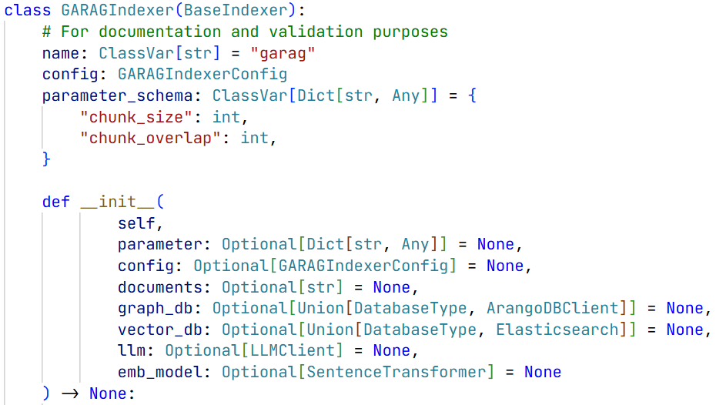
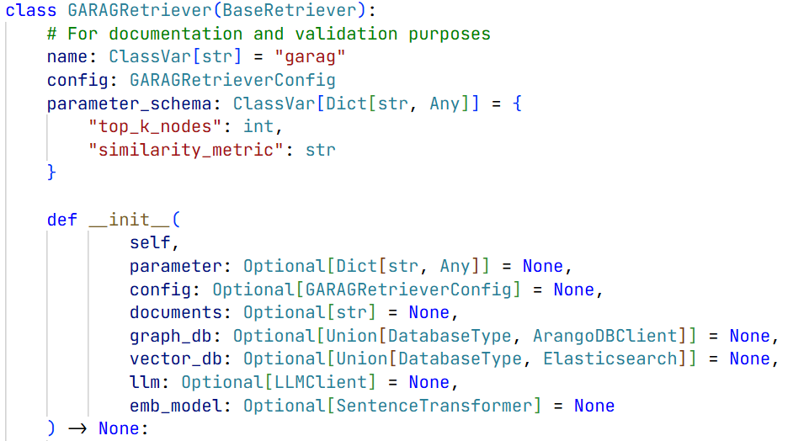
Low-Level Classes
Implementation of the indexing and retrieval techniques
Config:
Document Chunking
Node Construction (e.g., sentence, paragraph)
Edge Creation (e.g., semantic similarity, citation, co-reference)
Graph Building (networkx, DGL, etc.)
Graph Persistence (save/load structure to disk)
Embedding (nodes, edges, etc.)
LLM-Assisted Preprocessing (e.g., topic labeling, metadata)
Graph Enrichment (optional: summarization, classification)
Graph Storage Backend Integration
Config:
Query Embedding
Graph Traversal (e.g., BFS, DFS, Personalized)
Node Filtering (e.g., by type, relevance)
Similarity Search (embedding-based)
Top-K Selection (most relevant nodes/chunks)
Context Assembly (for prompting the LLM)
Reranking (optional: scoring model)
Prompt Preparation (with context + question)
LLM Answer Call (returns final answer)
Graph-Aware Retrieval Logic

Slide 13
Instantiation Options
Custom API Variant 1
config_indexer = { (custom config)
chunk_size = chunk_size,
chunk_overlap = chunk_overlap,
…
}
config_retriever = { (custom config)
top_k = 15,
similarity_metric = „cosine“,
…
}
rag = RAG(
…
indexer = indexer_name,
retriever = retriever_name,
indexer_config = config_indexer,
retriever_config = config_retriever,
…
)
rag.index()
answer = rag.query("What is the role of X?")
Custom API
rag = RAG(
documents = docs_path,
graph_db = db_name,
vector_db = db_name,
indexer = indexer_name, (default config)
retriever = retriever_name, (default config)
llm_index = my_llm, (default config)
llm_query = my_llm, (default config)
embedding_model = my_emb,
…
)
rag.index()
answer = rag.query("What is the role of X?")

Slide 14
Instantiation Options
Custom API Variant 2
config_indexer = { (custom config)
chunk_size = chunk_size,
chunk_overlap = chunk_overlap,
…
}
config_retriever = { (custom config)
top_k = 15,
similarity_metric = „cosine“,
…
}
indexer = GARAGIndexerConfig(**config_indexer)
retriever = GARAGRetrieverConfig(**config_retriever)
rag = RAG(
…
indexer = indexer_name,
retriever = retriever_name,
indexer_config = indexer,
retriever_config = retriever,
…
)
rag.index()
answer = rag.query("What is the role of X?")
Custom API
rag = RAG(
documents = docs_path,
graph_db = db_name,
vector_db = db_name,
indexer = indexer_name, (default config)
retriever = retriever_name, (default config)
llm_index = my_llm, (default config)
llm_query = my_llm, (default config)
embedding_model = my_emb,
…
)
rag.index()
answer = rag.query("What is the role of X?")

Slide 15
Instantiation Options
Custom API Variant 3
config_indexer = { (custom config)
chunk_size = chunk_size,
chunk_overlap = chunk_overlap,
…
}
config_retriever = { (custom config)
top_k = 15,
similarity_metric = „cosine“,
…
}
indexer = GARAGIndexer(**config_indexer)
retriever = GARAGRetriever(**config_retriever)
rag = RAG(
…
indexer = indexer,
retriever = retriever,
…
)
rag.index()
answer = rag.query("What is the role of X?")
Custom API
rag = RAG(
documents = docs_path,
graph_db = db_name,
vector_db = db_name,
indexer = indexer_name, (default config)
retriever = retriever_name, (default config)
llm_index = my_llm, (default config)
llm_query = my_llm, (default config)
embedding_model = my_emb,
…
)
rag.index()
answer = rag.query("What is the role of X?")

Slide 16
Instantiation Options
Custom API Variant 4
config_indexer = { (custom config)
chunk_size = chunk_size,
chunk_overlap = chunk_overlap,
…
}
config_retriever = { (custom config)
top_k = 15,
similarity_metric = „cosine“,
…
}
indexer_cfg = GARAGIndexerConfig(**config_indexer)
retriever_cfg = GARAGRetrieverConfig(**config_retriever)
indexer = GARAGIndexer(config = indexer_cfg)
retriever = GARAGRetriever(config = indexer_cfg)
rag = RAG(
…
indexer = indexer,
retriever = retriever,
…
)
rag.index()
answer = rag.query("What is the role of X?")
Custom API
rag = RAG(
documents = docs_path,
graph_db = db_name,
vector_db = db_name,
indexer = indexer_name, (default config)
retriever = retriever_name, (default config)
llm_index = my_llm, (default config)
llm_query = my_llm, (default config)
embedding_model = my_emb,
…
)
rag.index()
answer = rag.query("What is the role of X?")

Slide 17
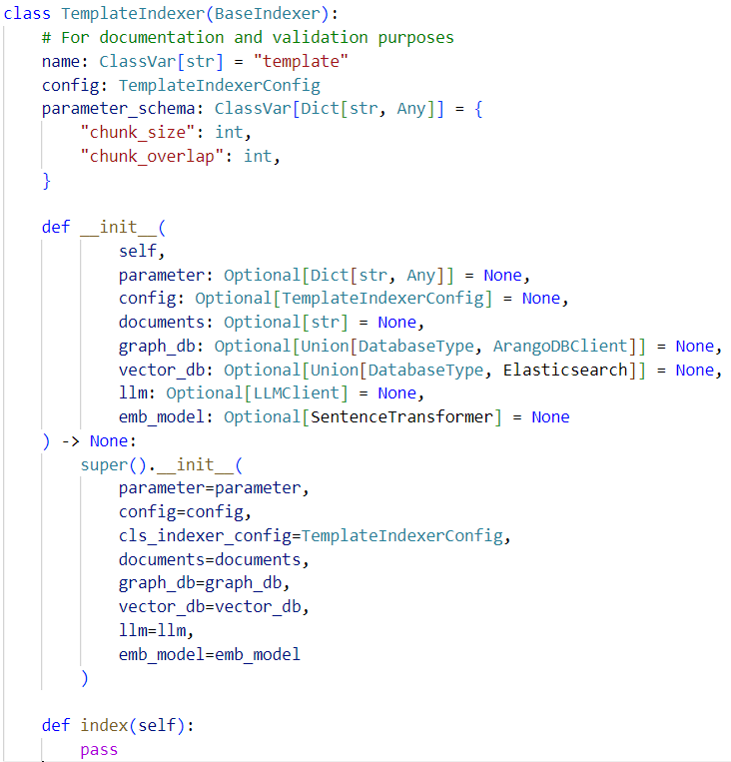
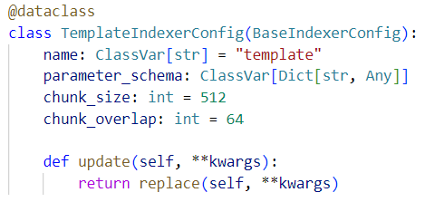
Adding New Indexing & Retrieval Techniques
New techniques can be easily added trough “Indexer” & “Retriever” classes

Slide 18
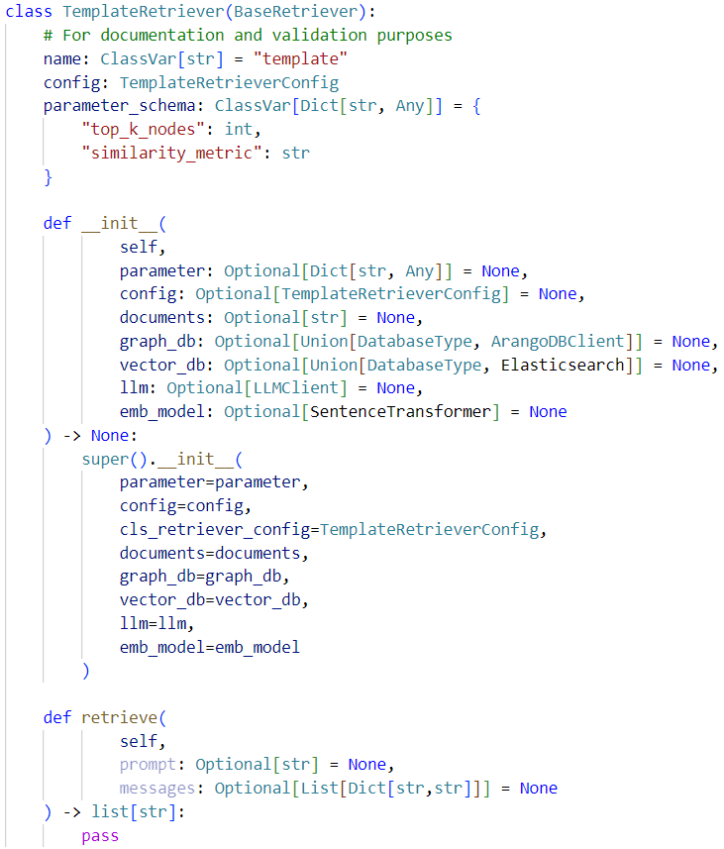
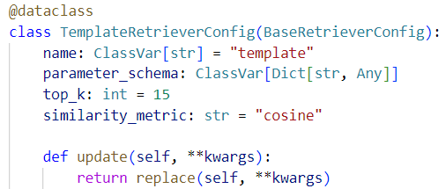
Adding New Indexing & Retrieval Techniques
New techniques can be easily added trough “Indexer” & “Retriever” classes

