Slide 1
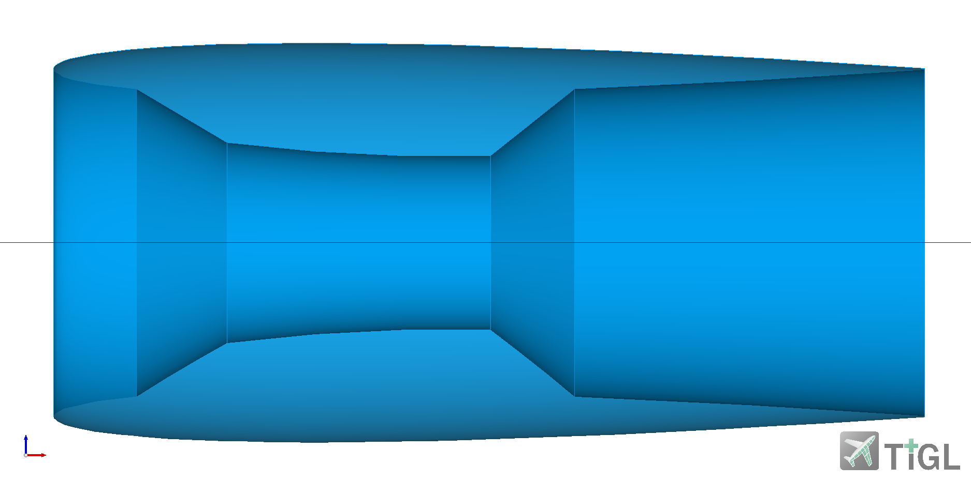




<endZetaBlending>
<startZetaBlending>
Section profile
$$0$$
$$ζ=−1..1$$
Transformation of the reference section
$$0$$
$(x,y)$ in section coordinates
<endZeta>
Rotation curve
<startZeta>
$$ζ=−1..1$$

Slide 2
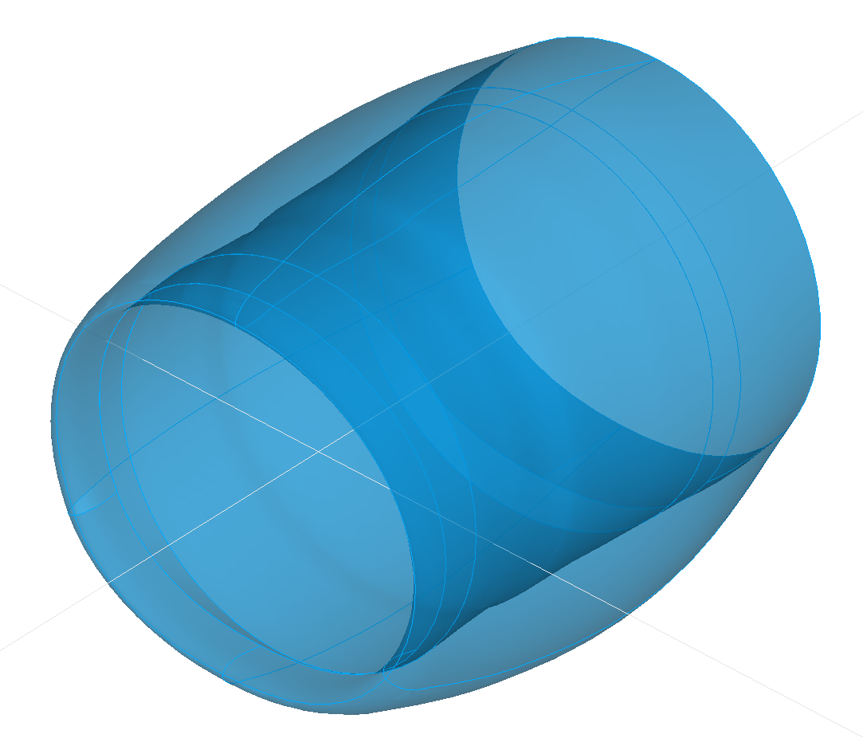
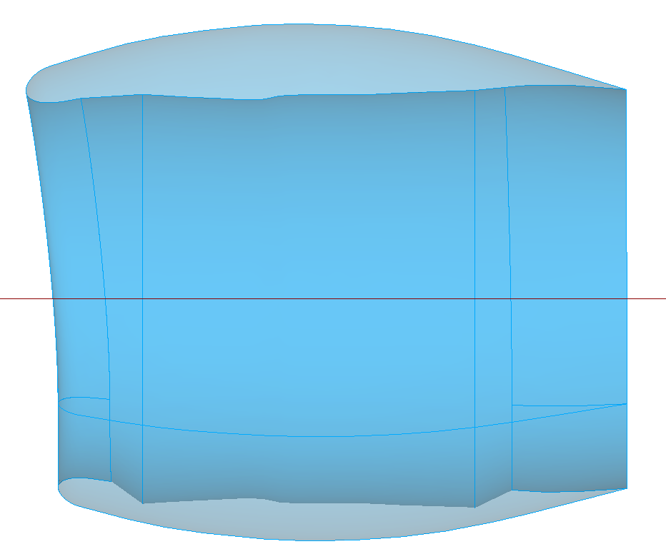







Upper section at 0°
$$θ=x_{trans}$$
$$z$$
$$h=y_{trans}$$
$$r=z_{trans}$$
$$x$$
$$y$$
Outboard section
at 240°
Inboard section at 120°
Lower section at 180°
Upper section
<transformation>
<translation>
<x>0</x>
<y>-0.257</y>
<z>0.365</z>
rotation around x [deg]:
horizontal translation:
radial translation:
$$z$$
Rotation curve cut-outs
$$x$$
<translation>
<x>120</x>
<y>-0.2</y>
<z>0.365</z>
Coordinate origin ≙ fan position
Inboard
section
<translation>
<x>180</x>
<y>-0.2</y>
<z>0.33</z>
Lower section

Slide 3
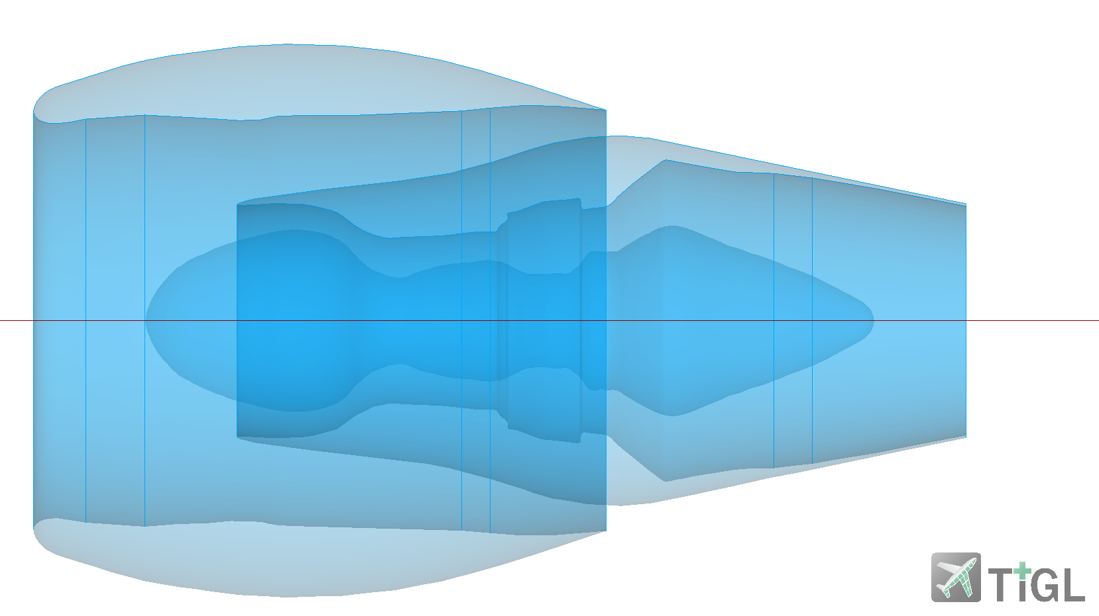

Fan cowl
Fan blades
Core cowl
$$z$$
$$x$$
Center cowl
Coordinate origin ≙ fan position

Slide 4
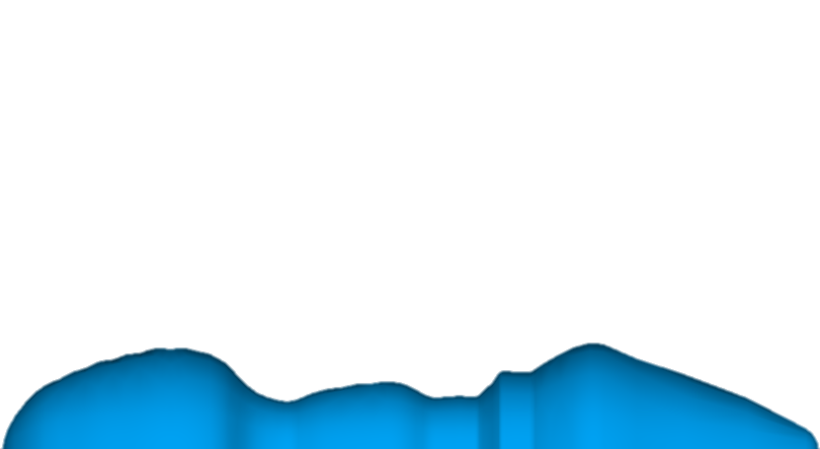


Fan blades
Rotation curve profile
$$z$$
Center cowl
$$x$$
Coordinate origin ≙ fan position
xOffset

Slide 5
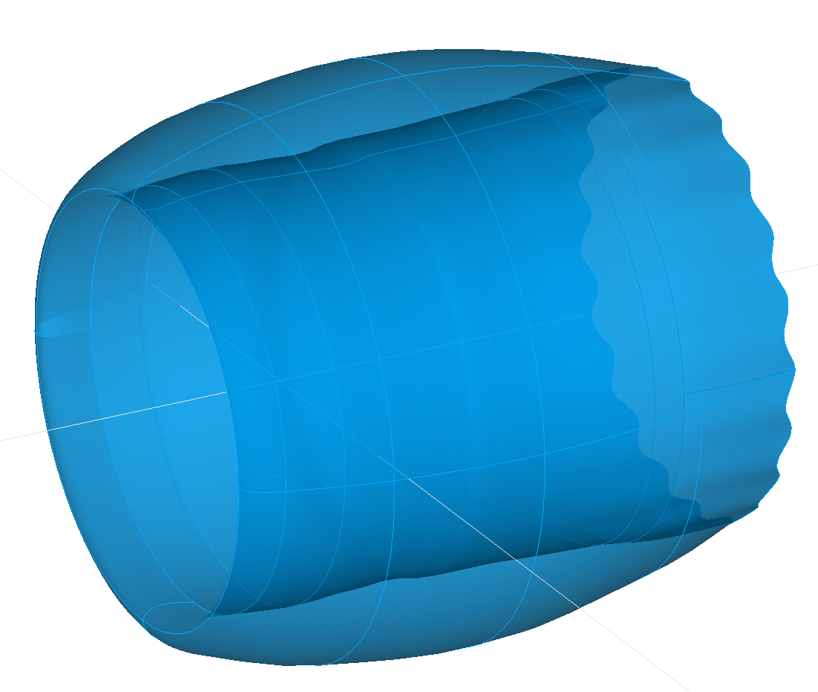
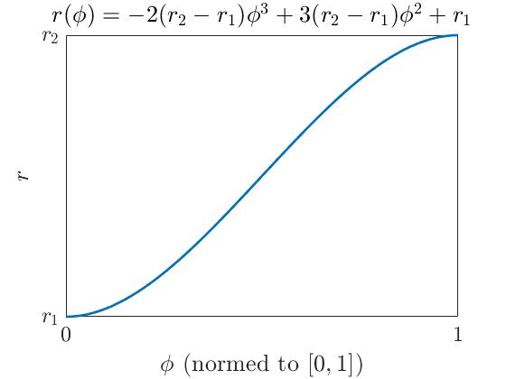








guide curves
profile of <startSectionUID>
profiles
<guideCurveProfile uID=“chevronTrailingEdge”>
<name>Chevron trailing edge guide curve</name>
<pointList>
<rX>0.1;0.2;…;0.5;…;0.9</rX>
<rY>-0.02;0;…;-0.02;…;-0.02</rY>
<rZ>0.02;0;…;0.02;…0.02</rZ>
<fromZeta>
$$ζ=−1..1$$
rX = $φ$
$$0$$
rZ = $Δr$
rY = $Δx$
$$z$$
$$y$$
$$x$$
<toZeta>
$$Δr$$

