Slide 1
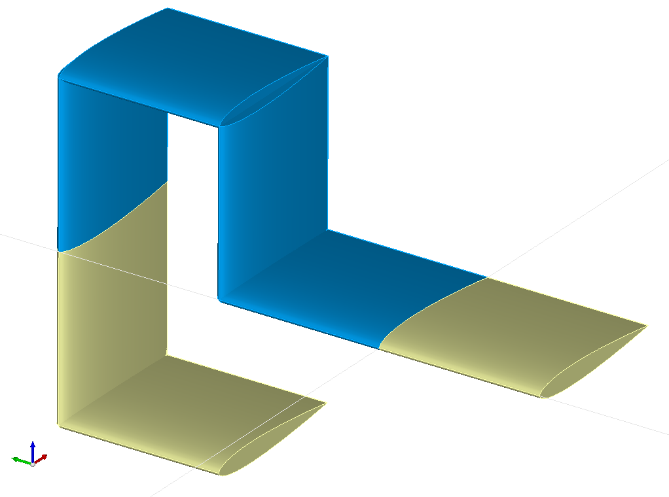
<wing uID=“wing4“>
<name>Wing 4</name>
<parentUID>wing3</parentUID>
<wing uID=“wing3“ symmetry=“x-y-plane“ >
<name>Wing 3</name>
<parentUID>wing2</parentUID>
<wing uID=“wing2“ symmetry=“none“ >
<name>Wing 2</name>
<parentUID>wing1</parentUID>
<wing uID=“wing1“ symmetry=“x-z-plane“ >
<name>Wing 1</name>
z
y
x

