Slide 1
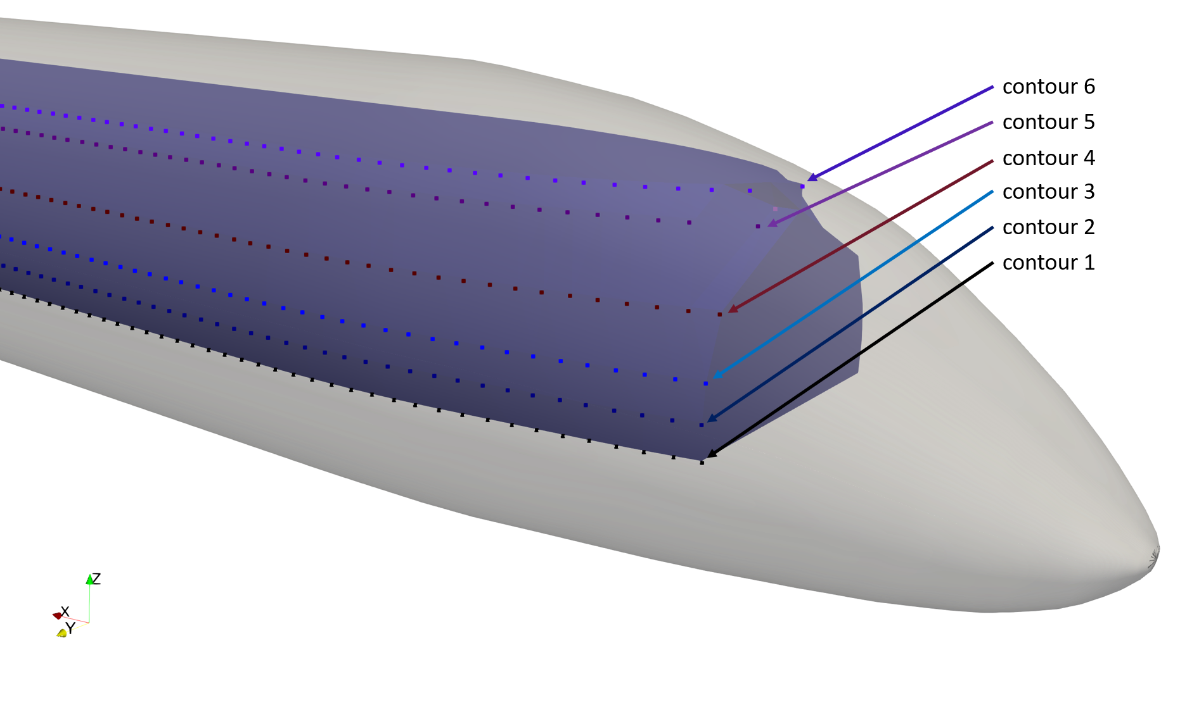







contour 6:
<y> $y_{6,1};y_{6,2};..;y_{6,N}$ </y>
<z> $z_{6}$ </z>
N points for each contour
contour 3:
<y> $y_{3,1};y_{3,2};..;y_{3,N}$ </y>
<z> $z_{3}$ </z>
contour 1:
<y> $y_{1,1};y_{1,2};..;y_{1,N}$ </y>
<z> $z_{1}$ </z>
For each contour:
<x> $x_{1};x_{2};..;x_{N}$ </x>

